Slide 1

C++ Course
Reviewed and Updated by:
Bertoa Nicolas, 2013 / 2015
Rodriguez Matias, 2013 / 2014
Quesada Manuela, 2013 / 2014

Slide 2

Class 1 – Introduction
History
Preprocessor, Compiler, Linker
Namespaces
Assertions
Standard Output
Strings

Slide 3

History of C++
General-purpose programming language (imperative, object oriented, generic)
Designed with a bias toward system programming with performance, efficiency and flexibility.
Applications: desktop, servers, performance-critical, entertainment, etc
Created by Bjarne Stroustrup

Slide 4
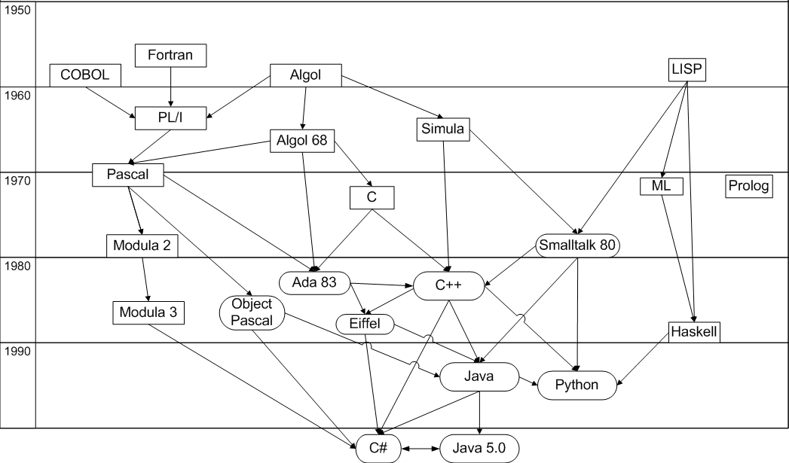
History of C++

Slide 5
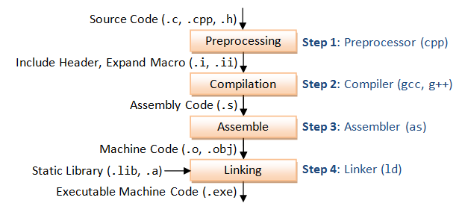
The compilation process
Notes:
hoy en dia la mayoria de los compilers (o toolchains) no crean archivos de preprocessor ni de assembly code a menos que uno lo pida explicitamente con switch de cmd line. Este slide podria modernizarse. Algunos compilers usan una arch en capas, tienen Front End (parser+diagnostics) y Back End (optimizer+assembly code generation)

Slide 6
Preprocessor
Replaces patterns in the source code with other patterns the programmer has defined using preprocessor directives.
Preprocessor directives are used to save typing and to increase the readability of the code.
The pre-processed code is often written to an intermediate file (translation unit)

Slide 7
Header Files
Usually have the .h extension
Usually header files only contain declarations and do not provide the actual definition of the code (separate interface from implementation)
MyFile.h
int sum(int a, int b);
MyFile.cpp
#include “MyFile.h”
int sum(int a, int b) {
return a + b;
}

Slide 8
Header Files
They keep code more organized.
If you separate concepts into specific files, it is easier to find the code you are looking for.
Terrain.h
Characters.h
Collision.h
Level.h
FileSystem.h

Slide 9
#include preprocessor directive
When the preprocessor finds an #include directive, it replaces it by the entire content of the specified header or file.
MyFile.h
int sum(int a, int b);
MyFile.cpp
#include “MyFile.h”
int sum(int a, int b) {
return a + b;
}

Slide 10
#include preprocessor directive
When the preprocessor finds an #include directive, it replaces it by the entire content of the specified header or file.
MyFile.h
int sum(int a, int b);
MyFile.cpp
int sum(int a, int b);
int sum(int a, int b) {
return a + b;
}

Slide 11
#include preprocessor directive
#include <header>
This is used to include headers provided by the implementation, such as the headers that compose the standard library (iostream, string, etc)
#include <iostream>
#include <string>
void print(std::string s) {
std::cout << s << “\n”;
}

Slide 12
#include preprocessor directive
#include “file.h”
File is searched in current path. If it is not found, the compiler shearches it as if we included <file>
MyFile.h
int sum(int a, int b);
MyFile.cpp
#include “MyFile.h”
int sum(int a, int b) {
return a + b;
}

Slide 13
Include guards
Construct used to avoid the problem of double inclusion when dealing with the include directive.
Grandfather.h
int k;
Child.h
#include “Grandfather.h”
#include “Father.h”
Father.h
#include “Grandfather.h”

Slide 14
Include guards
Construct used to avoid the problem of double inclusion when dealing with the include directive.
Grandfather.h
int k;
Child.h
int k;
#include “Grandfather.h”
Father.h
#include “Grandfather.h”

Slide 15
Include guards
Construct used to avoid the problem of double inclusion when dealing with the include directive.
Grandfather.h
int k;
Child.h
int k;
int k;
Father.h
#include “Grandfather.h”

Slide 16
Include guards
Construct used to avoid the problem of double inclusion when dealing with the include directive.
Grandfather.h
int k;
Child.h
int k;
int k;
Father.h
#include “Grandfather.h”
Compilation error Double definition

Slide 17
Include guards
Use #ifndef, #define, #endif construct on each header file
Grandfather.h
#ifndef GRANDFATHER_H
#define GRANDFATHER_H
int k;
#endif
Child.h
#ifndef CHILD_H
#define CHILD_H
#include “Grandfather.h”
#include “Father.h”
#endif
Father.h
#ifndef FATHER_H
#define FATHER_H
#include “Grandfather.h”
#endif

Slide 18
Include guards
Use #ifndef, #define, #endif construct on each header file
Grandfather.h
#ifndef GRANDFATHER_H
#define GRANDFATHER_H
int k;
#endif
Child.h
#ifndef CHILD_H
#define CHILD_H
#ifndef GRANDFATHER_H
#define GRANDFATHER_H
int k;
#endif
#include “Father.h”
#endif
Father.h
#ifndef FATHER_H
#define FATHER_H
#include “Grandfather.h”
#endif

Slide 19
Include guards
Use #ifndef, #define, #endif construct on each header file
Grandfather.h
#ifndef GRANDFATHER_H
#define GRANDFATHER_H
int k;
#endif
Child.h
#ifndef CHILD_H
#define CHILD_H
#ifndef GRANDFATHER_H
#define GRANDFATHER_H
int k;
#endif
#ifndef FATHER_H
#define FATHER_H
#include “Grandfather.h”
#endif
#endif
Father.h
#ifndef FATHER_H
#define FATHER_H
#include “Grandfather.h”
#endif

Slide 20
Include guards
Use #ifndef, #define, #endif construct on each header file
Grandfather.h
#ifndef GRANDFATHER_H
#define GRANDFATHER_H
int k;
#endif
Child.h
#ifndef CHILD_H
#define CHILD_H
#ifndef GRANDFATHER_H
#define GRANDFATHER_H
int k;
#endif
#ifndef FATHER_H
#define FATHER_H
#endif
#endif
Father.h
#ifndef FATHER_H
#define FATHER_H
#include “Grandfather.h”
#endif

Slide 21
Include guards
Use #ifndef, #define, #endif construct on each header file
Grandfather.h
#ifndef GRANDFATHER_H
#define GRANDFATHER_H
int k;
#endif
Child.h
int k;
Father.h
#ifndef FATHER_H
#define FATHER_H
#include “Grandfather.h”
#endif

Slide 22
#define preprocessor directive
#define identifier replacement
Preprocessor replaces any occurrence of identifier by replacement.
#define VALUE 100
#define SUM(a, b) (a+b)
int x = 5;
SUM(x, VALUE);

Slide 23
#define preprocessor directive
#define identifier replacement
Preprocessor replaces any occurrence of identifier by replacement.
int x = 5;
x + 100;

Slide 24
Compiler
The first pass parses the pre-processed file. It breaks the source code into small units and organizes it into a structure called a tree.
A global optimizer is sometimes used between the first and second passes to produce smaller, faster code.
a + b
+
a
b

Slide 25
Compiler
In the second pass, the code generator walks through the parse tree and generates either assembly language code or machine code for the nodes of the tree.
The end result is an object module (.o or .obj)
X
X
X
X
X
X
X

Slide 26
Linker
The linker combines a list of object modules into an executable program that can be loaded and run by the operating system.
When a function in one object module makes a reference to a function or variable in another object module, the linker resolves these references.
.obj
.lib
.exe
.obj
.lib

Slide 27
Linker
The linker can search through special files called libraries order to resolve all its references.
A library is a collection of object modules in a single file (.lib, .a)
.obj
.lib
.exe
.obj
.lib

Slide 28
Internal Linkage
Name that can be referred only in the translation unit in which it was defined
Storage is created to represent the identifier only for the file being compiled.
Internal linkage is specified by the keyword static in C and C++ or unnamed namespace
By default, consts and typedefs have internal linkage.

Slide 29
Internal Linkage
A.cpp
static int n;
void f() {
n = 4;
}

Slide 30
External Linkage
Name that can be used in translation units different from the one in which it was defined
The storage is created once, and the linker must resolve all other references to that storage.
Variables defined outside all functions (with the exception of const in C++) and function definitions default to external linkage.

Slide 31
External Linkage
A.cpp
int n;
void f() {
n = 4;
}
B.cpp
extern int n;
void g() {
n = 10;
}

Slide 32
No Linkage
Local variables exist only temporarily, on the stack, while a function is being called.
The linker doesn’t know about automatic variables, and so these have no linkage.

Slide 33
What is wrong?
A.cpp
int x = 1;
B.cpp
int x;

Slide 34
What is wrong?
A.cpp
int x = 1;
B.cpp
int x;
x is defined twice

Slide 35
What is wrong?
A.cpp
int x = 1;
B.cpp
extern int x;
extern to prevent initialization

Slide 36
What is wrong?
A.cpp
int f() {
return 0;
}
B.cpp
int g() {
return f();
}

Slide 37
What is wrong?
A.cpp
int f() {
return 0;
}
B.cpp
int f();
int g() {
return f();
}
If we declare f() before defining g(), it will work

Slide 38
Namespaces and Scope
Localize the names of identifiers to avoid name collisions.
Allows the same name to be used in different contexts without conflicts arising.
The namespace keyword allows you to partition the global namespace by creating a declarative region

Slide 39
Namespaces and Scope
namespace math {
size_t factorial(size_t n);
}
int main() {
size_t fact = math::factorial(10);
}

Slide 40
Namespace options
A namespace must be declared outside of all other scopes.
There is, however, one exception: a namespace can be nested within another
namespace math {
namespace trigonometric {
float sin(float angle);
}
}
int main() {
float angle = math::trigonometric::sin(180);
}

Slide 41
Using statement
The using statement was invented to alleviate the problem of having to specify the namespace and the scope resolution operator each time you need to refer to members of a namespace.
namespace math {
size_t factorial(size_t n);
}
using namespace math;
int main() {
size_t fact = factorial(10);
}

Slide 42
Using statement
The using statement was invented to alleviate the problem of having to specify the namespace and the scope resolution operator each time you need to refer to members of a namespace.
namespace math {
size_t factorial(size_t n);
}
using math::factorial;
int main() {
size_t fact = factorial(10);
}

Slide 43
Strings
#include <string>
std::string str1 = “A String”;
std::string str2 = str1 + “Another string”;
std::string str3 = str + str1;

Slide 44
Standard Output
#include <iostream>
std::cout << “A message” << std::endl;
std::string str = “Another message”;
std::cout << str << std::endl;
int i = 14;
std::cout << i << std::endl;
std::cout << i << “ ” << str << “Another string” << std::endl;

Slide 45
Asserts
The assert macro in the <cassert> library takes a Boolean expression and, if the expression evaluates to false, prints an error message and terminates the program. If the expression evaluates to true, it does nothing.
#include <cassert>
assert(condition);

Slide 46
Asserts
You should use asserts in your code whenever you are “assuming” something about the state of your variables.
#include <cassert>
int division(int a, int b) {
assert(b != 0);
return a / b;
}

Slide 47
Asserts
Warning: not to put any code that must be executed for correct program functioning inside asserts, because they are removed automatically in Release Mode.
#include <cassert>
// Returns false if failed
bool update();
assert(update() == true);

Slide 48
main function
Entry point of your application. It is the first
Two representations:
int main() { … }
int main(int argc, char* argv[]) { … }
return 0 by default

Slide 49

Q&A

