Slide 1
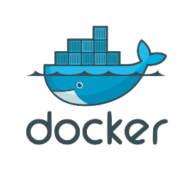
Docker from Scratch
@pablovilla83

Slide 2
What is Docker?
Open source project – 38+k stars, 11+k forks, 180 pull requests, 1,945 issues
Tool designed to make it easier to create, deploy, and run applications
Envelope for software delivery
Pushing code to the server shouldn’t be too hard. Docker helps to fix the problem of “will it run in Production?”
The application stack has increased in complexity (Apache server vs Node JS project with tons of dependencies). Making sure code behaves the same way across all devices is nearly impossible.

Slide 3
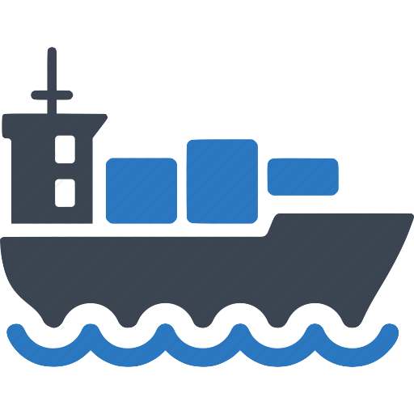
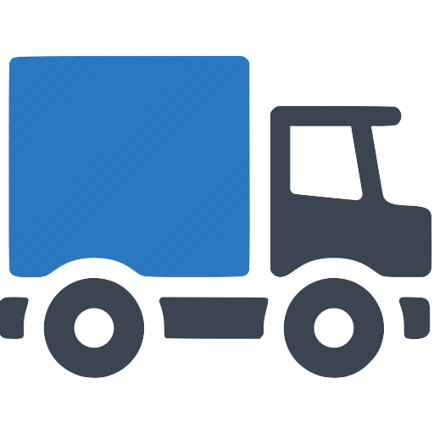
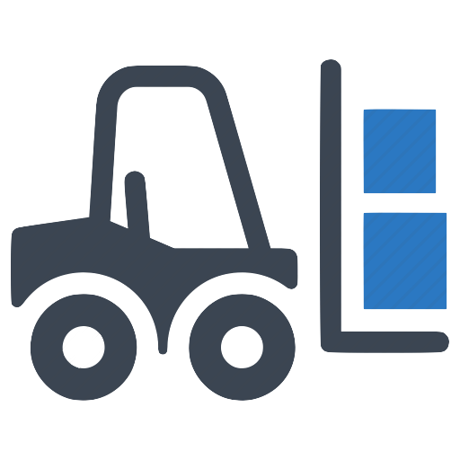
What is Docker? Contd.
The transportation industry has solved this problem
Achieved separation of concerns. I focus on my load and I can handle it to a wide variety of infrastructure providers
Developer worries about the inside of the box. DevOps worries about the outside

Slide 4
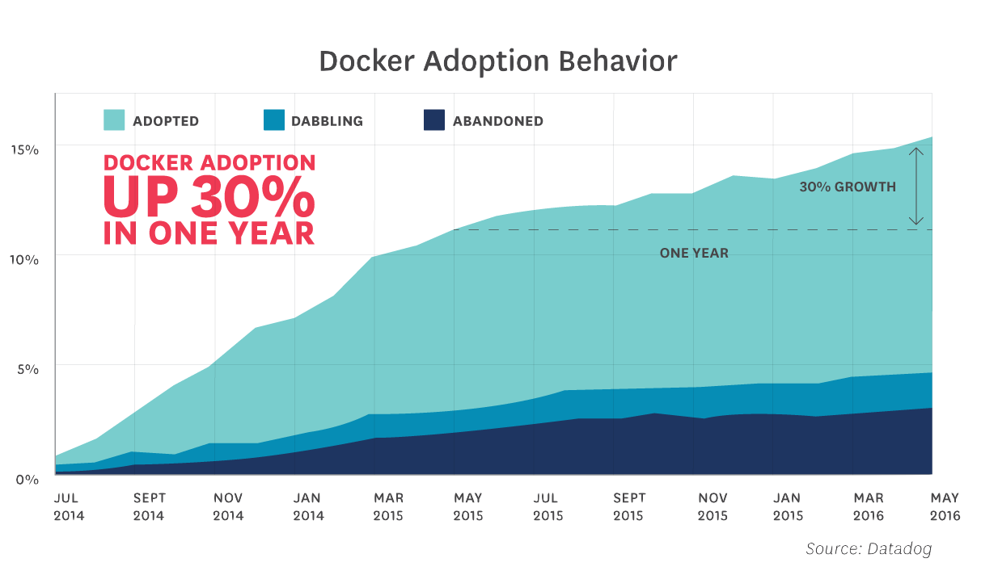
% of datadog customers

Slide 5
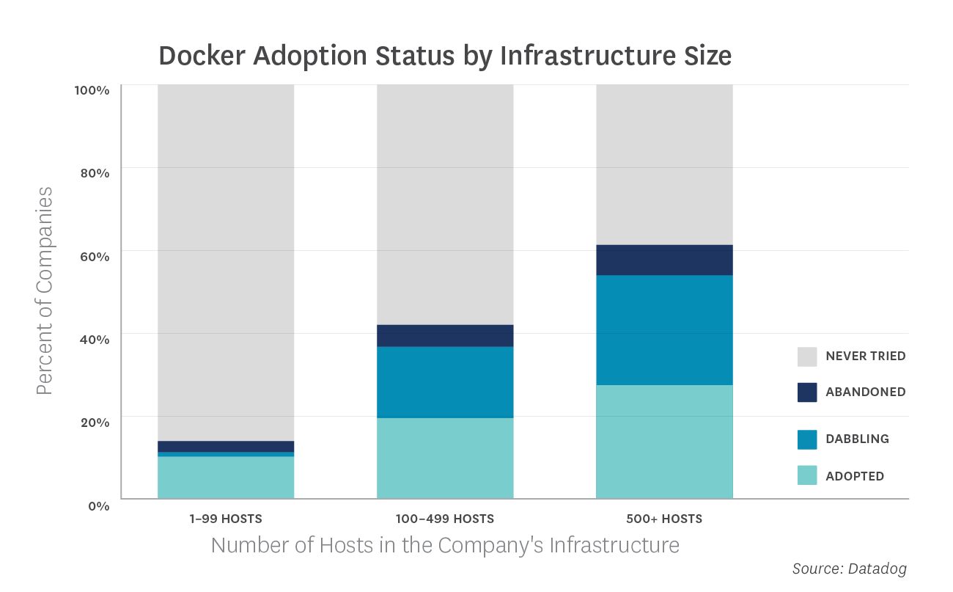

Slide 6
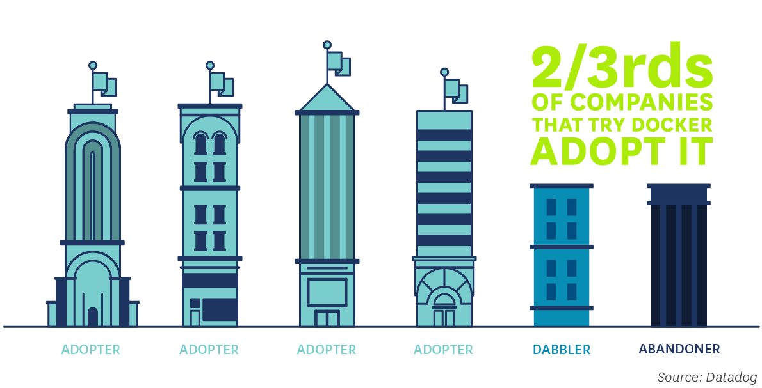

Slide 7
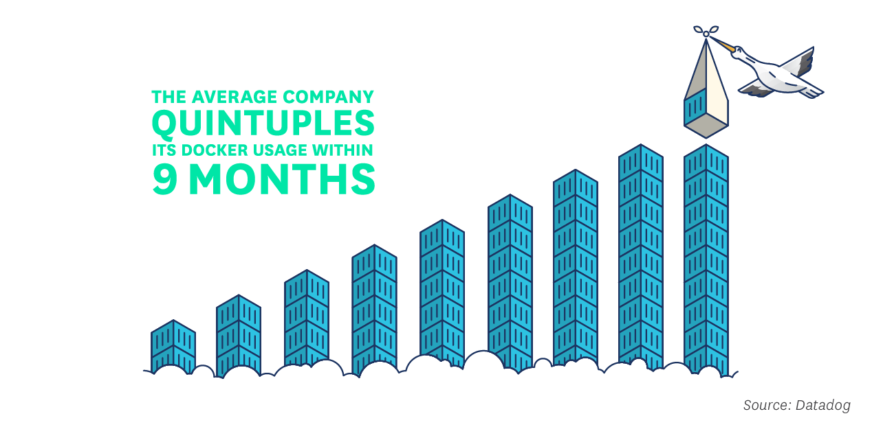

Slide 8
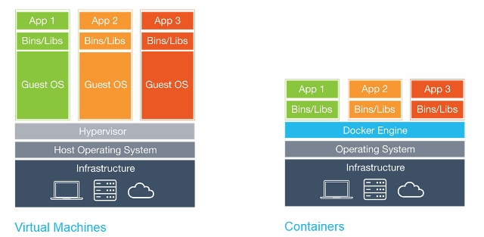
Differences between VM’s and Containers
Virtual Machines
Containers

Slide 9
Advantages of Containers
Containers include the minimal application requirements to run, making them lightweight. I avoid dealing with stuff I don’t need.
Portability across machines of an entire environment. As long as the Host OS runs Docker, I’m all set!
Version control for an application’s runtime - DockerHub
Increased control of server’s resources. I don’t assign static resources to a VM, rather give the container exactly what it needs.
Boot speed.

Slide 10
Advantages of Containers Cont’d
A container stops when the main process finishes. Shorter lifetime.
This means that Applications can be deconstructed into much smaller components (i.e. micro-service architecture) – Docker changes the way in which we build software
Makes the management in production easier
Much better horizontal scaling and less overhead. Deploying a new container takes a few seconds at most.

Slide 11
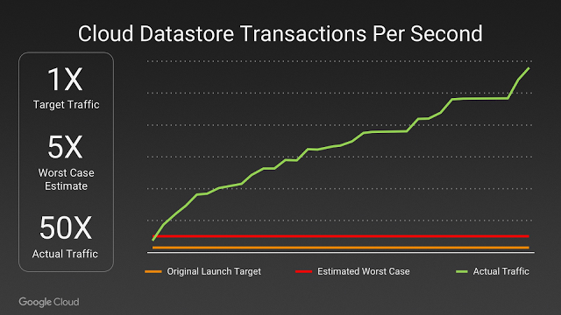
Example in the Wild: Pokémon GO

Slide 12
The application logic for the game runs on a Container Engine (GKE) powered by the open source Kubernetes project.
Containers can be scaled at planetary scale
The developers were free to develop live changes for their players
Pokémon GO was the largest Kubernetes deployment on GCP ever.
To support Pokémon GO’s massive player base, many tens of thousands of cores were provisioned for Niantic’s Container Engine cluster.

Slide 13
Hands on
https://github.com/pablovilla83/do-cdmx-nginx

Slide 14
Questions?

Slide 15
Thank you!
@pablovilla83

Slide 16
Sources and Extra Material
Docker for the virtualization admin
https://goto.docker.com/docker-for-the-virtualization-admin.html
8 surprising facts about Docker adoption
https://www.datadoghq.com/docker-adoption/
Bringing Pokémon Go to life in GCP
https://cloudplatform.googleblog.com/2016/09/bringing-Pokemon-GO-to-life-on-Google-Cloud.html
Docker commands
https://docs.docker.com/engine/reference/commandline/

