Slide 1
Reductions

Slide 2
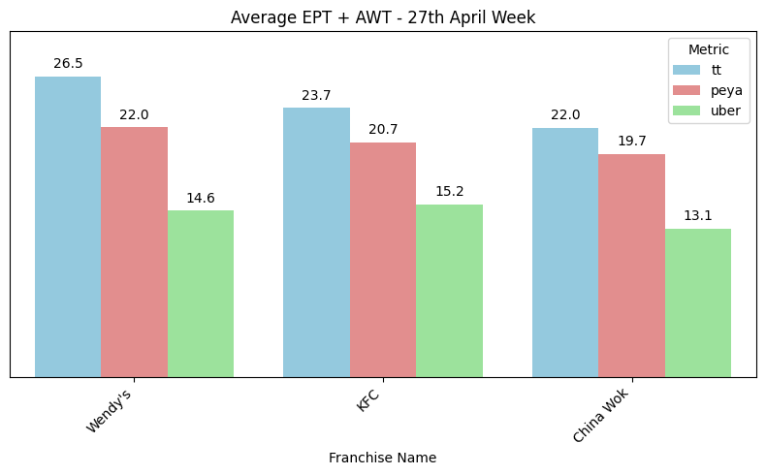
Introduction
Uber es más rápido en un 80% de las orders.
En 1 de cada 2 orders, Peya toma al menos un 30% más de tiempo que Uber.
Esto sugiere que los tiempos de preparación están sobrestimados.

Slide 3
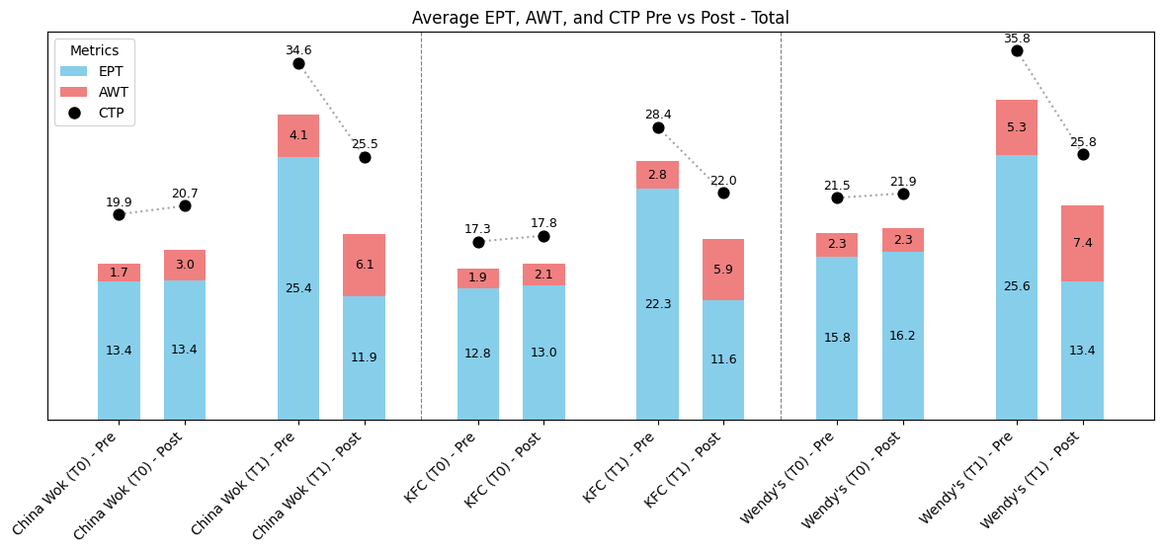
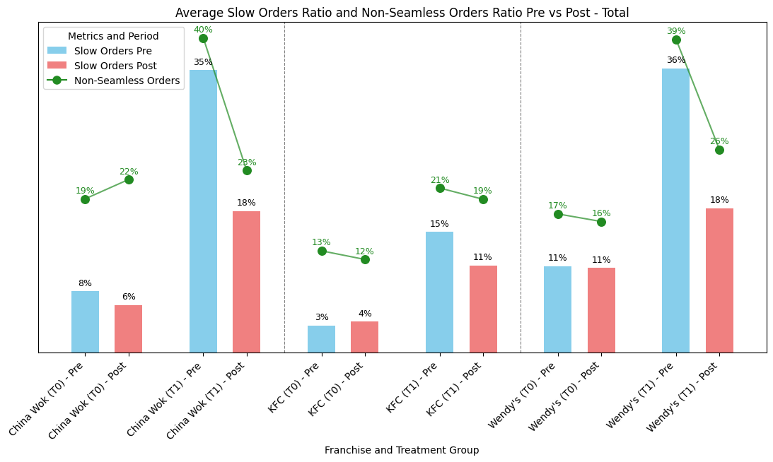
A1

Slide 4
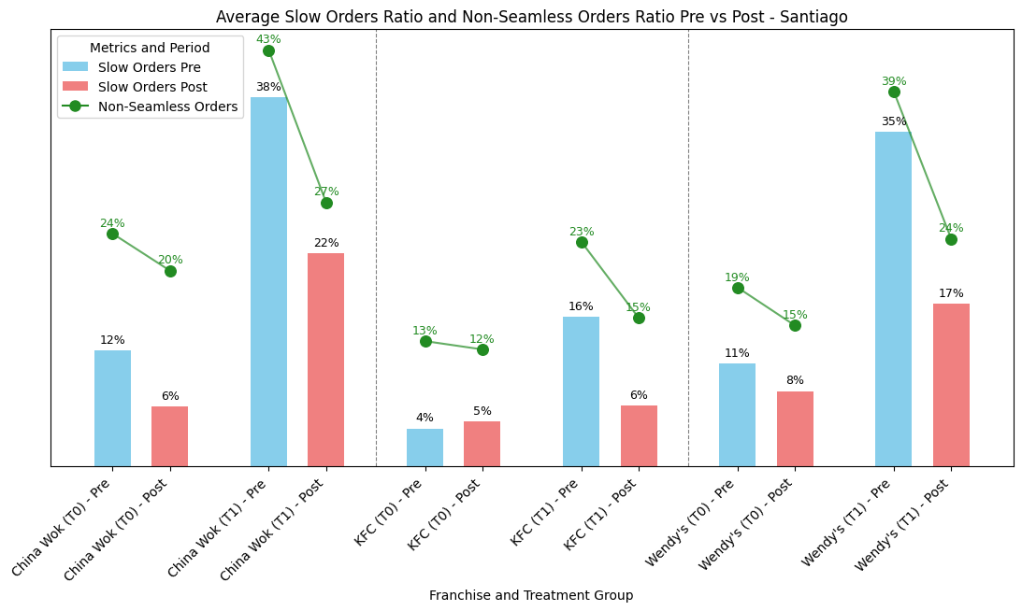
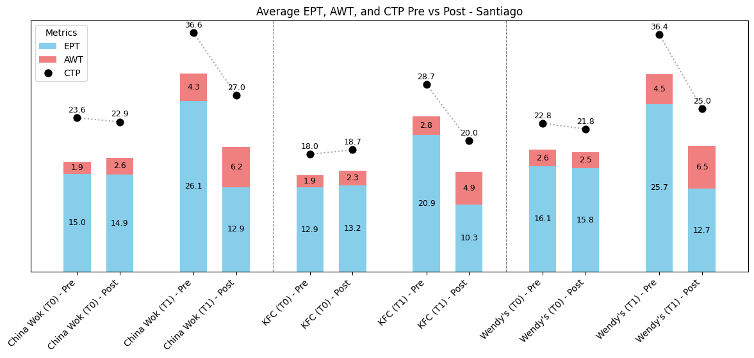
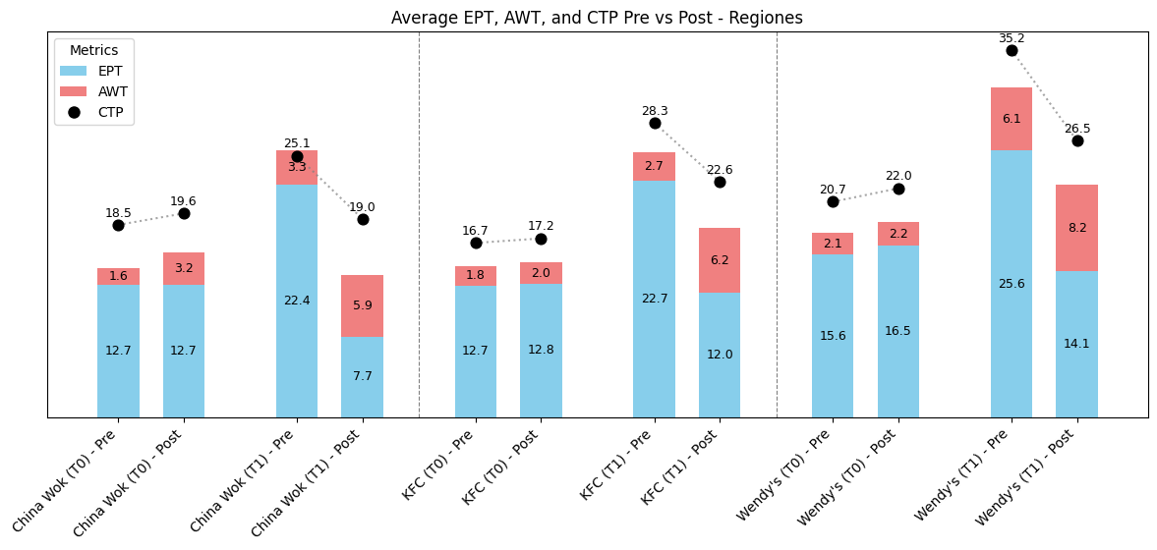

Slide 5
The Setup
Impact per franchise
Old: 27-10 May
franchise | selected stores | total stores | old EPT | new EPT | diff | diff %
China Wok | 7 | 16 | 23.7 | 14.9 | -8.8 | -37%
KFC | 28 | 140 | 28.9 | 15.2 | -13.6 | -47%
Wendy's | 10 | 43 | 29.1 | 16.1 | -12.9 | -45%
Pre: 8-11 May
Post: 15-18 May
franchise | Tt_Diff_Untreated | Tt_Diff_Treated | Slow_ratio_Diff_Untreated | Slow_ratio_Diff_Treated | ctp_Diff_Untreated | ctp_Diff_Treated
China Wok | -0.7 | -5.2 | -10.0 | -16.6 | -3.8 | -7.5
KFC | -0.5 | -6.7 | -3.8 | -16.3 | -2.2 | -8.4
Wendy's | -0.1 | -5.8 | -5.8 | -14.5 | -2.5 | -7.0

Slide 6
Friday to monday
Impact per franchise
avg old EPT: entre x e y fechas
avg new EPT: se tomó los numeros de
franchise | selected stores | total stores | avg old EPT | avg new EPT | diff | diff_pct
China Wok | 7 | 16 | 23.7 | 14.9 | -8.8 | -37%
KFC | 28 | 140 | 28.9 | 15.2 | -13.6 | -47%
Wendy's | 10 | 43 | 29.1 | 16.1 | -12.9 | -45%
Regiones
franchise | selected stores | total stores | avg old EPT | avg new EPT | diff | diff_pct
China Wok | 7 | 16 | 23.7 | 14.9 | -8.8 | -37%
KFC | 28 | 140 | 28.9 | 15.2 | -13.6 | -47%
Wendy's | 10 | 43 | 29.1 | 16.1 | -12.9 | -45%
Santiago
Incluir diferencias en ctp y slow
franchise_name | ept+awt_diff_untreated_mins | ept+awt_diff_treated_mins
China Wok | -0.7 | -5.2
KFC | -0.5 | -6.7
Wendy's | -0.1 | -5.8
Regiones
franchise_name | ept+awt_diff_untreated_mins | ept+awt_diff_treated_mins
China Wok | -0.7 | -5.2
KFC | -0.5 | -6.7
Wendy's | -0.1 | -5.8
Santiago

Slide 7
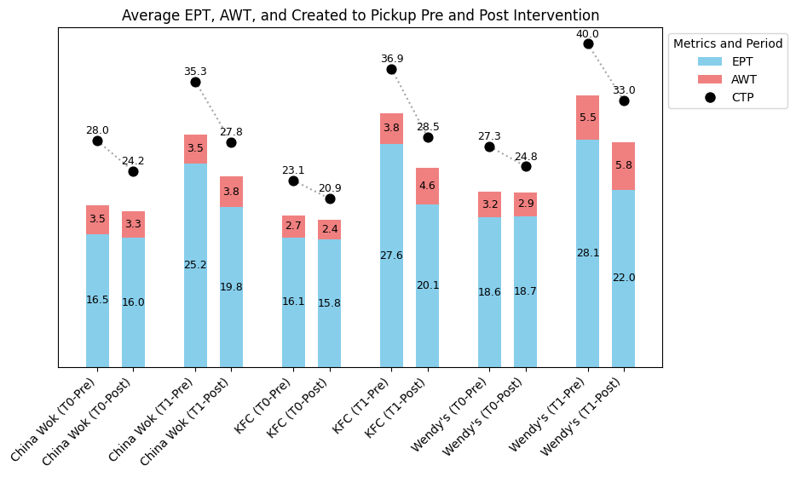
EPT + AWT, CTP
Pre: 8-11 May
Post: 15-18 May

Slide 8
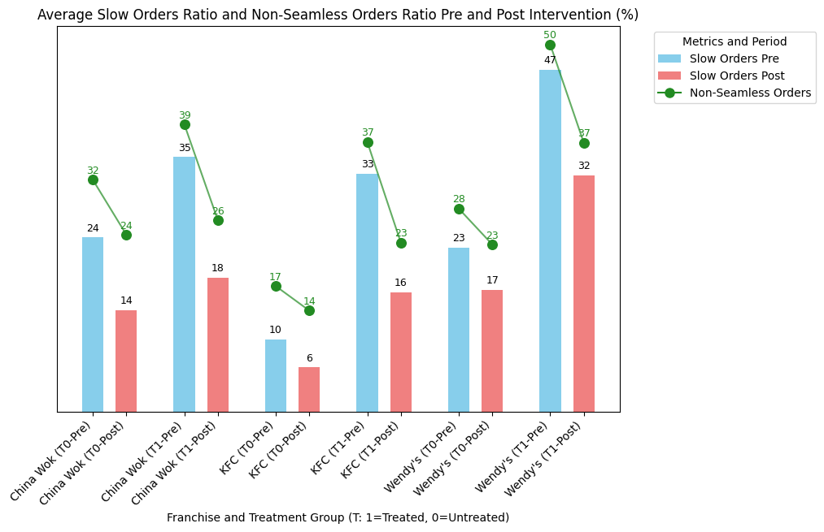
Slow, Seamless
Pre: 8-11 May
Post: 15-18 May

Slide 9
The Setup
Impact per franchise
Old: 27-10 May
franchise | selected stores | total stores | old ept | new ept | diff | diff %
China Wok | 7 | 16 | 23.7 | 10.4 | -13.3 | -56%
KFC | 28 | 140 | 28.9 | 11.3 | -17.6 | -61%
Wendy's | 10 | 43 | 29.1 | 11.2 | -17.8 | -61%
franchise | Tt_Diff_Untreated | Tt_Diff_Treated | Slow_ratio_Diff_Untreated | Slow_ratio_Diff_Treated | ctp_Diff_Untreated | ctp_Diff_Treated
China Wok | 1.20 | -10.33 | -1.7 | -13.3 | 0.95 | -7.06
KFC | 0.41 | -7.41 | 0.4 | -4.5 | 0.46 | -6.29
Wendy's | 0.66 | -9.73 | 0.2 | -16.9 | 0.64 | -9.64

Slide 10
Tuesday
Impact per franchise
avg old EPT: entre x e y fechas
avg new EPT: se tomó los numeros de
franchise | selected stores | total stores | avg old EPT | avg new EPT | diff | diff_pct
China Wok | 7 | 16 | 23.7 | 14.9 | -8.8 | -37%
KFC | 28 | 140 | 28.9 | 15.2 | -13.6 | -47%
Wendy's | 10 | 43 | 29.1 | 16.1 | -12.9 | -45%
Regiones
franchise | selected stores | total stores | avg old EPT | avg new EPT | diff | diff_pct
China Wok | 7 | 16 | 23.7 | 14.9 | -8.8 | -37%
KFC | 28 | 140 | 28.9 | 15.2 | -13.6 | -47%
Wendy's | 10 | 43 | 29.1 | 16.1 | -12.9 | -45%
Santiago
Incluir diferencias en ctp y slow
franchise_name | ept+awt_diff_untreated_mins | ept+awt_diff_treated_mins
China Wok | -0.7 | -5.2
KFC | -0.5 | -6.7
Wendy's | -0.1 | -5.8
Regiones
franchise_name | ept+awt_diff_untreated_mins | ept+awt_diff_treated_mins
China Wok | -0.7 | -5.2
KFC | -0.5 | -6.7
Wendy's | -0.1 | -5.8
Santiago

Slide 11
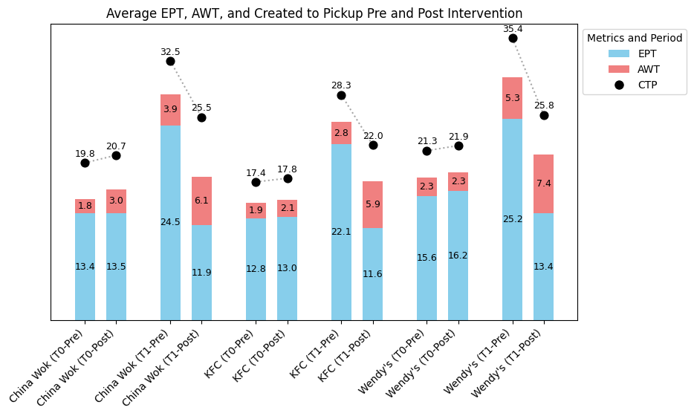
EPT + AWT, CTP
Pre: 12 May
Post: 19 May

Slide 12
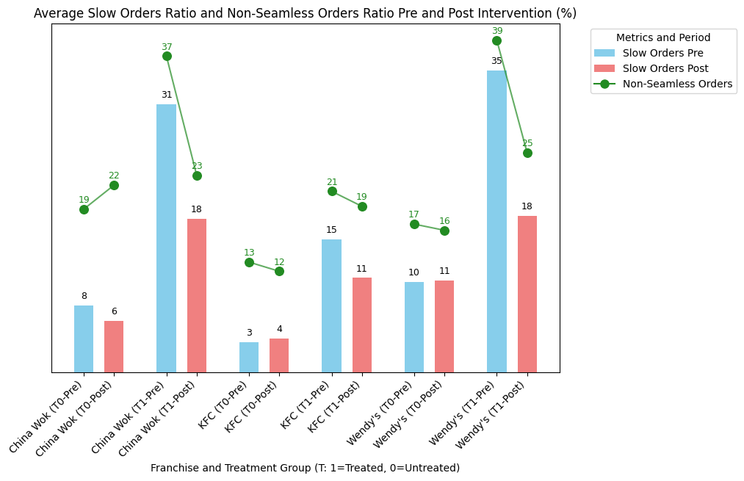
Slow, Seamless
Pre: 12 May
Post: 19 May

Slide 13
Next steps
El primer batch comprendía las franquicias KFC, Wendy's, y China Wok, cubriendo el 53% de las orders sin FiR.
El próximo batch estará conformado por Papa John's, Carl's Jr., Domino's Pizza y la Fuente Chilena.
El método de asignación de reducciones volverá a ser las tiendas de mayores EPT + AWT, abarcando un 30% del volumen de orders de cada franquicia.

Slide 14
Introducción de la data: contexto de la data de la competencia (rodri)
Mostrar resultados por vertical restaurante
Replicar resultados pero con métricas de created_to_pickup, slow,
Next steps: new franchises, logica, guardrails, low fir junto a operaciones,

