Slide 1
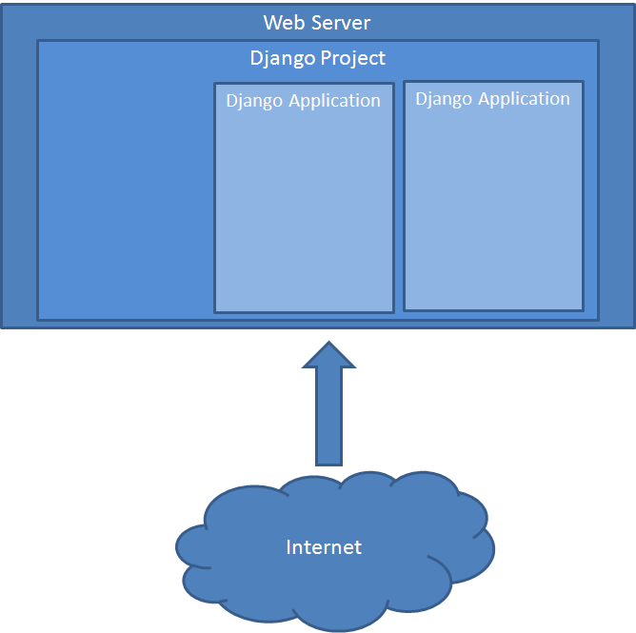
Notes:
This first picture illustrates the Django project and application concepts. The database, the root URL parser and base HTML belong to the project. An application can be plugged into the project. The database then needs to be sync’d with the application’s data model. The URL parser from the application is linked with the project URL parser and hopefully the project base HTML matches the applications’ HTML templates.
The web server shows the information that the Django project generates. This project can have different apps that fulfill a number of tasks. Every app can access the database through the models that it defines.

Slide 2
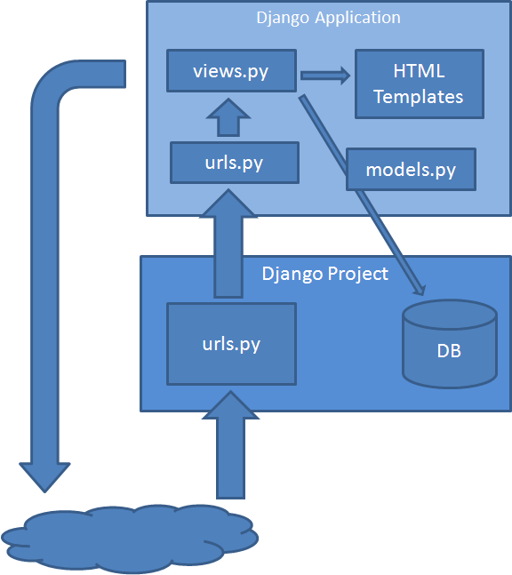
Notes:
A request comes in to the web server which transfers control to the Django project. The file urls.py analyses the URL and decides which function in views.py is called. The functions in views.py prepare the data to be presented with the HTML template and return the HTML to the client. The file models.py contains a class describing the data stored in a relational database table. This can contain as many classes as you need. It is possible to use multiple databases and to re-use existing databases.
The request is analyzed by the urls.py of the project that can access the urls.py of some application. There it’s decided which view is going to be executed. This view access the database data through the models of the app and generate the HTML code by itself or using an existing template.

Slide 3
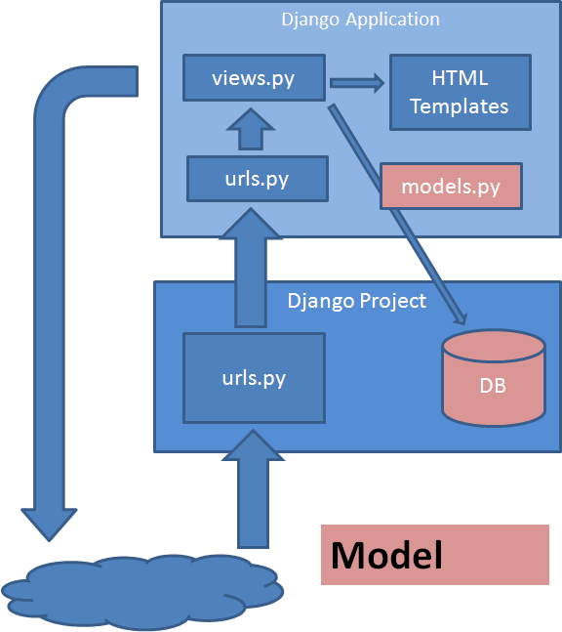
Notes:
This picture shows the “model” part of the Model View Controller pattern.
In Django models are high level abstractions that define how the underlaying database would be organized. Thus, we can switch between databses managers such as Postgres or SQLite without changing our models.

Slide 4
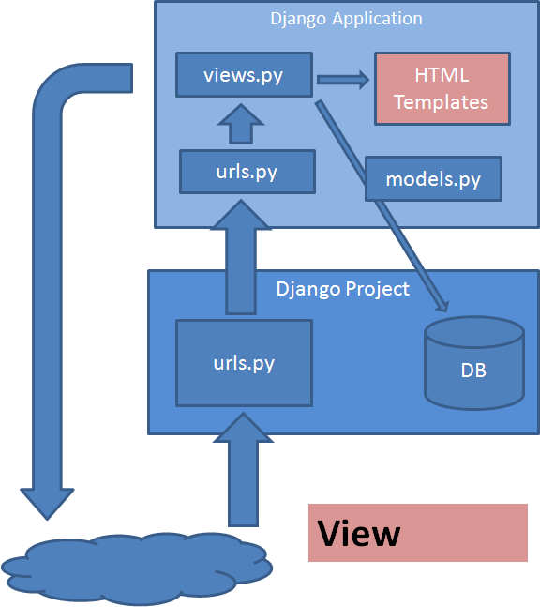
Notes:
The view part is the presentation through the HTML templates and the rest is the Controller: The url interpretation and the views.py processing. Depending on your interpretation of MVC one can argue that parts of views.py are Controller and parts are View. Let me leave it at that.
In some sense what the client gets when it asks the server for a page is a construction of that page based upon the HTML templates blueprint defined in the server side.

Slide 5
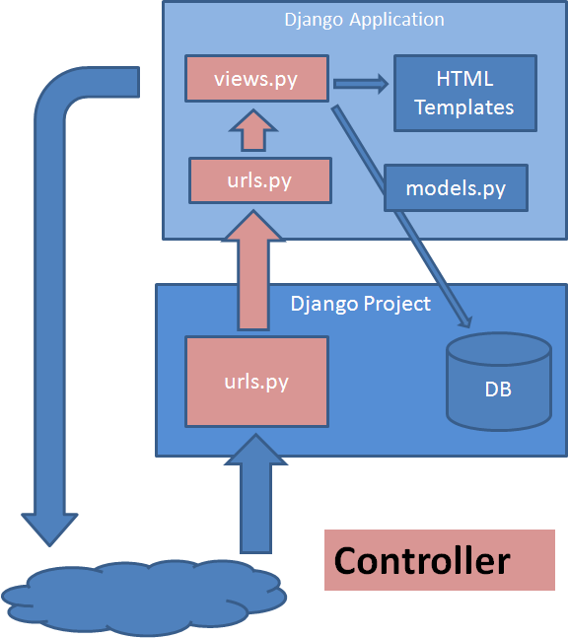
Notes:
So I’ve gone through the tutorials and started playing a bit with real life data, so I’m no expert, but I hope this overview is useful to anyone confused by the Django tutorials.
In the schema above a client petition resolution is shown. Basically when the client ask for a page, the urls module maps that requested page to the specific app’s urls, this module remaps the request again, but this time, to the corresponding view asked by the client.

