Slide 1

Kitchen Cloud – A Smart Recipe Sharing and Storage Platform
Seshadri Rao Gudlavalleru Engineering College, Gudlavalleru
Department of Computer Science and Engineering
By
P.Karuna 22481A05H7
P.Varshitha 22481A05J4
M.YeduKondalu 22481A05G1
M.Durga Charan 22481A05G3
Under the guidance of
Mr.G.Srikanth ,M.Tech(Ph.D.)
Assistant Professor, Department of CSE

Slide 2

Problem Statement
Existing recipe applications often lack the essential features of personalization, simplicity, and social engagement, making them less effective for modern users. Many individuals struggle to manage their recipes, which are scattered across multiple, unstructured sources such as notebooks, screenshots, and social media posts. To overcome these challenges, there is a need for a single, interactive platform that provides an easy, secure, and community-driven environment for storing, organizing, and discovering recipes efficiently.

Slide 3
Abstract
Kitchen Cloud is a recipe management web platform that allows users to create, organize, and share their favorite recipes online. Users can upload images, categorize recipes by cuisine or ingredients, and access them anytime. The platform encourages collaboration by enabling users to like, comment, and share recipes with others. With its intuitive interface and scalability, Kitchen Cloud makes cooking more organized, interactive, and enjoyable. It provides a secure cloud-based environment for storing personal and shared recipes, ensuring easy accessibility across devices. Additionally, its modern design and community features inspire users to explore new dishes and connect with fellow cooking enthusiasts worldwide.

Slide 4
Objectives of the Project
Develop a cloud-based recipe management platform.
Allow users to add, edit, and categorize recipes with images.
Build a social cooking community through likes and comments.
Ensure security, scalability, and easy access.
Provide a responsive and user-friendly interface.

Slide 5
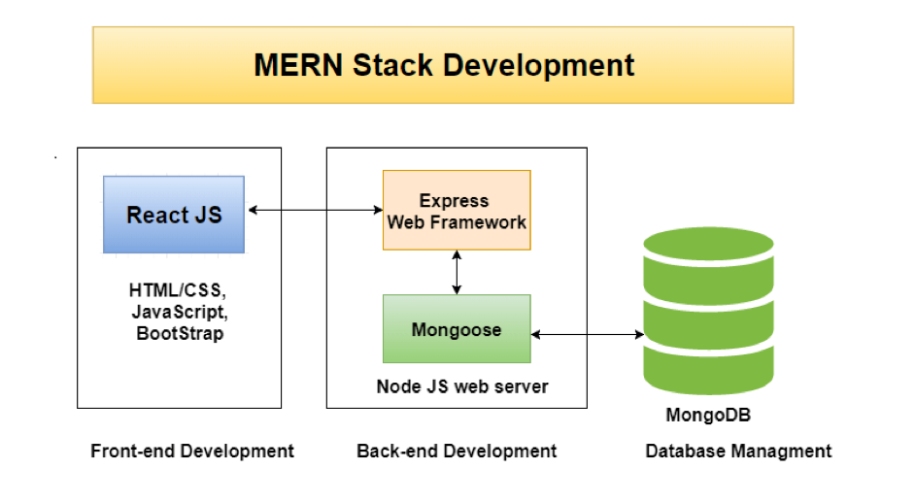
Methodology
The system is developed using the MERN stack (MongoDB, Express.js, React.js, Node.js).
Frontend: React.js for an interactive and responsive UI.
Backend: Node.js with Express.js for API development and authentication.
Database: MongoDB for efficient storage and retrieval of recipe and user data. Security is ensured using JWT-based authentication for safe user access.

Slide 6
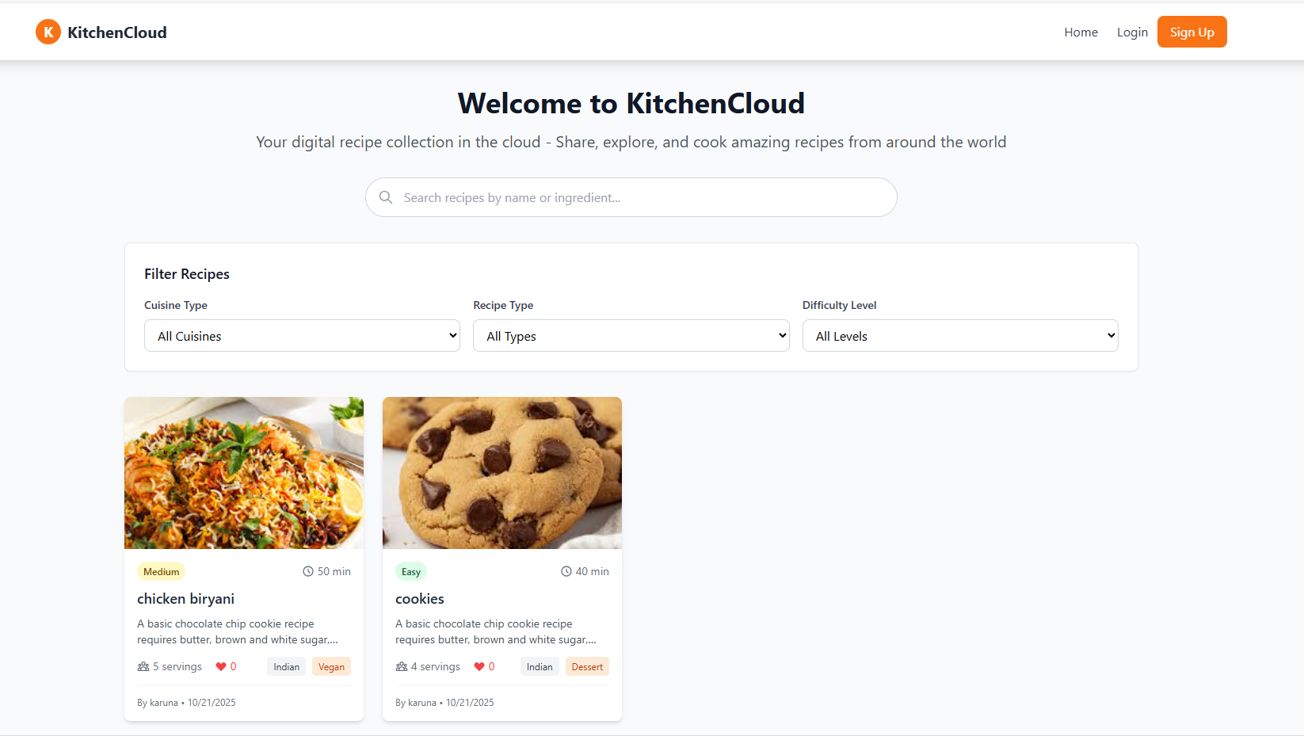

Slide 7
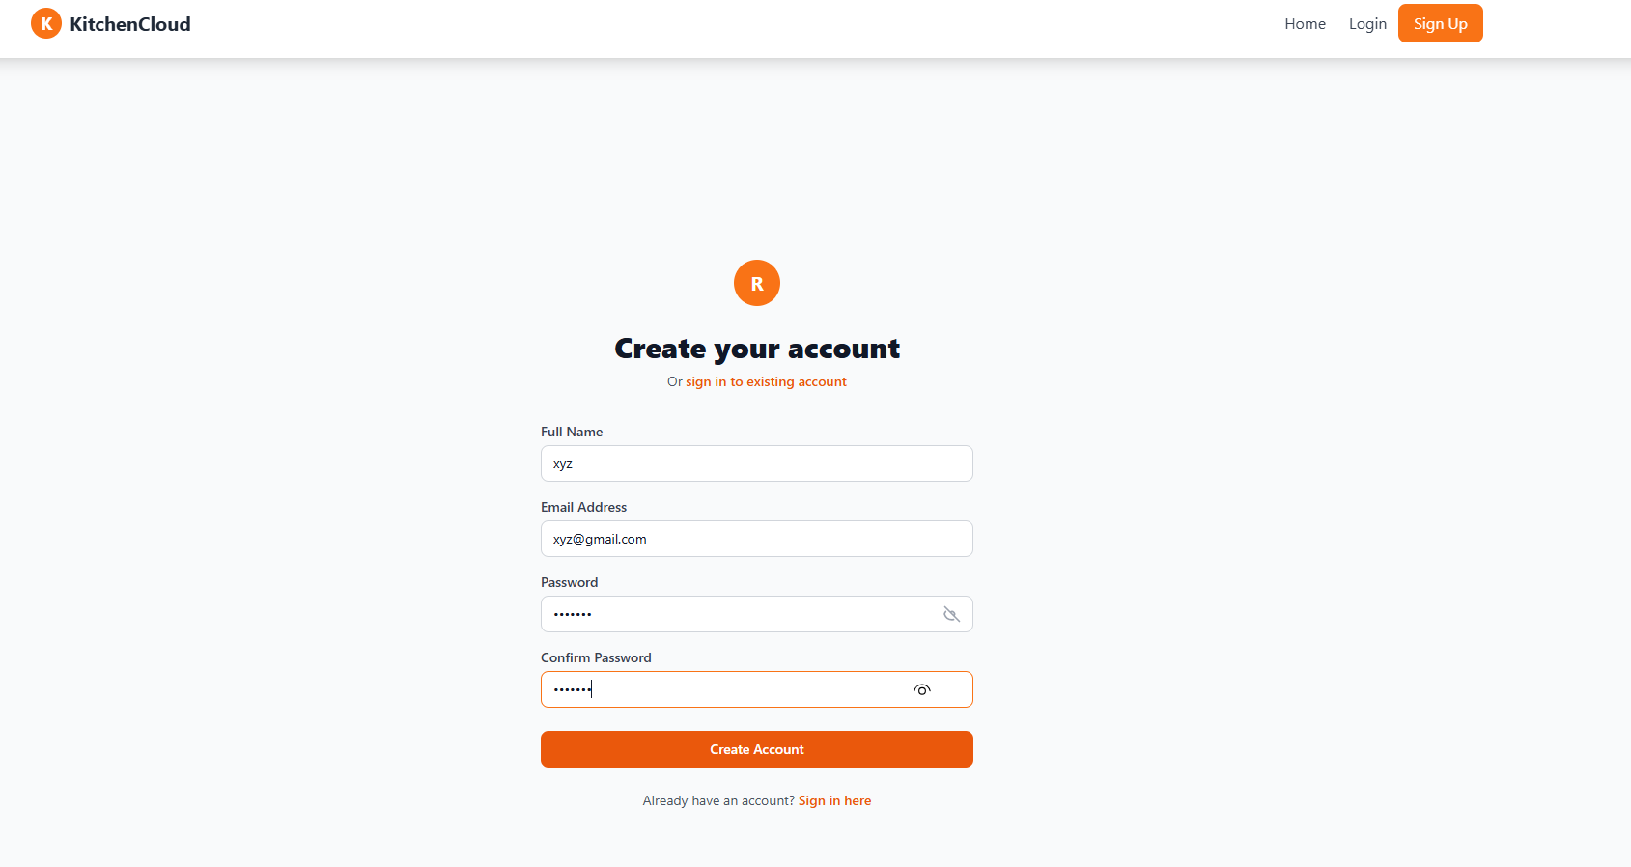

Slide 8
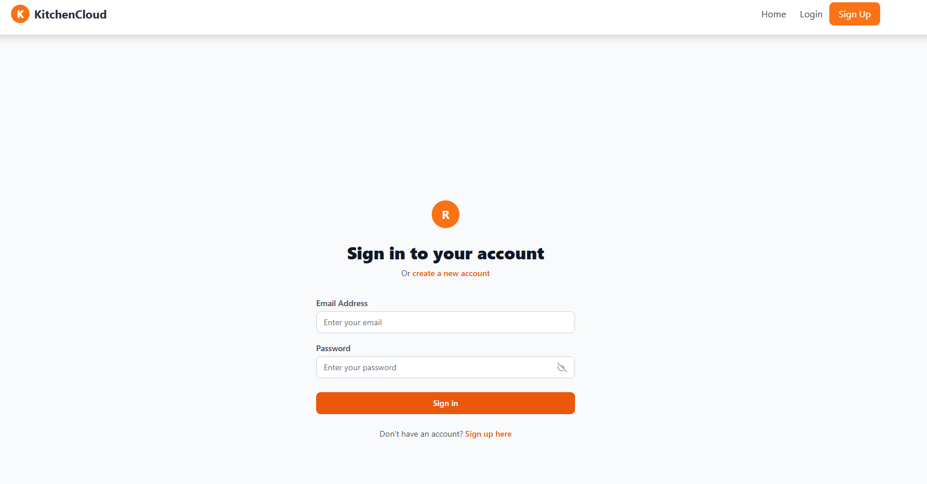

Slide 9
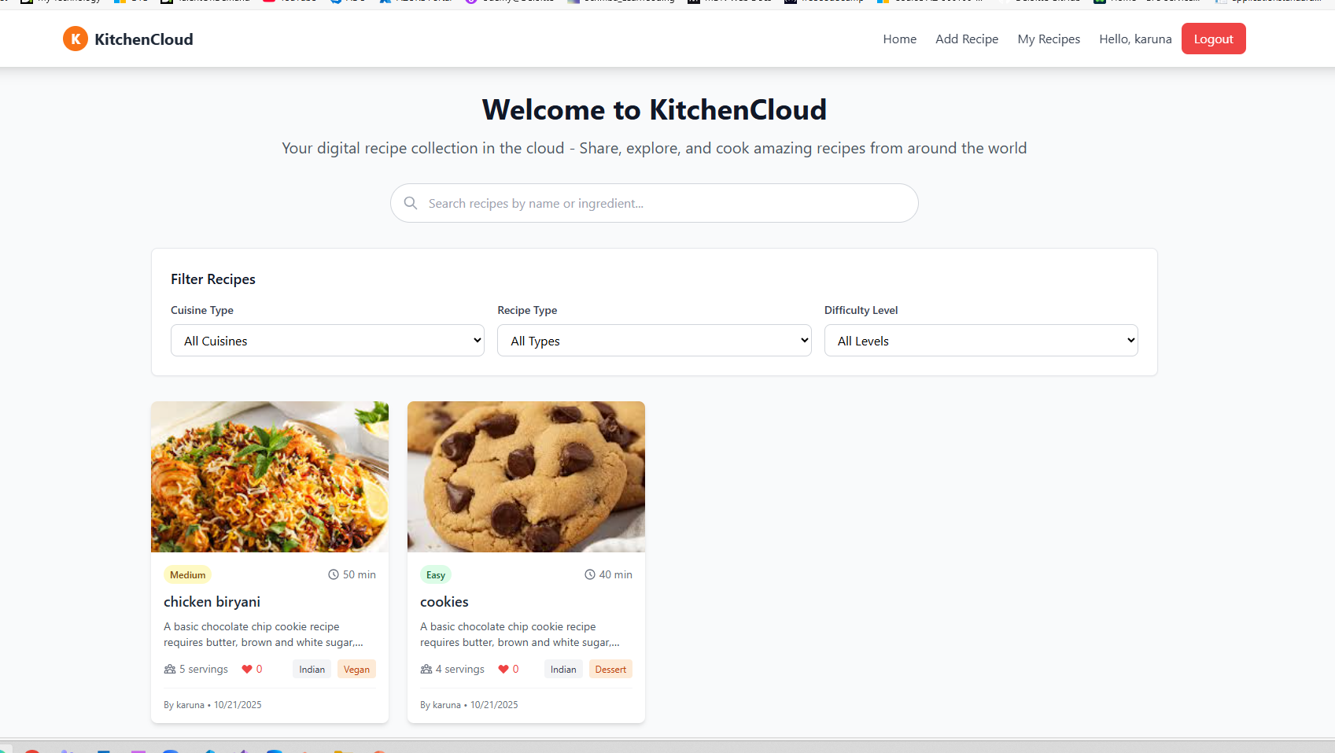

Slide 10
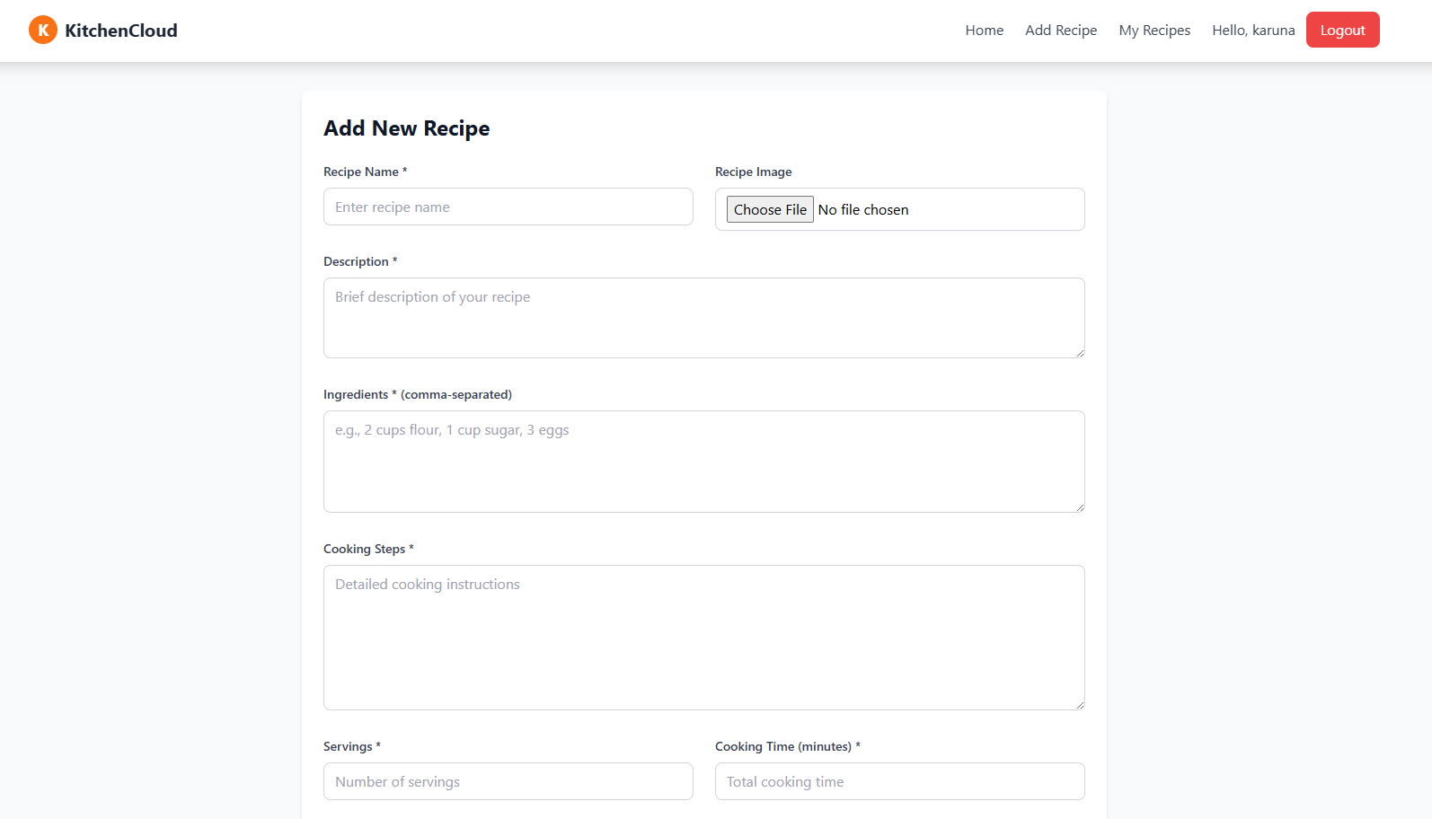

Slide 11
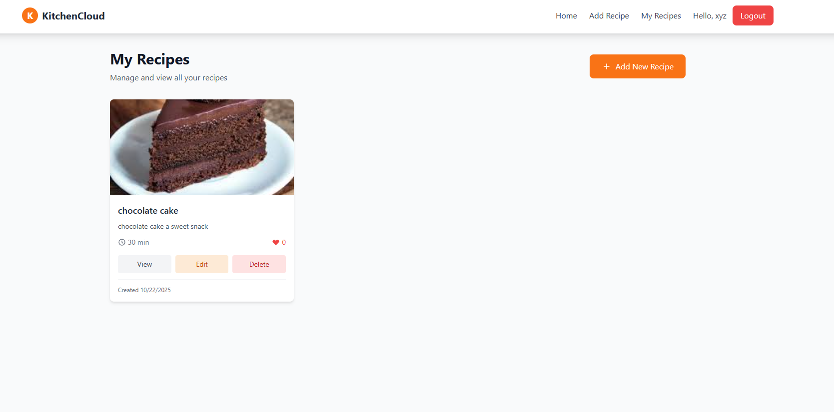

Slide 12
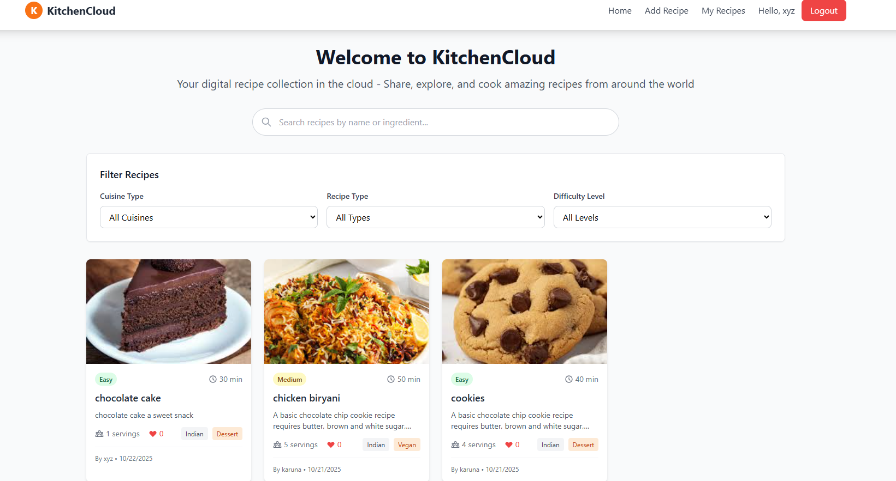

Slide 13
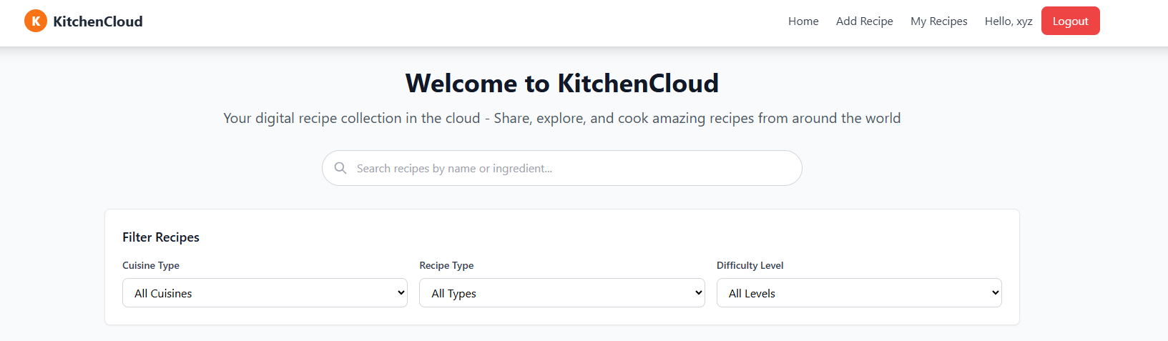

Slide 14
Advantages of Kitchen Cloud
Centralized cloud storage for all recipes.
Easy sharing and collaboration with others.
Accessible anytime, anywhere on any device.
Smart categorization and advanced search.
Interactive features: images, videos, and step-by-step guides.
Secure and reliable data management with MERN stack.
Scalable for future features like meal planning and AI suggestions.

Slide 15
Future Extensions

Slide 16
Conclusion
The Kitchen Cloud – A Smart Recipe Sharing and Storage Platform successfully provides an efficient and user-friendly solution for managing and sharing recipes online. By integrating the MERN stack, the system ensures scalability, security, and seamless performance. Users can easily create, organize, and categorize their recipes while engaging with a community through likes, comments, and sharing. The cloud-based design allows anytime, anywhere access, making recipe management simple and convenient. Overall, the project achieves its goal of combining technology and culinary creativity, offering a modern platform that makes cooking more organized, interactive, and enjoyable for users.

Slide 17
Thank You

