Slide 1

Kitchen Cloud – A Smart Recipe Sharing and Storage Platform
Seshadri Rao Gudlavalleru Engineering College, Gudlavalleru
Department of Computer Science and Engineering
By
P.Karuna 22481A05H7
P.Varshitha 22481A05J4
M.YeduKondalu 22481A05G1
M.Durga Charan 22481A05G3
Under the guidance of
Mr.G.Srikanth ,M.Tech(Ph.D.)
Assistant Professor, Department of CSE

Slide 2

Problem Statement
Existing recipe applications often lack the essential features of personalization, simplicity, and social engagement, making them less effective for modern users. Many individuals struggle to manage their recipes, which are scattered across multiple, unstructured sources such as notebooks, screenshots, and social media posts. To overcome these challenges, there is a need for a single, interactive platform that provides an easy, secure, and community-driven environment for storing, organizing, and discovering recipes efficiently.

Slide 3
Abstract
Kitchen Cloud is a recipe management web platform that allows users to create, organize, and share their favorite recipes online. Users can upload images, categorize recipes by cuisine or ingredients, and access them anytime. The platform encourages collaboration by enabling users to like, comment, and share recipes with others. With its intuitive interface and scalability, Kitchen Cloud makes cooking more organized, interactive, and enjoyable. It provides a secure cloud-based environment for storing personal and shared recipes, ensuring easy accessibility across devices. Additionally, its modern design and community features inspire users to explore new dishes and connect with fellow cooking enthusiasts worldwide.

Slide 4
Objectives
Enable Efficient Recipe Management Allow users to add, edit, store, and categorize recipes with images for a personalized cooking experience.
Build a Social Cooking Community Foster interaction through likes, comments, and sharing, encouraging engagement and collaboration among home cooks.
Ensure Security and Privacy Safeguard user data and platform integrity through robust authentication and secure cloud storage.
Achieve Scalability and Reliability Design a platform that can grow with a large user base, providing consistent and fast access anytime, anywhere.
Deliver a Responsive, User-Friendly Interface Create intuitive and visually appealing web and mobile experiences accessible across devices.

Slide 5
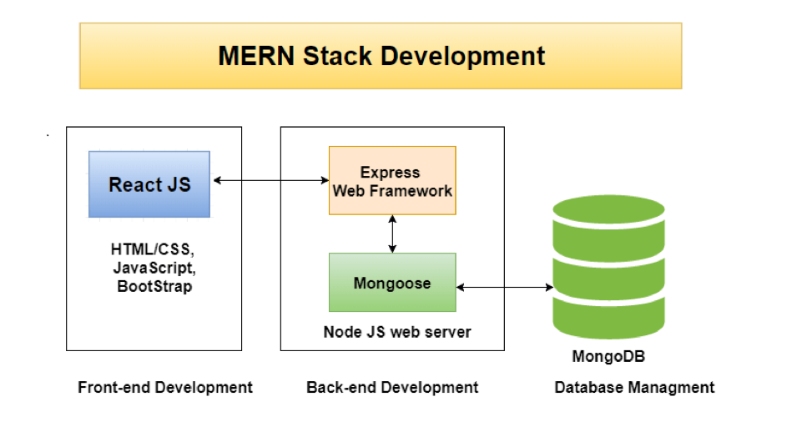
Methodology
Frontend:
Technology: React.js
Purpose: Delivers a dynamic, interactive, and responsive User Interface (UI).
Features: Implements reusable components, state management via hooks, and supports rapid prototyping.
Benefits: Enhances user experience with efficient rendering using the Virtual DOM.
Additional Tools: HTML, CSS, JavaScript, Bootstrap for styling and layout.
Backend:
Technology: Node.js with Express.js as the web framework.
Purpose: Handles API development, request routing, business logic, and user authentication.
Features: RESTful APIs, middleware integration, modular architecture for scalability.
Benefits: Asynchronous processing for high performance under concurrent loads.

Slide 6
Database:
Technology: MongoDB
Purpose: Stores and retrieves recipes and user information efficiently.
Features: NoSQL structure supports flexible, JSON-like documents and easy scalability.
Benefits: Facilitates fast access, data modeling flexibility, and integration with Mongoose for schema validation and business rules.
Security:
Practice: Utilizes JWT-based authentication to safeguard user sessions and API access.
Features: Stateless authentication, protects sensitive endpoints, prevents unauthorized access.

Slide 7
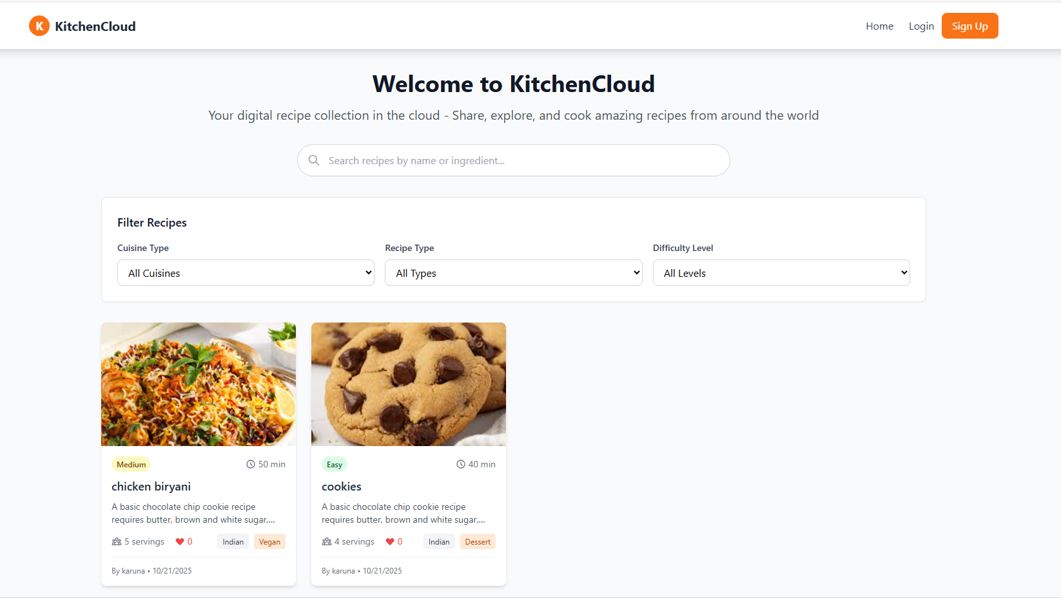
Home Page

Slide 8
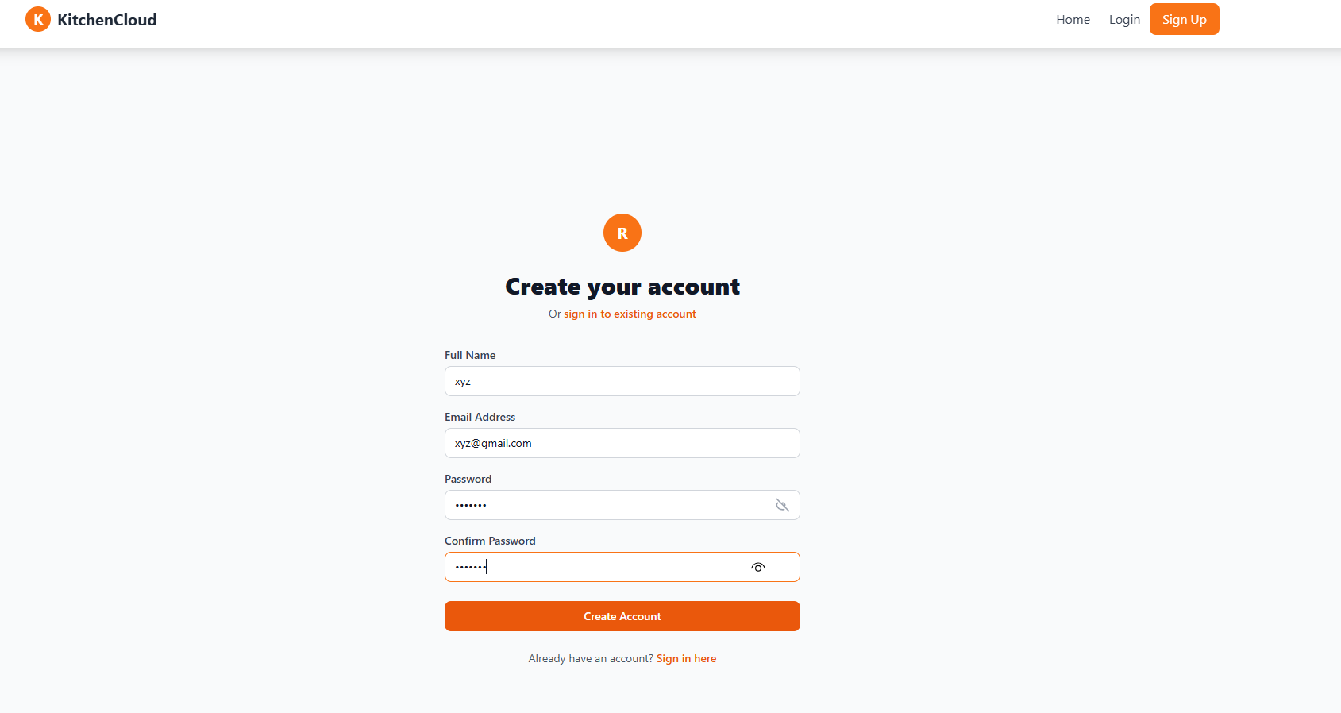
Signup page

Slide 9
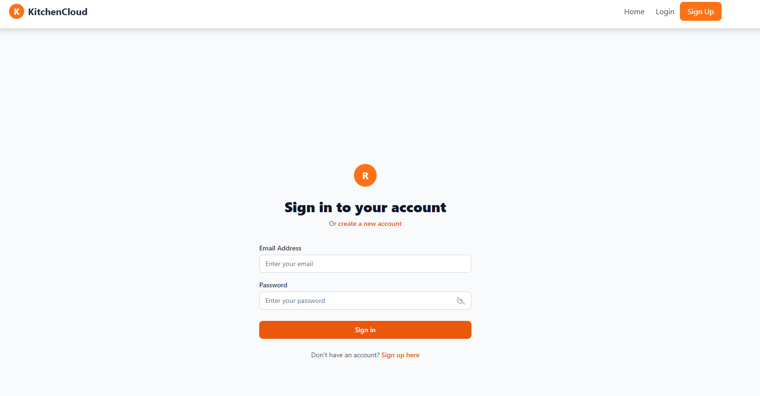
Login page

Slide 10
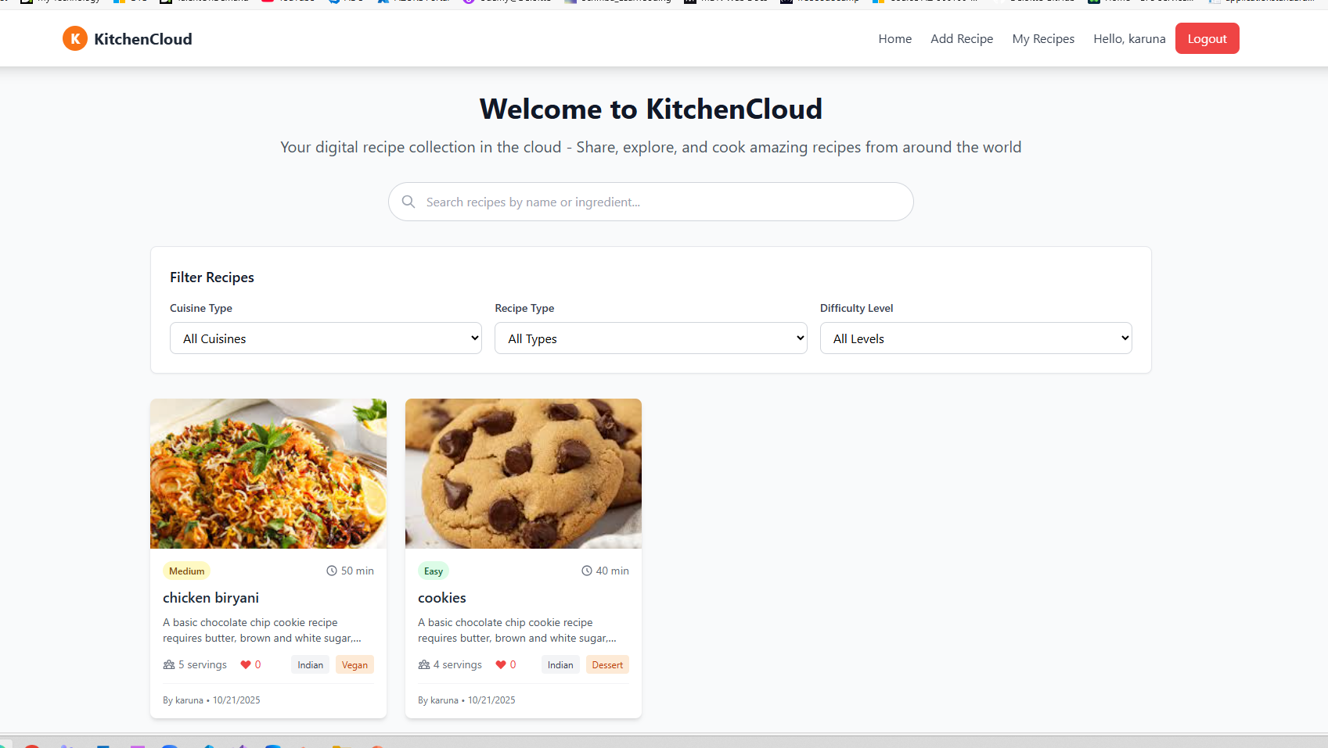

Slide 11
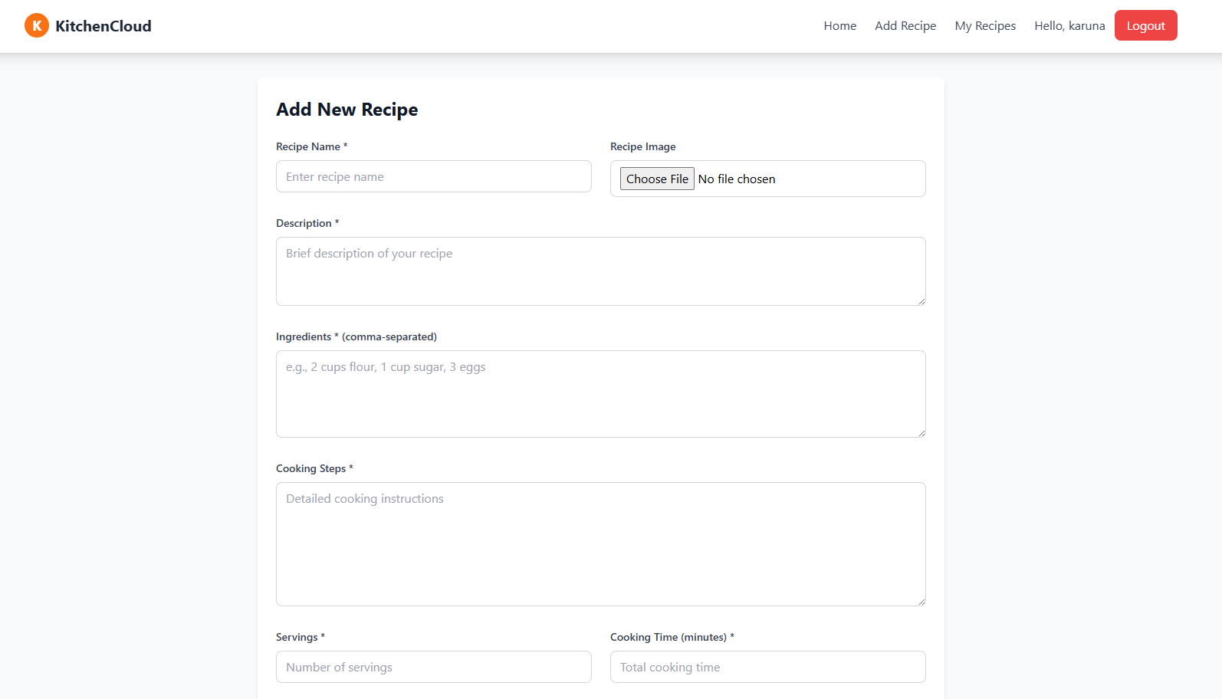

Slide 12
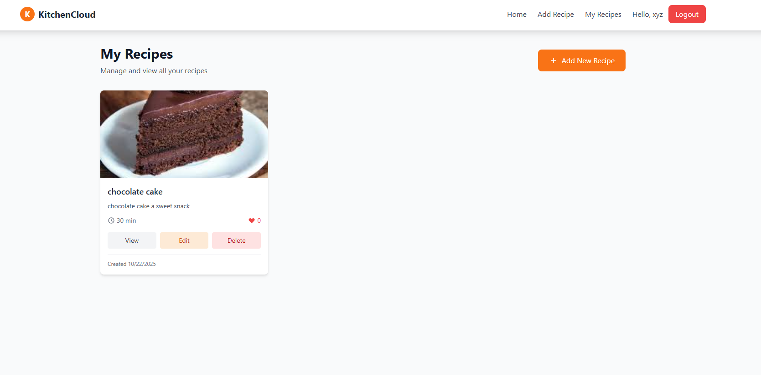

Slide 13
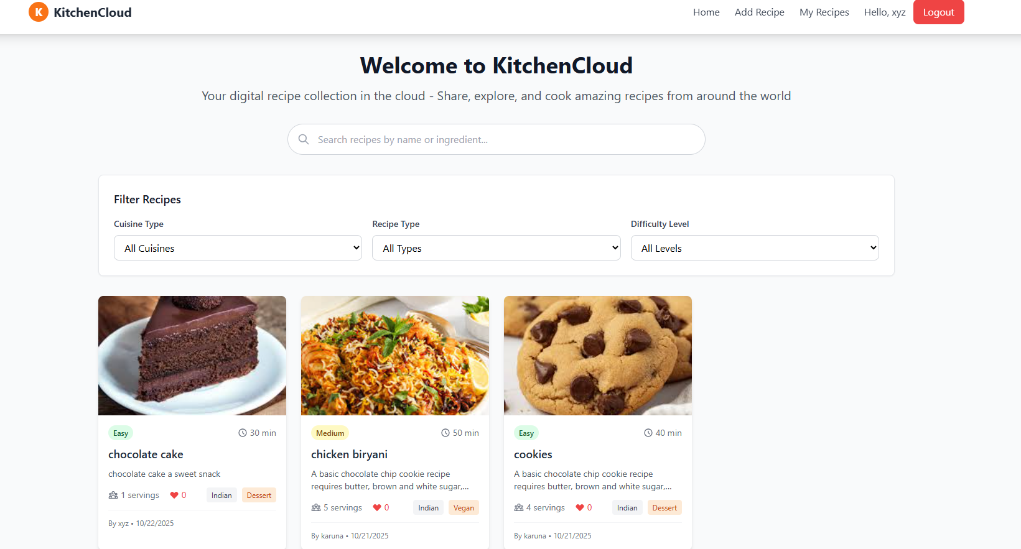

Slide 14
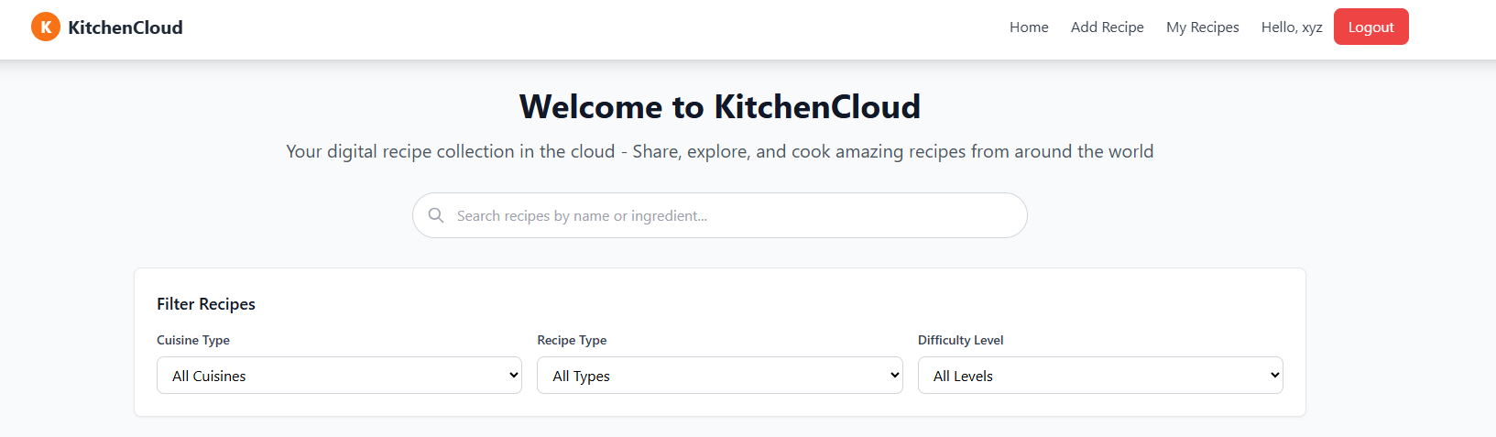

Slide 15
Advantages of Kitchen Cloud
Centralized cloud storage for all recipes.
Easy sharing and collaboration with others.
Accessible anytime, anywhere on any device.
Smart categorization and advanced search.
Interactive features: images, videos, and step-by-step guides.
Secure and reliable data management with MERN stack.
Scalable for future features like meal planning and AI suggestions.

Slide 16
Future Extensions
1.AI-Powered Recommendations: Use machine learning to suggest recipes based on users’ preferences, past activity, and dietary restrictions.
Personal Cookbooks: Allow users to curate and organize personalized collections and meal plans.
2. Community and Collaboration
Interactive Forums: Enable users to ask questions, give cooking tips, and share culinary experiences.
Collaborative Recipe Creation: Allow multiple users to co-create, edit, and improve recipes.
3. Multimedia and Smart Devices
Video and Step-by-step Guides: Incorporate user-generated video tutorials and interactive cooking guides.
Smart Kitchen Integration: Enable connectivity with IoT devices for features like hands-free recipe navigation and ingredient tracking.

Slide 17
Conclusion
The Kitchen Cloud – A Smart Recipe Sharing and Storage Platform successfully provides an efficient and user-friendly solution for managing and sharing recipes online. By integrating the MERN stack, the system ensures scalability, security, and seamless performance. Users can easily create, organize, and categorize their recipes while engaging with a community through likes, comments, and sharing. The cloud-based design allows anytime, anywhere access, making recipe management simple and convenient. Overall, the project achieves its goal of combining technology and culinary creativity, offering a modern platform that makes cooking more organized, interactive, and enjoyable for users.

Slide 18
Thank You

Slide 19
