Slide 1
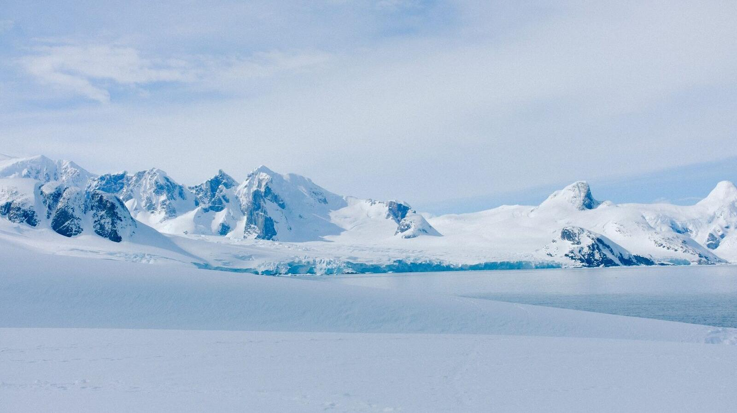



Title
Subtitle, event or meeting
Place · Date
Notes:
@ Shutterstock

Slide 2
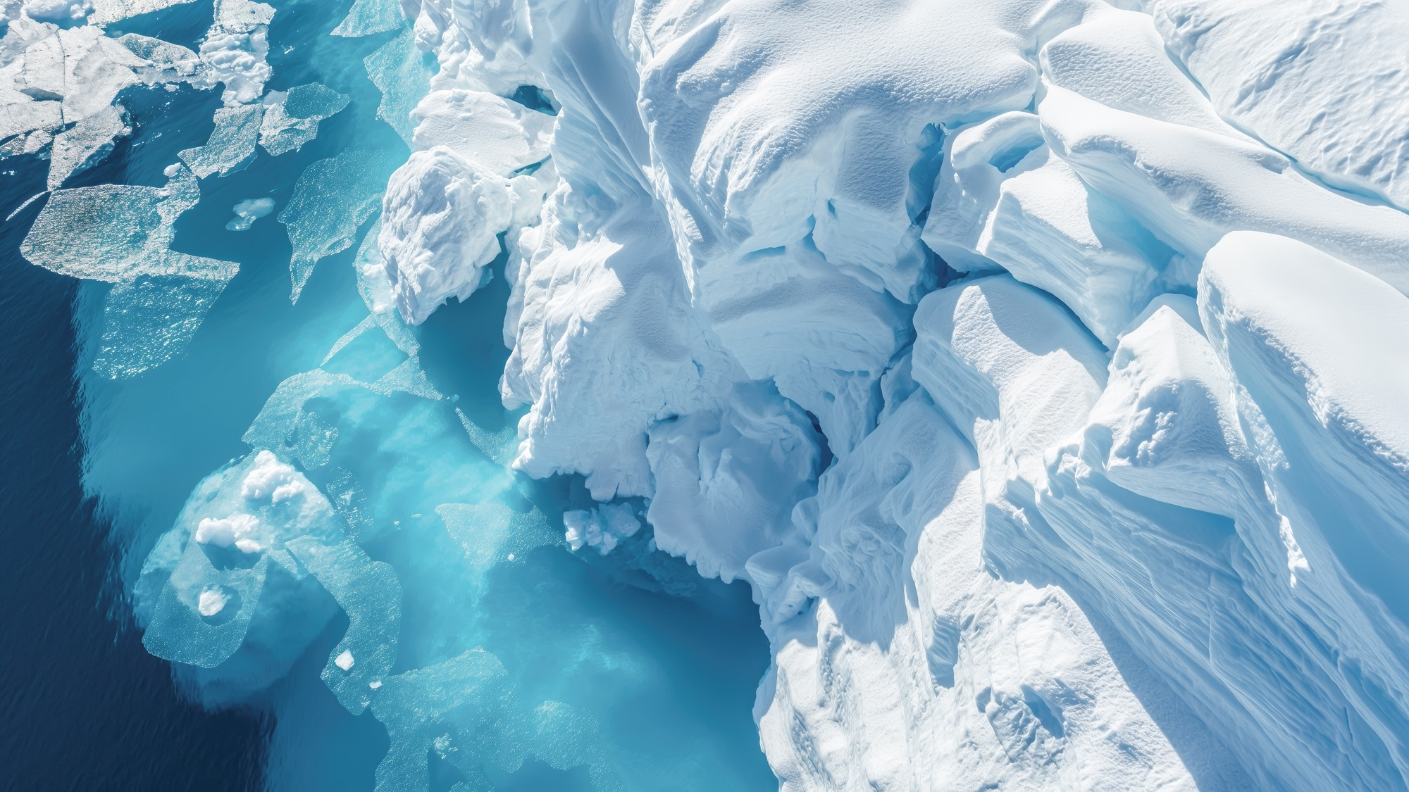
Title
Subtitle, event or meeting
Place · Date
Notes:
@ Shutterstock

Slide 3

Title of your presentation
Subtitle, event or meeting
Place · Date
Decade of Action for Cryospheric Sciences 2025–2034
03

Slide 4
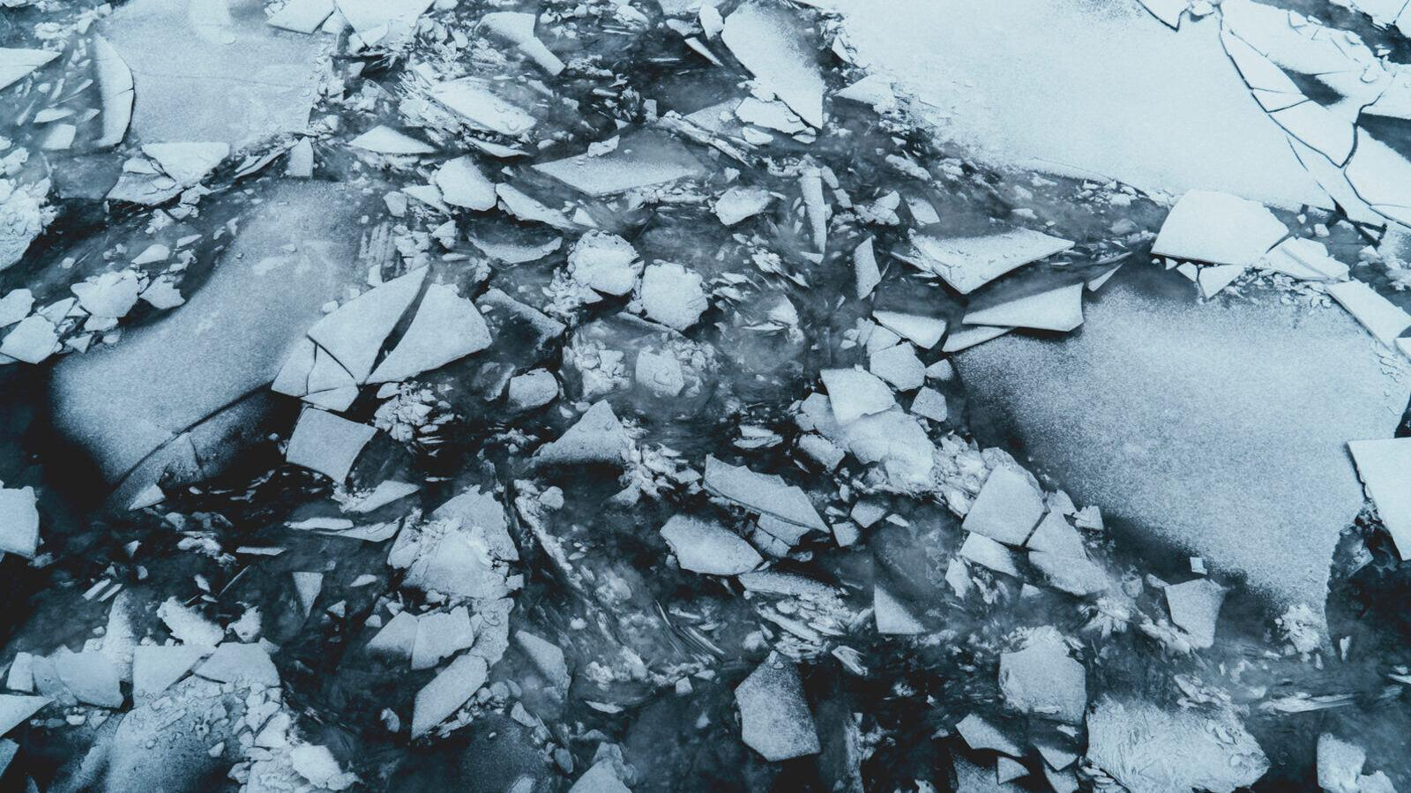


Section title
Text
04
Notes:
@ Shutterstock

Slide 5

Section title
Text
04
Notes:
@ Shutterstock

Slide 6
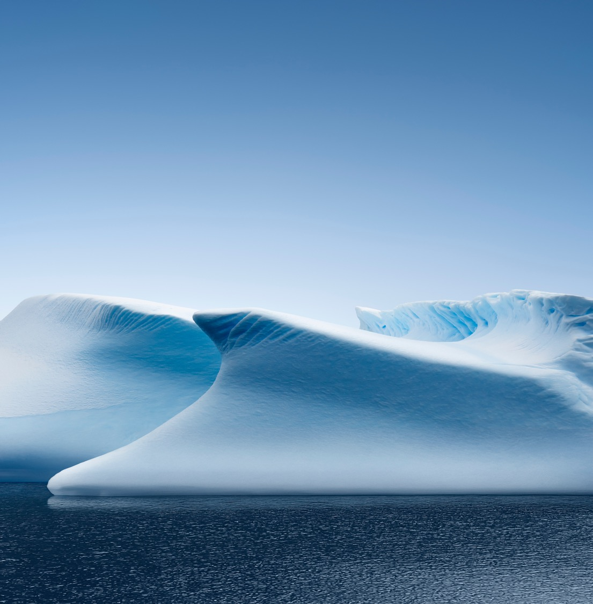
Section title
Text
04
Notes:
@ Ocean Bank Images

Slide 7


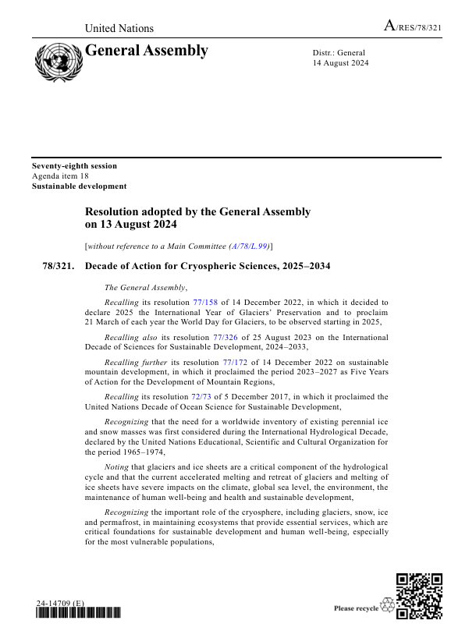
United Nations General Assembly Resolution
Decision 1
… To address the challenges associated with melting glaciers and changes to the cryosphere by advancing related scientific research and monitoring, under the overarching goal of advancing global scientific cooperation and sustainable development efforts as articulated in the International Decade of Sciences for Sustainable Development, 2024–2033
Decision 2
… To promote activities aimed at raising awareness of the Decade and the importance of glaciers, snow and ice in the climate system and the hydrological cycle, and the economic, social and environmental impacts of the impending changes in the Earth's cryosphere, and to share best practices and knowledge in this regard, including on building resilience to related risks;
Decision 3
… Invites the United Nations Educational, Scientific and Cultural Organization to lead the implementation of the Decade of Action, in collaboration with other relevant organizations of the United Nations system as well as other stakeholders, including those involved in the International Year of Glaciers' Preservation 2025
05

Slide 8



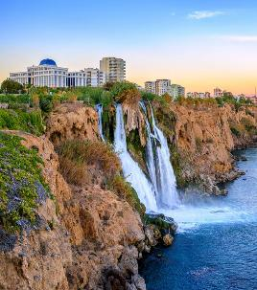



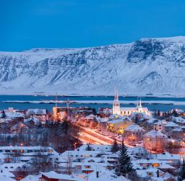




Upcoming Events
Strategic Management Committee & Working Group Meeting
Arctic Circle Assembly
(Side-event)
Cryosphere Action Summit
Reykjavík, Iceland
Beijing, China Hosted by the Chinese Academy of Sciences
Chamonix, France
8-10 October 2026
1-4 December 2026
2027 TBC
9-20 November 2026
8-10 December 2026
COP31
UN-Water Conference
Antalya, Türkiye
United Arab Emirates
06
Notes:
1

Slide 9




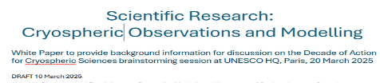
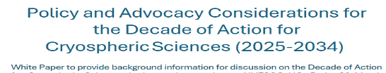
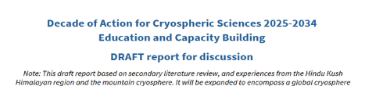





Synthesis Document
Five Background Documents and Once Concept Note
Expert partners prepared five background documents on five different aspects which guided the discussions during the UNESCO Brainstorming Session. The documents were then reviewed and enhanced by the participants and led to a Synthesis Document.
07

Slide 10


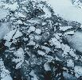


Overarching Challenges and Main Goals
Overarching Challenge
Main Goals
1.1 Build a Global Cryosphere Monitoring Inventory
1.2 Enhance Monitoring Capabilities
1.3 Make Observations Actionable
OC1: Global Cryosphere Modelling
2.1 Cryosphere Modelling for Decision Making
2.2 Inclusive Cryosphere Prediction
2.3 Creation of a Decision and Outreach Toolkit
OC2: Actionable Cryosphere Projections
3.1 Global Cryosphere Risk Assessment
3.2 Cryosphere Loss Vulnerability Assessment
3.3 Operationalize Cryosphere Loss into Adaptation Strategies
OC3: Cryospheric Risk Management Solutions
4.1 Incorporating Cryosphere Loss into Adaptation Strategies
4.2 Co-Develop Adaptation Strategies for those Living in/with the Cryosphere
4.3 Establish a Global Cryosphere Adaptation Knowledge Hub
OC4: Adaptation to Cryosphere Loss
5.1 Policy Integration and Engagement/Cryosphere Loss Prevention
5.2 Global Cryosphere Outreach and Communication
5.3 Education and Capacity Building
OC5: Amplify the Impact of Cryospheric Science
08

Slide 11
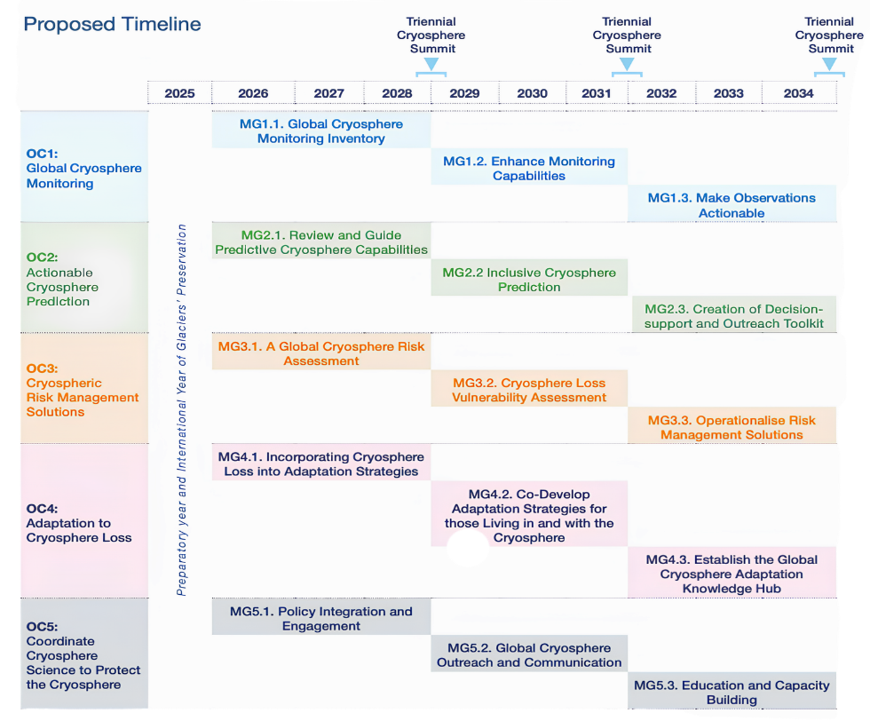
Timeline
Triennial Cryosphere Summits
Progress towards the Decade’s goals and its overall vision will be reviewed at Triennial Cryosphere Summits.
Timeline of Activities
Overarching Challenges and Main Goals will be aligned across the Decade to ensure:
A common strategic direction across Working Groups and Main Goals
Coordinated action and investment around shared cryosphere challenges
A clear pathway from science to impact, linking knowledge, risk assessment, adaptation and policy.

Slide 12
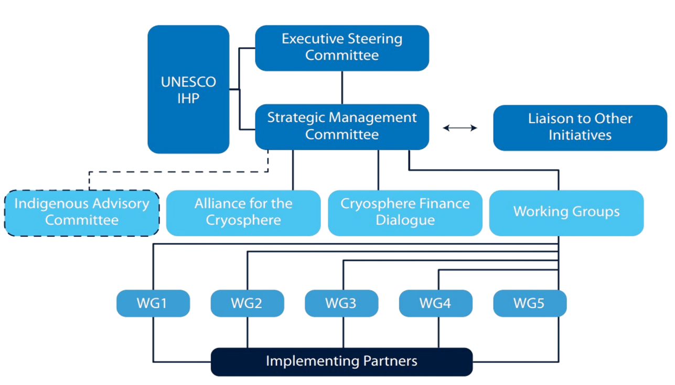

Governance Structure
Join the Decade of Action for Cryospheric Sciences (2025–2034)
Open-ended Groups

Slide 13
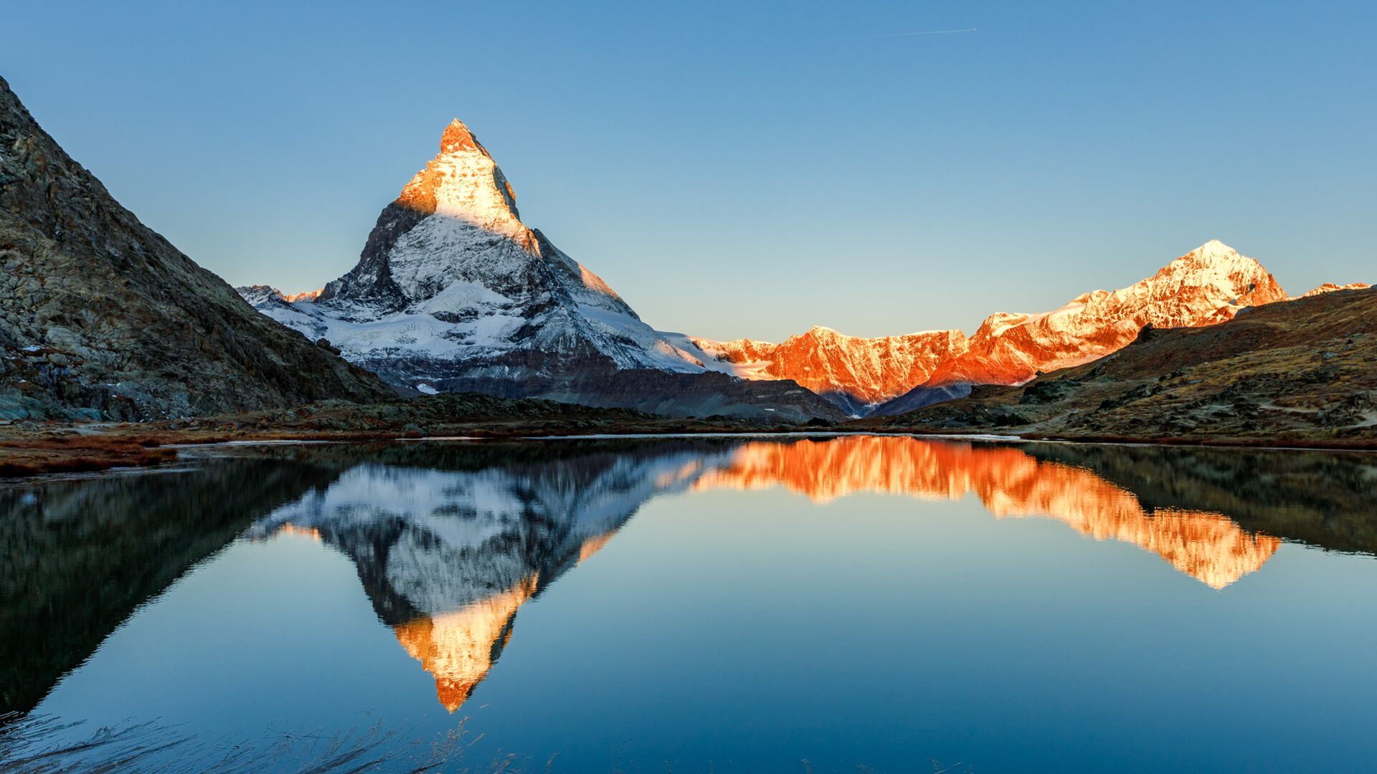

Thank you
www.un-cryosphere.org
Intergovernmental Hydrological Programme · UNESCO
Notes:
@ Shutterstock

Slide 14



TITLE
Evendame corecea voluptiunt platem adis rehende nihicil et hil modignam fugia corest, consedit doloreh entiis alit accabo. Temquos in cum quiaturi iur?
Harum soloribusae diam erias alia pratiam, ommolorrum ullendunt exeratemped et eiusam is denditae parum sus qui dellaciis se pellabo.
Decade of Action for Cryospheric Sciences 2025–2034
07

Slide 15
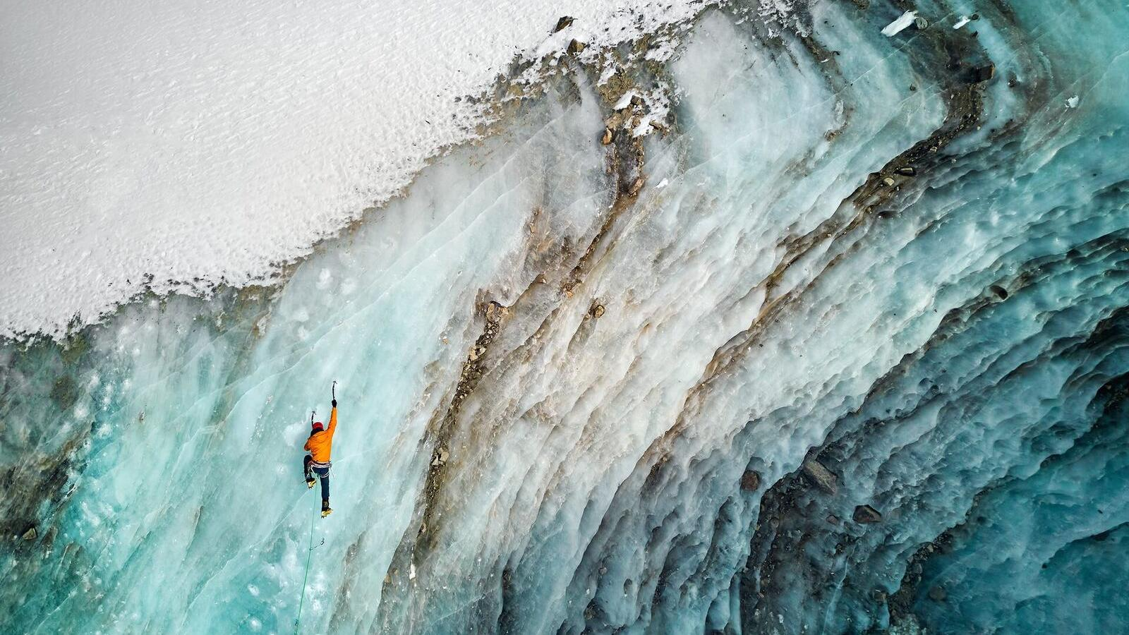


Title
Evendame corecea voluptiunt platem adis rehende nihicil et hil modignam fugia corest, consedit doloreh entiis alit accabo. Temquos in cum quiaturi iur?
Harum soloribusae diam erias alia pratiam, ommolorrum ullendunt exeratemped et eiusam is denditae parum sus qui dellaciis se pellabo.
Evendame corecea voluptiunt platem adis rehende nihicil et hil modignam fugia corest, consedit doloreh entiis alit accabo. Temquos in cum quiaturi iur?
Harum soloribusae diam erias alia pratiam, ommolorrum ullendunt exeratemped et eiusam is denditae parum sus qui dellaciis se pellabo.
Decade of Action for Cryospheric Sciences 2025–2034
08
Notes:
@ Shutterstock

Slide 16


Title
corecea voluptiunt platem adis rehende nihicil et hil modignam fugia corest, consedit doloreh entiis alit accabo.
09
Notes:
@ Shutterstock

Slide 17
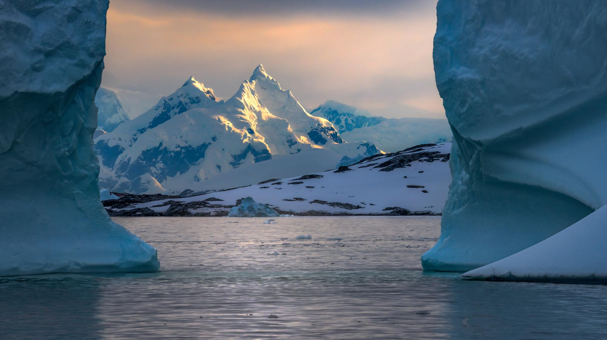

Title
Evendame corecea voluptiunt platem adis rehende nihicil et hil modignam fugia corest, consedit doloreh entiis alit accabo. Temquos in cum quiaturi iur?
Harum soloribusae diam erias alia pratiam, ommolorrum ullendunt exeratemped et eiusam is denditae parum sus qui dellaciis se pellabo.
10
Notes:
@ Shutterstock

Slide 18



Title
Evendame corecea voluptiunt platem adis rehende nihicil et hil modignam fugia corest, consedit doloreh entiis alit accabo. Temquos in cum quiaturi iur?
Harum soloribusae diam erias alia pratiam, ommolorrum ullendunt exeratemped et eiusam is denditae parum sus qui dellaciis se pellabo.
11
Notes:
@ Shutterstock

Slide 19
The Decade in figures
Replace these figures with your own. Keep the value short enough to read at a glance and put the qualification in the label beneath it.
5
Overarching challenges guiding the Decade
15
Main goals across the five challenges
10
Years of coordinated action, 2025 to 2034
2025
International Year of Glaciers’ Preservation
Decade of Action for Cryospheric Sciences 2025–2034
12

Slide 20
“
To address the challenges associated with melting glaciers and changes to the cryosphere by advancing related scientific research and monitoring.
United Nations General Assembly resolution 78/321, 13 August 2024
Decade of Action for Cryospheric Sciences 2025–2034
13

Slide 21
Next steps
How partners can engage with the Decade over the coming cycle.
01
Di audiaspid elescienimil etur apedis et eos ?
The groups are open-ended; register your institution through the Decade website.
02
Di audiaspid elescienimil etur apedis et eos ?
Share observation records and capabilities against Overarching Challenge 1.
03
Di audiaspid elescienimil etur apedis et eos ?
Align your reporting with the Decade’s Main Goals ahead of the first review.
Decade of Action for Cryospheric Sciences 2025-2034
14

Slide 22


Thank you

