Slide 1
Muhammad Ali Boxing Reform Act (MABRA)

Slide 2
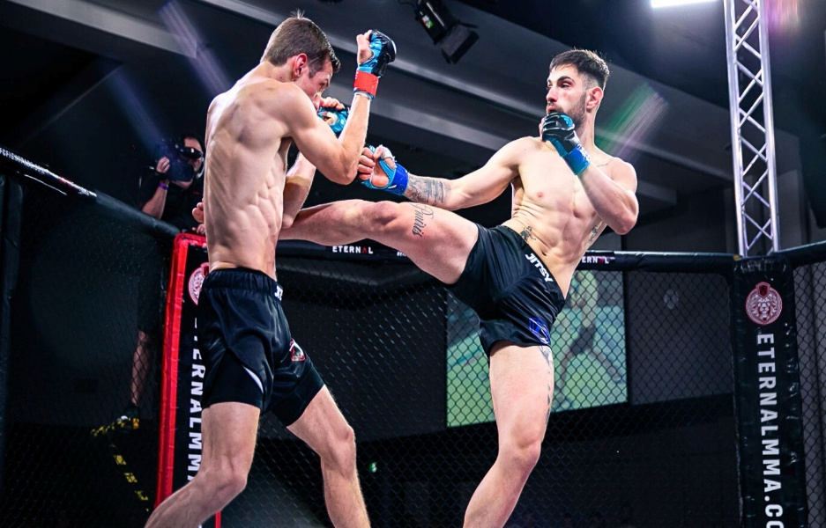
MMA Industry
MMA industry is expanding globally
Athlete are insufficiently protected under MABRA
Policy interventions promise fighters better outcomes

Slide 3
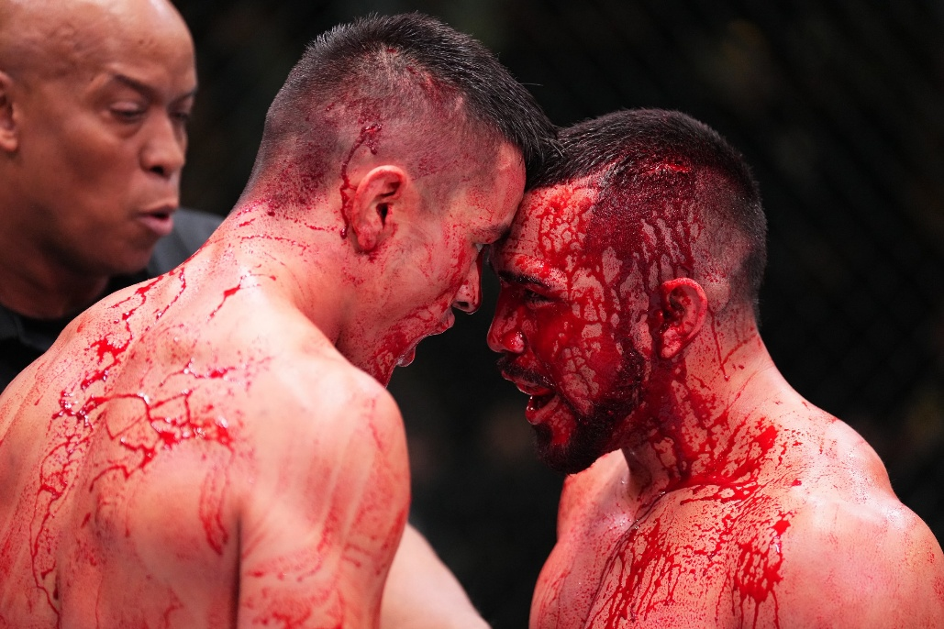
Challenges for Fighters
Low pay is prevalent across the industry (Lenartowicz et al., 2023)
Health coverage lacks despite bodily injuries (Lenartowicz et al., 2023)
Contracts favor promoters in terms of profits

Slide 4
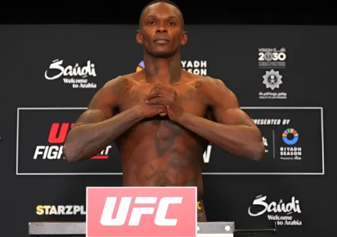
Three Policy Alternatives
Amend Muhammad Ali Act
Limit UFC dominance in MMA
Expand educational programs under Ali Act

Slide 5
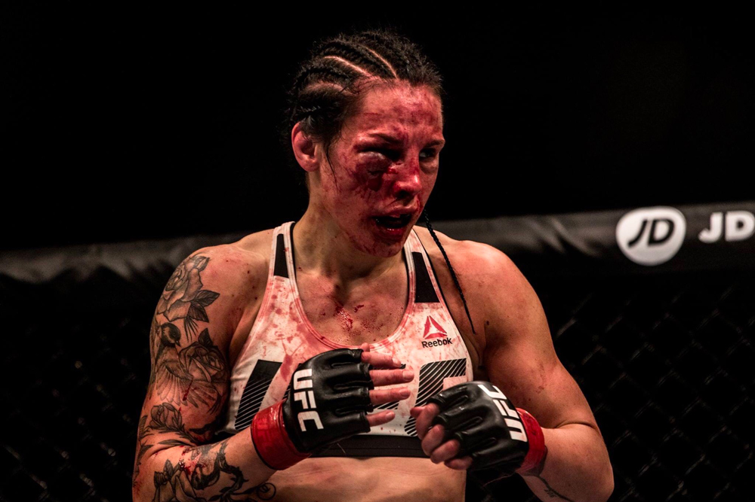
MABRA Amendment Benefits
Ensures standardized contracts for all fighters (Hyden, 2022)
Provides adequate health insurance coverage
Strengthens athlete financial position

Slide 6
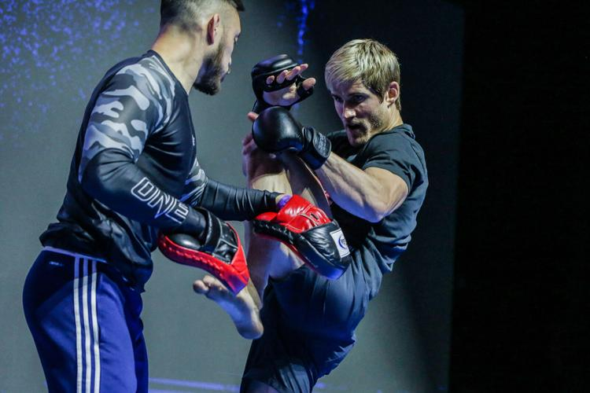
MABRA Amendment Costs
Lobbying and enactment would require $1–10 million (Hyden, 2022)
Legislative process is time consuming (Hyden, 2022)
MMA promoter profits could decrease after the amendment

Slide 7
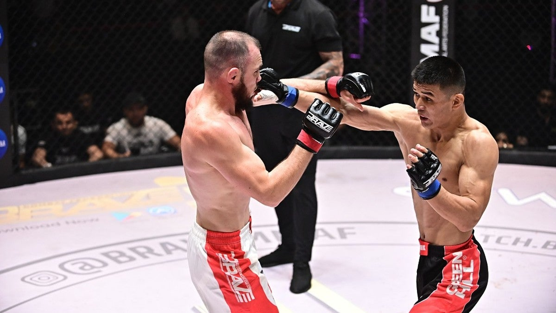
UFC Limitation
Breaks UFC’s dominant in MMA
Expands opportunities for other promoters to enter the market (Hale, 2024)
Improves chances for fighters to get fair contracts

Slide 8
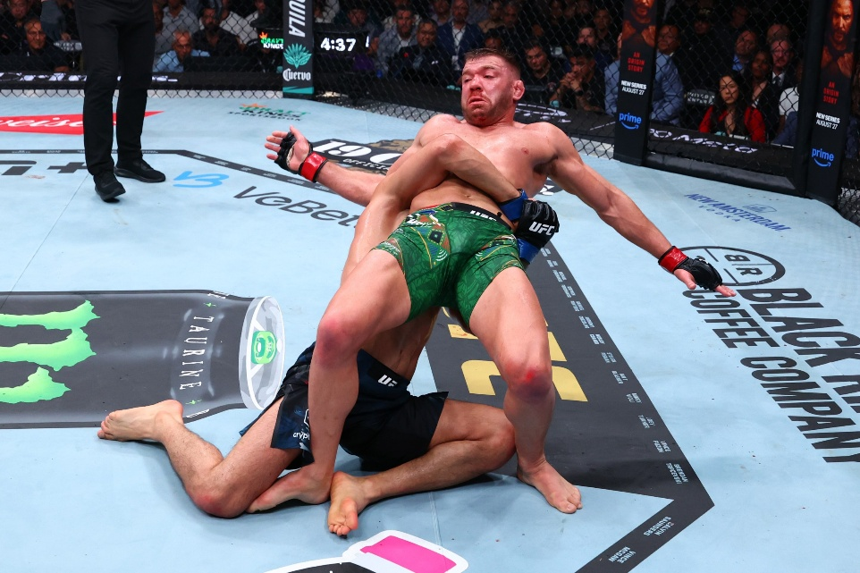
UFC Limitation Costs
Litigation costs often exceed $120M (Hale, 2024)
Compliance costs burdens promoters (Federal Trade Commission, n.d)
UFC revenues could decline due to added costs

Slide 9
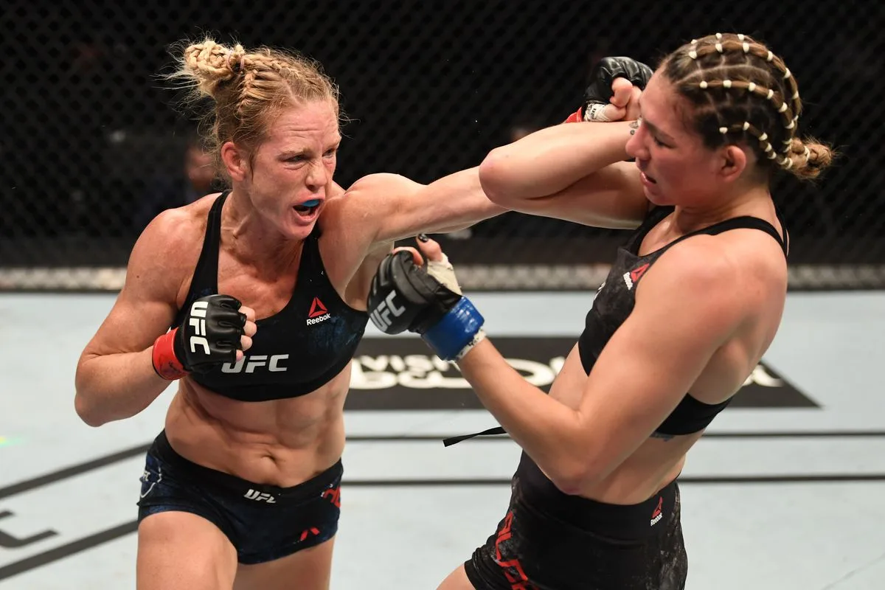
Education Outreach
Raises awareness about fighter rights under the Ali Act
Empowers athletes to negotiate better terms
Requires a funding model for long term success(Henson, 2024)

Slide 10
Final Recommendation
Policy | Costs | Outcomes
MABRA Amendment | $1–10M (in lobbying and administration) | Federal protections, fair contracts
Limit UFC’s Contractual Dominance | >$120 million (in litigation costs) | Competitive pay, diversified contracts
Educational Outreach under the Ali Act | $0.5–1M annually | Greater awareness and empowerment
Amend MABRA Act
Benefits outweigh costs related to amendment (see table)
Law reforms assures athlete welfare

Slide 11
References
Federal Trade Commission. (n.d). The antitrust laws. https://www.ftc.gov/advice-guidance/competition-guidance/guide-antitrust-laws/antitrust-laws
Hale, A. (2024). UFC reaches $375M settlement in Le v. Zuffa antitrust lawsuit. ESPN. https://www.espn.com/mma/story/_/id/41455273/ufc-reaches-375m-settlement-le-vs-zuffa-antitrust-lawsuit
Henson, L. (2024). Federal government advertising spending has doubled to $1.8 billion since 2018. https://www.rebuildlocalnews.org/federal-government-advertising-spending-has-doubled-to-1-8-billion-since-2018/
Hyden, M. (2022). Matters of dollars and cents, what does legislation really cost? https://www.rstreet.org/commentary/matters-of-dollars-and-cents-what-does-legislation-really-cost/
Lenartowicz, M., Dobrzycki, A., & Jasny, M. (2023). ‘Let's face it, it's not a healthy sport’: Perceived health status and experience of injury among Polish professional mixed martial arts athletes. International Review for the Sociology of Sport, 58(3), 589-607. https://doi.org/10.1177/10126902221119

