Slide 1
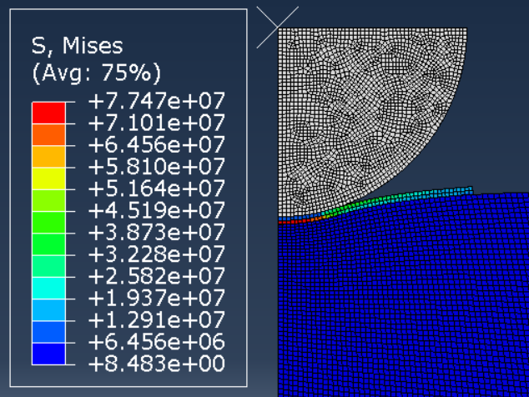
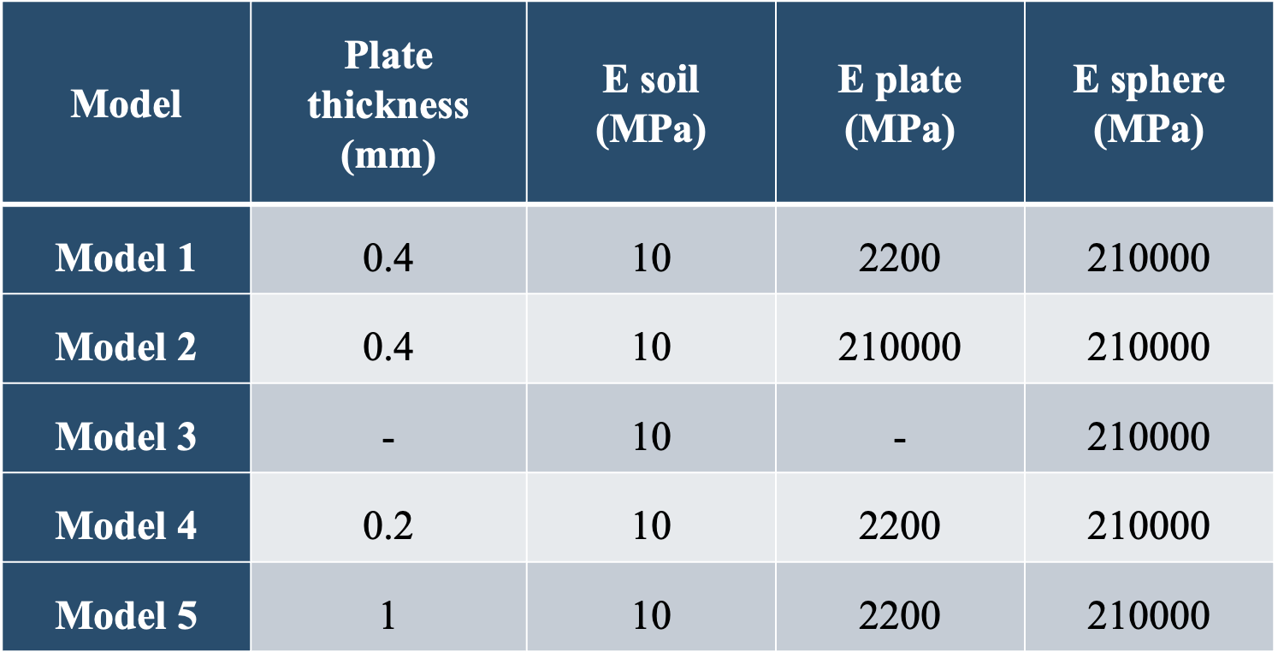
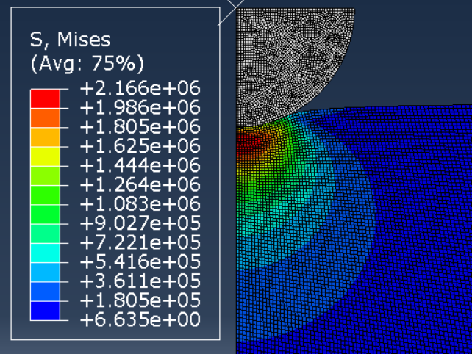




Optimizing Young's Modulus Measurement on Soft Soils: Enhancing Nonlinear Solitary Wave Propagation Device with a PLA Plate for Minimizing Plastic Deformation
Pablo Alvarado ¹, Bernardo Caicedo ², María José Torres ¹, Juan P. Villacreses ¹, Juan Fernando Jaramillo ¹
¹ Colegio de Ciencias e Ingenierías, Universidad San Francisco de Quito Interoceánica y Diego de Robles, Quito, Ecuador.
² Universidad de los Andes, Cr. 1 #18a, Bogotá, Colombia
BACKGROUND
Accurate measurement of Young’s modulus in soft soils using nonlinear solitary wave propagation devices is often challenged by plastic deformation. This study enhances the device’s performance by introducing a polylactide (PLA) plate between the device's last sphere and the sample being measured. The PLA plate is designed to dissipate stresses at the contact point, thereby reducing plastic deformation and improving measurement accuracy. A finite element model with axisymmetric representation was developed to simulate the interaction between the sphere and the study surface. The results showed that the addition of the PLA plate significantly improves the device's ability to measure in soft soils, with outcomes unified into a coefficient incorporated into the contact equation.
METHODS
Click here to insert your Abstract the
Hertz Contact Law + K term:
$$F=K∙\frac{4}{3}∙E^{∗}∙R^{1/2}∙d^{3/2}$$
Equivalent Young modulus (E*)L:
$$\frac{1}{E^{∗}}=\frac{1−v_{1}^{2}}{E_{1}}+\frac{1−v_{2}^{2}}{E_{2}}$$
on your printed poster.
Abaqus model assembly
Unified Coefficient Analysis
Click here to insert your Abstract text. Type it in or copy and paste from
Hertz Contact Law + K term:
$$F=K∙\frac{4}{3}∙E^{∗}∙R^{1/2}∙d^{3/2}$$
Equivalent Young modulus (E*):
$$\frac{1}{E^{∗}}=\frac{1−v_{1}^{2}}{E_{1}}+\frac{1−v_{2}^{2}}{E_{2}}$$
RESULTS
DISCUSSION
Material modeling optimization
Click here to insert your Abstract text. Type it in or copy and paste from your Word document or other source.
This text box will automatically re-size to your text. To turn off that feature, right click inside this box and go to Format Shape, Text Box, Autofit, and select the “Do Not Autofit” radio button.
To change the font style of this text box: Click on the border once to highlight the entire text box, then select a different font or font size that suits you. This text is Calibri 30pt and is easily read up to 5 feet away on a 1m x 1m poster.
Zoom out to 100% to preview what this will look like on your printed poster
PLA's 0.4 mm thickness was found as the most suitable material for modifying the strain wave device.
Incorporating a thin PLA plate had minimal effect on the results from the traditional Hertz contact equation.
The introduction of the K factor into the Hertz equation effectively accounts for plate effects, allowing for streamlined integration and accurate results.
The use of a unified coefficient can improve measurements in soil, potentially expanding the device's utility for compaction control and other geotechnical applications.
Thickness modeling optimization
REFERENCES
J. P. Villacreses, B. Caicedo, S. Caro and F. Yépez, "Feasibility of the use of nonlinear solitary waves for the nondestructive measurement of Young's modulus of rocks and compacted materials," Transportation Geotechnics, vol. 26, p. 100437, 2021.
X. Ni and P. Rizzo, "Use of highly nonlinear solitary waves in nondestructive testing," Materials evaluation, vol. 70, 2012.
P. Rizzo and K. Li, "Analysis of the geometric parameters of a solitary waves-based harvester to enhance its power output," Smart Materials and Structures, vol. 26, p. 075004, 2017.
B. Caicedo, Geotechnics of roads: fundamentals, CRC Press, 2018.
L. Ibagón, B. Caicedo, J. P. Villacreses and F. Yépez, "Modelling of washboard effect on unpaved roads experimental evidence on non-cohesive materials," Transportation Geotechnics, vol. 41, p. 101015, 2023.
M. Hodgson, P. Rizzo and S. J. Dickerson, "Wireless portable transducer for nondestructive evaluation applications based on highly nonlinear solitary waves," Measurement, vol. 214, p. 112760, 2023.
Comparison of Hertz Equation with and without the Derived K Factor
Department of Civil Engineering
Diego de Robles, Quito, Ecuador - Phone: (593) (02) 297-1700
Email: jvillacreses@usfq.edu.ec; bcaicedo@uniandes.edu.co; psalvarado@estud.usfq.edu.ec; mjtorres@estud.usfq.edu.ec; jjaramillomaldonado@estud.usfq.edu.ec

Slide 2
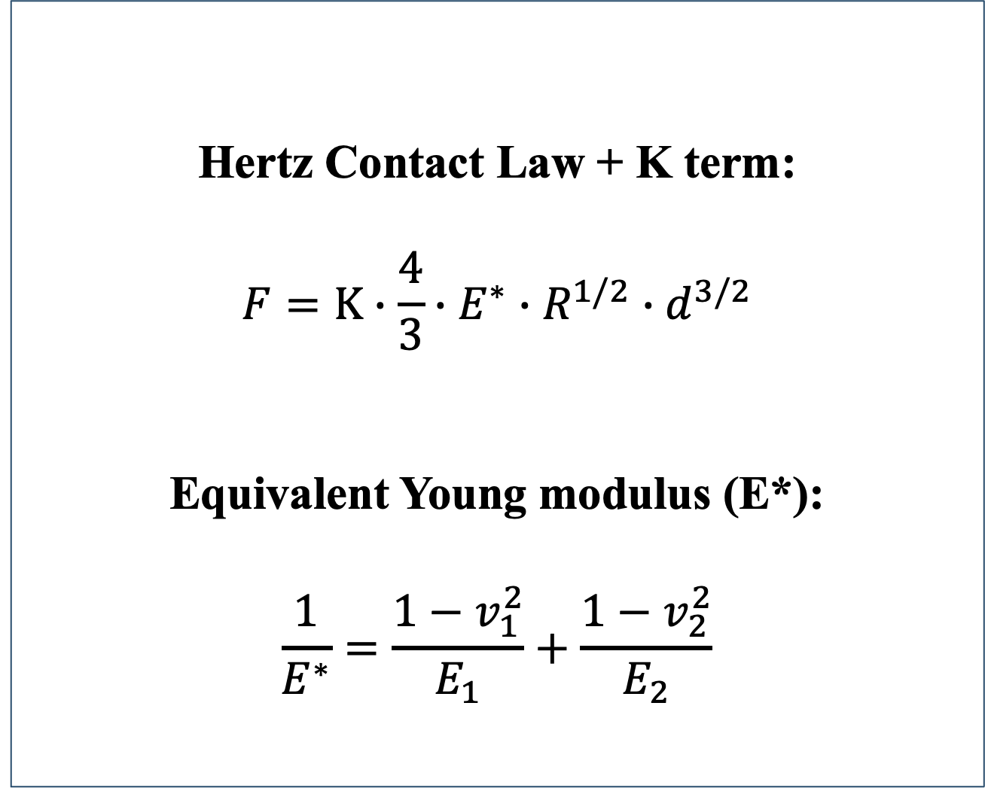

Optimizing Young's Modulus Measurement on Soft Soils: Enhancing Nonlinear Solitary Wave Propagation Device with a PLA Plate for Minimizing Plastic Deformation
Pablo Alvarado ¹, Bernardo Caicedo ², María José Torres ¹, Juan P. Villacreses ¹, Juan Fernando Jaramillo ¹
¹ Colegio de Ciencias e Ingenierías, Universidad San Francisco de Quito Interoceánica y Diego de Robles, Quito, Ecuador.
² Universidad de los Andes, Cr. 1 #18a, Bogotá, Colombia
BACKGROUND
Accurate measurement of Young’s modulus in soft soils using nonlinear solitary wave propagation devices is often challenged by plastic deformation. This study enhances the device’s performance by introducing a polylactide (PLA) plate between the device's last sphere and the sample being measured. The PLA plate is designed to dissipate stresses at the contact point, thereby reducing plastic deformation and improving measurement accuracy. A finite element model with axisymmetric representation was developed to simulate the interaction between the sphere and the study surface. The results showed that the addition of the PLA plate significantly improves the device's ability to measure in soft soils, with outcomes unified into a coefficient incorporated into the contact equation.
METHODS
Click here to insert your Abstract the
Hertz Contact Law + K term:
$$F=K∙\frac{4}{3}∙E^{∗}∙R^{1/2}∙d^{3/2}$$
Equivalent Young modulus (E*)L:
$$\frac{1}{E^{∗}}=\frac{1−v_{1}^{2}}{E_{1}}+\frac{1−v_{2}^{2}}{E_{2}}$$
on your printed poster.
Click here to insert your Abstract text. Type it in or copy and pa
Hertz Contact Law + K term:
$$F=K∙\frac{4}{3}∙E^{∗}∙R^{1/2}∙d^{3/2}$$
Equivalent Young modulus (E*):
$$\frac{1}{E^{∗}}=\frac{1−v_{1}^{2}}{E_{1}}+\frac{1−v_{2}^{2}}{E_{2}}$$
Abaqus model assembly
Unified Coefficient Analysis
RESULTS
DISCUSSION
Material modeling optimization
Click here to insert your Abstract text. Type it in or copy and paste from your Word document or other source.
This text box will automatically re-size to your text. To turn off that feature, right click inside this box and go to Format Shape, Text Box, Autofit, and select the “Do Not Autofit” radio button.
To change the font style of this text box: Click on the border once to highlight the entire text box, then select a different font or font size that suits you. This text is Calibri 30pt and is easily read up to 5 feet away on a 1m x 1m poster.
Zoom out to 100% to preview what this will look like on your printed poster
PLA's 0.4 mm thickness was found as the most suitable material for modifying the strain wave device.
Incorporating a thin PLA plate had minimal effect on the results from the traditional Hertz contact equation.
The introduction of the K factor into the Hertz equation effectively accounts for plate effects, allowing for streamlined integration and accurate results.
The use of a unified coefficient can improve measurements in soil, potentially expanding the device's utility for compaction control and other geotechnical applications.
Thickness modeling optimization
REFERENCES
J. P. Villacreses, B. Caicedo, S. Caro and F. Yépez, "Feasibility of the use of nonlinear solitary waves for the nondestructive measurement of Young's modulus of rocks and compacted materials," Transportation Geotechnics, vol. 26, p. 100437, 2021.
X. Ni and P. Rizzo, "Use of highly nonlinear solitary waves in nondestructive testing," Materials evaluation, vol. 70, 2012.
P. Rizzo and K. Li, "Analysis of the geometric parameters of a solitary waves-based harvester to enhance its power output," Smart Materials and Structures, vol. 26, p. 075004, 2017.
B. Caicedo, Geotechnics of roads: fundamentals, CRC Press, 2018.
L. Ibagón, B. Caicedo, J. P. Villacreses and F. Yépez, "Modelling of washboard effect on unpaved roads experimental evidence on non-cohesive materials," Transportation Geotechnics, vol. 41, p. 101015, 2023.
M. Hodgson, P. Rizzo and S. J. Dickerson, "Wireless portable transducer for nondestructive evaluation applications based on highly nonlinear solitary waves," Measurement, vol. 214, p. 112760, 2023.
Comparison of Hertz Equation with and without the Derived K Factor
Department of Civil Engineering
Diego de Robles, Quito, Ecuador - Phone: (593) (02) 297-1700
Email: jvillacreses@usfq.edu.ec; bcaicedo@uniandes.edu.co; psalvarado@estud.usfq.edu.ec; mjtorres@estud.usfq.edu.ec; jjaramillomaldonado@estud.usfq.edu.ec

