Slide 1
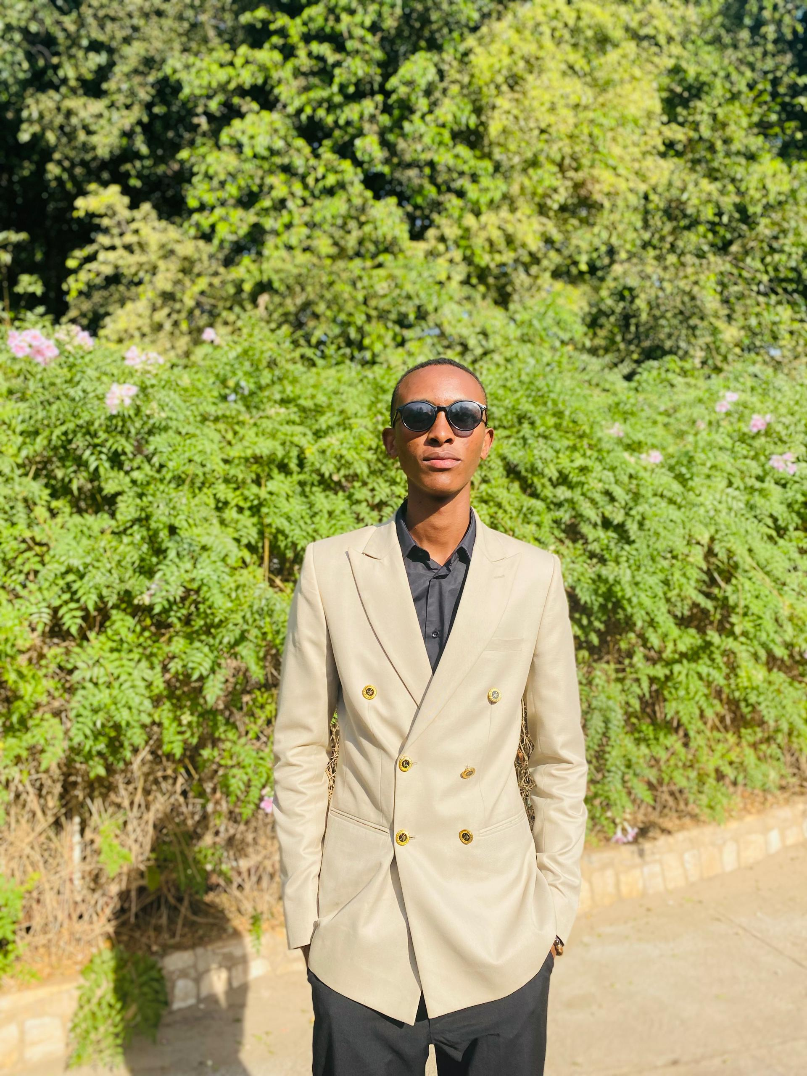
PACIFIQUE BAKUNDUKIZE
26798
LINKEDIN
GITHUB
My name is Pacifique Bakundukize. I am a second-year student specializing in Software Engineering in AUCA. I was born in Gisozi, Gasabo, Rwanda, and although I come from Rwanda, I grew up in Kampala, Uganda. This diverse background has shaped my perspective and enriched both my personal and academic journey.
I rely heavily on digital tools and resources in my studies and daily life. Whether it's using online databases, coding platforms, or collaborative software, I consistently leverage digital information to enhance my learning and problem-solving abilities.
In this course, I am eager to expand my knowledge of PL/SQL and further develop my skills in database development, which I believe will be instrumental in my future career.
Outside of academics, I have a variety of interests that keep me balanced and inspired. I enjoy playing football, exploring nature, coding, listening to music, watching movies, and spending time in prayer. These passions not only fuel my creativity but also help me maintain a well-rounded lifestyle. For a closer look at my professional background and ongoing projects, please feel free to visit my LinkedIn and GitHub profiles.

