Slide 1
Fruit Machine in Java
Pauline Cairns
8 June 2018

Slide 2
Let’s play the game . . .

Slide 3
Reels
Each game has three reels
Each reel has three symbols
Two set of reels, fruit & cards, each set saved as an Enum

Slide 4
Interaction of classes
Runner
HouseAlwaysWinMachine – extends FruitMachine
FruitMachine - abstract
- Scanner - keyboard
- reel1
- reel2
- reel3
- amountToPlayGame
- cashInFromPlayer
- payout
- super
Game selection from keyboard input
Calls methods:
FM – cashInFromPlayer
FM – playGame
P - getWinnings
- reelSelection
- resultOfSpin(ie win or lose)
Both methods abstract
- cashInFromPlayer
- payWinningsToPlayer
- randomiseReels (ie spin)
- playGame
Abstract:
- reelSelection
- resultOfSpin(ie win or lose)
SuckerMachine
– extends FruitMachine
Player
- super
- cashIn
- winnings
- reelSelection
- resultOfSpin(ie win or lose)
Both methods abstract
- insertCashIntoMachine
- getWinningsFromMachine

Slide 5
Issues encountered
Problems passing back and forth between Classes
Cash into machine
Player
Fruit Machine
Winnings from machine to player

Slide 6
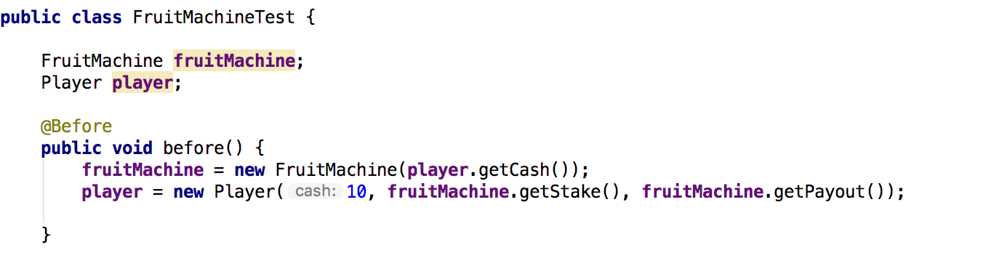
Issues encountered continued…

Slide 7
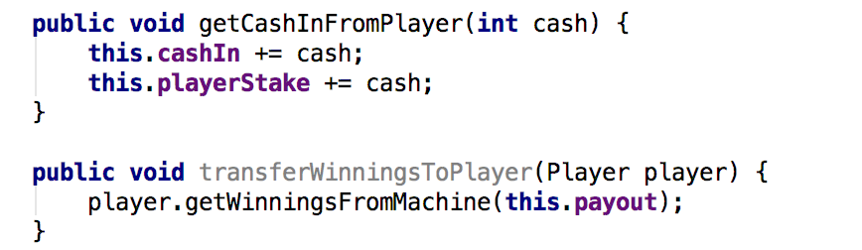
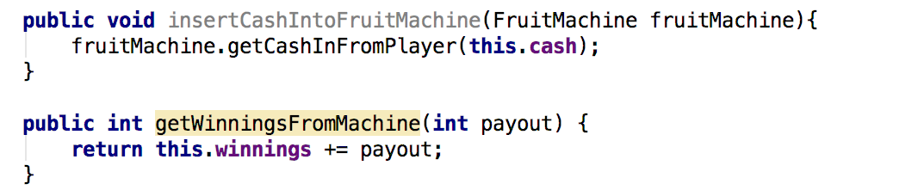
Issues encountered - solution
FruitMachine
Player

Slide 8
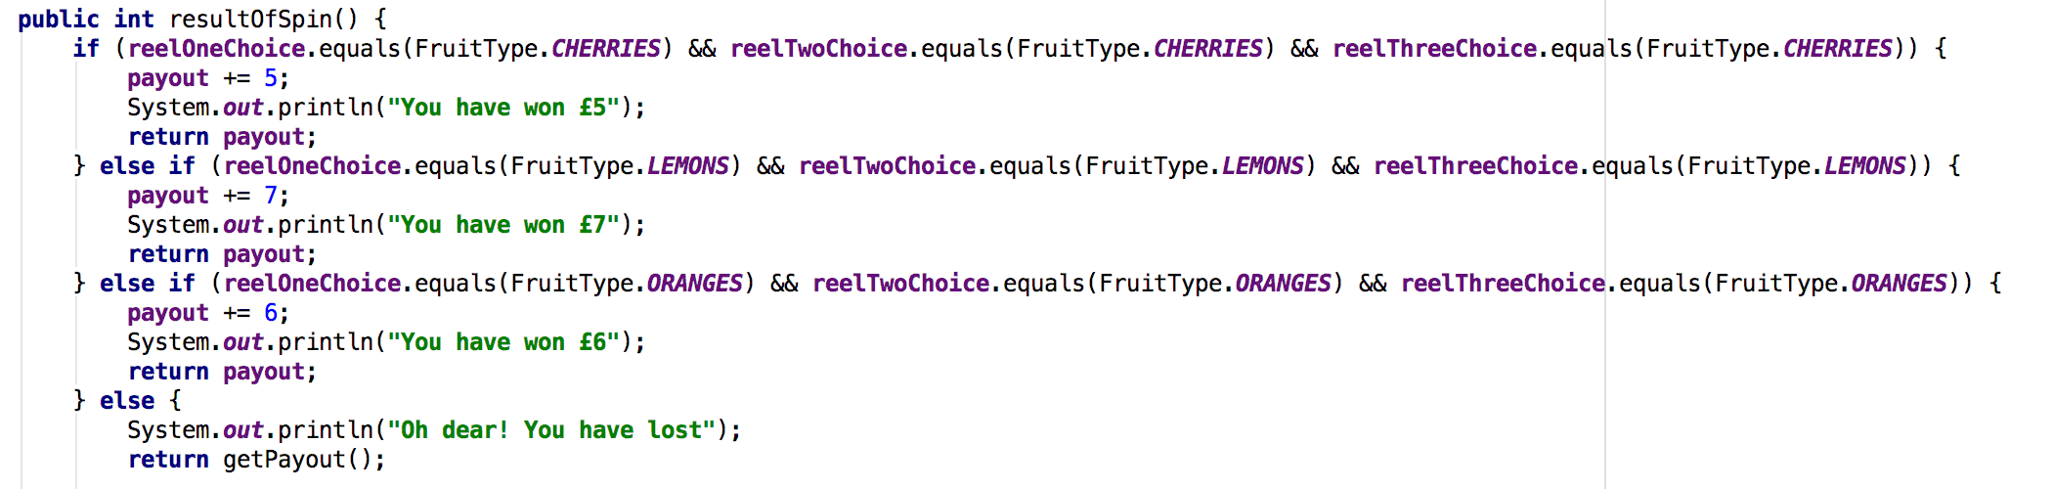
Things I liked
Initially code to determine win/lose

Slide 9
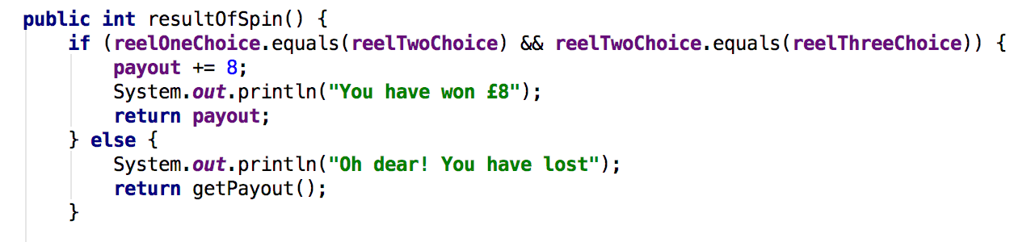
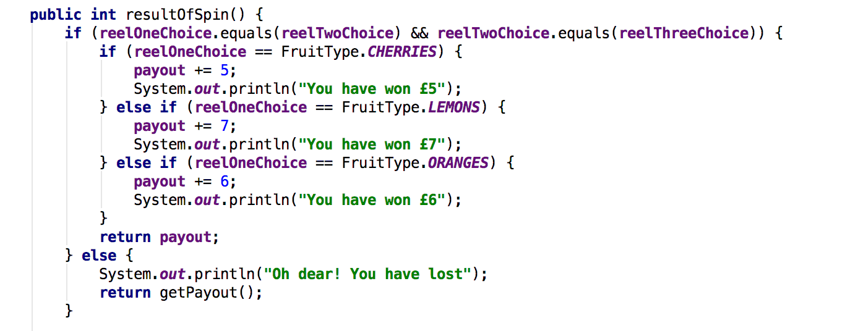
Things I liked – code became
CardReel
FruitReel

Slide 10
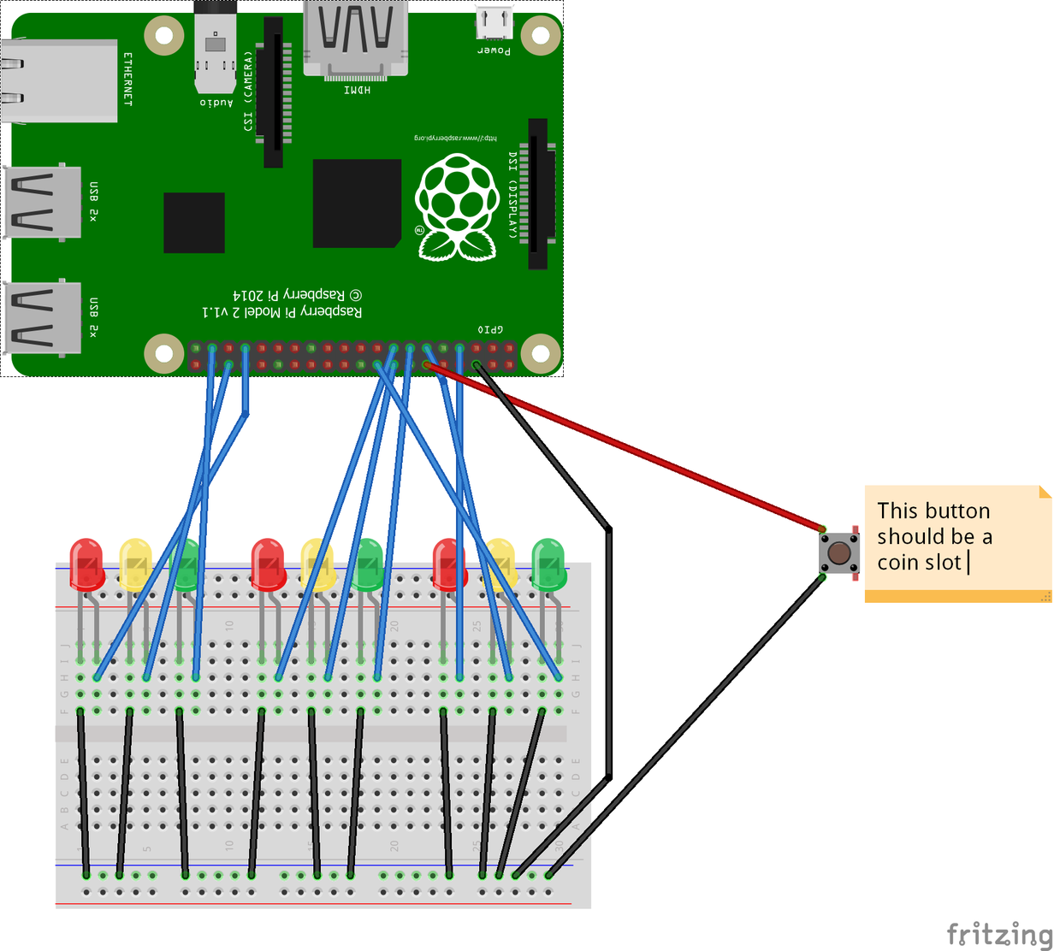
How I could extend further …
Raspberry Pi
Breadboard
LEDs reflecting the random selection

Slide 11
Nah…..
I’m a skint CodeClan student!
I need money!

Slide 12
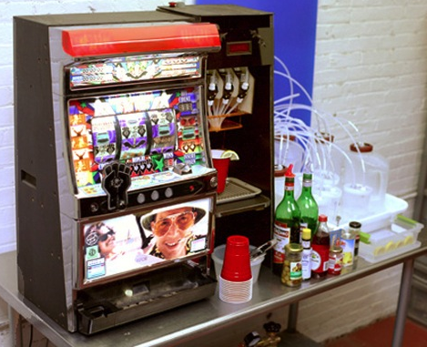
Electronic fruit machine in the CodeClan kitchen
Small print: predetermined payout rate programmed in
Cash and all forms of electronic payment transfer accepted!

Slide 13
Questions

Slide 14
4 pillars
Abstraction - two abstract methods allowed me to change reels and set different payout amounts.
Encapsulation – declared variables as private and provided public setter and getter methods to modify an view the variable values.
Polymorphism – not used
Inheritance - not used

Slide 15
SOLID
Single responsibility principle –
one class or method should do just one thing. For example, all the player can do is payout and take in cash, it can’t run the game.
Encapsulation was used
Open/closed principle – Open for extension but closed for modification.
Used abstract class which is instantiated in two children.
To make a new machine; set up a new class and extend Fruit Machine
Can add additional functionality to any machine.

Slide 16
SOLID
Liskov substitution principle – if you substitute a parent class with a child class then it shouldn’t break your application
requirement currently met as the two children classes of FruitMachine implement all of the FruitMachine’s methods.
Interface segregation principle – not implemented
Dependency inversion principle – not implemented

Slide 17
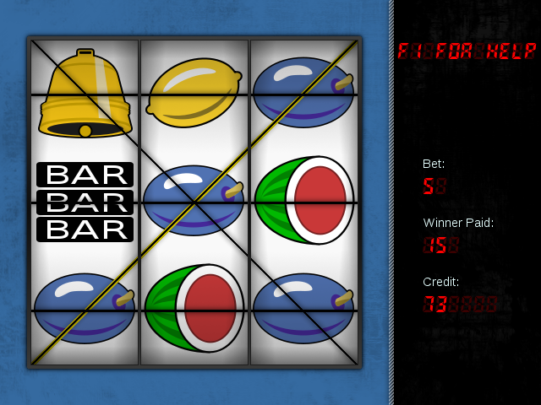
Income generation
Make an online app

