Slide 1
Horace: Current state and future after PACE
Horace:
Matlab package, used by neutron scientists for planning and analysing the results of inelastic neutron instruments.
Installation:
From unpacking zip file and adding two strings to user startup script to get on with things quickly
Installation ,compilation and tuning up C++ code performance and parallel performance to achieve best productivity.
User base:
From students, who are beginner in Matlab to very experienced scientists , who use part of Horace to build its own analysis code.
No one of them have background in software engineering or desire to learn some of it.
Operates:
On single PC with 8 Gb of RAM, after downloading and 2 minutes installation
Using multiple parallel(MPI) processes (~10) on a supercomputer with 1Tb of RAM parallel file system after some efforts.
Can work on a parallel cluster with ~100 nodes after complex installation and buying expensive software.
Performance:
Mainly IO speed bound performance, though some less often used critical area exist

Slide 2
User requests (we decided to satisfy):
The same interface and all existing things remain the same. ?
(Mantid VATES History)
Range of new features.
Performance improvements
without the need to buy a Matlab parallel cluster soft
Better integration with other software
Add new interfaces as project progress and see the user
(and volunteer developers) response

Slide 3
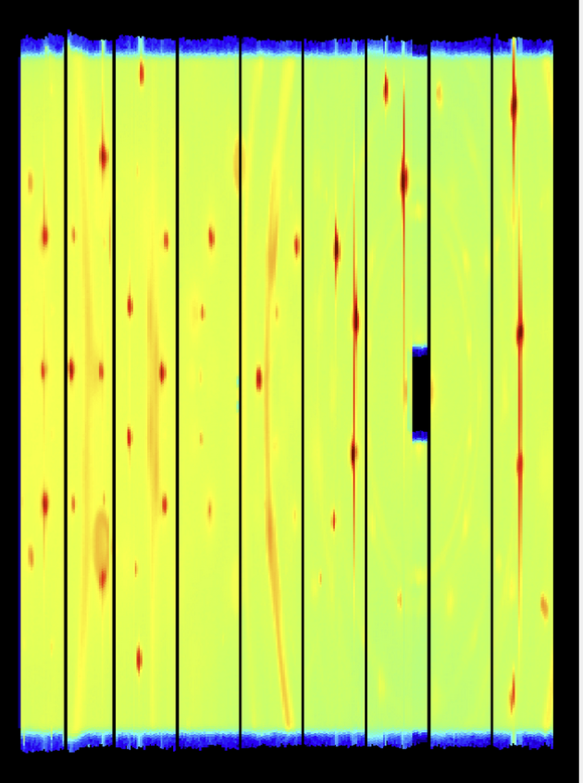
Horace inside: Large sqw object with operations and users requests:
4D (DND) image
In memory
The keys of the database ->
Effective cuts and evaluations
Resolution
Instrument info
Pixel array qx,qy,qz,S,Err,det_info (on file system)
Design problems:
Old style code with high interconnectivity and custom virtual functions
No explicit database interface due to efficiency considerations.

Slide 4
Work plan and what users want:
W1 | W2 | W2 | W4 | W5 | W6 | W7 | W8 | W9 | W10 | W11 | W12
C++ MPI frmwk investigation
 |  |  | Parallel C++ messaging framework
 |  |  |  |  |  |  |  |  | compiled Horace
rewriting sqw/dnd as new type classes
 |  |  |  | extracting projection interface
 |  |  |  |  |  |  |  | spherical projection
 |  |  |  |  |  |  |  | cylindrical projection
 |  |  |  |  |  |  |  | symmetrisation
 |  |  |  |  |  |  |  | q-dE projection
 |  |  |  |  |  |  |  | hdf file format
 |  |  |  |  |  |  |  | Parallel cut
 |  |  |  | parallel unit operations
 |  |  |  | Parallel cut
 |  |  |  | Parallel sqw eval
 |  |  |  | HDF file format
Productivity:
New features
Interoperability:

Slide 5
Suggested redesign: Divide current sqw object into smaller object and create well defined interfaces between them

Slide 6
Is CMAKE appropriate?
No, lets Matlab care about it, but only if C++ is a thin layer.
Is Markdown appropriate?
May be.
The problem of synchronization between Matlab and Markdown documentation. (Toby textify?)
The question of access to the documentation for non-git users
Doxygen?
Where it is (Herbert and Horace are the same package)
Release notes

Slide 7
Continuous integration:
Current release procedure:
Run test script and packing procedure manually. Update production branch on ISISCOMPUTE and iDaaaS
(tests are failing running on iDaaaS)
Modern continuous integration:
We need it
Git integration
Unit tests redesign
Care about mac users?

