Slide 1
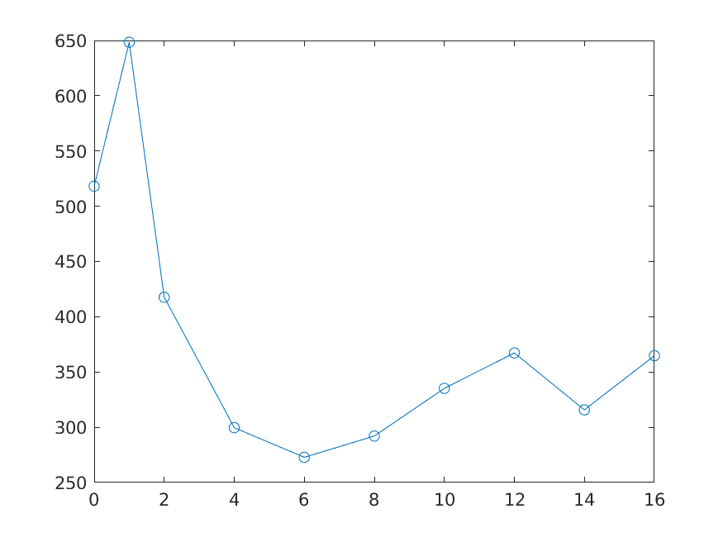
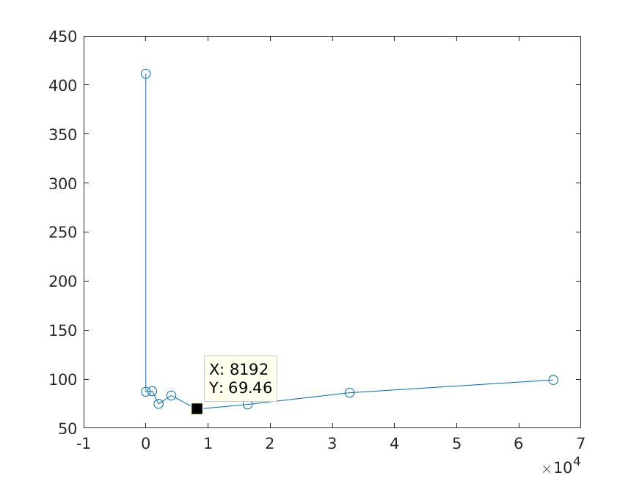
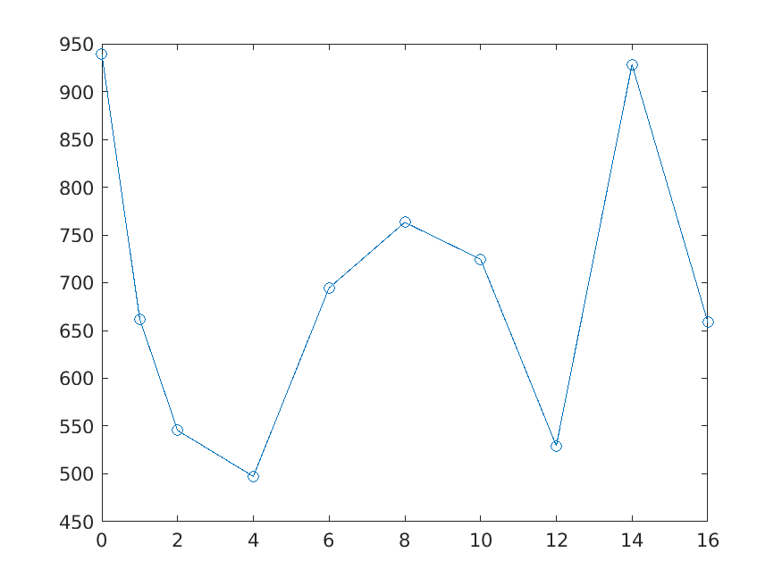
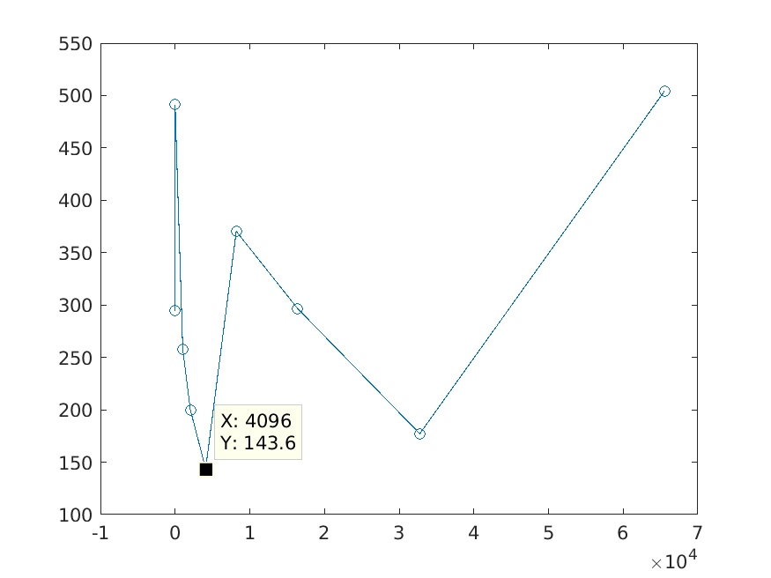
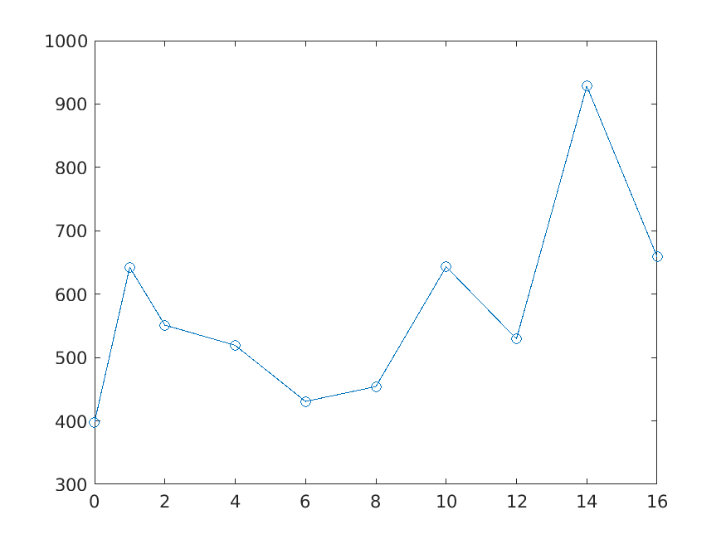
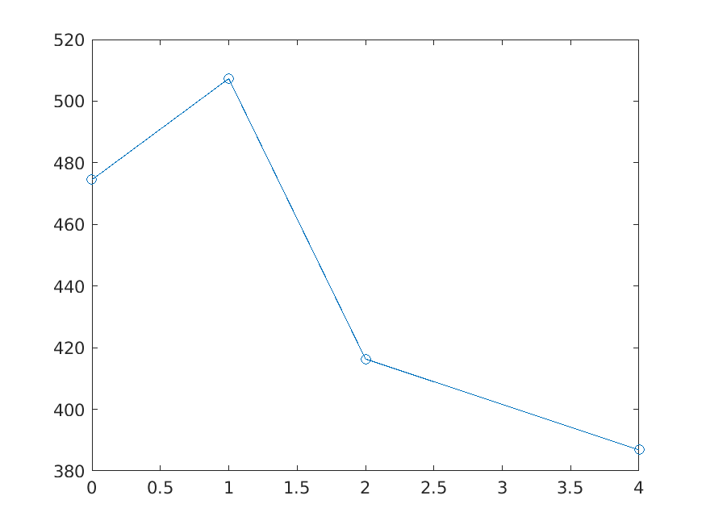
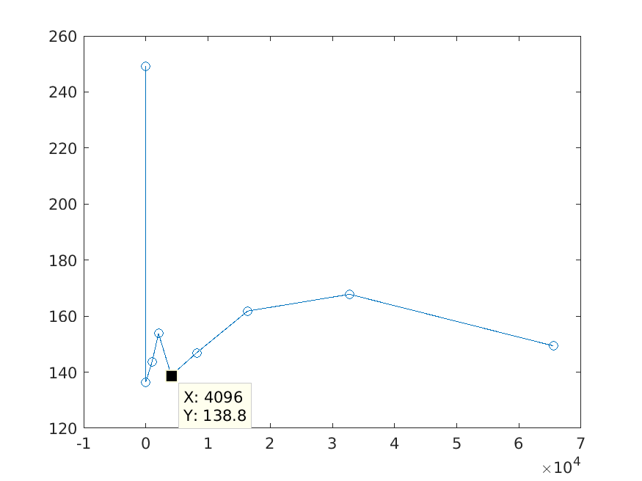
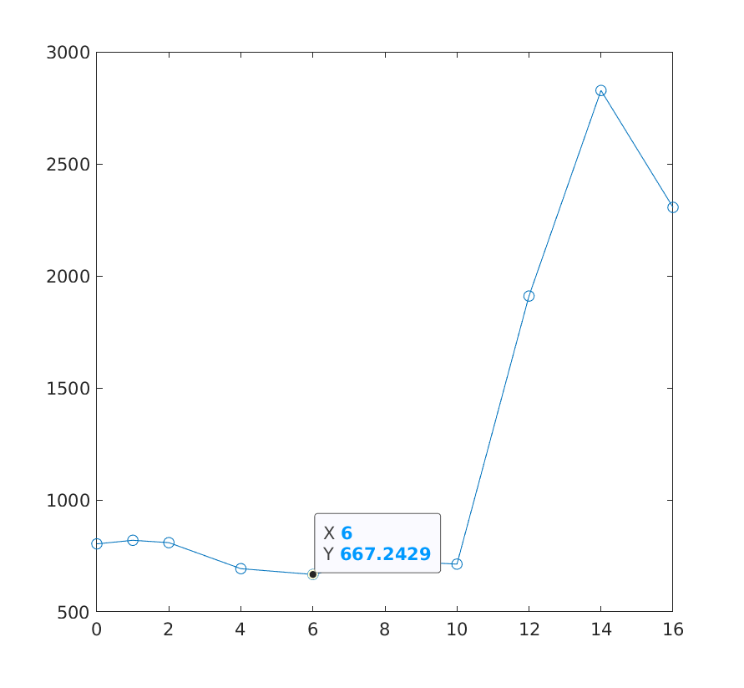
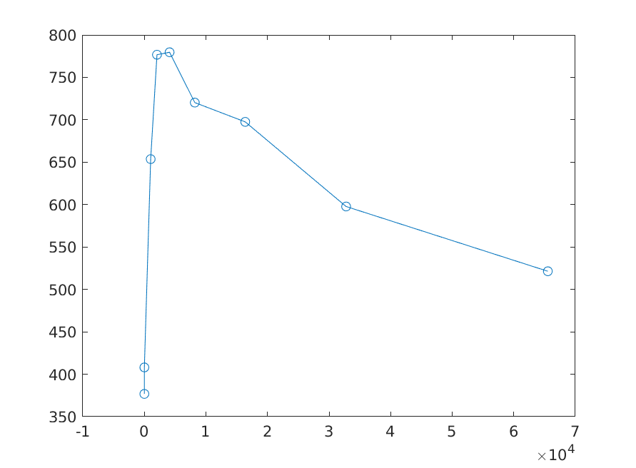
Machines performance on gen_sqw and combine (10Gb)
ndmlnx01
n-workers
cache-size
iDaaaS large
n-workers
cache-size
iDaaaS Small
lnxT7500

Slide 2
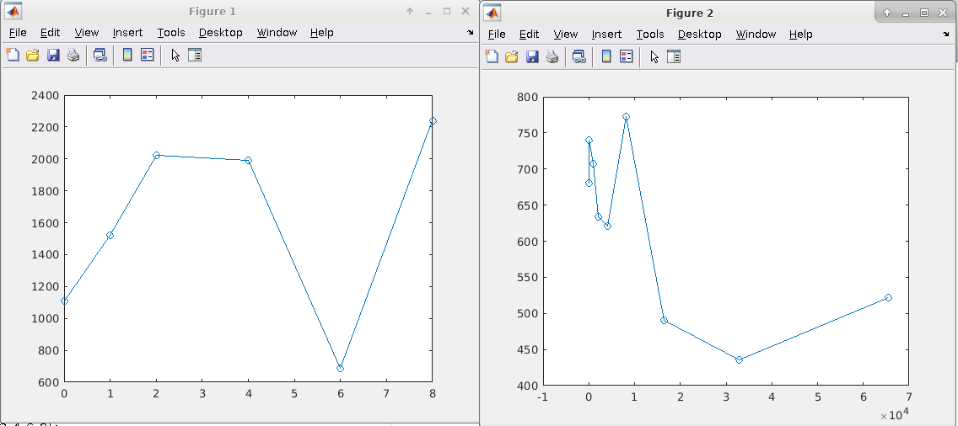
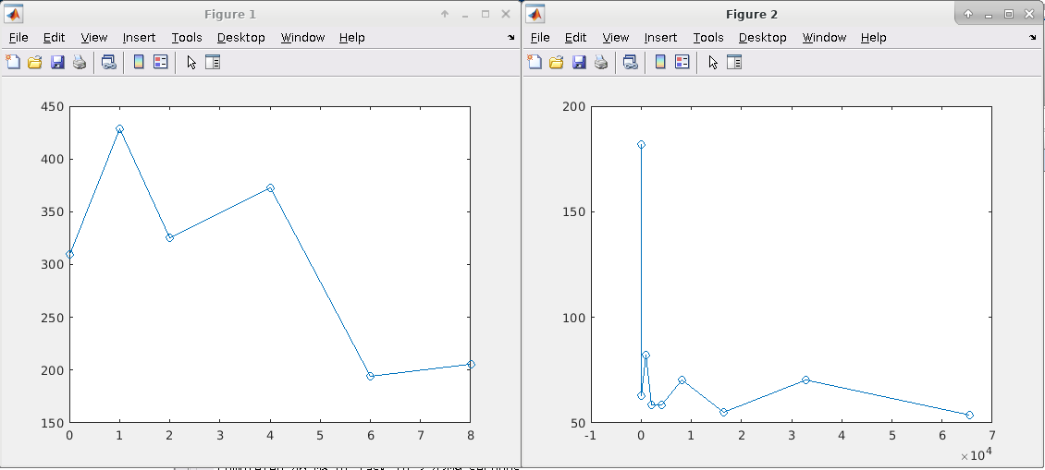
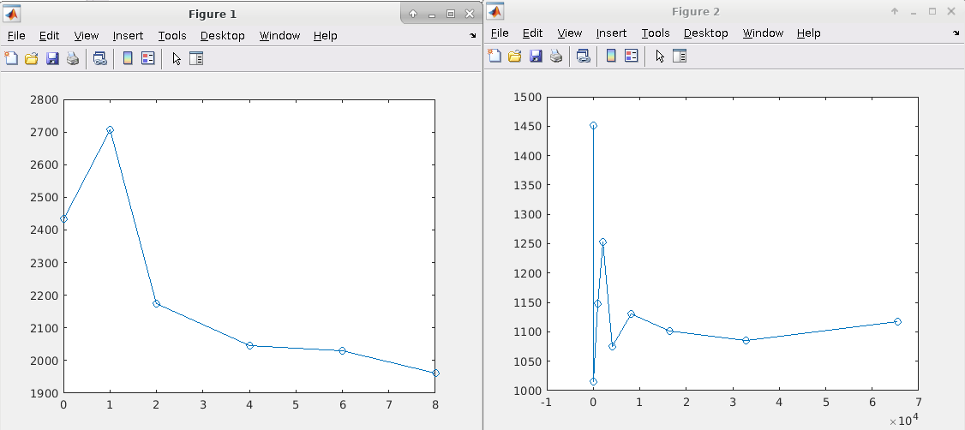
Testing on 21/04/202. iDaaaS large. Broken:
Time to generate 10Gb sqw file
from 50 nxspe files
Time to combine 10Gb sqw file
from 50 tmp files.
Time (sec)
Time (sec)
N parallel workers
Combine buffer size(bytes)
Testing on 01/05/2020. iDaaaS large (fixed)
Time to generate 10Gb sqw file
from 50 nxspe files
Time to combine 10Gb sqw file
from 50 tmp files.
Time to generate 150Gb sqw file
from 250 nxspe files
Time to combine 150Gb sqw file
from 250 tmp files.

Slide 3
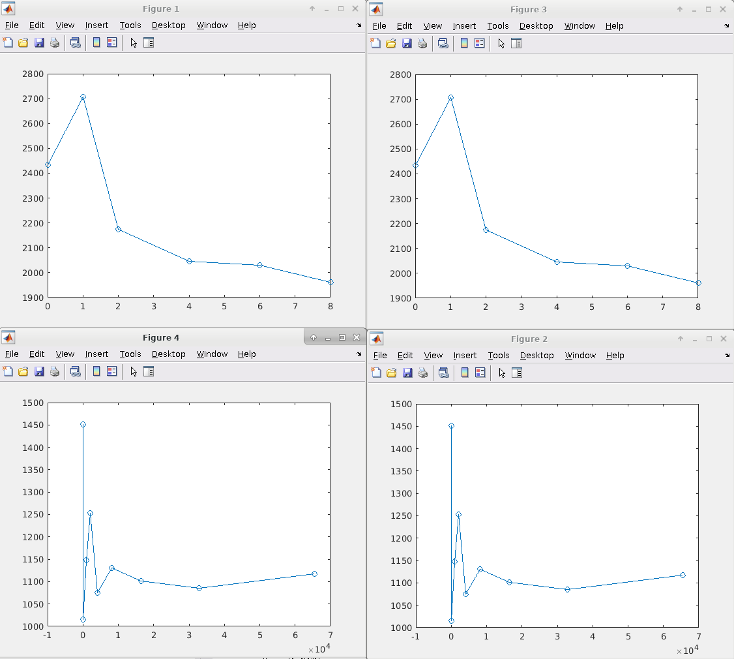
04/05/2020 Persistence. iDaaaS large. Two runs 50Gb

