Slide 1
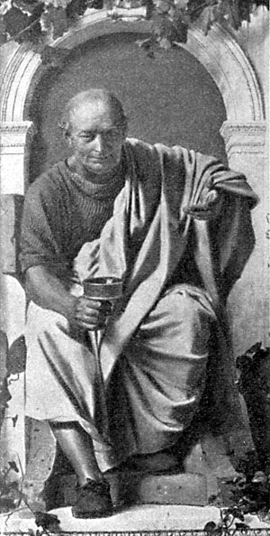
PACE Proper Analysis of Coherent Excitations
HORACE
Package for analysing results of inelastic experiments
https://pace-neutrons.github.io/Horace

Slide 2
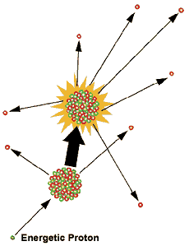
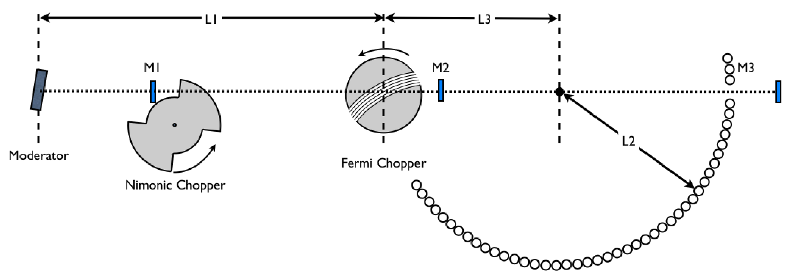
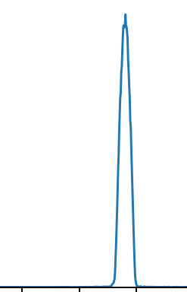
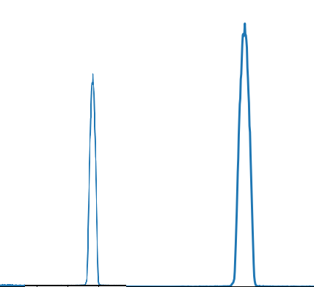
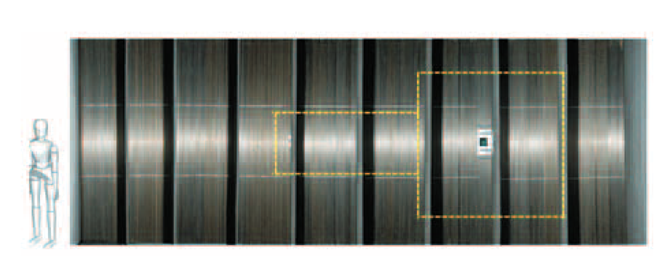
Inelastic experiment using direct inelastic instrument.
Measure
MERLIN PSD Detectors

Slide 3
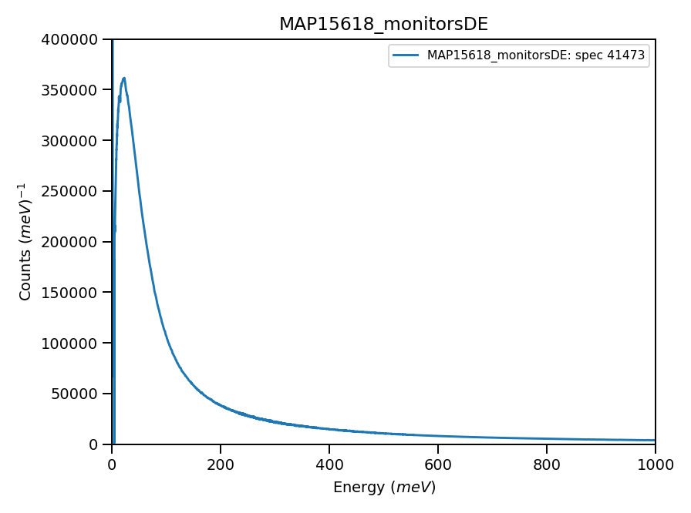
Inelastic experiment using direct inelastic instrument.
Measure
MERLIN PSD Detectors

Slide 4
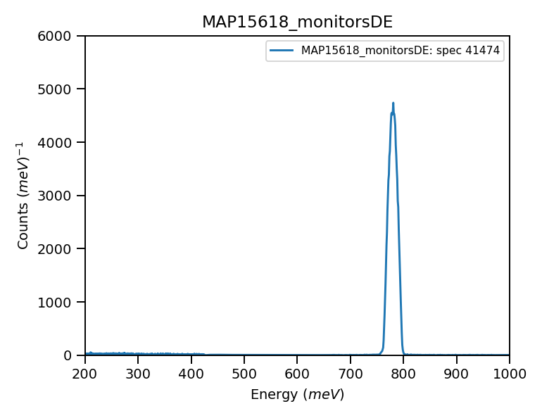
Inelastic experiment using direct inelastic instrument.
Measure
MERLIN PSD Detectors

Slide 5
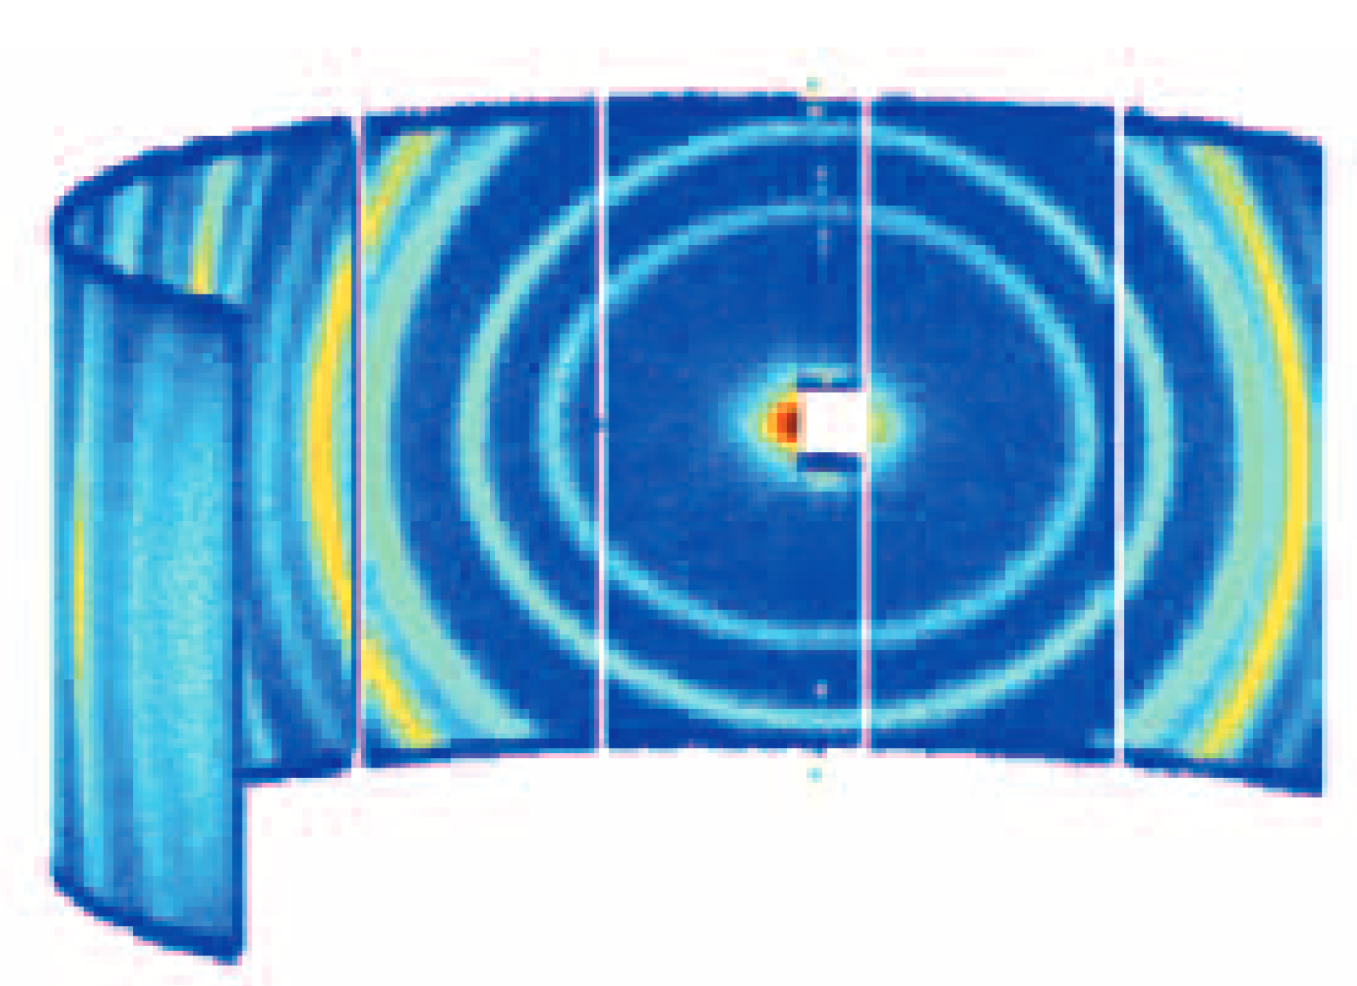
Inelastic experiment using direct inelastic instrument.
Measure
A surface in 4-Dimencional q-dE space

Slide 6
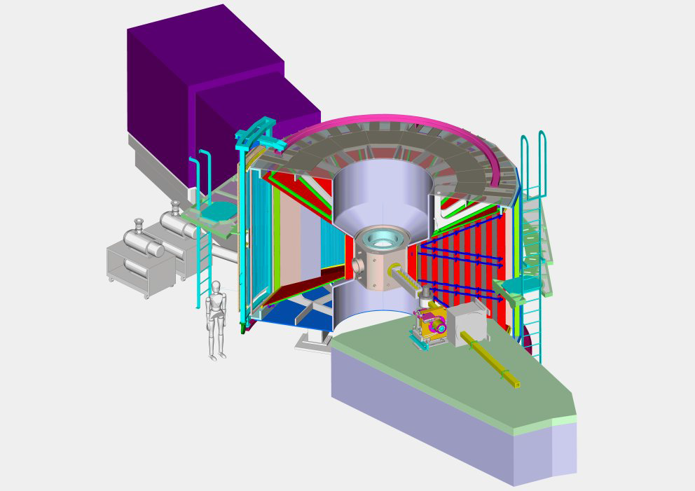
Measuring Excitations
MERLIN spectrometer (ISIS)
70,000 detector elements
300-500 energy bins
Upto 4 or 5 different Ei simultaneously

Slide 7
Inelastic experiment using direct inelastic instrument.
Single crystal position provides hypersurface in 4-D space. To cover whole 4-D volume, use rotating crystal. Typical experiment – 200 runs

Slide 8
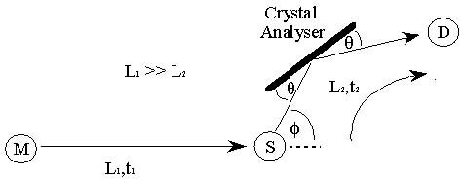
Indirect inelastic instrument:
MUSHRUM will change the game

Slide 9
From experiment to scientific result: HORACE-PACE workflow
Convert Time of flight to energy transfer
Construct 4-D
View, enhance and analyse
Compare with scientific models
Scientific models
SpinW – linear spin wave theory
MANTID
HORACE sqw object
HORACE
Tobyfit
Euphonics – results of DFT calculations
User models
MANTID MD workspace
MANTID fitting
Instrument models?

Slide 10
HORACE structure:
SQW object (Filebacked)
Algorithms to operate with sqw object
CUT
plot
Tobyfit
Instrument info
ISIS instruments models
Resolution function & Resolution convolution
1-4D image in reciprocal coordinate system
Experiment info
Image is calculated as average from pixels
and serves as the “key” for pixel database
Multifit
Fitting engine
Pixels (All neutron events)

Slide 11
HORACE resolution:

Slide 12
HORACE Workflow:
https://pace-neutrons.github.io/Horace
https://isis.analysis.stfc.ac.uk/workspaces
MARI, MERLIN, MAPS, LET
excitations-single crystal machine
There is a GUI (horace)
/mnt/ceph/auxiliary/excitations/rse_training

