Slide 1
EPIC: Issues with large number of small cuts (7-fold deceleration vrt. Horace-3)
Conclu-sion
#1147 Serializable eq method should be replaced by equal to tol
#1790 Make instruments, samples and detectors hashable
#1791Problem with unique references singleton implementation
Delete redundant unique objects from memory
Fix tests
#1788 hashable class
Still ~2 times slower
COW pointers management
?
#1798 Odd behaviour of multifit and covariance matrix
Failing objects comparison on Jenkins only
#896 Enable full mexing option in cut

Slide 2
EPIC: Issues with large number of small cuts (7-fold deceleration vrt. Horace-3)
Conclu-sion
I am here
#1147 Serializable eq method should be replaced by equal to tol
#1790 Make instruments, samples and detectors hashable
#1791Problem with unique references singleton implementation
Delete redundant unique objects from memory
Fix tests
#1788 hashable class
Still ~2 times slower
COW pointers management
?
#1798 Odd behaviour of multifit and covariance matrix
Failing objects comparison on Jenkins only
#896 Enable full mexing option in cut

Slide 3
EPIC: Issues with large number of small cuts (7-fold deceleration vrt. Horace-3)
Delete redundant unique objects from memory
Choice
#1791Problem with unique references singleton implementation
Conclu-sion
Hold unique in memory
#896 Enable full mexing option in cut
#1798 Odd behaviour of multifit and covariance matrix
Do nothing

Slide 4
Serializable Axioms:
Public interface (number of properties with setters/getters) and empty constructor exist.
Custom to_string, from_string methods which allow to save/ recover object contents and works through public interface above.
saveableFields method defining what the contents (public interface) is.
check_combo_arg method which validates interdependent properties and calculates internal contents if necessary.
Consequence (theorem):
>>sobj.sproperty = contents
Legitimate method!
function sobj = set.sproperty(sobj,value)
sobj.sproperty_ = value
If sobj.do_check_combo_arg_
sobj = sobj.check_combo_arg()
end

Slide 5
Hashable/serializable objects comparison:
serializable:
equal_to_tol– compares values of saveableFields()
hashable:
eq/neq – compares hashes
equal_to_tol– compares hashes first and if fail, goes to serializable equal_to_tol
isequal – compares objects and their internal structure ignoring hashes even if present

Slide 6
Hashable/serializable objects comparison:
Expose internal container’s operations to unit tests!
serializable:
equal_to_tol– compares values of saveableFields()
hashable:
eq/neq – compares hashes
equal_to_tol– compares hashes first and if fail, goes to serializable equal_to_tol
isequal – compares objects and their internal structure ignoring hashes even if present

Slide 7
Problem with unique references singleton implementation #1791
It is non-standard and Horace-specific. When maintainer looks at the code, he/she would not immediately understand what is there and need to read complex custom description on what is this and how to work with it, while any software graduate student is familiar with a standard singleton.
The storage and unique_references_contanter are mixed together, despite having different purposes.
because of (2), methods of "would be singleton" are implemented as a switch over group of keys. This is inferior design in comparison with normal set of class methods, which are visible and easy testable
50% code duplication between containers
Multiple methods doing the same things with a slightly different code. (contains vs find_in_container, replicate_runs vs set_all)
serializabe is not respected
Work of love BUT Majority of containers methods are not unit tested!!!
Does not work!!!
Fighting BUGS:
Code standards
Developers interchangeability
Documentation
Code testability
Unit test
Continuous integration

Slide 8
Problem with unique references singleton #1791
It is non-standard and Horace-specific. When maintainer looks at the code, he/she would not immediately understand what is there and need to read complex custom description on what is this and how to work with it, while any software graduate student is familiar with a standard singleton.
Singleton is a standard pattern in software engineering.
Search "Singleton in Matlab" returns bunch of references, e.g.:
https://uk.mathworks.com/matlabcentral/fileexchange/24911-design-pattern-singleton-creational
https://medium.com/@bishikh90/design-patterns-in-matlab-part-1-b0dac5dc9eb7
https://www.geeksforgeeks.org/singleton-design-pattern/
etc. They are all refer to a bit different implementations which have the same main features:
static protected storage
private constructor
static instance method which provides access to internal storage
and methods which interact with this storage.

Slide 9
Problem with unique references singleton #1791 The storage and unique_references_contanter are mixed together, despite having different purposes.
glcont = self.global_container('value', self.global_name_);
…
…
…
self.global_container('reset',self.global_name_,glcont);
Fields of the structure within static function in: unique_references_container
storage = unique_obj_store.instance().get_objects(self.basename)
…
…
…
unique_obj_store.instance().set_objects(storage);
Methods of standard singleton class:
unique_obj_store

Slide 10
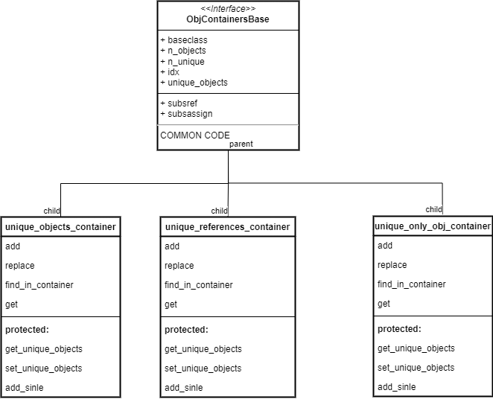
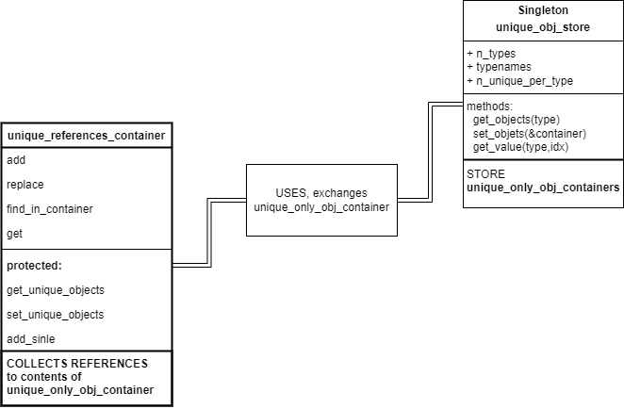
Suggested solution in progress:
Move 50% of common code here between references and objects and 50%-90% of code between unique_only_obj and unique_objects
Use common storage singleton
90% of common code

Slide 11
unique_only_obj_container. Memory management
Last filled
Local indices:
1
2
3
4
5
6
7
8
9
10
11
12
13
14
Delete Object from: unique_only_obj_container
Global indices:
Last filled
unique_references_container
1
2
3
12
5
6
7
8
9
10
11
4
13
14
x

Slide 12
Problem with unique references singleton implementation #1791
It is non-standard and Horace-specific. When maintainer looks at the code, he/she would not immediately understand what is there and need to read complex custom description on what is this and how to work with it, while any software graduate student is familiar with a standard singleton.
The storage and unique_references_contanter are mixed together, despite having different purposes.
because of (2), methods of "would be singleton" are implemented as a switch over group of keys. This is inferior design in comparison with normal set of class methods, which are visible and easy testable
50% code duplication between containers
Multiple methods doing the same things with a slightly different code. (contains vs find_in_container, replicate_runs vs set_all)
Work of love BUT Majority of containers methods are not unit tested!!!
Unfinished!
In progress
In progress

Slide 13
New design of unique references container
Design with object deletion:
DOES NOT WORK:
>>w1 = sqw(filename);
>>w2 = w1;
>>w1 = w1.set_mod_pulse(…);
>>w2 = w2.set_mod_pulse(…);
Some mitigation is possible/necessary (e.g. overloading repmat
but in fact you will need to mind deep/shallow copies
No deletion (Chris design)
Or modified Chris design
unique_reference_container
elements initialized by assignment from
unique_obj_storage
elements.
Used unique objects remain stuck in unique_obj_storage for the length of a session and only grow

Slide 14
EPIC: Issues with large number of small cuts (7-fold deceleration vrt. Horace-3)
Delete redundant unique objects from memory
delete()
for
unique_references_container
Choice
#1791Problem with unique references singleton implementation
Conclu-sion
Hold unique in memory
#1798 Odd behaviour of multifit and covariance matrix
Do nothing

Slide 15
END & choice

Slide 16
EPIC: Issues with large number of small cuts (7-fold deceleration vrt. Horace-3)
Conclu-sion
#1147 Serializable eq method should be replaced by equal to tol
#1790 Make instruments, samples and detectors hashable
#1791Problem with unique references singleton implementation
Delete redundant unique objects from memory
Fix tests
#1788 hashable class
Still ~2 times slower
COW pointers management
?
#1798 Odd behaviour of multifit and covariance matrix
Failing objects comparison on Jenkins only
#896 Enable full mexing option in cut

Slide 17
Hashable class (#1788)
[obj,hash]=build_hash(obj) – separate function similar to serialize
Hashable class:
Child of serializable
Overloaded build_hash,
Retrieves existing hash if available.
Uses simplified modified code convert_to_hashable_array, extracting only important information from a class. Similar to to_bare_string but simpler.
hashableFields method defining what important is, defaults to saveableFields
Overloaded to_string ; from_string methods to store restore hashes
Changes from #1147: Customized eq/neq (comparing hashes) and equal_to_tol_single (comparing hashes first).

Slide 18
Hashable class, example – IX_experiment (#1788)
run_id is not included in list of hashableFields so two IX_experiment with the same information but different run_id-s are compared equal.
Every saveable field assignment clears existing hash.
Hash calculated once when requested and lives with object until object have changed

Slide 19
EPIC: Issues with large number of small cuts (7-fold deceleration vrt. Horace-3)
Conclu-sion
#1147 Serializable eq method should be replaced by equal to tol
#1790 Make instruments, samples and detectors hashable
#1791Problem with unique references singleton implementation
Delete redundant unique objects from memory
Fix tests
#1788 hashable class
Still ~2 times slower
COW pointers management
?
#1798 Odd behaviour of multifit and covariance matrix
Failing objects comparison on Jenkins only
#896 Enable full mexing option in cut

Slide 20
Make instruments, samples and detectors hashable (#1790)
Change instrument classes comparison from serializable to hashable
Simple though abundant change.
Problem with hashable objects comparison. Tests failing as equal_to_tol is inadequate #1147
Problem with one test failing on Jenkins only -> #1798
PROBLEM WITH PERFORMANCE FIXED
In addition, huge simplification of operations with hashable objects, no problem with different hashes
on different system

Slide 21
EPIC: Issues with large number of small cuts (7-fold deceleration vrt. Horace-3)
Conclu-sion
#1147 Serializable eq method should be replaced by equal to tol
#1790 Make instruments, samples and detectors hashable
#1791Problem with unique references singleton implementation
Delete redundant unique objects from memory
Fix tests
#1788 hashable class
Still ~2 times slower
COW pointers management
?
#1798 Odd behaviour of multifit and covariance matrix
Failing objects comparison on Jenkins only
#896 Enable full mexing option in cut

Slide 22
EPIC: Issues with large number of small cuts (7-fold deceleration vrt. Horace-3)
Conclu-sion
#1147 Serializable eq method should be replaced by equal to tol
#1790 Make instruments, samples and detectors hashable
#1791Problem with unique references singleton implementation
Delete redundant unique objects from memory
Fix tests
#1788 hashable class
Still ~2 times slower
COW pointers management
?
#1798 Odd behaviour of multifit and covariance matrix
Failing objects comparison on Jenkins only
#896 Enable full mexing option in cut

Slide 23
Serializable eq method should be replaced by equal_to_tol (#1147)
Problems:
Complete mess with equal_to_tol function. Overloaded on multiple Horace objects to different degrees of accuracy and quality and different ways of treating arrays of objects.
To avoid mess, serializable have custom eq method which have similar (but different) to equal_to_tol parameters
equal_to_tol function invokes serializable’s eq method to deal with serializable comparison

Slide 24
Serializable eq method should be replaced by equal_to_tol (#1147)
Solution:
equal_to_tol function separated into 4 pieces.
eq_to_tol_process_inputs– accumulates all keys and parameters used in all comparison operations through Horace.
Returns structure with processed fields. If meets such structure as input, passes it through. May be modified by keys.
eq_to_tol_type_equal – compares types. Allows to compare double and single.
eq_to_tol_size_equal – compare object sizes to be equal
equal_to_tol itself. – invokes all 3 above together.
serializable overloads equal_to_tol and:
Uses function’s eq_to_tol_process_inputs
Deploys generic processing for arrays of serializable
Invokes protected equal_to_tol_single which does serializableFields comparison (as before)
When necessary, children of serializable overload equal_to_tol_single; eq_to_tol_type_equal to do their own class specific comparison.
E.g. Comparison of two different class projections line_proj and ubmat_proj

Slide 25
EPIC: Issues with large number of small cuts (7-fold deceleration vrt. Horace-3)
Conclu-sion
#1147 Serializable eq method should be replaced by equal to tol
#1790 Make instruments, samples and detectors hashable
#1791Problem with unique references singleton implementation
Delete redundant unique objects from memory
Fix tests
#1788 hashable class
Still ~2 times slower
COW pointers management
?
#1798 Odd behaviour of multifit and covariance matrix
Failing objects comparison on Jenkins only
#896 Enable full mexing option in cut

Slide 26
EPIC: Issues with large number of small cuts (7-fold deceleration vrt. Horace-3)
Conclu-sion
#1147 Serializable eq method should be replaced by equal to tol
#1790 Make instruments, samples and detectors hashable
#1791Problem with unique references singleton implementation
Delete redundant unique objects from memory
Fix tests
#1788 hashable class
Still ~2 times slower
COW pointers management
?
#1798 Odd behaviour of multifit and covariance matrix
Failing objects comparison on Jenkins only
#896 Enable full mexing option in cut

Slide 27
EPIC: Issues with large number of small cuts (7-fold deceleration vrt. Horace-3)
Conclu-sion
#1147 Serializable eq method should be replaced by equal to tol
#1790 Make instruments, samples and detectors hashable
#1791Problem with unique references singleton implementation
Delete redundant unique objects from memory
Fix tests
#1788 hashable class
Still ~2 times slower
COW pointers management
?
#1798 Odd behaviour of multifit and covariance matrix
Failing objects comparison on Jenkins only
#896 Enable full mexing option in cut

