Slide 1
Horace 4 issues from user experience and Horace 4.1 highlights
Fully fledged filebacked objects (almost)
hor_config with properties:
mem_chunk_size: 10000000
fb_scale_factor: 10
Filebacked if:
Number of pixels > mem_chunk_size*fb_scale_factor
ss = sqw()
0-dimensional object:
-------------------------
.
.
Extent of data:
Number of spe files: 0
Number of pixels: 1
.
.
Object is: memory based
ss = sqw('Fe_ei800_align.sqw’)
4-dimensional object:
-------------------------
.
.
Extent of data:
Number of spe files: 186
Number of pixels: 1286313318
.
.
Object is: filebacked

Slide 2
Horace 4 issues from user experience and Horace 4.1 highlights
Filebacked if:
Number of pixels > mem_chunk_size*fb_scale_factor
Filebacked objects: tip and tricks:
faster
sq_obj = sqw('Fe_ei800_align.sqw’);
w2a = cut(sq_obj,proj,….);
w2b = cut(sq_obj,proj,….);
sq_file = 'Fe_ei800_align.sqw’;
w2a = cut(sq_file,proj,….);
w2b = cut(sq_file,proj,….);
If cut result is filebacked it will disappear with object
save(w2a,’file_with_sqw.sqw’)
save(’file_with_sqw.mat’,’w2a’)

Slide 3
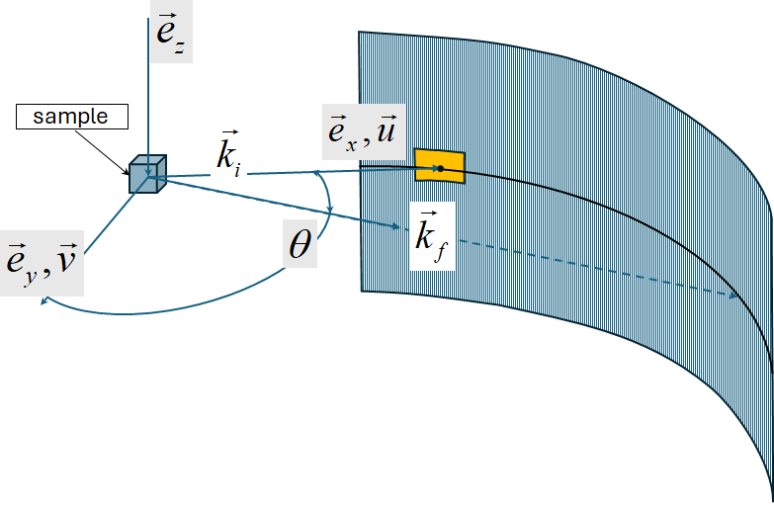
Horace 4 issues from user experience and Horace 4.1 highlights
Horace Instrument view cut – Mantid instrument view with difference
wout = instrument_view_cut(sqw_source,[0,theta_step,theta_max],[En_min,En_step,En_max]);
Interface to cut with kf_sphere_proj
which you should not use in your cuts. (Not ready)
Full SQW object operation

Slide 4
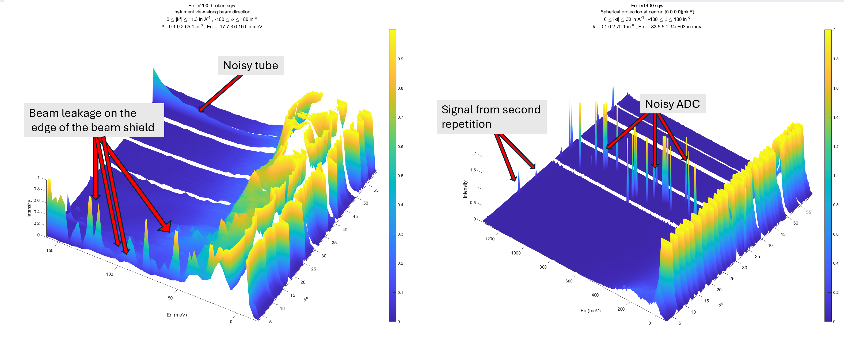
Horace 4 issues from user experience and Horace 4.1 highlights
Horace Instrument view cut – Mantid instrument view with difference
wout = instrument_view_cut(sqw_source,[0,theta_step,theta_max],[En_min,En_step,En_max]);

Slide 5
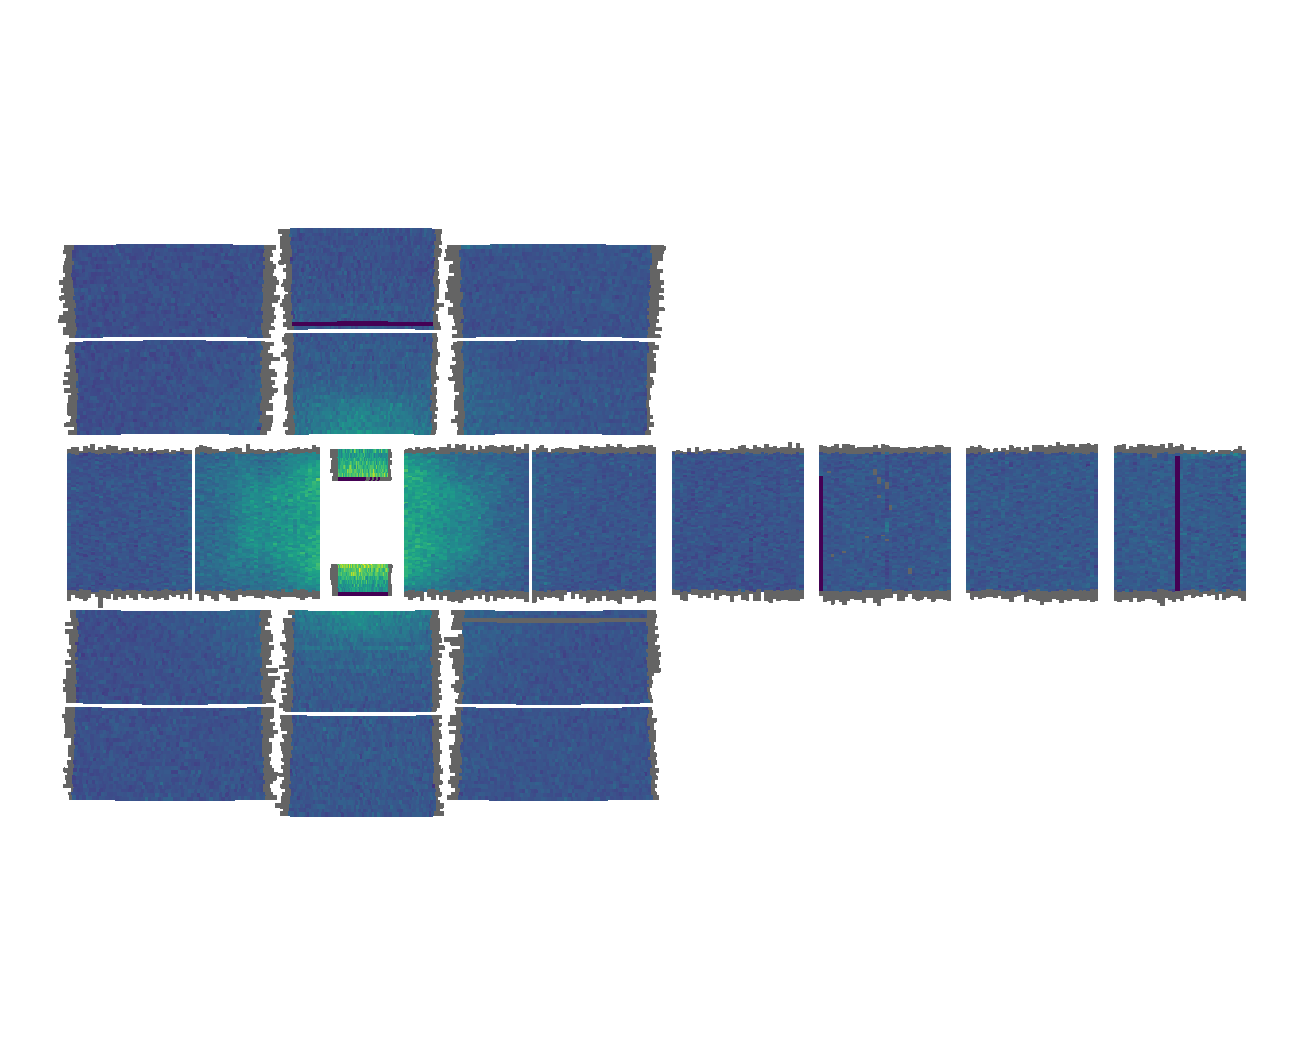
Horace 4 issues from user experience and Horace 4.1 highlights
Data Diagnostics: Instrument view cut
Normally Horace works with scattering function build in reciprocal coordinate system related to a crystal.
If sample is not sufficiently large to allow neutrons thermalization or instrument have various problems with
its detectors or background scattering, some scattering artefacts may add noise or unrelated signals to
measured function. These artefacts will have spherical symmetry around the beam direction.
To clearly identify such artefacts one may use instrument_view_cut
Full SQW object operation
https://abuts.github.io/Horace/v4.1.0/manual/Data_diagnostics.html#instrument-view-cut

Slide 6
Horace 4 issues from user experience and Horace 4.1 highlights
sqw_op :-> gateway for unary & binary operations overs sqw files
ADVANCED!!!
Full SQW object operation
w2_14 = instrument_view_cut(sqw_file_or_obj,[0,0.2,70],4);
x1 = w2_14.p{1};
x2 = w2_14.p{2};
F = griddedInterpolant({x1,x2},w2_14.s);
sqw1400_no_bg = sqw_op(sqw_file_or_obj,@remove_background,{w2_14,F},'outfile',target_filename);
function sig_var = remove_background(pageop_obj,bg_data,bg_model,rlu)
% retrieve page of pixel data in Crystal Cartesian coordinate system
data = pageop_obj.page_data;
% 2D background
pix = bg_data.proj.transform_pix_to_img(data(1:5,:));
bg_signal = bg_model(pix(2,:),data(4,:));
sig_var = data([8,9],:);
sig_var(1,:) = data(8,:)-bg_signal;
over_compensated = sig_var(1,:)<0;
sig_var(2,over_compensated) = 0;

Slide 7
Horace 4 issues from user experience and Horace 4.1 highlights
sqw_op :-> gateway for unary & binary operations overs sqw files
Background data
ADVANCED!!!
Full SQW object operation
w2_14 = instrument_view_cut(sqw_file_or_obj,[0,0.2,70],4);
x1 = w2_14.p{1};
x2 = w2_14.p{2};
F = griddedInterpolant({x1,x2},w2_14.s);
sqw1400_no_bg = sqw_op(sqw_file_or_obj,@remove_background,{w2_14,F},'outfile',target_filename);
function sig_var = remove_background(pageop_obj,bg_data,bg_model,rlu)
% retrieve page of pixel data in Crystal Cartesian coordinate system
data = pageop_obj.page_data;
% 2D background
pix = bg_data.proj.transform_pix_to_img(data(1:5,:));
bg_signal = bg_model(pix(2,:),data(4,:));
sig_var = data([8,9],:);
sig_var(1,:) = data(8,:)-bg_signal;
over_compensated = sig_var(1,:)<0;
sig_var(2,over_compensated) = 0;

Slide 8
Horace 4 issues from user experience and Horace 4.1 highlights
sqw_op :-> gateway for unary operations overs sqw files
ADVANCED!!!
Full SQW object operation
w2_14 = instrument_view_cut(sqw_file_or_obj,[0,0.2,70],4);
x1 = w2_14.p{1};
x2 = w2_14.p{2};
F = griddedInterpolant({x1,x2},w2_14.s);
sqw1400_no_bg = sqw_op(sqw_file_or_obj,@remove_background,{w2_14,F},'outfile',target_filename);
Background model
function sig_var = remove_background(pageop_obj,bg_data,bg_model,rlu)
% retrieve page of pixel data in Crystal Cartesian coordinate system
data = pageop_obj.page_data;
% 2D background
pix = bg_data.proj.transform_pix_to_img(data(1:5,:));
bg_signal = bg_model(pix(2,:),data(4,:));
sig_var = data([8,9],:);
sig_var(1,:) = data(8,:)-bg_signal;
over_compensated = sig_var(1,:)<0;
sig_var(2,over_compensated) = 0;

Slide 9
Horace 4 issues from user experience and Horace 4.1 highlights
sqw_op :-> gateway for unary operations overs sqw files
ADVANCED!!!
Full SQW object operation

Slide 10
Horace 4 issues from user experience and Horace 4.1 highlights
sqw_op_bin_pixes :-> random operations overs sqw files
ADVANCED!!!
Full SQW object operation

