Slide 1
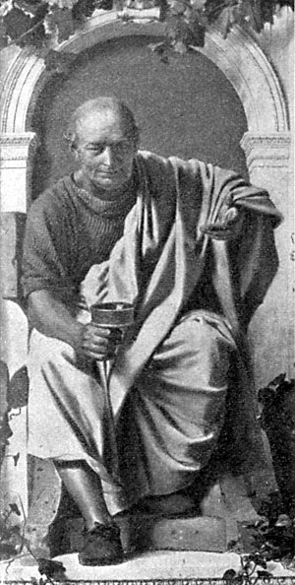
PACE Proper Analysis of Coherent Excitations
HORACE
Package for analysis of the results of inelastic experiments
https://pace-neutrons.github.io/Horace

Slide 2
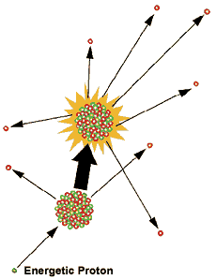
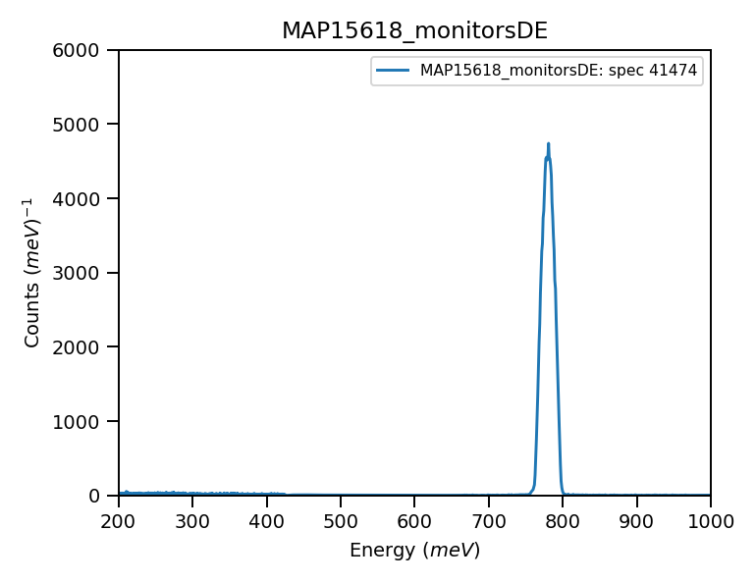
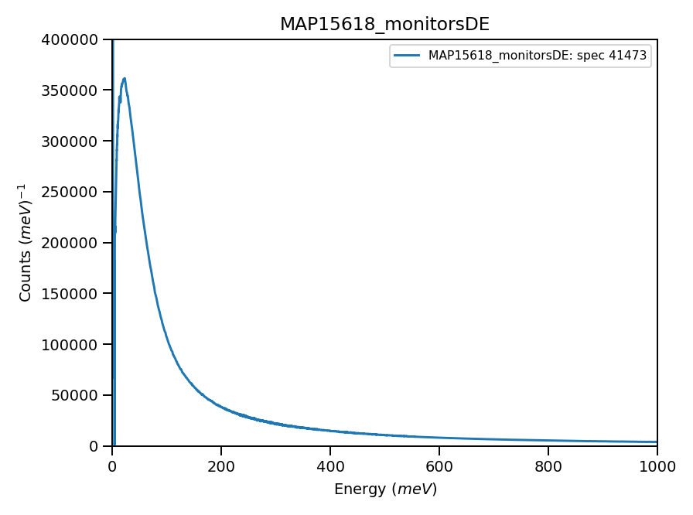
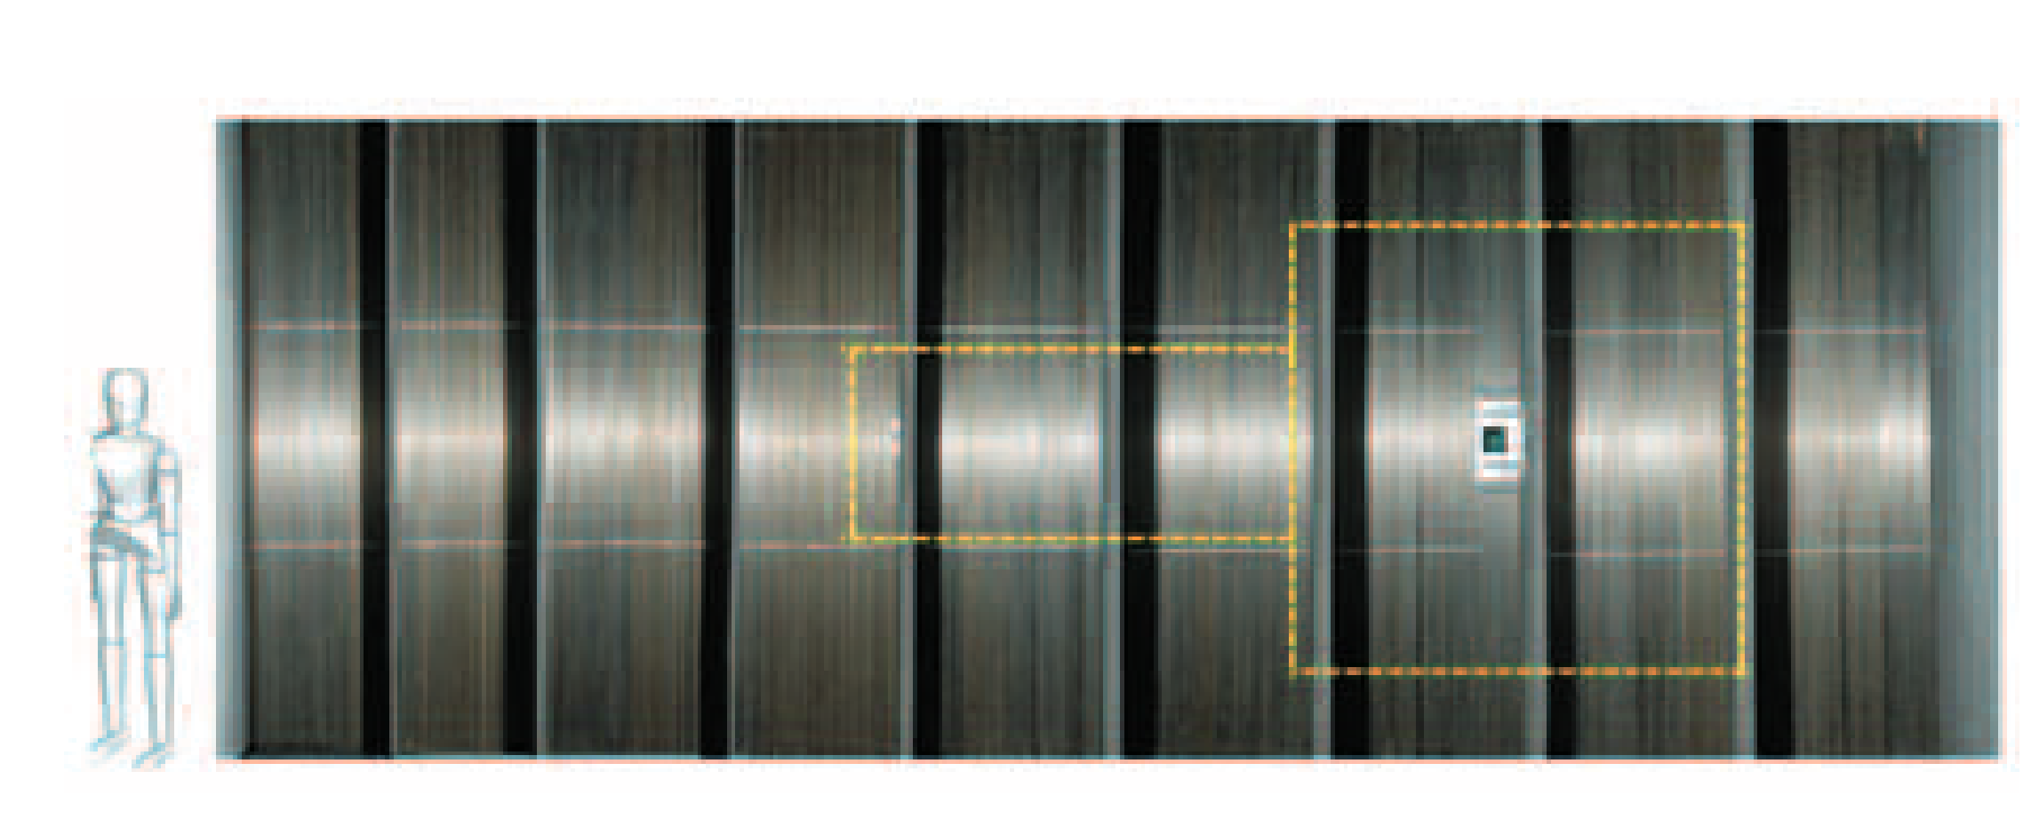
Inelastic experiment using direct inelastic instrument.
Time of flight technique
Chopper
Moderator
PSD Detectors
sample

Slide 3
Inelastic experiment using direct inelastic instrument.
Rotating crystal

Slide 4
From experiment to scientific result. HORACE-PACE place
Convert Time of flight to energy transfer
Construct 4-D
View, enhance and analyse
Compare with scientific models
Scientific models
SpinW – linear spin wave theory
MANTID
HORACE sqw object
HORACE
Tobyfit
Euphonics – results of DFT calculations
User models
MANTID MD workspace
MANTID fitting
Instrument models?

