Slide 1



Introduction to
Euphonic
Rebecca Fair – Excitations Training Course
08/07/21
Notes:
The abstract pattern can be removed or repositioned if required. Be careful to ‘Send to Back’ so that it does not obscure any important information.

Slide 2
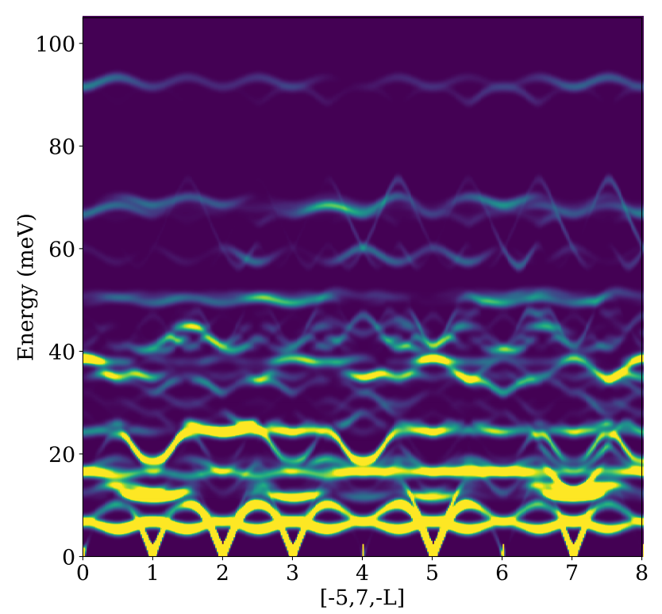
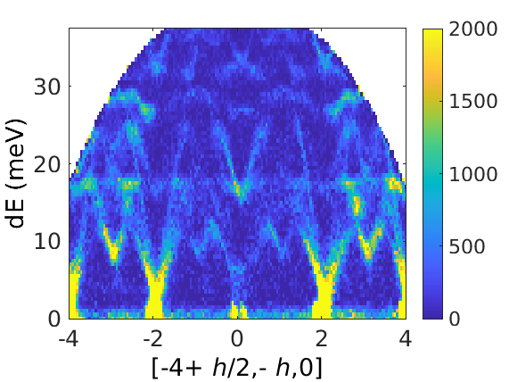
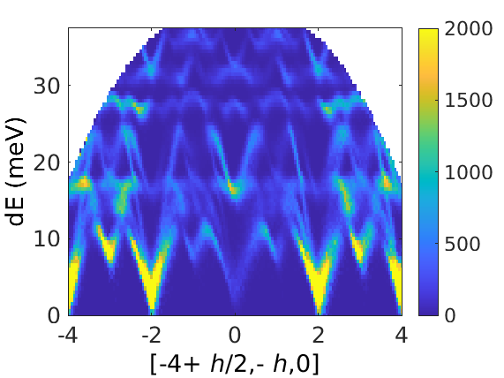
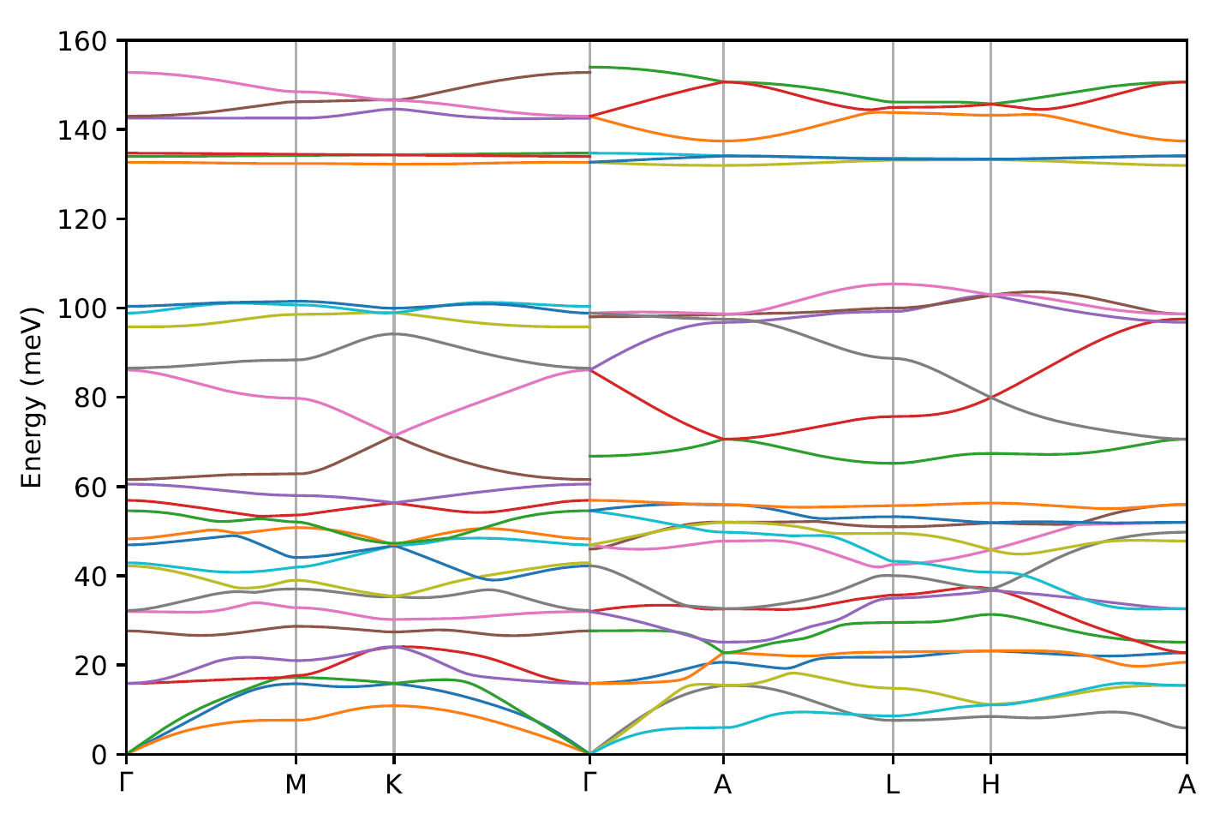
What is Euphonic?
Euphonic is a Python package that can calculate inelastic neutron scattering intensities from force constants
Horace simulation functions are provided via the Horace-Euphonic-Interface MATLAB Add-on
Aims to be efficient - a C extension is used for the most computationally expensive parts
Why simulate phonons?
Atomic vibrations can be easily related to experimental intensities
This provides a good test of theory
Notes:
Replace this guidance text with your own bullet pointed content.
For further guidance please see https://www.bdadyslexia.org.uk/advice/employers/creating-a-dyslexia-friendly-workplace/dyslexia-friendly-style-guide

Slide 3
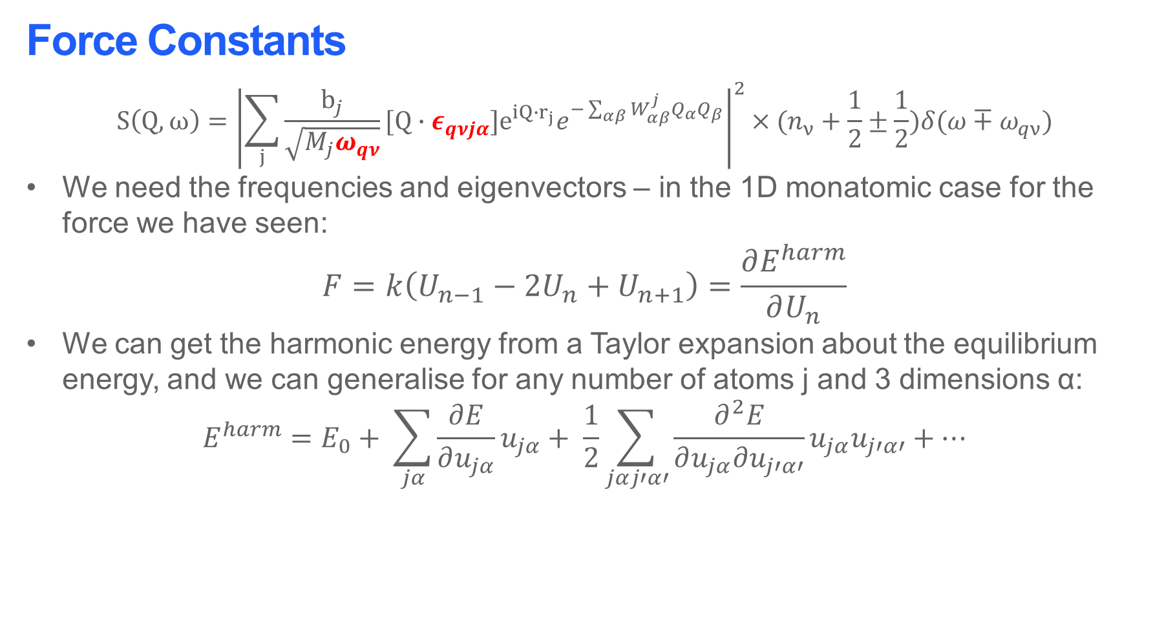
Force Constants
$$S\left(Q,ω\right)={\left|\sum_{j}{\frac{b_{j}}{\sqrt{M_{j}ω_{qν}}}[Q∙ε_{qνjα}]e^{iQ∙r_{j}}e^{−\sum_{αβ}{W_{αβ}^{j}Q_{α}Q_{β}}}}\right|}^{2}×(n_{ν}+\frac{1}{2}±\frac{1}{2})δ(ω∓ω_{qν})$$
We need the frequencies and eigenvectors – in the 1D monatomic case for the force we have seen:
$$F=k\left(U_{n−1}−2U_{n}+U_{n+1}\right)=\frac{∂E^{harm}}{∂U_{n}}$$
We can get the harmonic energy from a Taylor expansion about the equilibrium energy, and we can generalise for any number of atoms j and 3 dimensions α:
$$E^{harm}=E_{0}+ \sum_{jα}{\frac{∂E}{∂u_{jα}}u_{jα}}+ \frac{1}{2}\sum_{jαj′α′}{\frac{∂^{2}E}{∂u_{jα}∂u_{j′α′}}u_{jα}u_{j′α′}}+⋯$$

Slide 4
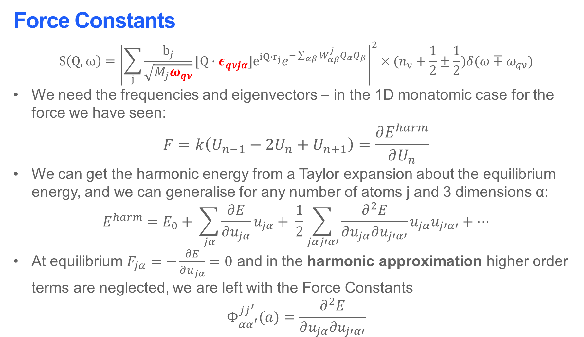
Force Constants
$$S\left(Q,ω\right)={\left|\sum_{j}{\frac{b_{j}}{\sqrt{M_{j}ω_{qν}}}[Q∙ε_{qνjα}]e^{iQ∙r_{j}}e^{−\sum_{αβ}{W_{αβ}^{j}Q_{α}Q_{β}}}}\right|}^{2}×(n_{ν}+\frac{1}{2}±\frac{1}{2})δ(ω∓ω_{qν})$$
We need the frequencies and eigenvectors – in the 1D monatomic case for the force we have seen:
$$F=k\left(U_{n−1}−2U_{n}+U_{n+1}\right)=\frac{∂E^{harm}}{∂U_{n}}$$
We can get the harmonic energy from a Taylor expansion about the equilibrium energy, and we can generalise for any number of atoms j and 3 dimensions α:
$$E^{harm}=E_{0}+ \sum_{jα}{\frac{∂E}{∂u_{jα}}u_{jα}}+ \frac{1}{2}\sum_{jαj′α′}{\frac{∂^{2}E}{∂u_{jα}∂u_{j′α′}}u_{jα}u_{j′α′}}+⋯$$
At equilibrium $F_{jα}=−\frac{∂E}{∂u_{jα}}=0$ and in the harmonic approximation higher order terms are neglected, we are left with the Force Constants
$$Φ_{αα^{′}}^{jj^{′}}(a)=\frac{∂^{2}E}{∂u_{jα}∂u_{j′α′}}$$

Slide 5
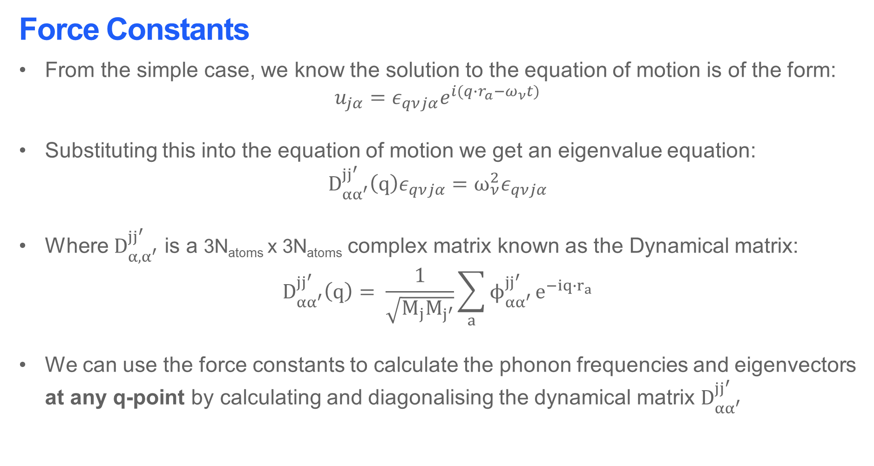
Force Constants
From the simple case, we know the solution to the equation of motion is of the form:
$$u_{jα}=ε_{qνjα}e^{i(q∙r_{a}−ω_{ν}t)}$$
Substituting this into the equation of motion we get an eigenvalue equation:
$$D_{αα^{′}}^{jj^{′} }\left(q\right)ε_{qνjα}=ω_{ν}^{2}ε_{qνjα}$$
Where $D_{α, α^{′}}^{jj^{′} }$ is a 3N_{atoms} x 3N_{atoms} complex matrix known as the Dynamical matrix:
$$D_{αα^{′}}^{jj^{′} }\left(q\right)= \frac{1}{\sqrt{M_{j}M_{j^{′}}}}\sum_{a}{ϕ_{αα^{′}}^{jj^{′} }}e^{−iq{∙r}_{a}}$$
We can use the force constants to calculate the phonon frequencies and eigenvectors at any q-point by calculating and diagonalising the dynamical matrix $D_{αα^{′}}^{jj^{′} }$
This is known as Fourier interpolation
M. T. Dove, Introduction to Lattice Dynamics, Cambridge University Press, Cambridge, 1993, 83-87
M. T. Dove, Structure and Dynamics, Oxford University Press, Oxford, 2003, Chapter 8

Slide 6

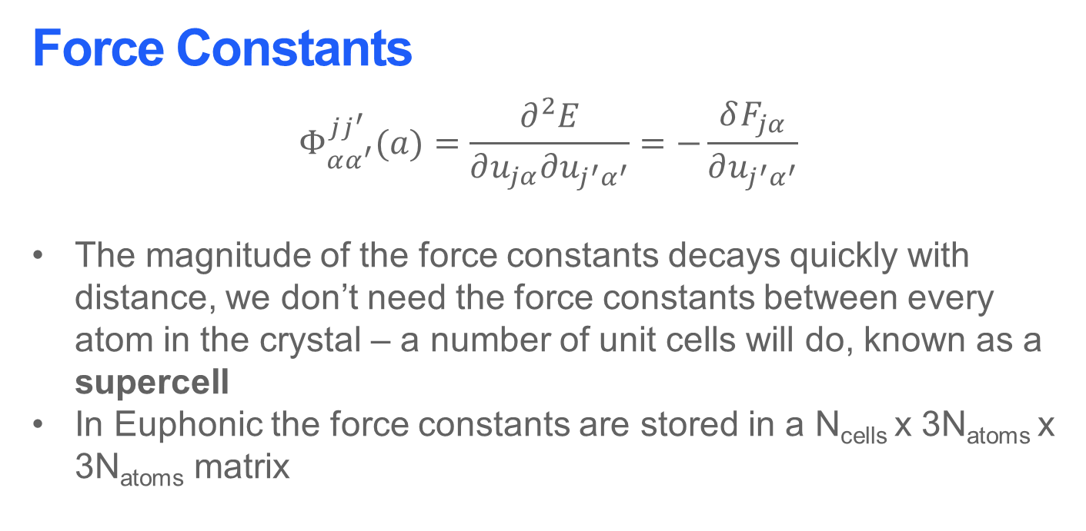
Force Constants
$$Φ_{αα^{′}}^{jj^{′}}(a)=\frac{∂^{2}E}{∂u_{jα}∂u_{j^{′}α^{′}}}=−\frac{δF_{jα}}{∂u_{j^{′}α^{′}}}$$
The magnitude of the force constants decays quickly with distance, we don’t need the force constants between every atom in the crystal – a number of unit cells will do, known as a supercell
In Euphonic the force constants are stored in a N_{cells} x 3N_{atoms} x 3N_{atoms} matrix
u_{j′α′}
j$′$
r_{a}
F_{jα}
j
Note: For polar materials the force constants decay more slowly due to long range Coulomb interactions – this requires an extra (computationally expensive) correction be applied to the force constants matrix. This also requires that the dielectric permitivitty tensor and Born charges be calculated.

Slide 7
Force Constants
Force constants can be calculated by a variety of modelling codes
Some common methods are finite displacement and density functional perturbation theory
Euphonic can currently read CASTEP and Phonopy force constants
Through Phonopy Euphonic also has access to force constants from a range of other computational codes
Euphonic also has its own JSON format for reading/writing force constants
CASTEP
(.castep_bin)
Euphonic
Euphonic format
(.json)
VASP
Phonopy
(phonopy.yaml)
Quantum ESPRESSO
CRYSTAL
and more…

Slide 8
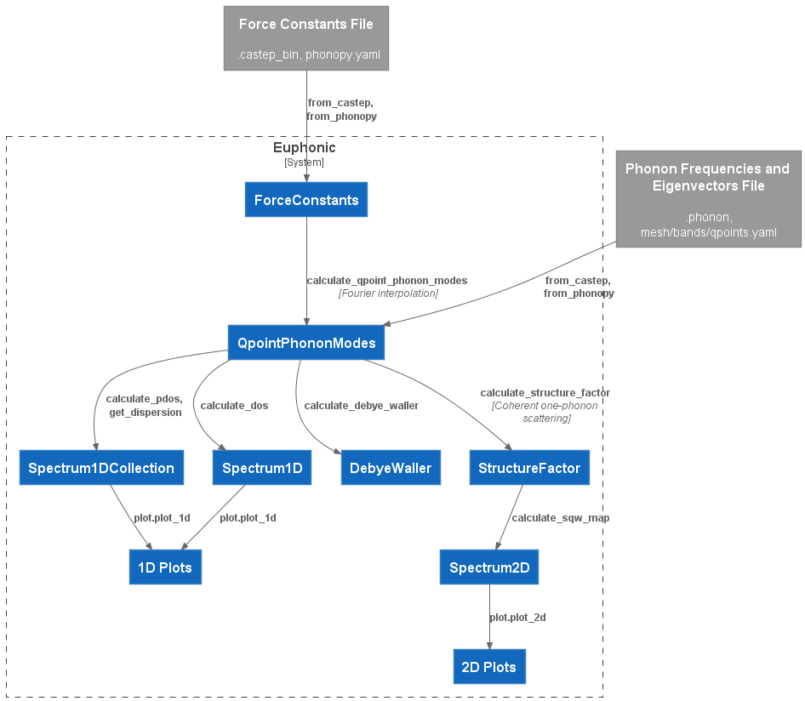
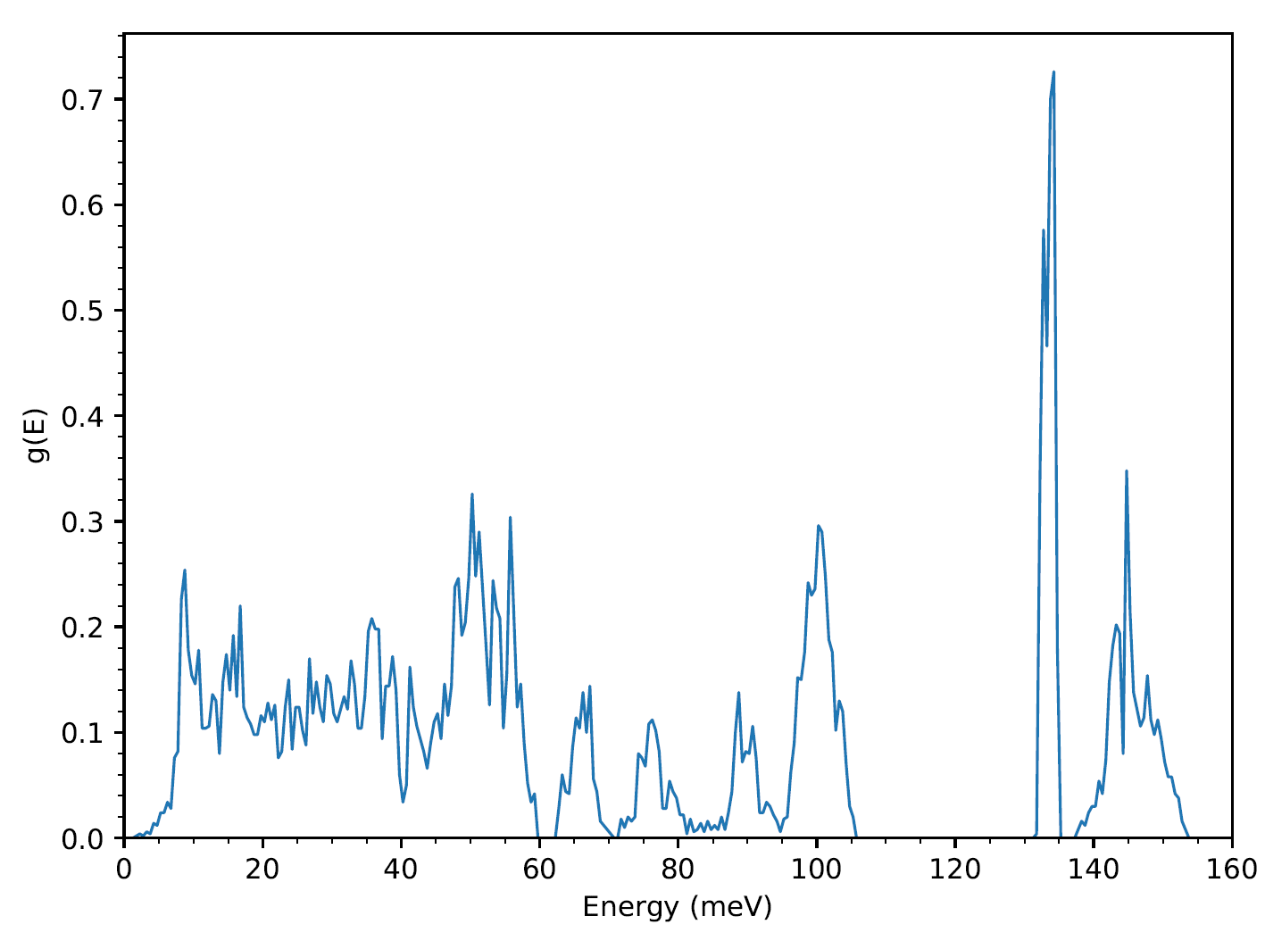
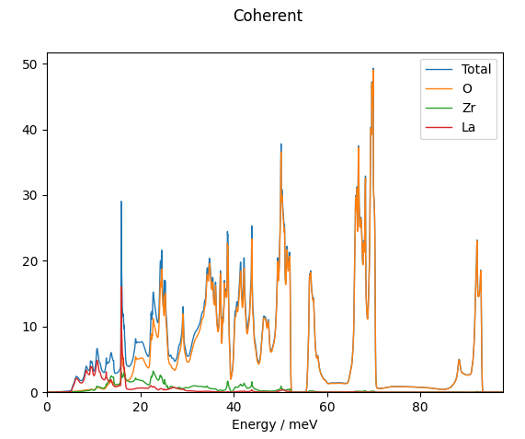
Euphonic Data Flow and Objects

Slide 9
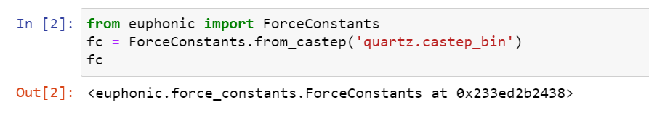
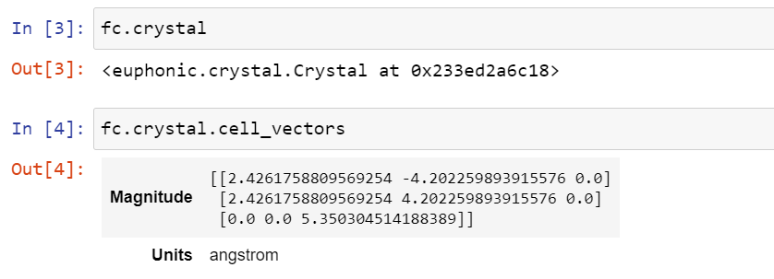
The ForceConstants object
Most important data in Euphonic is contained in an object – so that relevant metadata and functions can be easily accessed and used
For example, the force constants don’t make much sense without the crystal information, this is stored inside a Crystal object, in the crystal attribute

Slide 10
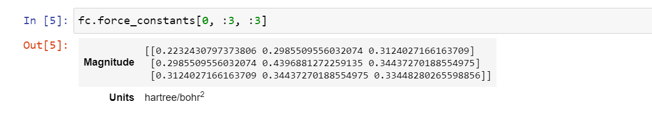
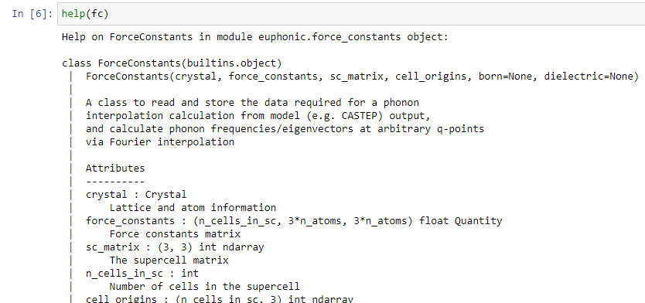
The ForceConstants object
The force constants themselves are stored inside the force_constants attribute
Help can also be accessed to view more attributes/methods on objects
…

Slide 11
Euphonic Data Flow and Objects

Slide 12
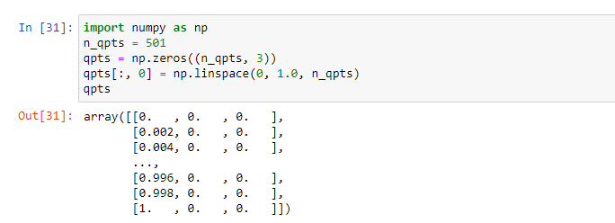

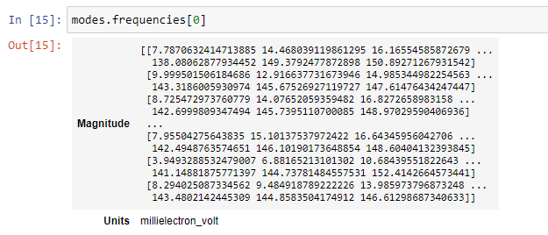
Calculating Phonon Frequencies and Eigenvectors
Phonon frequencies and eigenvectors are stored in a QpointPhononModes object. These are calculated with the ForceConstants.calculate_qpoint_phonon_modes method. This requires a shape (N, 3) Numpy array of q-points
QpointPhononModes contains both frequencies and eigenvectors

Slide 13

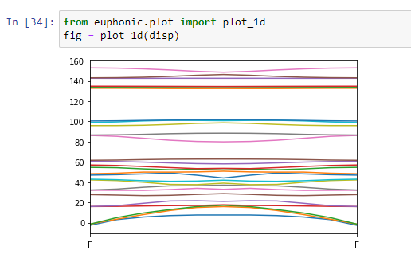
Plotting Dispersion
From a QpointPhononModes object we can get the dispersion with the with the QpointPhononModes.get_dispersion method. This converts the shape (N, 3) q-points to a length N vector that can be plotted on the X-axis and returns a Spectrum1DCollection object
A Spectrum1DCollection contains data for multiple 1D Spectra in the x_data and y_data attributes. It can be plotted easily with euphonic.plot.plot_1d, which returns a Matplotlib figure

Slide 14
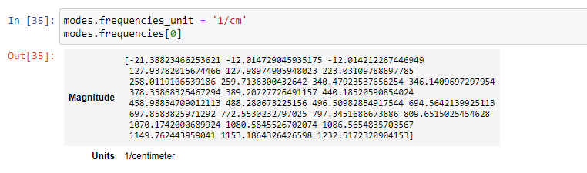
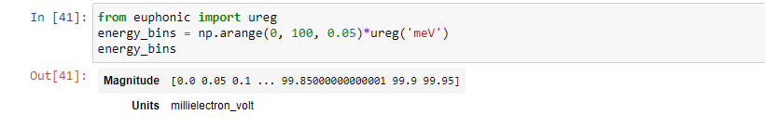
Units in Euphonic – Numpy and Pint libraries
For efficiency Euphonic makes extensive use of the Numpy library for storing and processing vector and matrix data
You may have noticed many of the previously shown quantities have both a magnitude and a unit
This is because Euphonic uses the Pint (pint.readthedocs.io) library to wrap dimensioned data as a pint.Quantity. This can wrap Numpy arrays as well as scalars
This allows units to easily be changed e.g.
Dimensioned data can also be created using euphonic.ureg, this is required for creating some things such as energy bins for use in Euphonic

Slide 15
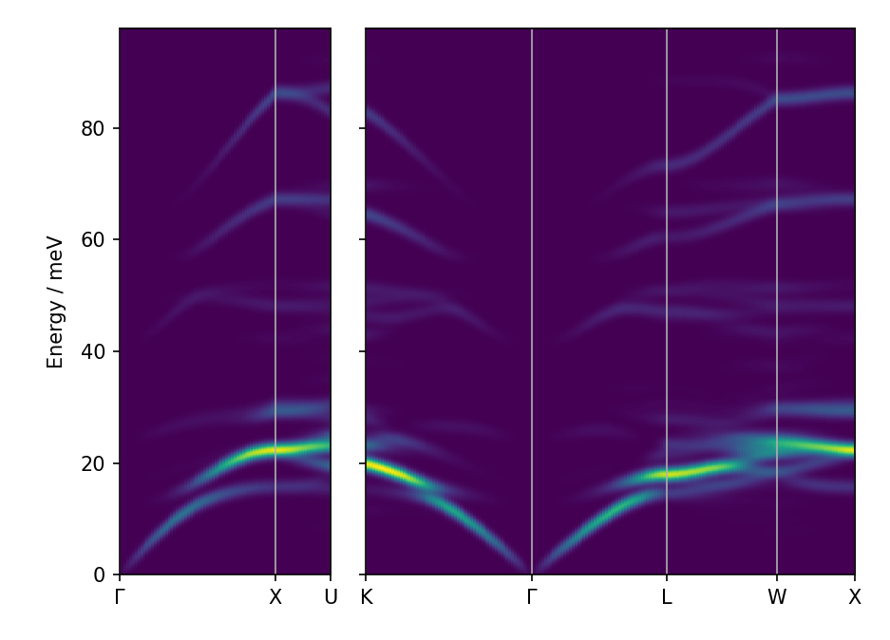
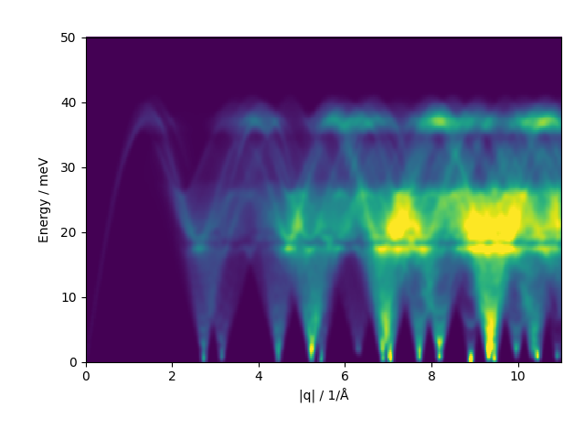
Command Line Tools
Euphonic also comes with a variety of useful command line tools for quick plotting of things such as dispersion, density of states and scattering intensities

Slide 16
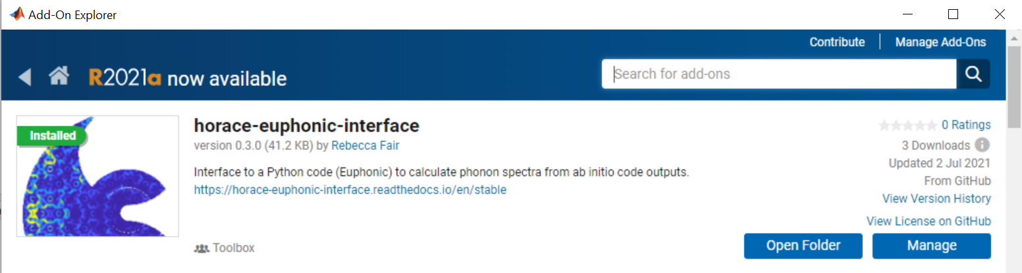
Euphonic and Horace
Euphonic can be used to create simulations in Horace using Horace-Euphonic-Interface
It is distributed as a Matlab Toolbox (.mltbx), which is available via the Matlab File Exchange and Github
It can also be installed from within Matlab using the Add-on explorer

Slide 17
Euphonic and Horace
% Read in experimental cut
cut = read_horace('quartz.d2d');
% Read force constants
fc = euphonic.ForceConstants.from_castep('quartz.castep_bin')
% Set up model
coh_model = euphonic.CoherentCrystal(...
fc, ...
'conversion_mat', [1 0 0; 0 1 0; 0 0 -1],
'debye_waller_grid', [6 6 6], ...
'temperature', 100, ...
'asr', 'reciprocal', ...
'use_c', true, ...
‘n_threads', 8);
% Simulate
scale_factor = 2e2;
effective_fwhm = 1;
cut_sim = disp2sqw_eval(...
cut, @coh_model.horace_disp, {scale_factor}, effective_fwhm);
% Plot
plot(cut_sim);
This is largely a Matlab wrapper around the Python code, with some additions to enable easy simulation with Horace
euphonic.CoherentCrystal is only available via Horace-Euphonic-Interface and acts to gather all the model parameters together
CoherentCrystal.horace_disp returns the phonon frequencies and weights (per mode intensities) for every simulation q-point for use with disp2sqw_eval

Slide 18
Euphonic and Horace
% Read in experimental cut
cut = read_horace('quartz.d2d');
% Read force constants
fc = euphonic.ForceConstants.from_castep('quartz.castep_bin')
% Set up model
coh_model = euphonic.CoherentCrystal(...
fc, ...
'conversion_mat', [1 0 0; 0 1 0; 0 0 -1],
'debye_waller_grid', [6 6 6], ...
'temperature', 100, ...
'asr', 'reciprocal', ...
'use_c', true, ...
‘n_threads', 8);
% Simulate
scale_factor = 2e2;
effective_fwhm = 1;
cut_sim = disp2sqw_eval(...
cut, @coh_model.horace_disp, {scale_factor}, effective_fwhm);
% Plot
plot(cut_sim);
This is largely a Matlab wrapper around the Python code, with some additions to enable easy simulation with Horace
euphonic.CoherentCrystal is only available via Horace-Euphonic-Interface and acts to gather all the model parameters together
CoherentCrystal.horace_disp returns the phonon frequencies and weights (per mode intensities) for every simulation q-point for use with disp2sqw_eval

Slide 19
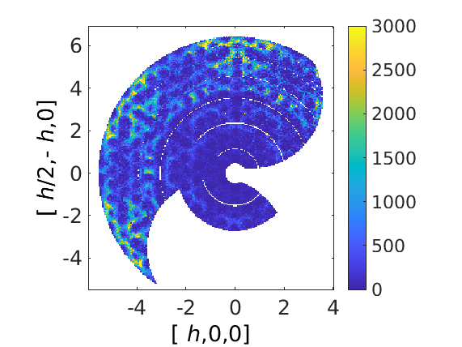
Euphonic and Horace
% Read in experimental cut
cut = read_horace('quartz.d2d');
% Read force constants
fc = euphonic.ForceConstants.from_castep('quartz.castep_bin')
% Set up model
coh_model = euphonic.CoherentCrystal(...
fc, ...
'conversion_mat', [1 0 0; 0 1 0; 0 0 -1],
'debye_waller_grid', [6 6 6], ...
'temperature', 100, ...
'asr', 'reciprocal', ...
'use_c', true, ...
‘n_threads', 8);
% Simulate
scale_factor = 2e2;
effective_fwhm = 1;
cut_sim = disp2sqw_eval(...
cut, @coh_model.horace_disp, {scale_factor}, effective_fwhm);
% Plot
plot(cut_sim);
This is largely a Matlab wrapper around the Python code, with some additions to enable easy simulation with Horace
euphonic.CoherentCrystal is only available via Horace-Euphonic-Interface and acts to gather all the model parameters together
CoherentCrystal.horace_disp returns the phonon frequencies and weights (per mode intensities) for every simulation q-point for use with disp2sqw_eval

Slide 20
Useful Links
Euphonic Docs: https://euphonic.readthedocs.io
Horace-Euphonic-Interface Docs: https://horace-euphonic-interface.readthedocs.io

