Slide 1
Measuring Phonons with Neutrons
D. J. Voneshen – Excitations training course
8/7/2021

Slide 2
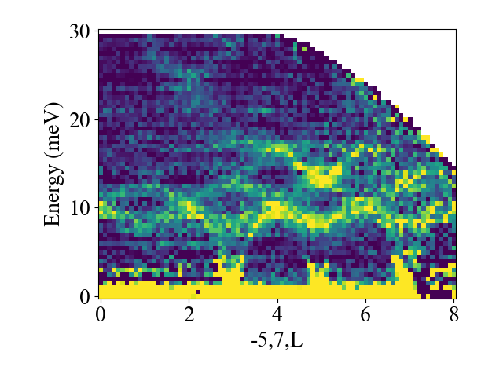
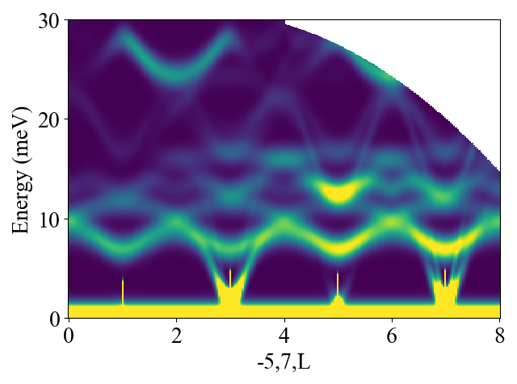
Contents
What and why phonons?
One phonon cross section
Measuring single crystals
Measuring powders
Incoherent approximation

Slide 3
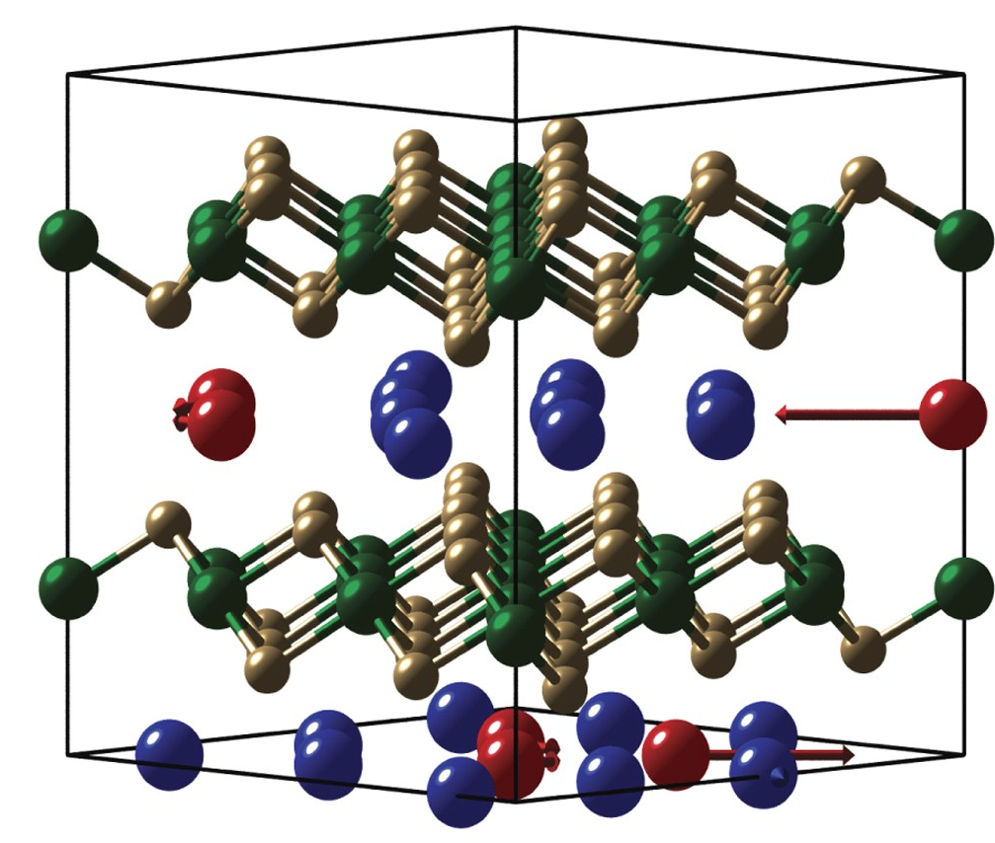
Why Phonons?
Not just background!
Lattice dynamics is important for
Bonding
Heat transfer
Phase transitions
Some superconductors

Slide 4
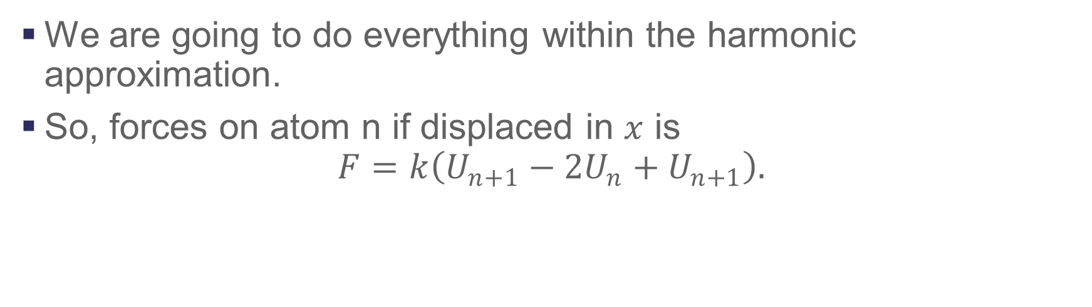
Phonons an overview
We are going to do everything within the harmonic approximation.
So, forces on atom n if displaced in $x$ is
$$F=k\left(U_{n+1}−2U_{n}+U_{n+1}\right).$$

Slide 5
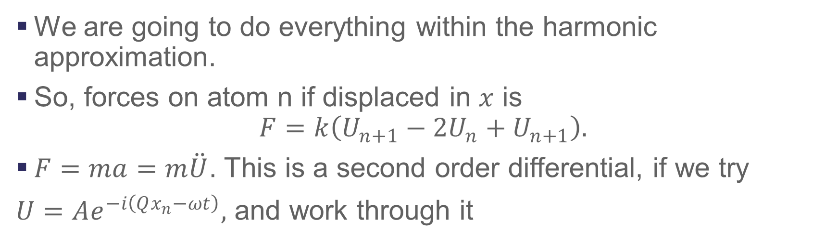
Phonons an overview
We are going to do everything within the harmonic approximation.
So, forces on atom n if displaced in $x$ is
$$F=k\left(U_{n+1}−2U_{n}+U_{n+1}\right).$$
$F=ma=m\ddot{U}$. This is a second order differential, if we try
$U=Ae^{−i\left(Qx_{n}−ωt\right)},$ and work through it

Slide 6
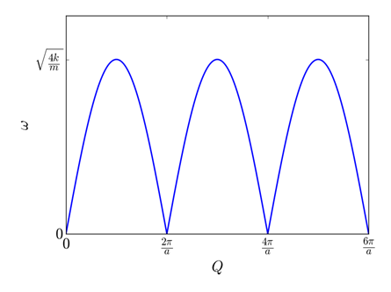
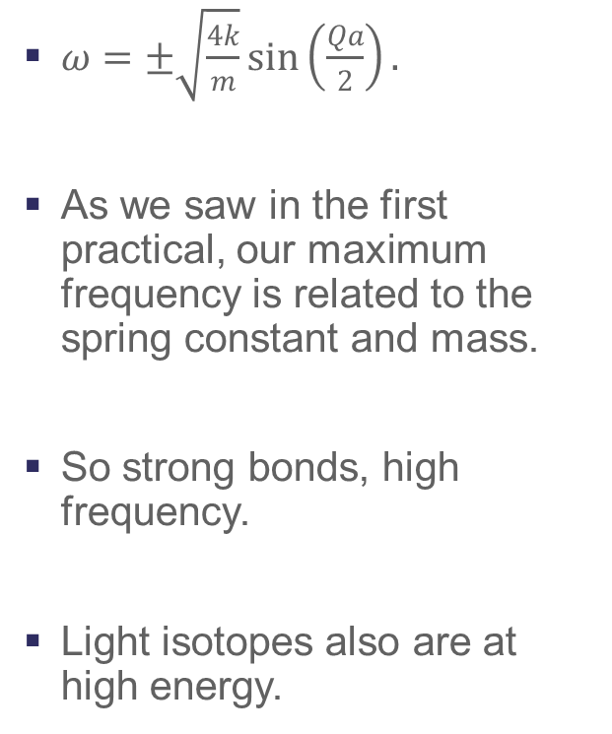
Phonons, an overview
$ω=±\sqrt{\frac{4k}{m}}\sin\left(\frac{Qa}{2}\right).$
As we saw in the first practical, our maximum frequency is related to the spring constant and mass.
So strong bonds, high frequency.
Light isotopes also are at high energy.

Slide 7
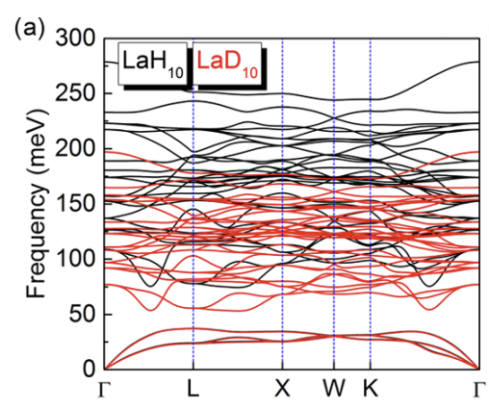
Phonons, an overview

Slide 8
Now to neutrons!

Slide 9
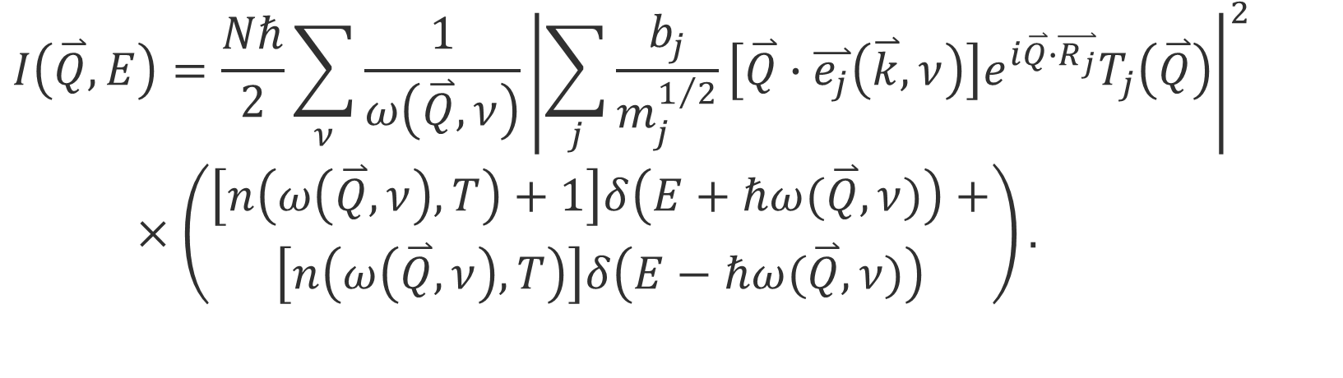
One phonon coherent scattering
$$I\left(\overset{⃑}{Q},E\right)=\frac{Nℏ}{2}\sum_{ν}{\frac{1}{ω\left(\overset{⃑}{Q},ν\right)}}{\left|\sum_{j}{\frac{b_{j}}{m_{j}^{1/2}}}\left[\overset{⃑}{Q}∙\overset{⃑}{e_{j}}\left(\overset{⃑}{k},ν\right)\right]e^{i\overset{⃑}{Q}∙\overset{⃑}{R_{j}}}T_{j}\left(\overset{⃑}{Q}\right)\right|}^{2}$$
$×\left(\begin{aligned}\left[n\left(ω\left(\overset{⃑}{Q},ν\right),T\right)+1\right]δ\left(E+ℏω(\overset{⃑}{Q},ν)\right)+ \\ \left[n\left(ω\left(\overset{⃑}{Q},ν\right),T\right)\right]δ\left(E−ℏω(\overset{⃑}{Q},ν)\right)\end{aligned}\right).$

Slide 10
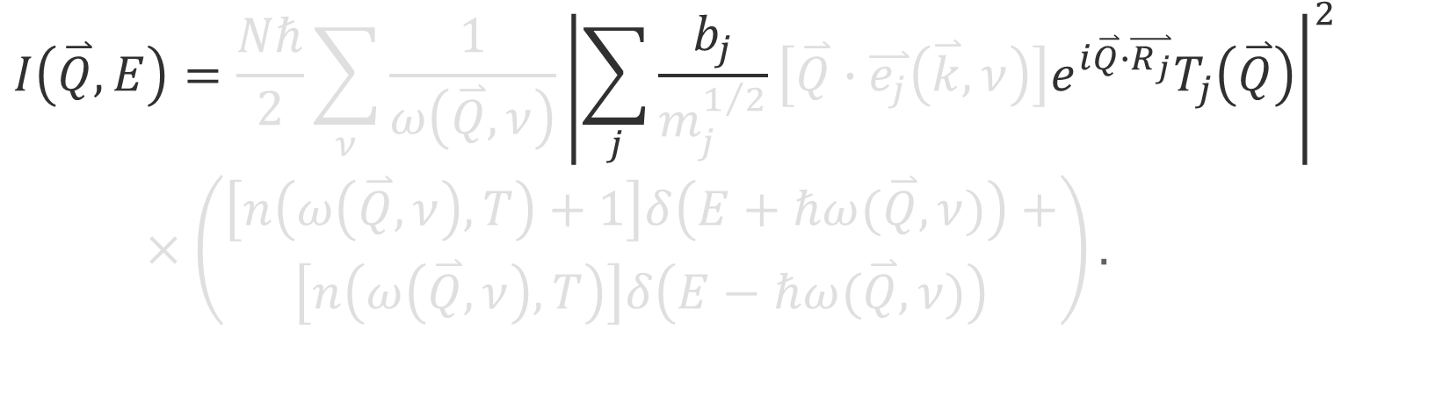
One phonon coherent scattering
$$I\left(\overset{⃑}{Q},E\right)=\frac{Nℏ}{2}\sum_{ν}{\frac{1}{ω\left(\overset{⃑}{Q},ν\right)}}{\left|\sum_{j}{\frac{b_{j}}{m_{j}^{1/2}}}\left[\overset{⃑}{Q}∙\overset{⃑}{e_{j}}\left(\overset{⃑}{k},ν\right)\right]e^{i\overset{⃑}{Q}∙\overset{⃑}{R_{j}}}T_{j}\left(\overset{⃑}{Q}\right)\right|}^{2}$$
$×\left(\begin{aligned}\left[n\left(ω\left(\overset{⃑}{Q},ν\right),T\right)+1\right]δ\left(E+ℏω(\overset{⃑}{Q},ν)\right)+ \\ \left[n\left(ω\left(\overset{⃑}{Q},ν\right),T\right)\right]δ\left(E−ℏω(\overset{⃑}{Q},ν)\right)\end{aligned}\right).$

Slide 11
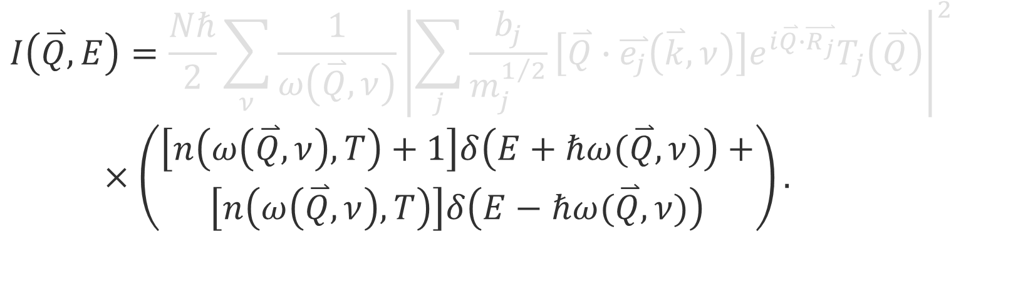
One phonon coherent scattering
$$I\left(\overset{⃑}{Q},E\right)=\frac{Nℏ}{2}\sum_{ν}{\frac{1}{ω\left(\overset{⃑}{Q},ν\right)}}{\left|\sum_{j}{\frac{b_{j}}{m_{j}^{1/2}}}\left[\overset{⃑}{Q}∙\overset{⃑}{e_{j}}\left(\overset{⃑}{k},ν\right)\right]e^{i\overset{⃑}{Q}∙\overset{⃑}{R_{j}}}T_{j}\left(\overset{⃑}{Q}\right)\right|}^{2}$$
$×\left(\begin{aligned}\left[n\left(ω\left(\overset{⃑}{Q},ν\right),T\right)+1\right]δ\left(E+ℏω(\overset{⃑}{Q},ν)\right)+ \\ \left[n\left(ω\left(\overset{⃑}{Q},ν\right),T\right)\right]δ\left(E−ℏω(\overset{⃑}{Q},ν)\right)\end{aligned}\right).$

Slide 12
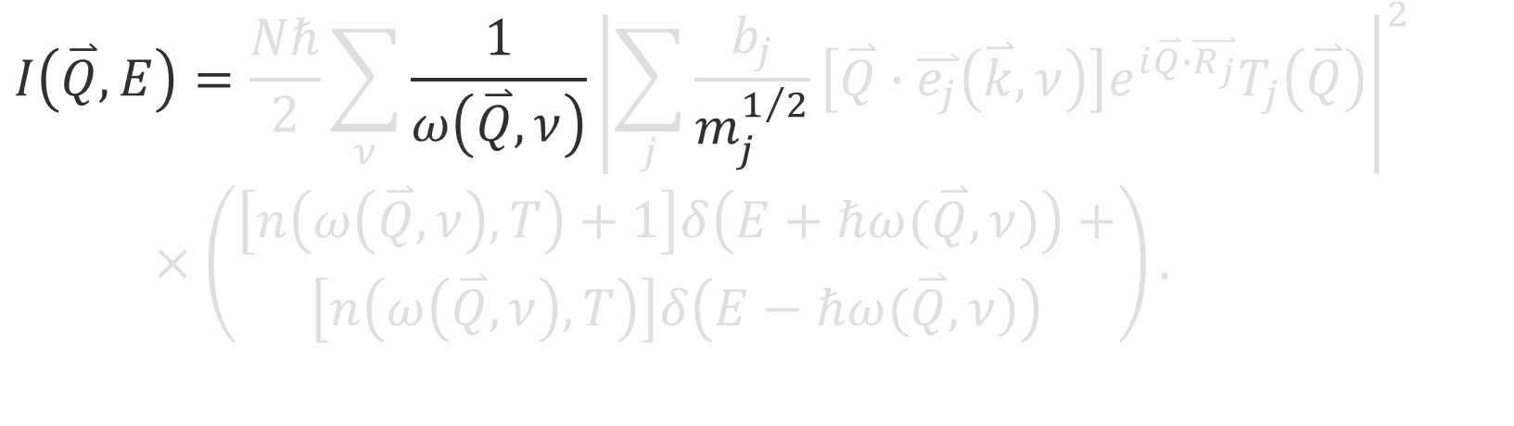
One phonon coherent scattering
$$I\left(\overset{⃑}{Q},E\right)=\frac{Nℏ}{2}\sum_{ν}{\frac{1}{ω\left(\overset{⃑}{Q},ν\right)}}{\left|\sum_{j}{\frac{b_{j}}{m_{j}^{1/2}}}\left[\overset{⃑}{Q}∙\overset{⃑}{e_{j}}\left(\overset{⃑}{k},ν\right)\right]e^{i\overset{⃑}{Q}∙\overset{⃑}{R_{j}}}T_{j}\left(\overset{⃑}{Q}\right)\right|}^{2}$$
$×\left(\begin{aligned}\left[n\left(ω\left(\overset{⃑}{Q},ν\right),T\right)+1\right]δ\left(E+ℏω(\overset{⃑}{Q},ν)\right)+ \\ \left[n\left(ω\left(\overset{⃑}{Q},ν\right),T\right)\right]δ\left(E−ℏω(\overset{⃑}{Q},ν)\right)\end{aligned}\right).$

Slide 13
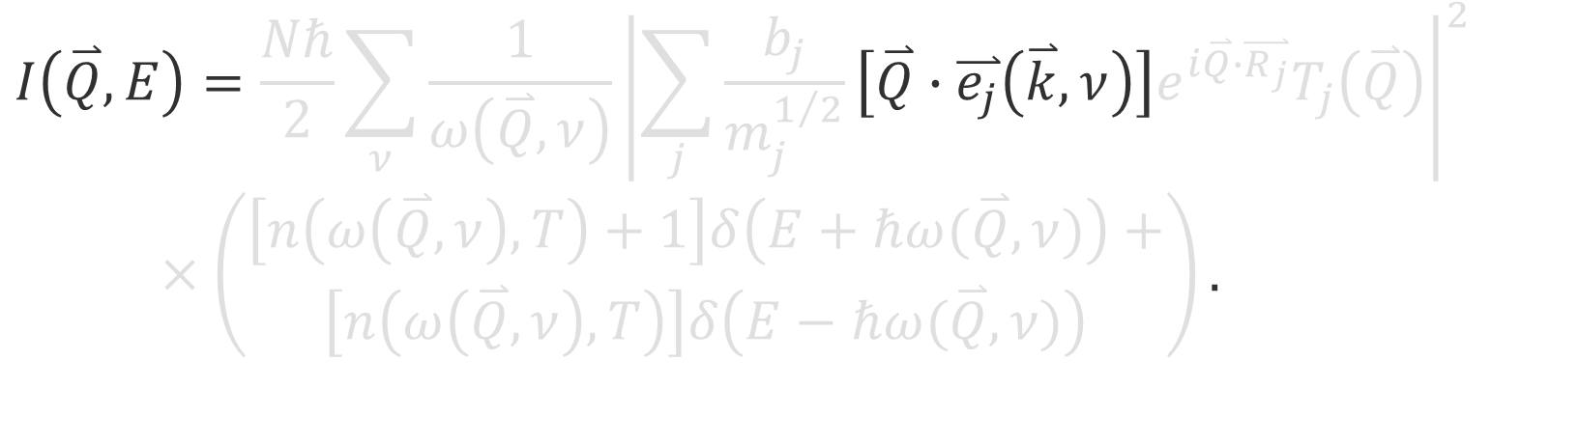
One phonon coherent scattering
$$I\left(\overset{⃑}{Q},E\right)=\frac{Nℏ}{2}\sum_{ν}{\frac{1}{ω\left(\overset{⃑}{Q},ν\right)}}{\left|\sum_{j}{\frac{b_{j}}{m_{j}^{1/2}}}\left[\overset{⃑}{Q}∙\overset{⃑}{e_{j}}\left(\overset{⃑}{k},ν\right)\right]e^{i\overset{⃑}{Q}∙\overset{⃑}{R_{j}}}T_{j}\left(\overset{⃑}{Q}\right)\right|}^{2}$$
$×\left(\begin{aligned}\left[n\left(ω\left(\overset{⃑}{Q},ν\right),T\right)+1\right]δ\left(E+ℏω(\overset{⃑}{Q},ν)\right)+ \\ \left[n\left(ω\left(\overset{⃑}{Q},ν\right),T\right)\right]δ\left(E−ℏω(\overset{⃑}{Q},ν)\right)\end{aligned}\right).$

Slide 14
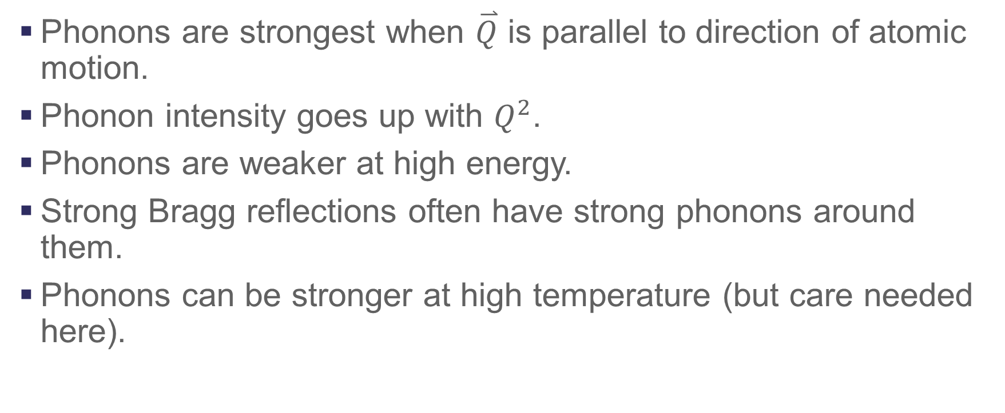
One phonon scattering-key points
Phonons are strongest when $\overset{⃑}{Q}$ is parallel to direction of atomic motion.
Phonon intensity goes up with $Q^{2}$.
Phonons are weaker at high energy.
Strong Bragg reflections often have strong phonons around them.
Phonons can be stronger at high temperature (but care needed here).

Slide 15
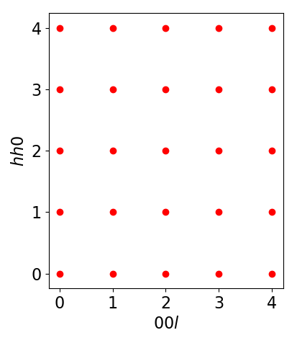
Measuring a longitudinal acoustic phonon
We want to measure a longitudinal phonon along 00L.
Which peak would be best to measure around?

Slide 16

Measuring a longitudinal acoustic phonon
We want to measure a longitudinal phonon along 00L.
Which peak would be best to measure around?
$$\overset{⃑}{Q}$$

Slide 17
Measuring a transverse acoustic phonon
What about a transverse phonon along 00l?

Slide 18

Measuring a transverse acoustic phonon
What about a transverse phonon along 00l?
$$\overset{⃑}{Q}$$

Slide 19
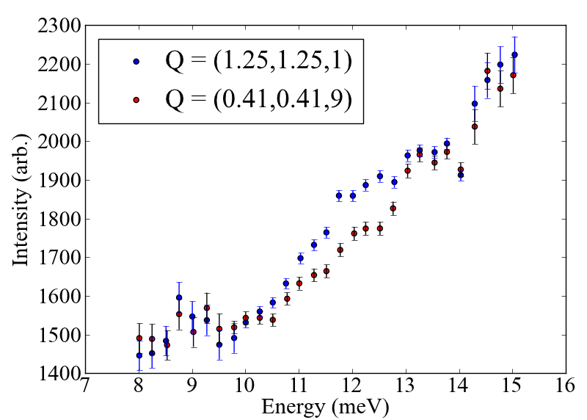

Exploiting $Q∙e$, an example
We were looking for a phonon around 12 meV.
However, the background from the cryostat/mount was huge.
Rotate sample 90°. Suppresses, phonon but background unchanged

Slide 20
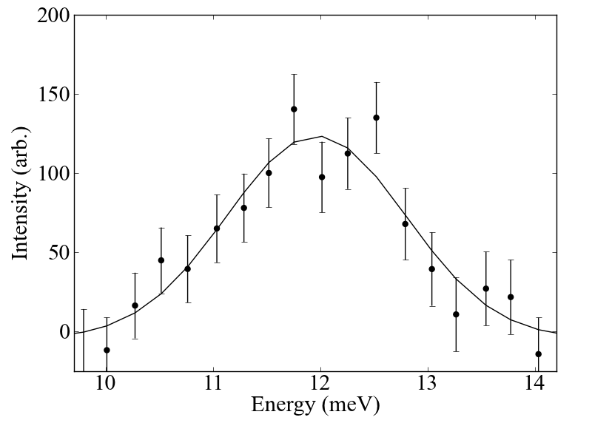
Exploiting $Q∙e$, an example
We were looking for a phonon around 12 meV.
However, the background from the cryostat/mount was huge.
Rotate sample 90°. Suppresses phonon but background unchanged

Slide 21
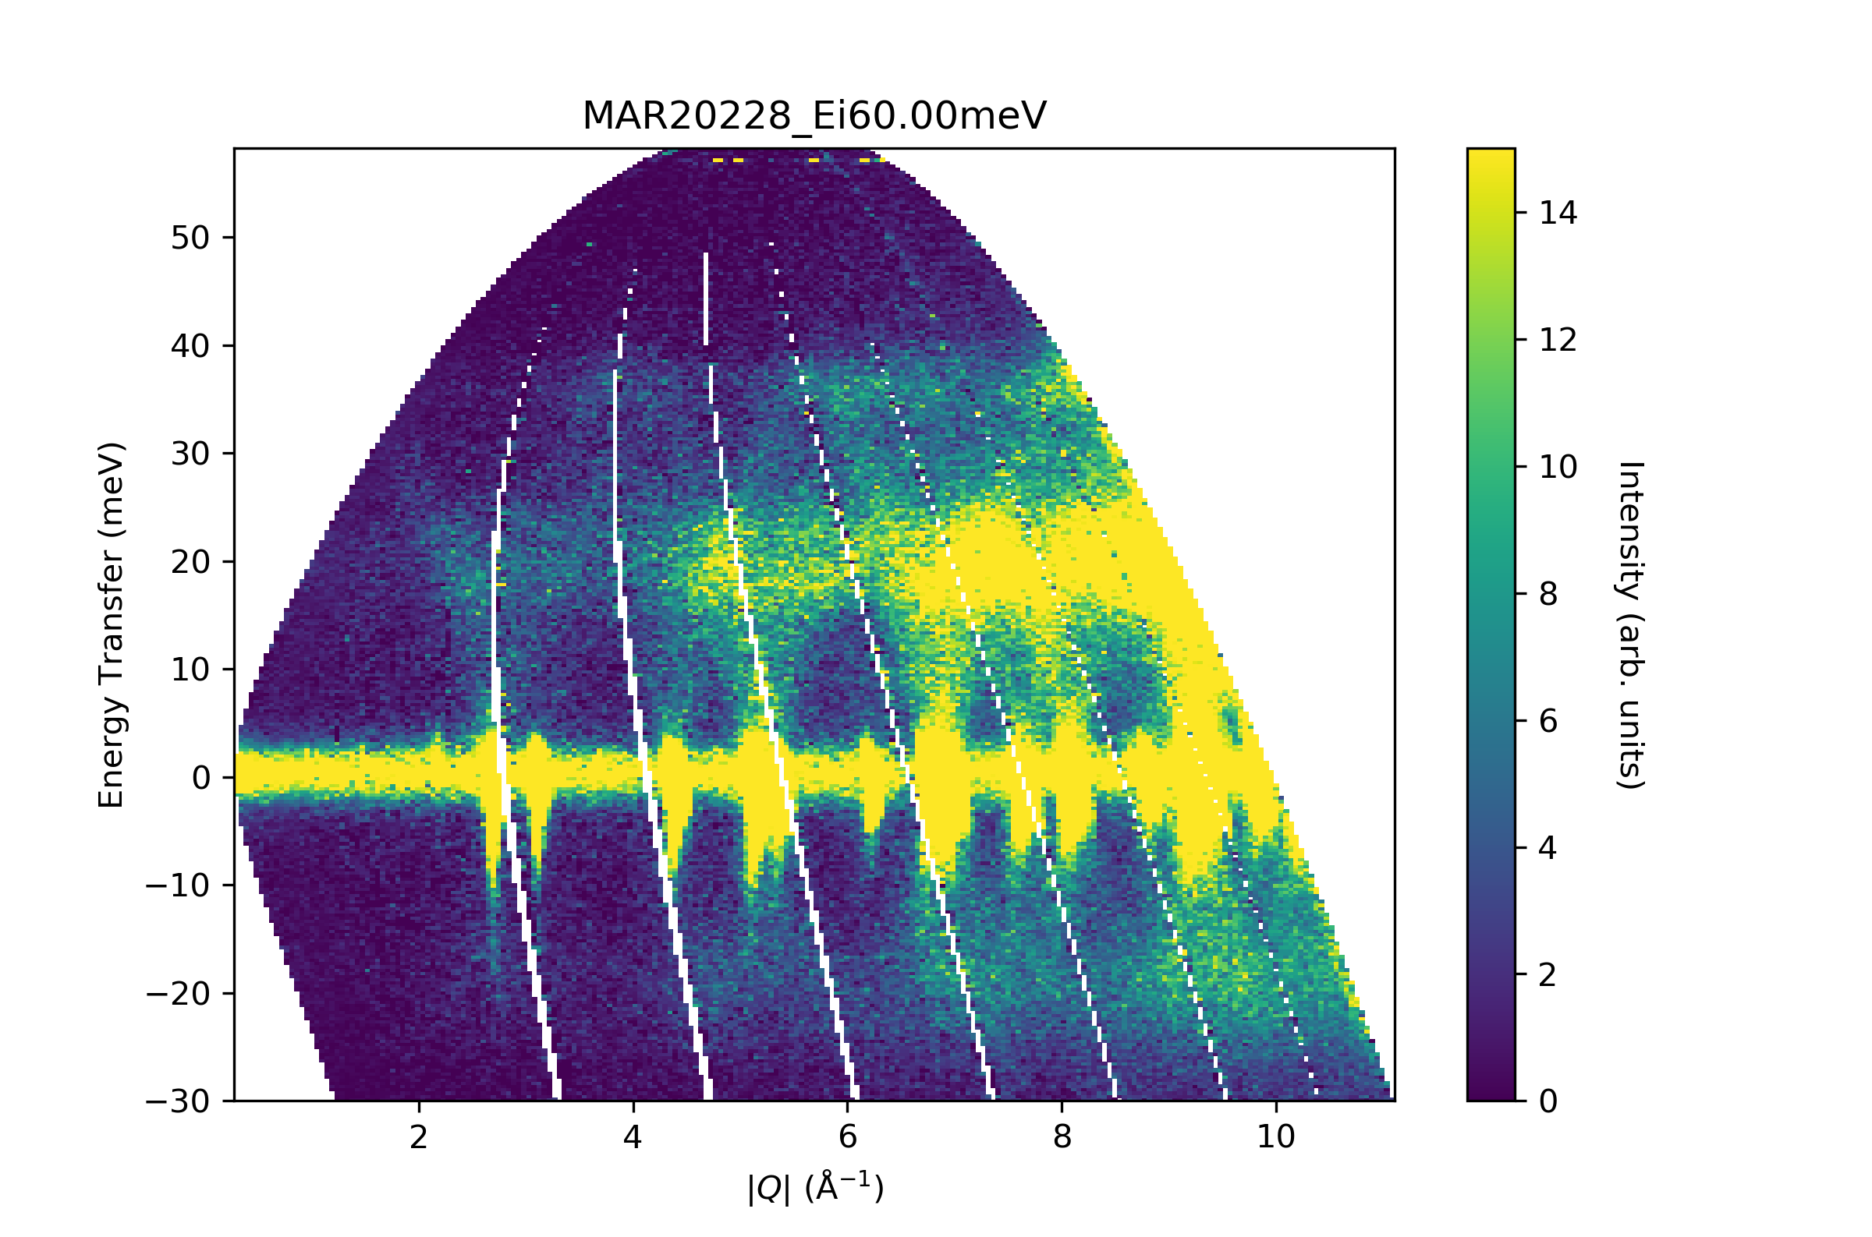
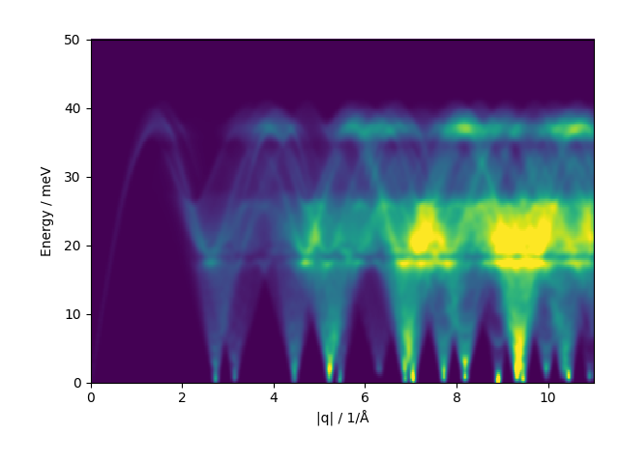
Powders!
Good news, powder experiments are simpler!
Much simpler.
With them we can extract the neutron weighted phonon density of states.
But, going beyond that is hard.

Slide 22
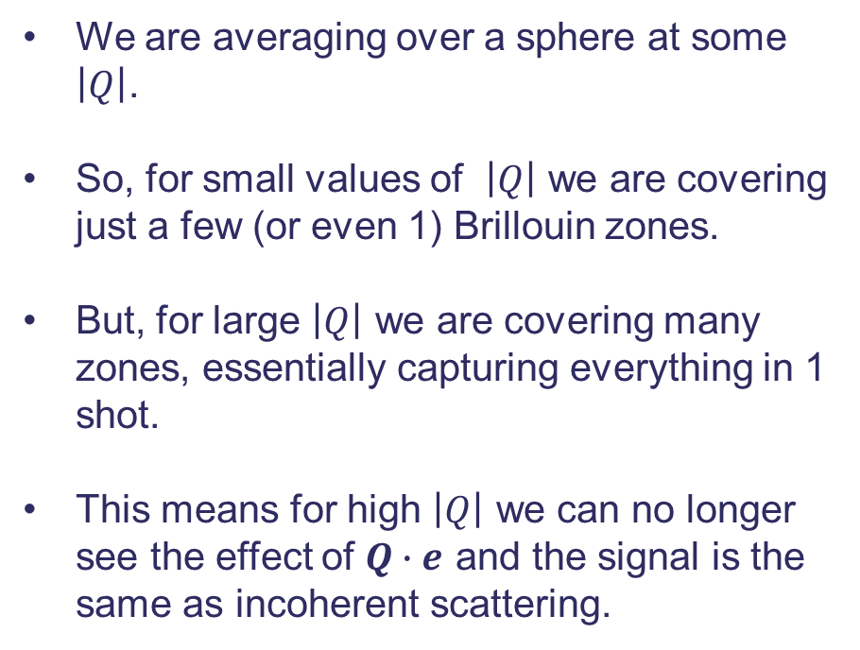
Powders, what are we doing?
We are averaging over a sphere at some $\left|Q\right|$.
So, for small values of $\left|Q\right|$ we are covering just a few (or even 1) Brillouin zones.
But, for large $\left|Q\right|$ we are covering many zones, essentially capturing everything in 1 shot.
This means for high $\left|Q\right|$ we can no longer see the effect of $Q∙e$ and the signal is the same as incoherent scattering.

Slide 23
Powders, what are we doing?
We are averaging over a sphere at some $\left|Q\right|$.
So, for small values of $\left|Q\right|$ we are covering just a few (or even 1) Brillouin zones.
But, for large $\left|Q\right|$ we are covering many zones, essentially capturing everything in 1 shot.
This means for high $\left|Q\right|$ we can no longer see the effect of $Q∙e$ and the signal is the same as incoherent scattering.

Slide 24
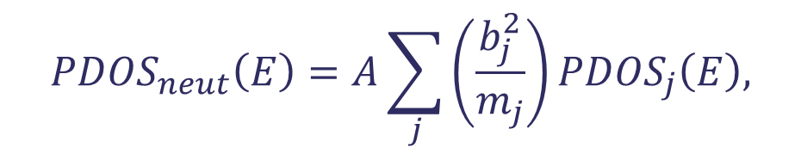
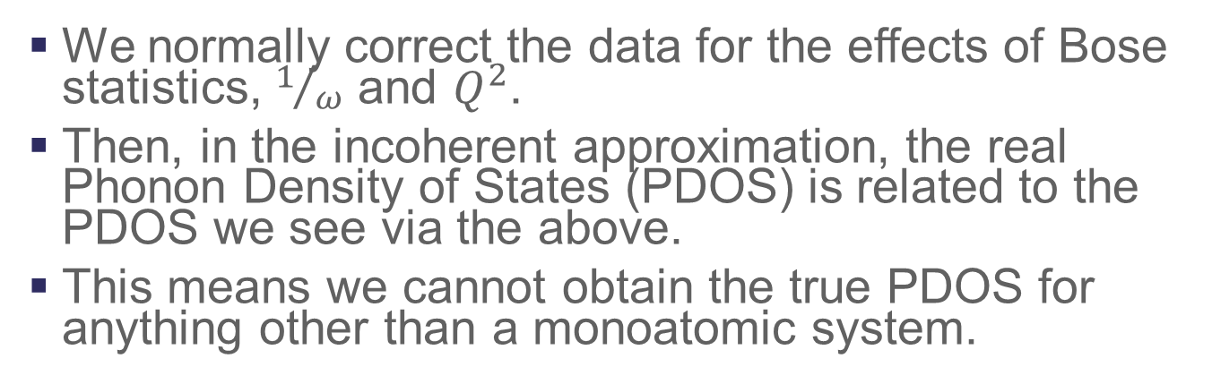
The neutron weighted phonon density of states
$${PDOS}_{neut}\left(E\right)=A\sum_{j}{\left(\frac{b_{j}^{2}}{m_{j}}\right)}{PDOS}_{j}\left(E\right),$$
We normally correct the data for the effects of Bose statistics, $1/ω$ and $Q^{2}$.
Then, in the incoherent approximation, the real Phonon Density of States (PDOS) is related to the PDOS we see via the above.
This means we cannot obtain the true PDOS for anything other than a monoatomic system.

Slide 25
Beyond the harmonic approximation
This is where all the interesting stuff happens
But, it gets tricky fast.
Phonon-phonon scattering (broadening)
Multiphonon signals (signal above the top of the dispersion)

Slide 26
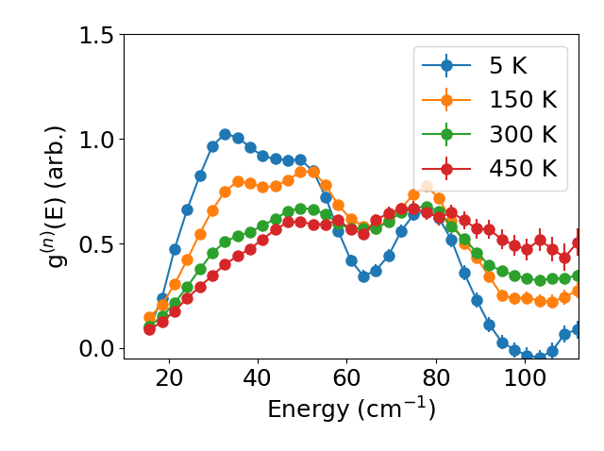
Beyond the harmonic approximation

Slide 27


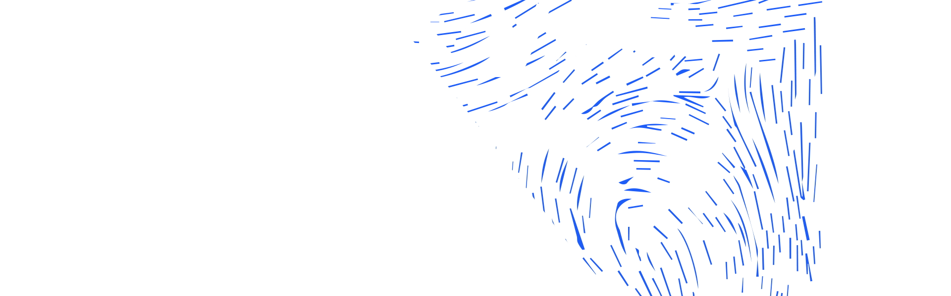




Science and Technology Facilities Council
@STFC_matters
Science and Technology Facilities Council
Notes:
The abstract pattern can be removed or repositioned if required. Be careful to ‘Send to Back’ so that it does not obscure any important information.

