Slide 1
Linear Spin Wave Calculations with SpinW part II
Notes:
1

Slide 2
Overview
Spin-spin correlation tensor
Polarised neutron intensities
Twinned crystals
Simulated annealing and Monte Carlo calculations
Magnetic structure refinement
Calculating magnetisation, susceptibility

Slide 3
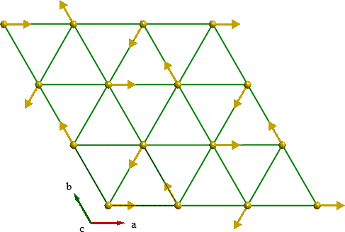
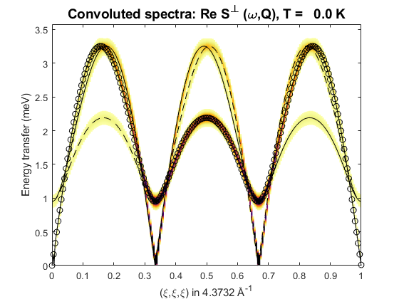
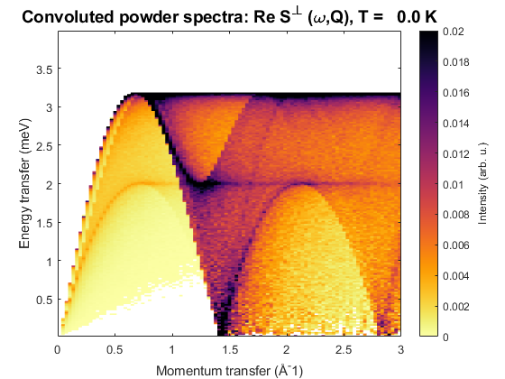
Recap
tri = spinw;
tri.genlattice('lat_const', [4 4 6], 'angled', [90 90 120]);
tri.addatom('r', [0 0 0], 'S', 2, 'label', 'MCr3', 'color', 'gold');
tri.genmagstr('mode', 'helical', 'S', [1; 0; 0], ...
'n', [0 0 1], 'k', [1/3 1/3 0])
tri.addmatrix('label', 'J', 'value', 1)
tri.gencoupling();
tri.addcoupling('mat', 'J', 'bond', 1);
spec = tri.spinwave({[0,0,0], [1,1,1], [1,0,0] 200});
spec = sw_egrid(spec);
sw_plotspec(spec, 'dE', 0.1)
modQ = linspace(0,3,100);
spec = tri.powspec(modQ, 'nRand', 10000, 'Evect', linspace(0,4,200));
figure; sw_plotspec(spec)

Slide 4
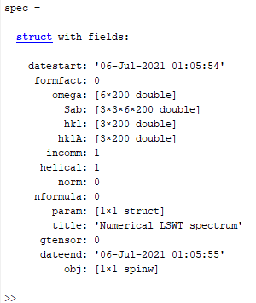
Spin-spin correlation function
spinwave returns a spectrum struct
Initially only has Sab – a 3x3xMxN array, M=# modes, N=# Q-pts.
Use sw_neutron to calculate interesting cross-sections.
sw_egrid internally calls sw_neutron to calculate Sperp – the component of S perpendicular to Q which is measured in unpolarised neutron scattering.

Slide 5
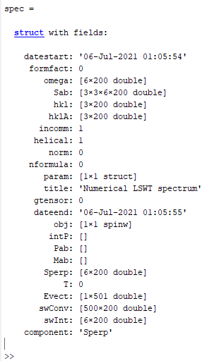
Spin-spin correlation function
spinwave returns a spectrum struct
Initially only has Sab – a 3x3xMxN array, M=# modes, N=# Q-pts.
Use sw_neutron to calculate interesting cross-sections.
sw_egrid internally calls sw_neutron to calculate Sperp – the component of S perpendicular to Q which is measured in unpolarised neutron scattering.
But can use either sw_egrid or sw_neutron with the 'component' option to calculate other quantities.

Slide 6
Spin-spin correlation function
Can calculate and plot:
Individual components of S^{αβ} or their sum. E.g.
Polarised neutron cross-sections – first have to run sw_neutron with the 'pol',true option and to define the horizontal scattering plane.
This is because polarised cross-sections use the Blume-Maleyev coordinate system where x||Q, z is vertical and y⊥(x,z).
Can specify the horizontal plane either by a u and v matrix (like Horace) – these are reciprocal lattice vectors. Or, can specify the direction of the plane normal in the SpinW Cartesian coordinate system: x||a, z⊥(a,b) and y⊥(x,z).
sw_plotspec(sw_egrid(spec, 'component', 'Sxx+Syy'), 'dE', 0.1)
spec = sw_neutron(spec, 'pol', true, 'uv', {[1,0,0], [0,1,0]})
sw_plotspec(sw_egrid(spec, 'component', 'Pz'), 'dE', 0.1)
spec = sw_neutron(spec, 'pol', true, 'n', [0,0,1])
sw_plotspec(sw_egrid(spec, 'component', 'Pz'), 'dE', 0.1)

Slide 7
Spin-spin correlation function
Can calculate and plot:
'Pa' – a=x,y,z – half polarized intensity with incident beam polarised along a certain direction
'Pab' – a,b=x,y,z – xyz polarized intensity σ^{αβ} with incident and scattered beam polarized along the specified direction
'Mab' – a,b=x,y,z – magnetisation component along the specified direction.
sw_plotspec(sw_egrid(spec, 'component', 'Pz'), 'dE', 0.1)
sw_plotspec(sw_egrid(spec, 'component', 'Pyy'), 'dE', 0.1)
sw_plotspec(sw_egrid(spec, 'component', 'Myz-Mzy'), 'dE', 0.1)

Slide 8
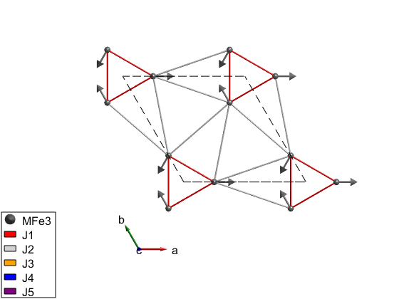
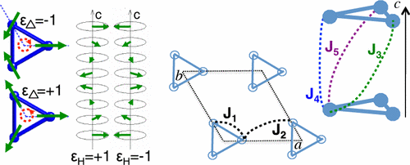
Polarised neutron example
System is iron-langasite Ba₃NbFe₃Si₂O₁₄. (SpinW tutorial 15)
Loire et al., Phys. Rev. Lett., 106 207201 (2011)

Slide 9
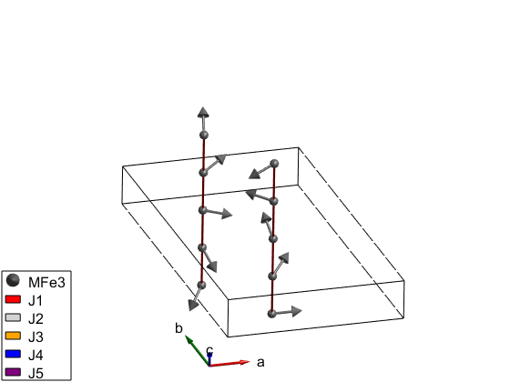
Polarised neutron example
System is iron-langasite Ba₃NbFe₃Si₂O₁₄. (SpinW tutorial 15)
Loire et al., Phys. Rev. Lett., 106 207201 (2011)

Slide 10
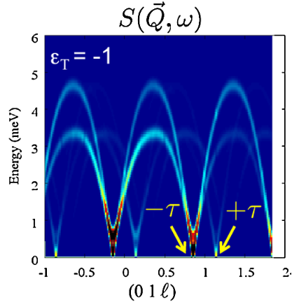
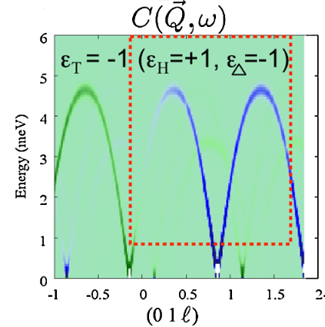
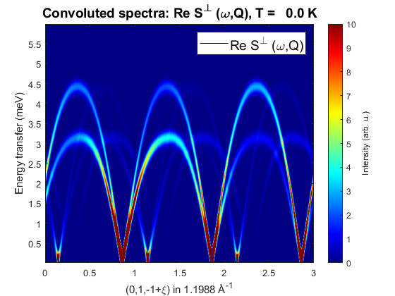
Polarised neutron example
System is iron-langasite Ba₃NbFe₃Si₂O₁₄. (SpinW tutorial 15)
banbSpec = banb.spinwave({[0 1 -1] [0 1 2] 500});
banbSpec = sw_neutron(banbSpec,'pol',true,'uv',{[0 1 0] [0 0 1]});
figure
banbSpec = sw_egrid(banbSpec,'component','Sperp', ...
'Evect',linspace(0,6,500));
sw_plotspec(banbSpec,'mode','color','dE',0.25,'axLim',[0 10]);
colormap(jet)
Loire et al., Phys. Rev. Lett., 106 207201 (2011)

Slide 11
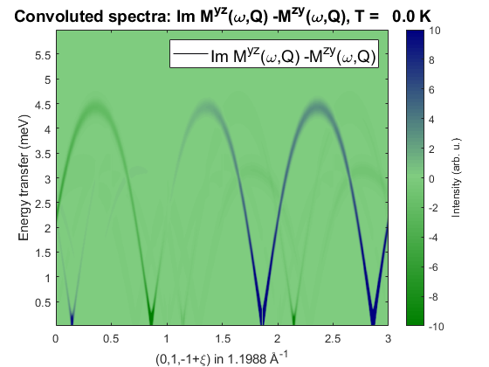
Polarised neutron example
System is iron-langasite Ba₃NbFe₃Si₂O₁₄. (SpinW tutorial 15)
banbSpec = banb.spinwave({[0 1 -1] [0 1 2] 500});
banbSpec = sw_neutron(banbSpec,'pol',true,'uv',{[0 1 0] [0 0 1]});
figure
banbSpec = sw_egrid(banbSpec,'component','-Myz+Mzy', ...
'Evect',linspace(0,6,500));
sw_plotspec(banbSpec,'mode','color','dE',0.25,'axLim',[-10 10],'imag',true);
colormap(makecolormap([0 0.5 0],[0.5 0.8 0.5],[0 0 0.5],81));
Loire et al., Phys. Rev. Lett., 106 207201 (2011)

Slide 12
Questions so far?

Slide 13
Twinned Crystals
Spin-spin correlation tensor
Polarised neutron intensities
Twinned crystals
Simulated annealing and Monte Carlo calculations
Magnetic structure refinement
Calculating magnetisation, susceptibility

Slide 14
Twinned Crystals
Twinned crystals can be handled by using addtwin:
Example for a cut integrating over energy, with a model of Pr(Ca,Sr)Mn₂O₇
pcsmo.addtwin('axis', [0 0 1], 'phid', 90)
nQ = 101; Qhv = linspace(-2,2,nQ); Qkv = linspace(-2,2,nQ); Qlv = 0;
nE = 201; Ev = linspace(0,100,nE);
Ecut = [34 36];
[Qh, Qk, Ql] = ndgrid(Qhv,Qkv,Qlv);
spec = pcsmo.spinwave([Qh(:) Qk(:) Ql(:)]', 'sortMode', false, 'hermit', false);
spec = sw_egrid(spec,'component','Sperp','Evect',Ev);
spec = sw_instrument(spec,'dE',5);
spec3D = reshape(spec.swConv,nE-1,nQ,nQ);
Eidx = find(Ev>Ecut(1) & Ev<Ecut(2));
figure;
cut1 = squeeze(sum(spec3D(Eidx,:,:),1))/numel(Eidx)/(Ev(2)-Ev(1));
imagesc(Qhv/2,Qkv/2,cut1);
xlabel('Qh'); ylabel('Qk');

Slide 15
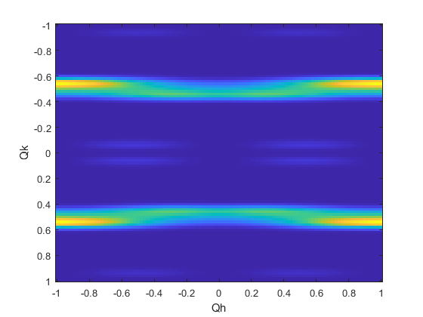
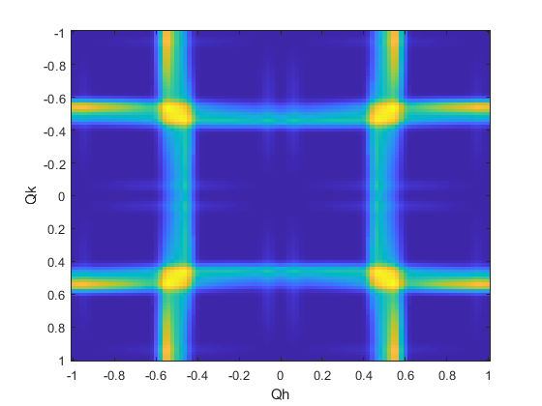
Twinned Crystals
Twinned crystals can be handled by using addtwin:
Example for a cut integrating over energy, with a model of Pr(Ca,Sr)Mn₂O₇
pcsmo.addtwin('axis', [0 0 1], 'phid', 90)
nQ = 101; Qhv = linspace(-2,2,nQ); Qkv = linspace(-2,2,nQ); Qlv = 0;
nE = 201; Ev = linspace(0,100,nE);
Ecut = [34 36];
[Qh, Qk, Ql] = ndgrid(Qhv,Qkv,Qlv);
spec = pcsmo.spinwave([Qh(:) Qk(:) Ql(:)]', 'sortMode', false, 'hermit', false);
spec = sw_egrid(spec,'component','Sperp','Evect',Ev);
spec = sw_instrument(spec,'dE',5);
spec3D = reshape(spec.swConv,nE-1,nQ,nQ);
Eidx = find(Ev>Ecut(1) & Ev<Ecut(2));
figure;
cut1 = squeeze(sum(spec3D(Eidx,:,:),1))/numel(Eidx)/(Ev(2)-Ev(1));
imagesc(Qhv/2,Qkv/2,cut1);
xlabel('Qh'); ylabel('Qk');
Without twin calculation
Twin calculation

Slide 16
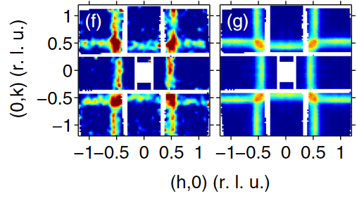
Twinned Crystals
Twinned crystals can be handled by using addtwin:
Example for a cut integrating over energy, with a model of Pr(Ca,Sr)Mn₂O₇
pcsmo.addtwin('axis', [0 0 1], 'phid', 90)
nQ = 101; Qhv = linspace(-2,2,nQ); Qkv = linspace(-2,2,nQ); Qlv = 0;
nE = 201; Ev = linspace(0,100,nE);
Ecut = [34 36];
[Qh, Qk, Ql] = ndgrid(Qhv,Qkv,Qlv);
spec = pcsmo.spinwave([Qh(:) Qk(:) Ql(:)]', 'sortMode', false, 'hermit', false);
spec = sw_egrid(spec,'component','Sperp','Evect',Ev);
spec = sw_instrument(spec,'dE',5);
spec3D = reshape(spec.swConv,nE-1,nQ,nQ);
Eidx = find(Ev>Ecut(1) & Ev<Ecut(2));
figure;
cut1 = squeeze(sum(spec3D(Eidx,:,:),1))/numel(Eidx)/(Ev(2)-Ev(1));
imagesc(Qhv/2,Qkv/2,cut1);
xlabel('Qh'); ylabel('Qk');
Without twin calculation
Twin calculation

Slide 17
Simulated Annealing
Spin-spin correlation tensor
Polarised neutron intensities
Twinned crystals
Simulated annealing and Monte Carlo calculations
Magnetic structure refinement
Calculating magnetisation, susceptibility

Slide 18


Simulated Annealing
SpinW has a routine for running a Monte Carlo simulated annealing calculation to:
Optimise a magnetic structure
Calculate physical properties (magnetisation, susceptibility, heat capacity)
Algorithm is:
Create a large ensemble / box of random spins using nExt
Partition this into non-interacting sublattices.
Choose a starting simulated temperature initT
Calculate the initial energy
For each spin, choose a new random orientation
Calculate the change in energy
Apply the Metropolis criteria:
Loop for nMC steps
Lower the simulated temperature T by step
determined by cool and loop until endT

Slide 19
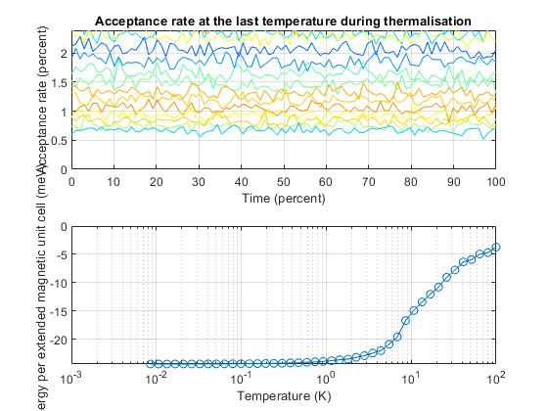
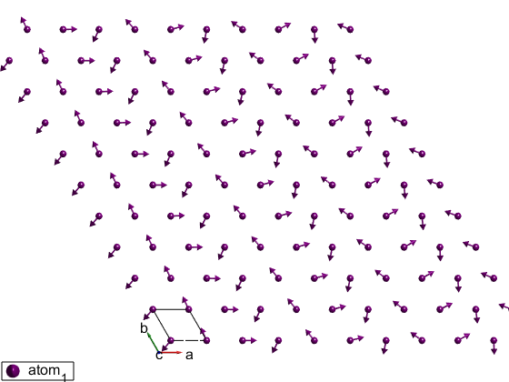
Simulated Annealing
Uses the anneal method of the spinw object.
tri = sw_model('triAF', [-4 16]);
% Removes units
tri.unit.kB = 1;
tri.unit.muB = 1;
tri.field([0 0 0]);
tri.anneal('verbosity',2, 'cool',@(T)(0.8*T), 'initT', 100, 'endT', 1e-2, ...
'nMC',1e3, 'nStat',0, 'random',true, 'nExt',[50 50 1], 'spinDim', 2);

Slide 20
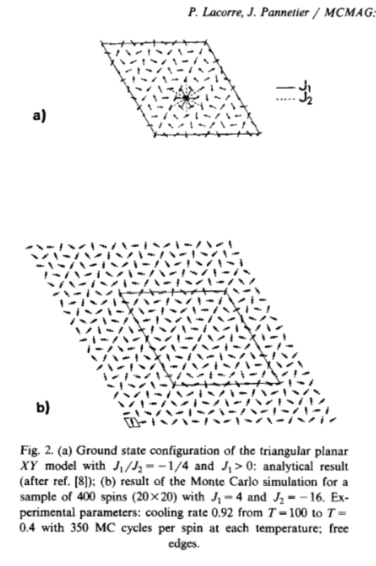
Simulated Annealing
Uses the anneal method of the spinw object.
tri = sw_model('triAF', [-4 16]);
% Removes units
tri.unit.kB = 1;
tri.unit.muB = 1;
tri.field([0 0 0]);
tri.anneal('verbosity',2, 'cool',@(T)(0.8*T), 'initT', 100, 'endT', 1e-2, ...
'nMC',1e3, 'nStat',0, 'random',true, 'nExt',[50 50 1], 'spinDim', 2);

Slide 21
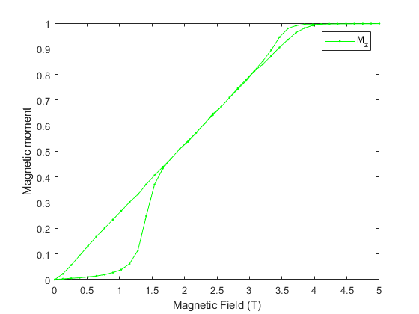
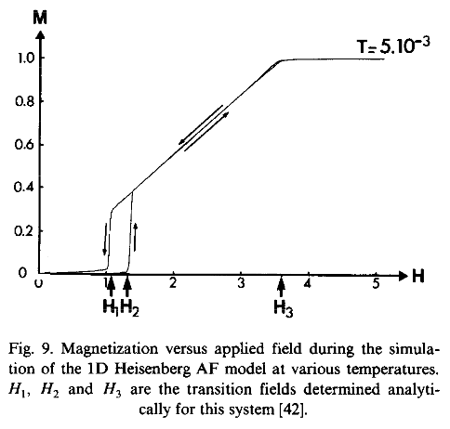
Simulated Annealing
Uses the annealoop method to calculate physical properties.
hChain = sw_model('chain', 2);
hChain.addmatrix('value', diag([0 0 -0.2]), 'label', 'A'); hChain.addaniso('A')
hChain.unit.kB = 1; hChain.unit.muB = 1;
hChain.anneal('verbosity',2, 'cool',@(T)(0.8*T), 'initT', 100, 'endT', 1e-2, ...
'nMC',1e3, 'nStat',0, 'random',true, 'nExt',[150 1 1]);
fieldSweep = [linspace(0,5,40) linspace(5,0,40)];
pStat = hChain.annealloop('x' ,fieldSweep, 'func',@(obj,x)obj.field([0 0 x]), ...
'nMC',2e4 ,'nStat',1e4, 'tid',2, 'fineT', 1e-2);
M = squeeze(sum(pStat.avgM,2))/hChain.nmagext;
figure; plot(pStat.x,M(3,:),'g.-')
xlabel('Magnetic Field (T)'); ylabel('Magnetic moment'); legend('M_z')

Slide 22
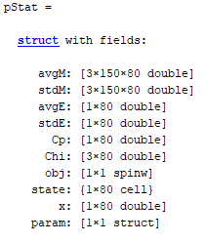
Simulated Annealing
Uses the annealoop method to calculate physical properties.
hChain = sw_model('chain', 2);
hChain.addmatrix('value', diag([0 0 -0.2]), 'label', 'A'); hChain.addaniso('A')
hChain.unit.kB = 1; hChain.unit.muB = 1;
hChain.anneal('verbosity',2, 'cool',@(T)(0.8*T), 'initT', 100, 'endT', 1e-2, ...
'nMC',1e3, 'nStat',0, 'random',true, 'nExt',[150 1 1]);
fieldSweep = [linspace(0,5,40) linspace(5,0,40)];
pStat = hChain.annealloop('x' ,fieldSweep, 'func',@(obj,x)obj.field([0 0 x]), ...
'nMC',2e4 ,'nStat',1e4, 'tid',2, 'fineT', 1e-2);
M = squeeze(sum(pStat.avgM,2))/hChain.nmagext;
figure; plot(pStat.x,M(3,:),'g.-')
xlabel('Magnetic Field (T)'); ylabel('Magnetic moment'); legend('M_z')

Slide 23
Questions so far?
(and 5 min break)

Slide 24
SpinW Demonstration
SpinW Demonstration

Slide 25
Summary
Spin-spin correlation functions
How to calculate polarised neutron cross-sections
Twinned samples
Simulated Annealing Monte Carlo calculations
How to calculate physical properties

