Slide 1
Fitting with SpinW
and Horace
Notes:
1

Slide 2
Overview
The Horace-SpinW interface
The built-in SpinW fitting function for TAS data

Slide 3
Recap
Horace evaluation and fitting
3 types of fit functions:
wsimple = func_eval(w_in, @fun, par)
wmodel = sqw_eval(w_in, @sqwfun, par)
wdispmodel = disp2sqw_eval(w_in, @dispfun, par, fwhm)
[w_fit, fitpars] = multifit(w_in, @fun, init_par)
mfobj = multifit(w_in)
mfobj = mfobj.set_fun(@fun)
mfobj = mfobj.set_pin(init_par)
[w_fit, fitpars] = mfobj.fit()
function out = fun(x, y, par)
xc = par(1); yc = par(2); sigx = par(3); sigy = par(4);
out = par(5) * exp(-(x-xc).^2./(2*sigx)-(y-yc).^2./(2*sigy));
end

Slide 4
Recap
Horace evaluation and fitting
3 types of fit functions:
wsimple = func_eval(w_in, @fun, par)
wmodel = sqw_eval(w_in, @sqwfun, par)
wdispmodel = disp2sqw_eval(w_in, @dispfun, par, fwhm)
[w_fit, fitpars] = multifit_sqw(w_in, @sqwfun, init_par)
mfobj = multifit_sqw(w_in)
mfobj = mfobj.set_fun(@sqwfun)
mfobj = mfobj.set_pin(init_par)
[w_fit, fitpars] = mfobj.fit()
function out = sqwfun(h,k,l,en,par)
JS = par(1); Gam = par(2);
omega = JS * (1-cos(pi*h));
out = par(3) * Gam ./ ((en - omega).^2 + Gam.^2);
end

Slide 5
Recap
Horace evaluation and fitting
3 types of fit functions:
SpinW is this type of function – calculates energies w and intensity s from input (h,k,l)
SpinW has a built-in function which does what’s in box:
wsimple = func_eval(w_in, @fun, par)
wmodel = sqw_eval(w_in, @sqwfun, par)
wdispmodel = disp2sqw_eval(w_in, @dispfun, par, fwhm)
[w_fit, fitpars] = multifit(w_in, , init_par)
mfobj = multifit_sqw(w_in)
mfobj = mfobj.set_fun( ...
@(h,k,l,e,par)disp2sqw(h,k,l,e,@dispfun,par(1:end-1),par(end))
mfobj = mfobj.set_pin(init_par)
[w_fit, fitpars] = mfobj.fit()
function [w,s] = dispfun(h,k,l,par)
w = par(1) * (1-sin(pi*h));
s = par(2) + w*0;
end

Slide 6
Horace-SpinW interface
SpinW has a built-in horace_sqw function:
It wraps the spinwave method and sw_neutron functions and also does an energy convolution.
First parameters are for the model.
The last two parameters are widths for the energy convolution and an intensity scaling factor.
You can also pass any arguments recognised by spinwave.
J = 1.2; K = 0.2; fwhm = 0.75; scalefactor = 1;
tri = sw_model('triAF', J);
tri.addmatrix('label', 'K', 'value', diag([0 0 K])); tri.addaniso('K');
ws = cut_sqw(sqw_file, [0.05], [-0.1, 0.1], [-0.1, 0.1], [0.5]);
fitobj = multifit_sqw(ws);
fitobj.set_fun(@tri.horace_sqw);
fitobj.set_pin({[J K fwhm scalefactor], 'mat', {'J_1', 'K(3,3)'}, ...
'hermit', false, 'formfact', true});
ws_sim = fitobj.simulate();
[ws_fit, fit_dat] = fitobj.fit()
J = 1.2; K = 0.2; fwhm = 0.75; scalefactor = 1;
tri = sw_model('triAF', J);
tri.addmatrix('label', 'K', 'value', diag([0 0 K])); tri.addaniso('K');
ws = cut_sqw(sqw_file, [0.05], [-0.1, 0.1], [-0.1, 0.1], [0.5]);
fitobj = multifit_sqw(ws);
fitobj.set_fun(@tri.horace_sqw);
fitobj.set_pin({[J K fwhm scalefactor], 'mat', {'J_1', 'K(3,3)'}, ...
'hermit', false, 'formfact', true});
ws_sim = fitobj.simulate();
[ws_fit, fit_dat] = fitobj.fit()
J = 1.2; K = 0.2; fwhm = 0.75; scalefactor = 1;
tri = sw_model('triAF', J);
tri.addmatrix('label', 'K', 'value', diag([0 0 K])); tri.addaniso('K');
ws = cut_sqw(sqw_file, [0.05], [-0.1, 0.1], [-0.1, 0.1], [0.5]);
fitobj = multifit_sqw(ws);
fitobj.set_fun(@tri.horace_sqw);
fitobj.set_pin({[J K fwhm scalefactor], 'mat', {'J_1', 'K(3,3)'}, ...
'hermit', false, 'formfact', true});
ws_sim = fitobj.simulate();
[ws_fit, fit_dat] = fitobj.fit()

Slide 7

Horace-SpinW interface
The 'mat' argument tells SpinW which parameters can be varied by Horace and what they correspond in the model.
In simple cases, just the name of the corresponding SpinW matrix, or a string denoting which single matrix element (e.g. 'K(3,3)') suffices.
For more complicated cases, an additional parameter 'selector', a 3×3 logical matrix needs to be used. This tells the matparser function which matrix elements the parameter corresponds to – e.g. for a DM interaction:
'selector' is a 3×3×N array where N is the number of parameters
Each 3×3 matrix denotes which elements of the corresponding matrix in 'mat' goes with that parameter
Dvec = [0.1 0.2 0.3];
swobj.addmatrix('label', 'DM', 'value', Dvec);
swobj.addcoupling('mat', 'DM', 'bond', 1);
sel(:,:,1) = [0 0 0; 0 0 1; 0 -1 0]; % Dx
sel(:,:,2) = [0 0 1; 0 0 0; -1 0 0]; % Dy
sel(:,:,3) = [0 1 0; -1 0 0; 0 0 0]; % Dz
fitobj.set_fun(@swobj.horace_sqw);
fitobj.set_pin({Dvec, 'mat', {'DM', 'DM', 'DM'}, ...
'selector', sel, 'hermit', false})
fitobj.fit()

Slide 8
Horace-SpinW interface
horace_sqw also does an energy convolution to return S(Q,ω) from the calculated ω(Q) and intensity.
The 'resfun' option tells horace_sqw what function to use. Options are:
'gauss' - a gaussian (one parameter: fwhm) [default]
'lor' - a lorentzian (one parameter: fwhm)
'voigt' - a pseudovoigt (two parameters: fwhm and lorentzian fraction)
'sho' - a damped harmonic oscillator (3 parameters: Gamma Temperature Amplitude)
A function handle to a function which will be accepted by Horace's disp2sqw method
horace_sqw appends the parameters needed by resfun to the end of the parameter vector and then adds a scale factor between the data and calculation after that. E.g.
[model_pars, res_pars, scale_factor]

Slide 9
Horace-SpinW interface
In addition, horace_sqw has some other arguments
'useFast' - This tells horace_sqw to use a faster but slightly less accurate code than spinwave. In particular, this code achieves a speed gain by:
Only calculating Sperp rather than the full S^{αβ} tensor
Only calculating magnon creation (positive energy / neutron energy loss) modes.
Ignoring twins
'coordtrans' - A 4×4 matrix to transform the input (Qh,Qk,Ql,ℏω) coordinates received from Horace before passing to SpinW

Slide 10
Questions so far?

Slide 11
Horace-SpinW Examples
Pr(Ca,Sr)Mn2O7
Bilayer half-doped manganite. SpinW model here.
proj = projaxes([1 0 0], [0 1 0], 'type', 'rrr')
w1 = cut_sqw(sqw_file, proj, [-1, 0.05, 1], [-1, 0.05, 1], [], [34,35])
sample = IX_sample(true,[0,0,1],[0,1,0],'cuboid',[0.01,0.05,0.01]);
maps = maps_instrument(70, 300, 'S');
JF1 = -11.39; JA = 1.5; JF2 = -1.35; JF3 = 1.5; Jperp = 0.88; D = 0.074;
cpars = {'mat', {'JF1', 'JA', 'JF2', 'JF3', 'Jperp', 'D(3,3)'}, ...
'hermit', false, 'optmem', 0, 'useFast', true, 'formfact', true, ...
'resfun', 'gauss', 'coordtrans', diag([2 2 1 1])};
Prcasrmn2o7;
w1 = set_sample(w1, sample);
w1 = set_instrument(w1, maps);
tbf = tobyfit(w1);
tbf = tbf.set_fun (@pcsmo.horace_sqw, {[JF1 JA JF2 JF3 Jperp D 0.1] cpars{:}});
tbf = tbf.set_mc_points(5);
ws_sim = tbf.simulate();
Johnstone et al., Phys. Rev. Lett., 109 237202 (2012)

Slide 12
Horace-SpinW Examples
Pr(Ca,Sr)Mn2O7
Bilayer half-doped manganite. SpinW model here.
Johnstone et al., Phys. Rev. Lett., 109 237202 (2012)

Slide 13
Questions so far?

Slide 14
SpinW fitting for TAS data
SpinW also has an fitting function for triple-axis spectrometer data.
Assumes you’ve made a series of constant-Q scans along energy transfer
You first have to fit the peaks these scans manually and put the fitted peak centers and area/height into a text file with a specific format:
Then you can use the fitspec function. This:
Calculates the spectrum at the given Q-points
Bins the data into a given energy bin to account for unresolved modes
Fits the data with a particle-swarm optimizer (default) or simplex mehod.

Slide 15
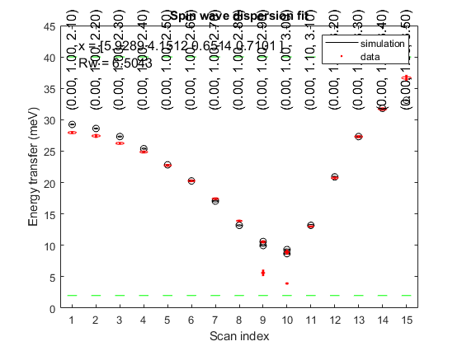
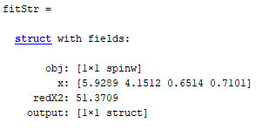
SpinW fitting for TAS data
Example from tutorial 35:
parfun = @(obj, p) matparser(obj, 'param', p, ...
'mat',{'Jab' 'Jc' 'K(1,1)' 'K(2,2)'},'init',true);
fitStr = luvo.fitspec('datapath', 'LuVO3_fitted_modes.txt', ...
'Evect', linspace(0,45,71), 'func', parfun, 'hermit', false, ...
'xmin', [3 1 0 0], 'xmax', [9 10 1 1])

Slide 16
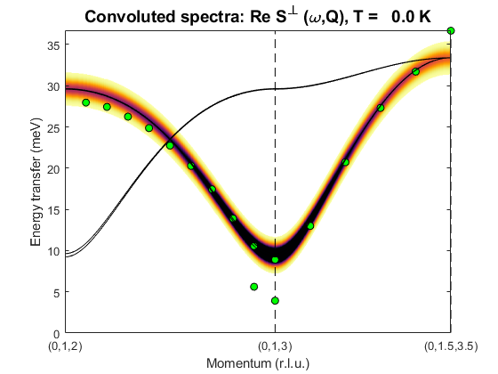
SpinW fitting for TAS data
Example from tutorial 35:
parfun = @(obj, p) matparser(obj, 'param', p, ...
'mat',{'Jab' 'Jc' 'K(1,1)' 'K(2,2)'},'init',true);
fitStr = luvo.fitspec('datapath', 'LuVO3_fitted_modes.txt', ...
'Evect', linspace(0,45,71), 'func', parfun, 'hermit', false, ...
'xmin', [3 1 0 0], 'xmax', [9 10 1 1])

Slide 17
Questions so far?
(and 5 min break)

Slide 18
SpinW Demonstration
Horace-SpinW Demonstration

Slide 19
Summary
SpinW-Horace interface, horace_sqw function in SpinW.
Internal SpinW fitting function for TAS data fitspec

