Slide 1
Single Crystal INS data analysis with Horace
Part 2
Notes:
1

Slide 2
Summary of Wednesday Session
help <command>
https://pace-neutrons.github.io/horace-docs/3.5.0
gen_sqw – needs u, v vectors to define the horizontal scattering plane
cut_sqw – needs another set of u,v,w to define cut axes (called projections).
gen_sqw_powder – note has only 2 axes.
Horace plots use a “Genie” syntax (see docs) rather than standard Matlab syntax.

Slide 3
Overview
Today
Intensity corrections
Background subtraction
Symmetrisation
Data diagnostics
Run Inspector
Masking data
Simulating data
Friday
Fitting
Resolution convolution

Slide 4

Intensity corrections
You can perform arithmetic on Horace objects (sqw and dnd)
>> w1 = 2*w2 – w3
In addition to simple scaling, can use more complex operations
Converting S(Q,ω) to χ’’(Q,ω) via the fluctuation-dissipation theorem¹:
>> chi = bose(w1, 300)
Can also scale by a coordinate axis, e.g. plot I/ħω:
>> divE = w1 / signal(w1,'E') % also 'Q', 'h', 'k', 'l'
Correct for magnetic form factor (I/F²):
>> w1_ff_corr = MagneticIons('Fe0').correct_mag_ff(w1)
List of known ions: >> MagneticIons().IonNames
¹ A. Boothroyd, Principles of Neutron Scattering from Condensed Matter, OUP 2020, Section 3.7

Slide 5
Background Subtraction
Binary operations like minus only works between two objects:
If both are sqw, they must have the exact same set of pixels
If both are dnd, they must be the same dimension/size
If one is sqw and one is dnd, they must have the same dimension/bin size
For two objects of the same type, there is a 1-to-1 correspondence between bins/pixels of both objects – operation applied to signal, errors propagated in quadrature.
If one object is a dnd and the other is sqw, the dnd object is treated as if it has the same pixels as the sqw object but all the pixels in the same bin have the same signal value.
Common subtraction methods:
Measure at different temperatures (e.g. [low T] – [high T])
Subtract empty sample / instrument
Subtract separate sample (e.g. phonon blank)
Subtract equivalent Q region where signal is low
(e.g. [low Q]- [high Q] for magnetism)
most
common
← sqw-sqw
← sqw-sqw
← sqw-sqw
← sqw-dnd
least

Slide 6
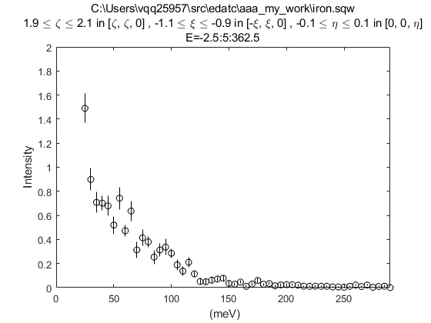
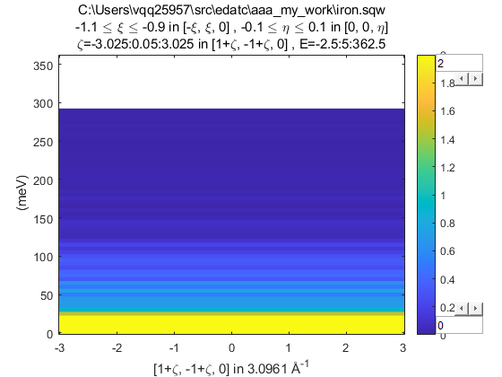
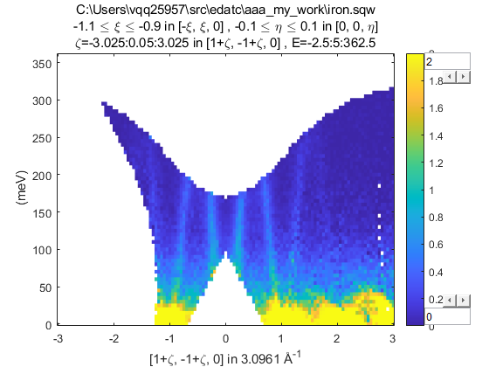
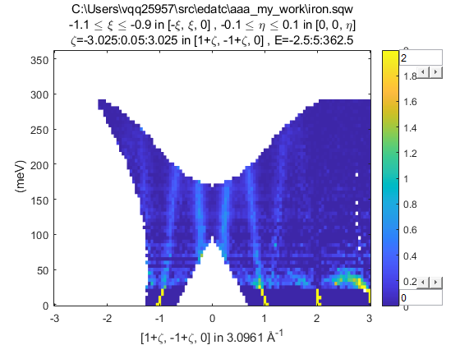
Background Subtraction
For the demo / worksheet we only have one dataset so will use the somewhat contrived final method.
Use the replicate function to convert a 1D cut to 2D slice
The can subtract the original 2D slice:

Slide 7
Symmetrisation
symmetrise_sqw(w_in, v1, v2, offset)
Can be use to fold data in a plane defined by v1 and v2, combining data into one side, for improving low statistics.
Only works on sqw objects in memory.
To symmetrise a full sqw file, need to do it in gen_sqw using the transform_sqw option:
https://pace-neutrons.github.io/horace-docs/3.5.0/Symmetrising_etc.html#symmetrising-whole-data-files

Slide 8
Data Diagnostics
The sqw file is created from a series of measurements – but sometimes something goes wrong during these (e.g. motor/sample gets stuck, get temperature spike, sample comes loose/shifts, etc)
Can use the run_inspector to split a sqw cut and view the resulting contribution from each input reduced (SPE/NXSPE) file.
After figuring out problematic runs, can gen_sqw again, or use split and join on in-memory objects.
https://pace-neutrons.github.io/horace-docs/3.5.0/Data_diagnostics.html

Slide 9
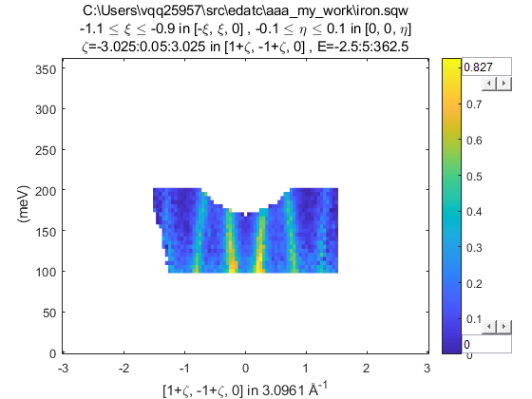
Masking
Alternatively, can mask out small sections of the data:
mask(w_in, mask_array)
mask_array = mask_points(w_in, 'keep', range)
mask_array = mask_points(w_in, 'remove', range)
range is a vector [lo_x1,hi_x1, lo_x2,hi_x2, ... , lo_xn,hi_xn]
mask_array is a logical array same size as the binned data. 1 or true indicates to keep that bin, 0 or false will be masked. The mask_points function can be used to generate such an array.
>> plot(mask(w1, mask_points(w1, 'keep', [-1.5,1.5, 100,200])))
https://pace-neutrons.github.io/horace-docs/3.5.0/Reshaping_etc.html#mask

Slide 10
Questions so far?

Slide 11
Simulating Data
3 ways of creating a synthetic workspace in Horace:
func_eval(w_in, @fun, par)
sqw_eval(w_in, @sqwfun, par)
disp2sqw_eval(w_in, @dispfun, par, fwhm)
@ indicates a function handle in Matlab
func_eval passes the plot axes coordinates (e.g. defined by a projection) to the function – used for basic functions like gaussians or lorentzian peaks, or linear background etc.
sqw_eval and disp2sqw_eval pass the (Q,E) coordinates to the user function and are used for theoretical model of scattering
@sqwfun should return the scattering function S(Q,E)
@dispfun should return the dispersion E(Q) and the corresponding weight S at that value of energy (returns 2 outputs). Horace then performs a simple energy convolution with a Gaussian of width fwhm to get S(Q,E).

Slide 12
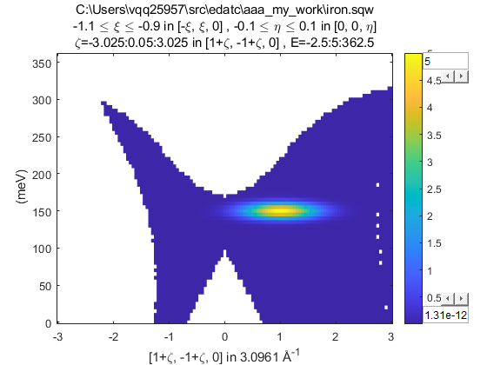
Simulating Data
3 ways of creating a synthetic workspace in Horace:
func_eval(w_in, @fun, par)
sqw_eval(w_in, @sqwfun, par)
disp2sqw_eval(w_in, @dispfun, par, fwhm)
Example of a @fun for func_eval:
function out = fun(x, y, par)
xc = par(1); yc = par(2);
sigx = par(3); sigy = par(4);
out = par(5) * exp(-(x-xc).^2./(2*sigx)-(y-yc).^2./(2*sigy));
end
plot(func_eval(w1, @fun, ...
[1,150,0.2,50,5]));
← 2D function – takes 2 coordinates

Slide 13
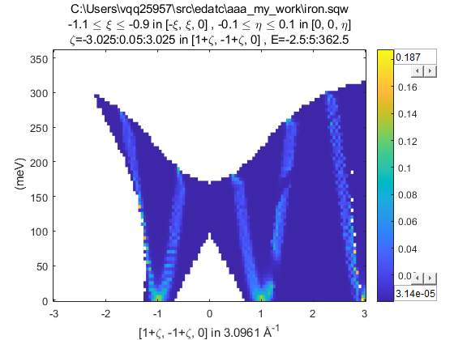
Simulating Data
3 ways of creating a synthetic workspace in Horace:
func_eval(w_in, @fun, par)
sqw_eval(w_in, @sqwfun, par)
disp2sqw_eval(w_in, @dispfun, par, fwhm)
Example of a @sqwfun for sqw_eval:
function out = sqwfun(h,k,l,en,par)
JS = par(1); Gam = par(2);
omega = JS * (1-cos(pi*h));
out = par(3) * Gam ./ ((en - omega).^2 + Gam.^2);
end
plot(sqw_eval(w1, @sqwfun, ...
[200,5,1]));
← always takes h,k,l,en coordinates

Slide 14
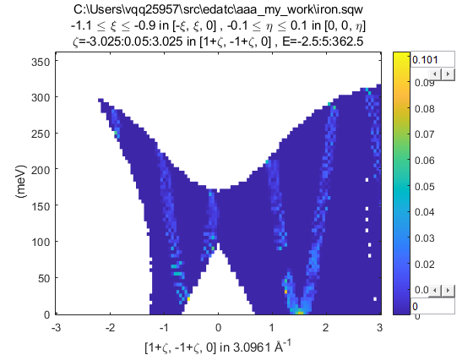
Simulating Data
3 ways of creating a synthetic workspace in Horace:
func_eval(w_in, @fun, par)
sqw_eval(w_in, @sqwfun, par)
disp2sqw_eval(w_in, @dispfun, par, fwhm)
Example of a @dispfun for sqw_eval:
function [w,s] = dispfun(h,k,l,par)
JS = par(1);
w = JS * (1-sin(pi*h));
s = par(2) + w*0;
end
plot(…
disp2sqw_eval(w1, @dispfun,...
[200,1]));
← always takes h,k,l coordinates
returns 2 values w and s

Slide 15
Simulating Data
func_eval, sqw_eval, disp2sqw_eval can be used to generate simulated data.
All require an input sqw or dnd object to provide the coordinates
And a user defined function specified by a handle (prefix @)
sqw_eval and disp2sqw_eval will pass to the functions
the (Q,E) coordinates of the bin centres if given a dnd object
the (Q,E) coordinates of every pixel if given a sqw object
So calculations with a sqw will be more accurate but take longer

Slide 16
Questions so far?
(and 5 min break)

Slide 17
Horace CLI Demonstration
Horace CLI Demonstration

Slide 18
Summary
bose, signal can be used with arithmetic operators to change the signal intensity of cuts
Background subtraction
run_inspector can be used to view a cut decomposed into contributions from each sample orientation.
func_eval, sqw_eval, disp2sqw_eval can be used to generate simulated data.
Tomorrow:
Fitting
Resolution convolution

