Slide 1
Single Crystal INS data analysis with Horace
Part 1
Notes:
1

Slide 2
Overview
Matlab intro
Arrays
Operators
Indexing
Objects and methods
Creating sqw file (CLI)
Powder data
Making cuts
Projections
Non-orthogonal projections
Sample mis-alignment corrections
Horace coordinate conventions
Advanced plotting
Genie-like syntax
“spaghetti”-plot

Slide 3
Matlab
By default all results are echoed
; operator suppresses output and allows a new statement
>> no_echo = [1,2; 3,4]; echo = [6,7,8]
... used to continue long commands onto next line
>> gen_sqw (spe, par, sqw, efix, emode, alatt, angdeg,...
u, v, psi, omega, dpsi, gl, gs)
% is the comment operator.
print saves a figure to file
disp displays text on screen

Slide 4
Matlab
Several types of arrays:
Numeric arrays (elements are numbers)
Strings (character arrays)
Cell arrays (mixed type elements, equivalent to Python list)
1D or 2D can be constructed with the [] or {} operators.
[] used to construct numeric or character arrays
{} used to construct cell arrays
, or space used to delimit elements
; operator used to delimit rows
>> row_1d = [1,2,3,4]
>> column_1d = [1;2;3;4]
>> array_2d = [1,2,3; 4,5,6; 7,8,9]
>> string = 'abc'
>> string = ['xyz' num2str(5)] % 'xyz5'
>> cell_array = {'a', [1,2,3], 'xyz'}

Slide 5
Matlab
' (dashed / prime) is the transpose operator:
>> col_vec = [1, 2, 3]'
* denotes matrix-matrix or matrix-vector multiplication
.* is element-wise multiplication
>> [1,0; 0,0] * [1,2; 3,4] % result: [1,2; 0 0]
>> [1,0; 0,0] .* [1,2; 3,4] % result: [1,0; 0 0]
>> [1,0; 0,2] * [1, 1] % error
>> [1,0; 0,2] * [1; 1] % result: [1; 2]
>> [1,1] * [1,0; 0,2] % result: [1 2]
>> [1;1] * [1,0; 0,2] % error

Slide 6
Matlab
1-based indexing, ranges are inclusive
: operator to indicates ranges
() operator to index into array
step indicated by middle value
arrays are stored column-wise in memory
>> mm = [1,2,3; 4,5,6; 7,8,9];
>> mm(1) % ans = 1
>> mm(1:3,1) % ans = [1, 4, 7]
>> mm(1:3) % equivalent to mm(1:3,1)
>> mm(1:2:9) % ans = [1, 7, 5, 3, 9]
N-Dimension arrays indexed by n-arguments – e.g. mm(1,2,3,4)

Slide 7
Matlab
Blocks need explicit end keyword.
for loops requires a row vector as input
== is equality, || is “or” operator, && is “and” operator
>> for i = [1,2,3,4]; disp(i); end % Prints 1,2,3,4
>> j=0; for i = 1:10; j = j + i; end; j % j = 55
>> if 1 == 2; disp('something weird'); end % Prints nothing
“dot notation” is used to access object properties or methods
Class methods can also be called using the method name with the object as the first argument:
object.property
object.method(x,y,z)
method(object, x, y, z)
Just an example (syntax will not work – no object called “object”)

Slide 8
Don’t need to memorise previous
Access this presentation at:
https://github.com/pace-neutrons/edatc/blob/main/presentations/edatc21_slides_03_horace1.pptx

Slide 9
Overview
Matlab intro
Arrays
Operators
Indexing
Objects and methods
Creating sqw file (CLI)
Powder data
Making cuts
Projections
Non-orthogonal projections
Sample mis-alignment corrections
Horace coordinate conventions
Advanced plotting
Genie-like syntax
“spaghetti”-plot

Slide 10
Horace
Horace is mainly a command-line interface (CLI) program
Today, we’ll introduce this CLI.
Recap – basic tasks using Horace:
Creating a 4D S(Q,ω) dataset (sqw file) from runs at different angles
Viewing / plotting this data in particular (Q,ω) regions
Fitting the data
https://pace-neutrons.github.io/horace-docs/3.5.0/
>> help <command> % e.g. help gen_sqw
← gen_sqw
← cut_sqw
← multifit

Slide 11
gen_sqw
gen_sqw (spe_files, par_file, sqw_file, efix, emode, alatt, angdeg, u, v, psi, omega, dpsi, gl, gs)
spe_files – cell array (list) of reduced data file names
par_file – detector parameter file (not usually used)
sqw_file – output sqw file name
efix – fixed energy (E_{i} for direct geometry)
emode – 1 for direct, 2 for indirect
alatt – [a,b,c] lattice parameters
angdeg – [alpha,beta,gamma] lattice angles (in degrees)
u, v – vectors defining the horizontal scattering plane
psi – a vector of rotation angles about the vertical axis (in degrees)
omega, dpsi, gl, gs – sample misalignment angles (in degrees)
GL
u
Ω
ψ
n
GS
v

Slide 12
gen_sqw_powder
gen_sqw_powder(spe_files, par_file, sqw_file, efix, emode)
spe_files – cell array (list) of reduced data file names
par_file – detector parameter file (not usually used)
sqw_file – output sqw file name
efix – fixed energy (E_{i} for direct geometry)
emode – 1 for direct, 2 for indirect
alatt – [a,b,c] lattice parameters
angdeg – [alpha,beta,gamma] lattice angles (in degrees)
u, v – vectors defining the horizontal scattering plane
psi – a vector of rotation angles about the vertical axis (in degrees)
omega, dpsi, gl, gs – sample misalignment angles (in degrees)

Slide 13
cut_sqw
w = cut_sqw(data_source, proj, p1_bin, p2_bin, p3_bin, p4_bin)
>> help sqw/cut
data_source – a filename (string) or a sqw object in memory
proj – a projection object (more details next)
p1_bin, p2_bin, p3_bin – vector defining binning along u1, u2, u3
p4_bin – vector defining binning along energy axis
u1, u2, u3 are defined by the projection proj.
Bins can be either 1, 2, or 3 numbers:
[bin_size] – 1 number rebin full limit of data in this axis with new bin_size
[lo, hi] – integrate over this axis between lo and hi limits.
[lo, bin_size, hi] – rebin this axis between lo and hi limits with new bin_size

Slide 14
Horace projections
Recap – 2 types of coordinates systems used by Horace:
u and v vectors defining the horizontal plane in generating the data
u, v (and optional w) vectors defining Q-axes for cuts
A projection is used to define 3 vectors u1, u2, u3 which define the 3 Q axes for cuts/plots.
A projection is a class with properties:
u – the first axis
v – the second axis
w – the third axis
type – a string of 3 letters: ‘r’=r.l.u., ‘a’=absolute (Å⁻¹)
nonorthogonal – true or false (default: false)
nonorthogonal=true means u1=u, u2=v, u3=w
nonorthogonal=false means u1=u; u2 ⊥ u1 in plane of u,v; u3 ⊥ u,v
← “projection”

Slide 15
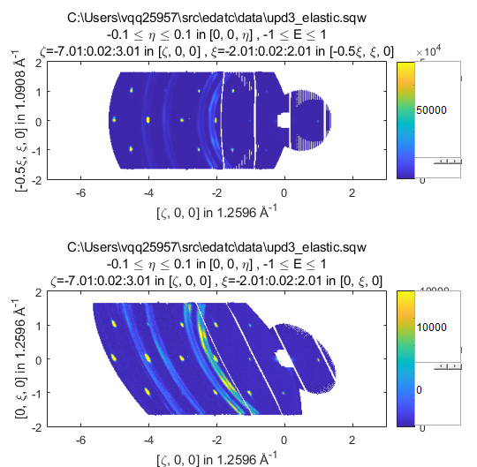
Nonorthogonal projections
Matlab graphs can only have orthogonal plot axes.
Using nonorthogonal=true gives a distorted view
nonorthogonal=false
nonorthogonal=true

Slide 16
Generic projections
Current version of Horace can only handle 3D rectilinear projections.
Work currently in progress to allow definition of projections defined by a general transformation of Q.
This will include:
Powder projection
Cylindrical projection

Slide 17
cut_sqw
w = cut_sqw(data_source, proj, p1_bin, p2_bin, p3_bin, p4_bin)
w = cut_sqw(data_source, proj, p1_bin, p2_bin, p3_bin, p4_bin, '-nopix')
Recap: Horace can create two types of objects using cut:
dnd (d1d, d2d, d3d, d4d)objects contain only histogrammed (binned) data
sqw objects contains both histogrammed data which can be plotted and all the detector-energy elements (“pixels”) which were rebinned.
dnd objects are created with the '-nopix' flag – good for plotting as don’t take up much memory
sqw objects (created by default) needed for a lot of operations (re-rebin, symmetrisation, resolution convolution)
smooth only works on dnd.

Slide 18
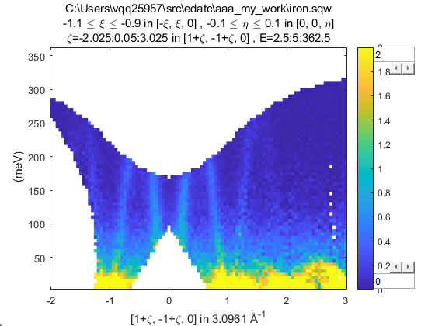
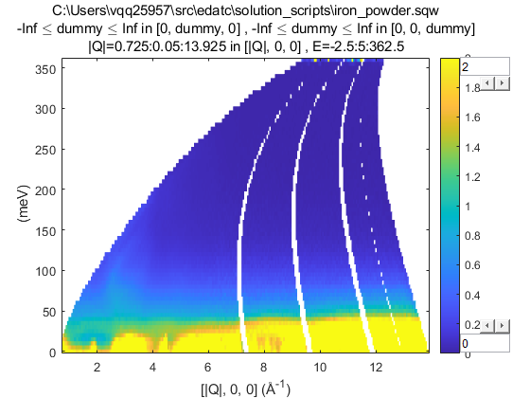
cut_sqw
proj = projaxes([1,1,0], [-1,1,0], 'type', 'rrr');
w1 = cut_sqw('iron.sqw', proj, [-2,0.05,3],[-1.1,0.9],[-.1,.1], 5, '-nopix')
w1 = cut_sqw('iron_powder.sqw', 0.05, 5, '-nopix')
4D sqw file
2D sqw file

Slide 19
Questions so far?

Slide 20
Overview
Matlab intro
Arrays
Operators
Indexing
Objects and methods
Creating sqw file (CLI)
Powder data
Making cuts
Projections
Non-orthogonal projections
Sample mis-alignment corrections
Horace coordinate conventions
Advanced plotting
Genie-like syntax
“spaghetti”-plot

Slide 21
Sample misalignment corrections
https://pace-neutrons.github.io/horace-docs/3.5.0/Correcting_for_sample_misalignment.html
bragg_positions() – make cuts and fit Bragg peaks automatically
bragg_positions_view() – function to view Bragg peak fits
refine_crystal() – function to calculate a transformation matrix to convert from original (hkl) to corrected (hkl) from the Bragg position fits
change_crystal() – applies the correction matrix to data in memory
change_crystal_horace() – applies correction matrix to sqw file
crystal_pars_correct() – calculate “correct” lattice parameters / angles and misalignment orientation (dpsi, gl, gs) from correction matrix
uv_correct() – calculate u and v vectors defining the true horizontal plane.

Slide 22
Advanced Plotting
https://pace-neutrons.github.io/horace-docs/3.5.0/Plotting.html
Horace 1D and 2D plots are not quite standard Matlab plots and use their own syntax based on the (now defunct) “Genie” program
plot(object) – object can be sqw or dnd. Replaces current plot if it exists
acolor, aline, amark – alter default color, line, marker (applies to next plot)
lx, ly, lz – sets limits in x, y, z directions (z=color axis in 2D)
keep_figure – next plot command will create a new figure window.
make_current – next plot command will replace current plot in figure window.
pl, pm, pe, pp – 1D, overplots line, markers, errors or points (markers+errors)
pd, ph – 1D only, overplots data (markers+errors+line) or histogram
ds – 2D, plots a contour map of the data

Slide 23
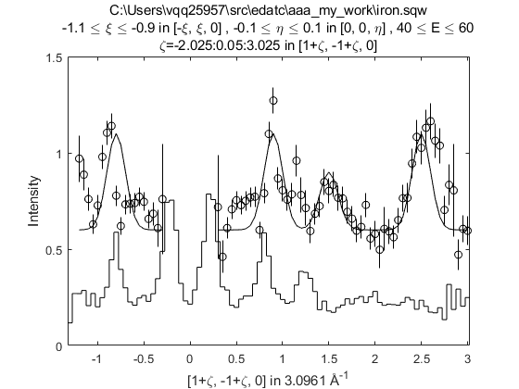
Advanced Plotting
pl, pm, pe, pp – 1D, overplots line, markers, errors or points (markers+errors)
pd, ph – 1D only, overplots data (markers+errors+line) or histogram

Slide 24
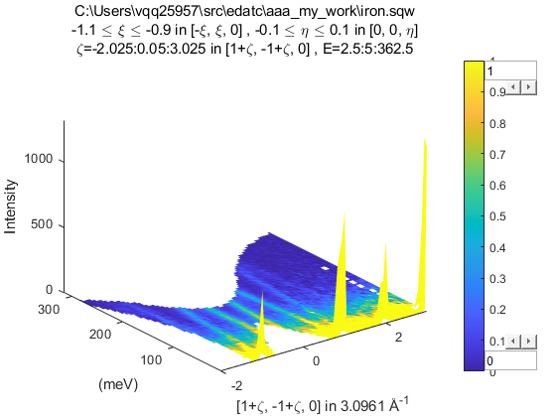
Advanced Plotting
ds – 2D, plots a contour map of the data

Slide 25
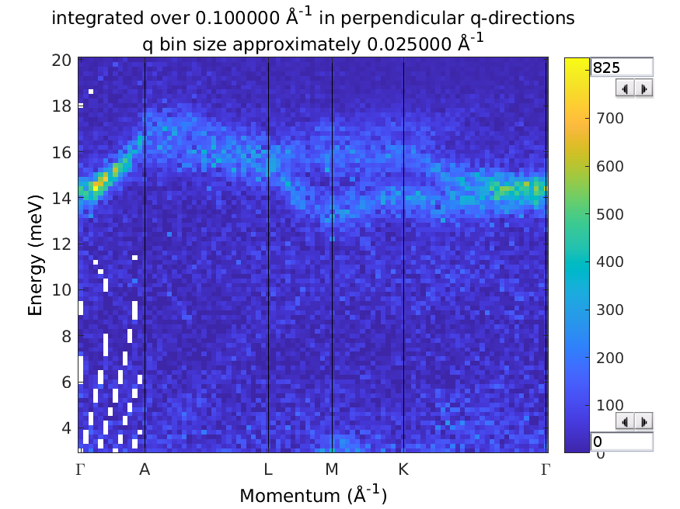
Advanced Plotting
spaghetti_plot – function to plot data along particular Q directions
spaghetti_plot([0,0,-3; 0,0,-3.5; -0.5,0,-3.5; -0.5,0,-3; -2/3 1/3 -3; 0 0 -3], 'upd3_ei25.sqw', 'labels',{'\Gamma','A','L','M','K','\Gamma'}, 'ebin',[3,0.2,20], 'qbin',0.025, 'qwidth',0.1)

Slide 26
Questions so far?
(and 5 min break)

Slide 27
Horace CLI Demonstration
Horace CLI Demonstration

Slide 28
Summary
help <command>
https://pace-neutrons.github.io/horace-docs/3.5.0
gen_sqw – needs u, v vectors to define the horizontal scattering plane
cut_sqw – needs another set of u,v,w to define cut axes (called projections).
gen_sqw_powder – note has only 2 axes.
Horace plots use a “Genie” syntax (see docs) rather than standard Matlab syntax.

Slide 29
Next
Thursday
Background subtraction
Symmetrisation
Spurions
Simulating data
Fitting
Friday
Resolution convolution
Fitting

