Slide 1
Single Crystal INS data analysis with Horace
Part 3
Notes:
1

Slide 2
Overview
Yesterday
Intensity corrections
Background subtraction
Symmetrisation
Data diagnostics
Identifying spurions
Masking data
Simulating data
Today
Fitting
Resolution convolution

Slide 3
Recap
3 ways of creating a synthetic workspace in Horace:
func_eval(w_in, @fun, par)
sqw_eval(w_in, @sqwfun, par)
disp2sqw_eval(w_in, @dispfun, par, fwhm)
function out = fun(x, y, par)
xc = par(1); yc = par(2); sigx = par(3); sigy = par(4);
out = par(5) * exp(-(x-xc).^2./(2*sigx)-(y-yc).^2./(2*sigy));
end

Slide 4
Recap
3 ways of creating a synthetic workspace in Horace:
func_eval(w_in, @fun, par)
sqw_eval(w_in, @sqwfun, par)
disp2sqw_eval(w_in, @dispfun, par, fwhm)
function out = sqwfun(h,k,l,en,par)
JS = par(1); Gam = par(2);
omega = JS * (1-cos(pi*h));
out = par(3) * Gam ./ ((en - omega).^2 + Gam.^2);
end

Slide 5
Recap
3 ways of creating a synthetic workspace in Horace:
func_eval(w_in, @fun, par)
sqw_eval(w_in, @sqwfun, par)
disp2sqw_eval(w_in, @dispfun, par, fwhm)
3 different function signatures depending on the evaluation mechanism
These three types of functions can also be used for fitting
func_eval → multifit
sqw_eval → multifit_sqw
disp2sqw_eval → multifit_sqw and disp2sqw
function [w,s] = dispfun(h,k,l,par)
w = par(1) * (1-sin(pi*h));
s = par(2) + w*0;
end

Slide 6
multifit
multifit is the Horace fitting class.
https://pace-neutrons.github.io/horace-docs/3.5.0/Multifit.html
Uses the Levenberg-Marquardt algorithm
Designed to fit multiple cuts simultaneously
Expects user-defined model functions in the form func(x1,x2,x3,…,pars)
Can also have non-Matlab fit functions (e.g. Fortran, C/C++, Python)
Beta: work-in-progress contact me for details
Accepts up to two model functions: “foreground” and “background”.
Has the concept of a “local” and “global” model functions:
“global”: parameters are the same for all input cuts
By default “foreground” model function is “global”
“local”: parameters for each cut is different
By default “background” model function is “local”
Can specify “bindings” (or “ties”) between model/background parameters
https://pace-neutrons.github.io/horace-docs/3.5.0/Multifit.html#binding-parameters

Slide 7
multifit
multifit has two types of syntax
“legacy” function-style syntax:
>> [w_fit, fitpars] = multifit(w_in, @fun, init_par)
Object oriented syntax:
>> mfobj = multifit(w_in)
>> mfobj = mfobj.set_fun(@fun)
>> mfobj = mfobj.set_pin(init_par)
>> [w_fit, fitpars] = mfobj.fit()
Object-oriented syntax is highly recommended for complex multi-cut fits with background and bindings between model/background parameters.

Slide 8
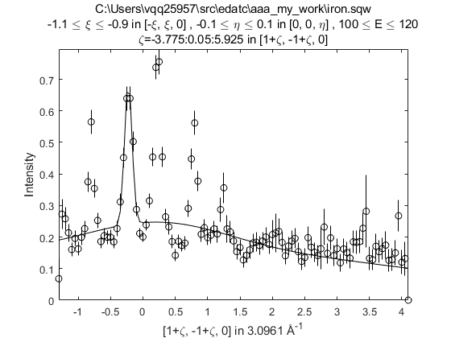
A simple fit
Make a 1D cut and fit a set of Gaussians to it.
>> w1 = cut_sqw('iron.sqw', projaxes([1,1,0], [-1,1,0], 'type', 'rrr'), 0.05, [-1.1,-0.9], [-0.1, 0.1], [100,120])
>> [wf, fp] = multifit(w1, @mgauss, [0.4 -0.8 0.1 0.4 -0.2 0.1 0.4 0.2 0.1])
>> plot(w1); pl(wf)

Slide 9
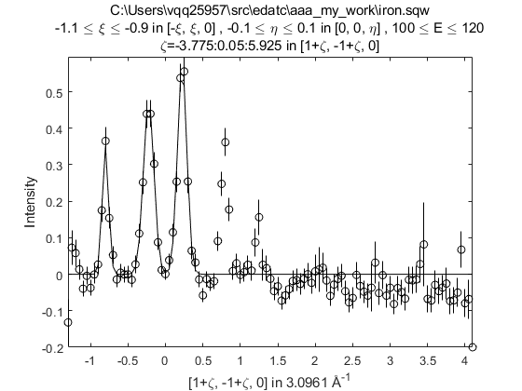
A simple fit
Make a 1D cut and fit a set of Gaussians to it.
>> w1 = cut_sqw('iron.sqw', projaxes([1,1,0], [-1,1,0], 'type', 'rrr'), 0.05, [-1.1,-0.9], [-0.1, 0.1], [100,120])
>> [wf, fp] = multifit(w1-0.2, @mgauss, [0.4 -0.8 0.1 0.4 -0.2 0.1 0.4 0.2 0.1])
>> plot(w1-0.2); pl(wf)

Slide 10
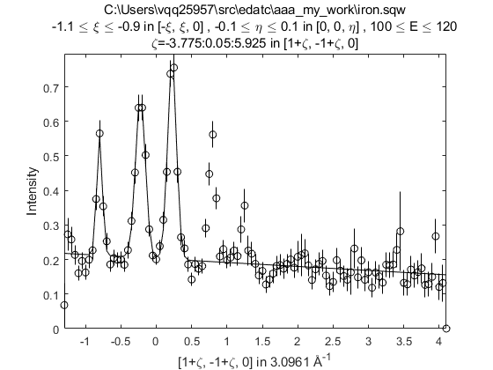
A simple fit
Make a 1D cut and fit a set of Gaussians to it.
>> w1 = cut_sqw('iron.sqw', projaxes([1,1,0], [-1,1,0], 'type', 'rrr'), 0.05, [-1.1,-0.9], [-0.1, 0.1], [100,120])
>> [wf, fp] = multifit(w1, @mgauss, [0.4 -0.8 0.1 0.4 -0.2 0.1 0.4 0.2 0.1], @linear_bg, [0.2 0])
>> plot(w1); pl(wf)

Slide 11
A simple fit
Make a 1D cut and fit a set of Gaussians to it.
>> w1 = cut_sqw('iron.sqw', projaxes([1,1,0], [-1,1,0], 'type', 'rrr'), 0.05, [-1.1,-0.9], [-0.1, 0.1], [100,120])
>> mf = multifit(w1); mf = mf.set_fun(@mgauss); mf = mf.set_pin([0.4 -0.8 0.1 0.4 -0.2 0.1 0.4 0.2 0.1]);
>> mf = mf.set_bfun(@linear_bg); mf = mf.set_bpin([0.2 0]);
>> [wf, fp] = mf.fit(); plot(w1); pl(wf)
Object-oriented syntax

Slide 12
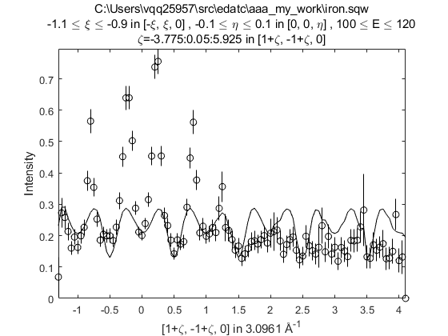
S(Q,E) model fit
Now try to fit the same dataset with a S(Q,E) model
>> w1 = cut_sqw('iron.sqw', projaxes([1,1,0], [-1,1,0], 'type', 'rrr'), 0.05, [-1.1,-0.9], [-0.1, 0.1], [100,120])
>> [wf, fp] = multifit_sqw(w1, @my_disp, [200, 0.4, 0.1])
>> plot(w1); pl(wf)
my_disp.m
function out = my_disp (qh, qk, ql, en, par)
om = par(1)*abs(cos(pi*qh));
out = par(2)*exp(-((om-en).^2)./(2*par(3)));
end

Slide 13
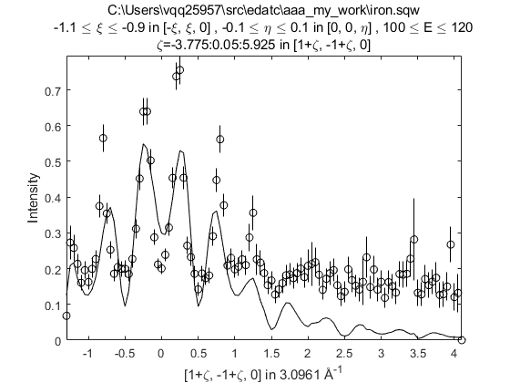
S(Q,E) model fit
Now try to fit the same dataset with a S(Q,E) model
>> w1 = cut_sqw('iron.sqw', projaxes([1,1,0], [-1,1,0], 'type', 'rrr'), 0.05, [-1.1,-0.9], [-0.1, 0.1], [100,120])
>> ff_fun = MagneticIons('Fe0').getFF_calculator(w1);
>> [wf, fp] = multifit_sqw(w1, @my_disp_ff, {[200, 0.4, 0.1] ff_fun})
>> plot(w1); pl(wf)
my_disp_ff.m
function out = my_disp (qh, qk, ql, en, par, ff_fun)
om = par(1)*abs(cos(pi*qh));
out = par(2)*exp(-((om-en).^2)./(2*par(3)));
out = out .* ff_fun(qh,qk,ql,en)';
end

Slide 14
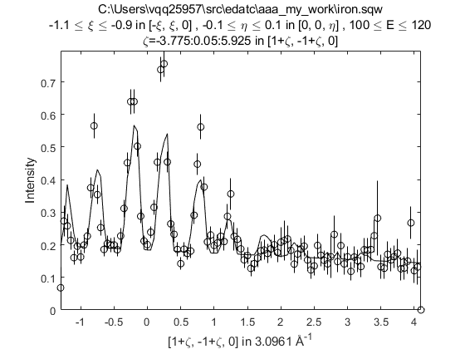
S(Q,E) model fit
Now try to fit the same dataset with a S(Q,E) model
>> w1 = cut_sqw('iron.sqw', projaxes([1,1,0], [-1,1,0], 'type', 'rrr'), 0.05, [-1.1,-0.9], [-0.1, 0.1], [100,120])
>> ff_fun = MagneticIons('Fe0').getFF_calculator(w1);
>> [wf, fp] = multifit_sqw(w1, @my_disp_ff, {[200, 0.4, 0.1] ff_fun}, @linear_bg, [0.1, 0])
>> plot(w1); pl(wf)
my_disp_ff.m
function out = my_disp (qh, qk, ql, en, par, ff_fun)
om = par(1)*abs(cos(pi*qh));
out = par(2)*exp(-((om-en).^2)./(2*par(3)));
out = out .* ff_fun(qh,qk,ql,en)';
end

Slide 15
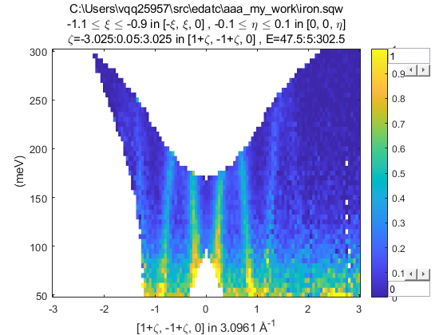
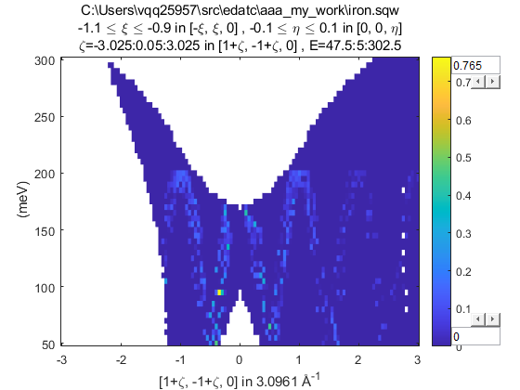
S(Q,E) model fit
Now try to fit the S(Q,E) model to a 2D dataset
>> w2 = cut_sqw('iron.sqw', projaxes([1,1,0], [-1,1,0], 'type', 'rrr'), [-3,0.05,3], [-1.1,-0.9], [-0.1, 0.1], [50,5,300])
>> ff_fun = MagneticIons('Fe0').getFF_calculator(w2);
>> wf2 = multifit_sqw(w2, @my_disp_ff, {[200, 0.4, 0.1] ff_fun});
>> plot(w2); keep_figure; plot(wf2)

Slide 16
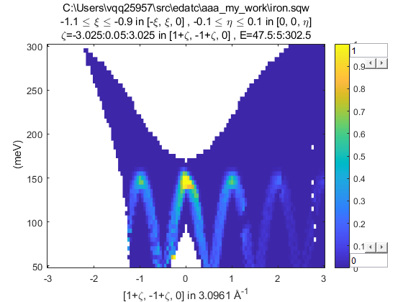
S(Q,E) model fit
What about evaluating the 1D fit parameters of the S(Q,E) model in 2D?
>> w1 = cut_sqw('iron.sqw', projaxes([1,1,0], [-1,1,0], 'type', 'rrr'), 0.05, [-1.1,-0.9], [-0.1, 0.1], [100,120])
>> w2 = cut_sqw('iron.sqw', projaxes([1,1,0], [-1,1,0], 'type', 'rrr'), [-3,0.05,3], [-1.1,-0.9], [-0.1, 0.1], [50,5,300])
>> ff_fun = MagneticIons('Fe0').getFF_calculator(w2);
>> [wf, fp] = multifit_sqw(w1, @my_disp_ff, {[200, 0.4, 0.1] ff_fun})
>> wf2 = sqw_eval(w2, @my_disp_ff, {fp.p ff_fun});
>> plot(w2); keep_figure; plot(wf2)
Dispersion model is incorrect!

Slide 17
S(Q,E) model fit
Now try to fit the S(Q,E) model to an array of 1D dataset
>> proj = projaxes([1,1,0], [-1,1,0], 'type', 'rrr');
>> en=80:20:160; for i = 1:numel(en); wc(i) = cut_sqw('iron.sqw', proj, 0.05, [-1.1,-0.9], [-0.1, 0.1], [-10 10]+en(i)); end
>> ff_fun = MagneticIons('Fe0').getFF_calculator(wc(1));
>> [wf, fp] = multifit_sqw(wc, @my_disp_ff, {[200, 0.4, 0.1] ff_fun}, @linear_bg, [0.1, 0])
>> for i = 1:numel(en); plot(wc(i)); pl(wf(i)); ly(0,1); keep_figure; end

Slide 18
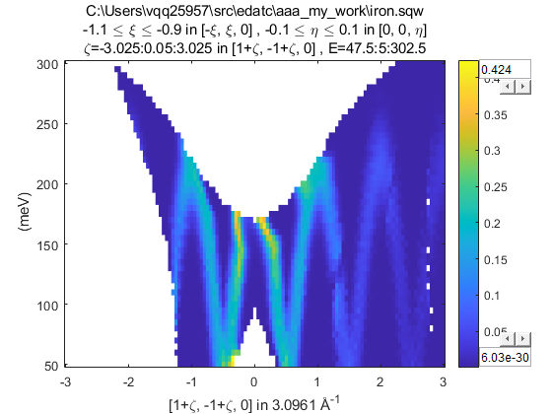
S(Q,E) model fit
Evaluating the 1D fitted parameters on the 2D plot?
>> proj = projaxes([1,1,0], [-1,1,0], 'type', 'rrr');
>> en=80:20:160; for i = 1:numel(en); wc(i) = cut_sqw('iron.sqw', proj, 0.05, [-1.1,-0.9], [-0.1, 0.1], [-10 10]+en(i)); end
>> ff_fun = MagneticIons('Fe0').getFF_calculator(wc(1));
>> [wf, fp] = multifit_sqw(wc, @my_disp_ff, {[200, 0.4, 0.1] ff_fun}, @linear_bg, [0.1, 0])
>> wf2 = sqw_eval(w2, @my_disp_ff, {fp.p ff_fun});
>> plot(w2); keep_figure; plot(wf2)

Slide 19
Fitting summary
Use multifit for functions which needs the plot axes (defined by the projection) – e.g. peak or linear functions
These functions are dimension specific (e.g. need different functions for 1D, 2D, 3D datasets)
User multifit_sqw for functions which needs the (h,k,l,en) coordinates – e.g. dispersion models
Can fit multiple cuts simultaneously
Can fit (sum of) two model functions (“foreground” and “background”) together.
By default, foreground functions have “global” parameters (same for all cuts), and background functions have “local” parameters (different for each cut)

Slide 20
Questions so far?

Slide 21

Resolution Convolution
The measured intensity at the detector is:
has contributions from:
Moderator time width
View aperture size / guide divergence
Chopper opening time width
Sample size
Detector size / detector width (time)
Often the resolution function is approximated as Gaussian
The asymmetry of the moderator pulse means this is not valid for ToF spectrometers
But Horace can still calculate a 4D Gaussian for you if you want…
In Horace, the convolution (integration) is computed numerically using the Monte Carlo method.
most
important
(for ToF direct
spectrometers)
least

Slide 22
Resolution Convolution Details
The contributions to the resolution function can be expressed in 11 variables:
t_{m} – time deviation at the moderator
y_{a}, z_{a} (or γ_{y}, γ_{z}) – the coordinates of the neutron at the aperture (or neutron guide divergences)
TobyFit was designed when neutron guides did not exist. Guide divergence broadening is approximated by a large aperture (beam-port window)
t_{ch} – time deviation at the chopper
x_{s}, y_{s}, z_{s} – neutron coordinate at the sample
x_{d}, y_{d}, z_{d}, t_{d} – neutron coordinate at the detector
These 11 deviations from the ideal case (bin centre or pixel coordinate) are sampled randomly producing a vector Y
The distributions from which Y is sampled depends on the sample and instrument
There is a linear transformation which maps Y to the sample frame coordinates (Q,E)
(δQ, δE) = T B Y
where the T and B matrices are given in Toby’s thesis, Appendix A (eq. A.66 and Table A1 respectively)
The (Q+δQ, E+δE) vector is then passed to the sqw model function.
T. G. Perring, High Energy Magnetic Excitations in Hexagonal Cobalt, Ph.D. Thesis, University of Cambridge, 1991
RAL Technical Report RALT-028-94

Slide 23

Resolution Convolution
So:
Is transformed into:
where (Q₀,E₀) is the coordinate of each pixel – that is I(Q₀,E₀) is the calculated intensity of each pixel
By default N=10 (mc_points) is used because there are a lot of pixels and they overlap significantly.
But this means that it takes 10x longer for the resolution calculation than without…

Slide 24
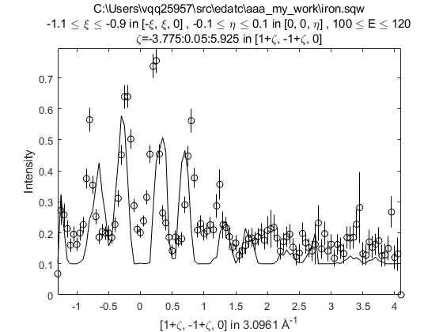
Resolution Convolution
Use the tobyfit class to calculate or fit with resolution convolution
First need to define a sample (IX_sample) and instrument on the workspace to be fitted or simulated.
>> w1 = cut_sqw('iron.sqw', projaxes([1,1,0], [-1,1,0], 'type', 'rrr'), 0.05, [-1.1,-0.9], [-0.1, 0.1], [100,120]);
>> xdir = [1,0,0]; ydir = [0,1,0]; ei = 401; freq = 600; chop_type = 's';
>> w1 = set_sample(w1, IX_sample(xdir, ydir, 'cuboid', [0.03,0.03,0.03]));
>> w1 = set_instrument(w1, maps_instrument(ei, freq, chop_type));
>> ff_fun = MagneticIons('Fe0').getFF_calculator(w1);
>> tf = tobyfit(w1);
>> tf = tf.set_fun(@fe_sqw_ff);
>> tf = tf.set_pin({[200 200 0.1] ff_fun});
>> tf = tf.set_bfun(@linear_bg);
>> tf = tf.set_bpin([0.1 0]);
>> wsim = tf.simulate()
>> plot(w1); pl(wsim)
Need to use object oriented interface
but otherwise exact same syntax as for
multifit

Slide 25
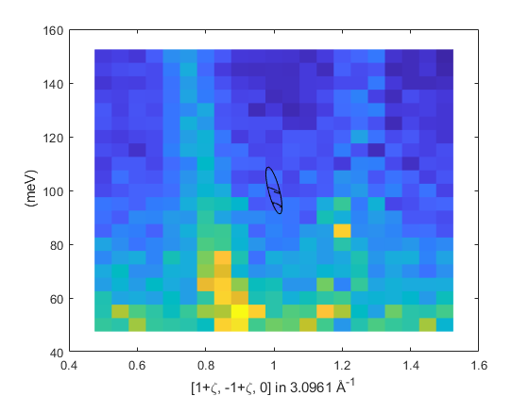
Resolution Convolution
Finally, can use the resolution_plot function to plot a resolution ellipsoid on a 2D cut (only 2D cuts).
>> w1 = cut_sqw('iron.sqw', projaxes([1,1,0], [-1,1,0], 'type', 'rrr'), [0.5,0.05,1.5], [-1.1,-0.9], [-0.1, 0.1], [50,5,150]);
>> xdir = [1,0,0]; ydir = [0,1,0]; ei = 401; freq = 600; chop_type = 's';
>> w1 = set_sample(w1, IX_sample(xdir, ydir, 'cuboid', [0.03,0.03,0.03]));
>> w1 = set_instrument(w1, maps_instrument(ei, freq, chop_type));
>> cov = resolution_plot(w1)
cov is the covariance matrix
This uses the Gaussian approximation

Slide 26
Questions so far?
(and 5 min break)

Slide 27
Horace CLI Demonstration
Horace CLI Demonstration

Slide 28
Summary
Two types of fitting in Horace:
(simpler) Functions of the plot (projection) axes coordinates
func_eval, multifit
function out = model(x1, x2, …, xn par)
Need to define different functions for different N-dimensions
S(Q,E) model functions
sqw_eval, multifit_sqw
function out = model(qh, qk, ql, en, par)
Can work for any dimensional objects
Need to use the tobyfit class to simulate or fit with resolution convolution.
Define the sample and instrument on the cut first
tobyfit uses exact same syntax as multifit

