Slide 1
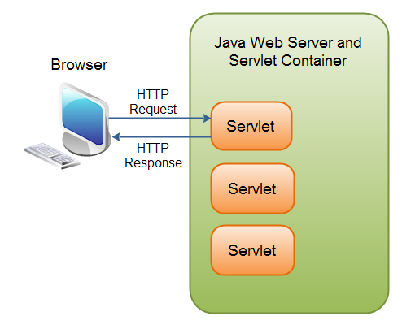
Servlet
A servlet is a small Java program that runs within a Web server. Servlets receive and respond to requests from Web clients, usually across HTTP

Slide 2
Servlet Container
A servlet container is responsible for managing the lifecycle of servlets, mapping a URL to a particular servlet and ensuring that the URL requester has the correct access rights.
By modifying the file web.xml you can add new servlets and map the servlet java class to the corresponding URL

Slide 3
Goal: create an addess book.
1- create the class SaveContactServlet
public class SaveContactServlet extends HttpServlet
2- extend the doPost method in order to save the contact
public void doPost(HttpServletRequest req, HttpServletResponse resp) throws IOException {
String contactName = req.getParameter("name");
String contactPhone = req.getParameter("phone");
String contactEmail = req.getParameter("email");
String contactPict = req.getParameter("pict");
DatastoreService datastore = DatastoreServiceFactory.getDatastoreService();
Entity contact;
contact = new Entity("Contact", contactName);
contact.setProperty("name", contactName);
contact.setProperty("phone", contactPhone);
contact.setProperty("email", contactEmail);
contact.setProperty("pict", contactPict);
datastore.put(contact);
resp.getWriter().println("Contact " + contactName + " saved with key " +
KeyFactory.keyToString(contact.getKey()) + "!");

Slide 4
<!-- SaveContactServlet Servlet -->
<servlet>
<servlet-name>SaveContact</servlet-name>
<servlet-class>eurecom.fr.helloworldgae.SaveContactServlet</servlet-class>
</servlet>
<!-- SaveContactServlet pattern/servlet -->
<servlet-mapping>
<servlet-name>SaveContact</servlet-name>
<url-pattern>/save</url-pattern>
</servlet-mapping>
3- Perform the registration of the servlet and the relative mapping to the URL

Slide 5
Part 2
View the contact list
1- Create a new Servlet and extend the doGet method
DatastoreService datastore = DatastoreServiceFactory.getDatastoreService();
// Take the list of contacts
Query query = new Query("Contact").addSort("name", Query.SortDirection.ASCENDING);
List<Entity> contacts =datastore.prepare(query).asList(FetchOptions.Builder.withDefaults());
if (contacts.isEmpty()) {
out.println("<h1>Your list is empty!</h1>");
} else {
// Let's build the table headers
out.println("<table style=\"border: 1px solid black; width: 100%; text-align: center;\">"
+ "<tr><th>Name</th><th>Phone Number</th><th>Details</th></tr>");
for (Entity contact: contacts) {
out.println("<tr><td>" + contact.getProperty("name") + "</td>"
+ "<td>" + contact.getProperty("phone") + "</td>"
+ "<td><a href=\"contactdetails?id="
+ KeyFactory.keyToString(contact.getKey())
+ "\">details</a></td>"
+ "</tr>");
}
out.println("</table>");
}
out.println("</body></html>");

Slide 6
We get the results in Json format with the class getJSON()
private String getJSON(List<Entity> contacts, HttpServletRequest req, HttpServletResponse resp) {
// Create a JSON array that will contain all the entities converted in a JSON version
JSONArray results = new JSONArray();
for (Entity contact: contacts) {
JSONObject contactJSON = new JSONObject();
try {
contactJSON.put("name", contact.getProperty("name"));
contactJSON.put("phone", contact.getProperty("phone"));
contactJSON.put("id", KeyFactory.keyToString(contact.getKey()));
contactJSON.put("email", contact.getProperty("email"));
} catch (JSONException e) {
// TODO Auto-generated catch block
e.printStackTrace();
}
results.put(contactJSON);
}
return results.toString();
}

Slide 7
As for the first servlet, we need to register it in the web.xml file. This is the same for the other features like Viewing the contact details, changing the contact information and deleting a contact from the database.
Final step, we need to present the website to the user.

Slide 8
<html>
<head> <!-- bootstrap code -->
<title>Contact List App Engine</title>
</head>
<body>
<div class="container">
<h1>Contact List</h1>
<div class="panel panel-primary">
<div class="panel-body">
Available Actions:
</div>
<div class="panel-footer">
<a href="contactlist">Contact List</a></br>
<a href="save">New Contact</a>
</div>
</div>
</div>
</body>
</html>

Slide 9
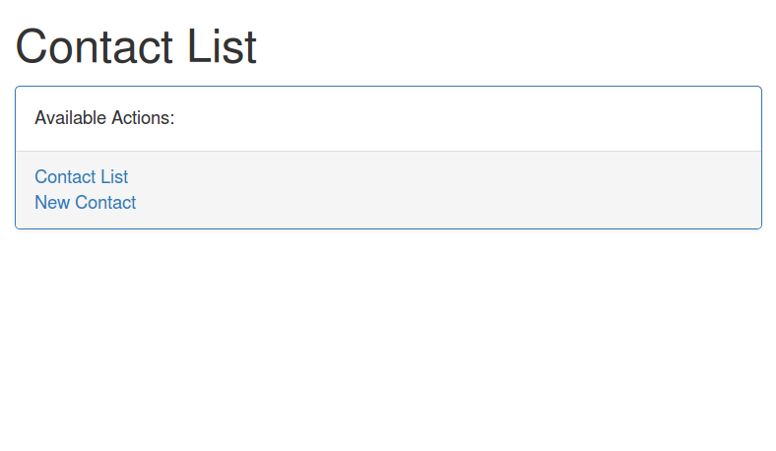

Slide 10
public class ContactDetailsServlet extends HttpServlet {
public void doGet(HttpServletRequest req, HttpServletResponse resp) throws IOException {
if (req.getParameter("id") == null) {
resp.getWriter().println("ID cannot be empty!");
return;
}
// Get the datastore
DatastoreService datastore = DatastoreServiceFactory.getDatastoreService();
// Get the entity by key
Entity contact = null;
try {
contact = datastore.get(KeyFactory.stringToKey(req.getParameter("id")));
} catch (EntityNotFoundException e) {
resp.getWriter().println("Sorry, no contact for the given key");
return;
}
// Let's output the basic HTML headers + bootstrap
PrintWriter out = resp.getWriter();
resp.setContentType("text/html");
out.println("<html><head><title>Contacts list</title>"
+"<link rel='stylesheet' href='https://maxcdn.bootstrapcdn.com/bootstrap/3.3.5/css/bootstrap.min.css'>"
+"<link rel='stylesheet' href='https://maxcdn.bootstrapcdn.com/bootstrap/3.3.5/css/bootstrap-theme.min.css'>"
+"<script src='https://maxcdn.bootstrapcdn.com/bootstrap/3.3.5/js/bootstrap.min.js'></script>"
+"</head><body><div class='container'>");
out.println(" <div class='panel panel-primary'><div class='panel-body'>"
+"<b>"+contact.getProperty("name")
+"</b></div><div class='panel-footer'><img src=\""
+ contact.getProperty("pict")
+ "\" alt=\"Profile picture\" border=1/>");
out.println("</br>Phone: " + contact.getProperty("phone") + "</br>"
+ "Email: <a href=\"mailto:"
+ contact.getProperty("email") + "\">"
+ contact.getProperty("email") + "</a>"
+ "</br>");
out.println("<a href=\"save?id=" + req.getParameter("id") + "\">Modify</a></br>"
+ "<a href=\"delete?id=" + req.getParameter("id") + "\">Delete Contact</a></div></div></div></body></html>");
}
}

Slide 11
