Slide 1
-JAI PIDUGU -KRINA PATEL -JOAO PINTO
PRIVATE STOCK APP

Slide 2
AGENDA
Concept & Similar Apps
A Typical User
Features & Support
Screenshots
Development status
Difficulties
Future work
Link to Wiki

Slide 3
Concept & Similar Apps
Image Gallery Application
Can view pictures stored locally
Can access images stored at a secure remote file-system
Similar Apps
Google Photos
QuickPic
MyRoll
Cyanogen Gallery

Slide 4
A Typical User
Someone who is concerned about the privacy of their images
Someone who’s generally mistrusting of large companies (Google, Facebook, etc.)
Someone who enjoys to take photos and frequently views them on their phone
Someone who is potentially technical enough to host their images on a remote repository for access

Slide 5
Features & Support
Authentication with PIN
View all images in an Instagram-like format
Search for images by tag
Refresh from remote repository and local images
Supports OS 4.0.3+

Slide 6
Technologies Used
Android Studio
Android Design Support Library
AsyncTask
ListView
Toast

Slide 7
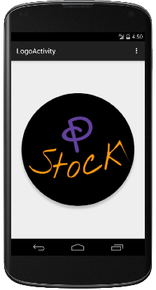
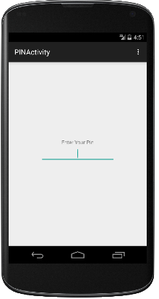
Screenshots
Logo Page
PIN Page

Slide 8
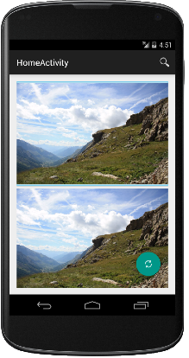
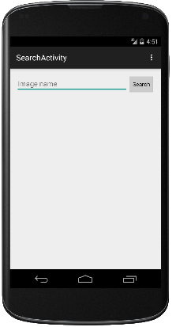
Screenshots (cont.)
Image Gallery
Search Option

Slide 9
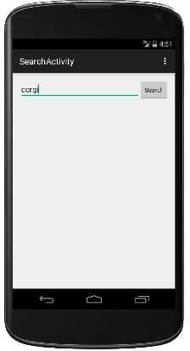
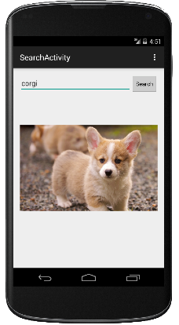
Screenshots (cont.)
Type name of the image
Searched Image

Slide 10
Development Status
Logo Activity
Authentication Activity (using PIN)
Home Activity with Image Feed
Search Activity with Remote File-System

Slide 11
Difficulties
Making Floating Action Button “float”
Needed to use app:borderWidth="0dp“
Using toasts inside an AsyncTask
Implementing side navigation pop-out
Debouncing the image search keyup event

Slide 12
Future Work
Complete side navigation
Allow multiple folders for files
Clean up UI, particularly Menu Actions
Implement searching images stored on phone
Create transitions between Activities

Slide 13
Link to Wiki
https://github.com/paceuniversity/CS6392015team3

Slide 14
Thank You

