Slide 1
The People Map
CS 389 2018 Team 6

Slide 2
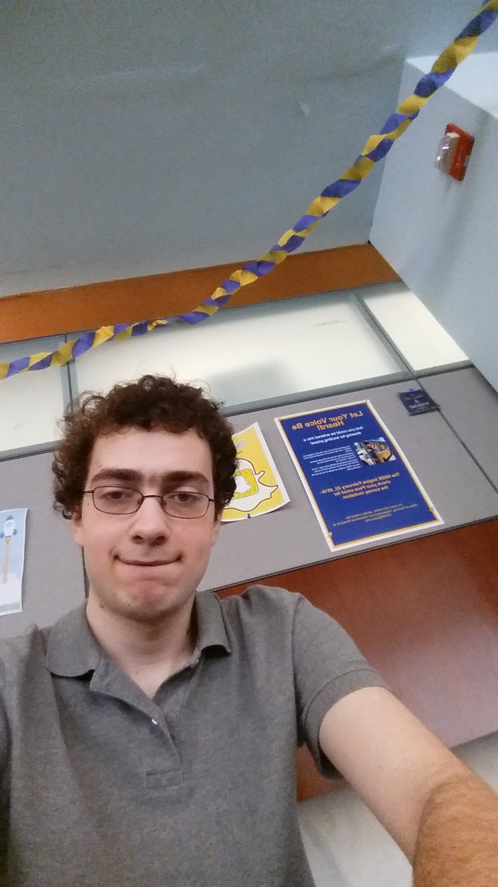
Team 6
Matthew Sokolovsky

Slide 3
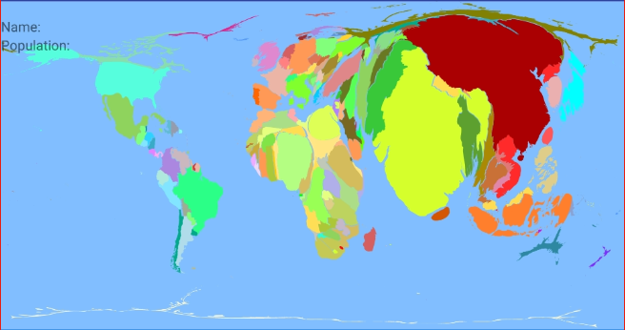
The People Map

Slide 4
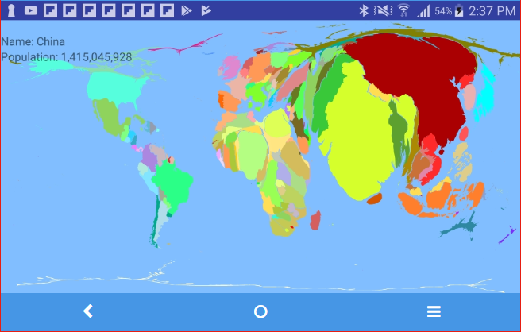
Why?
Notes:
I chose this app idea because I was interested in it. I do not see it as having any market potential. If I were to put this on Google Play, I would make it free. The app’s relation to the topic of China is that since China is the world’s most populous country it is the largest country on the map.

Slide 5
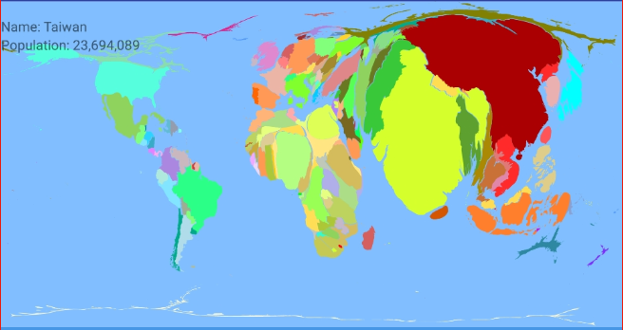
For Whom?
Notes:
I intended the app to be used by Americans, not so much by Chinese. This app might make some Chinese people angry because it has Taiwan as separate from China. Aside from that, I didn’t have a good idea of the audience for this app. I made it because I was interested in it, not because I knew other people were interested in it.

Slide 6
Data Sources
Natural Earth
World Population Review
ScapeToad

Slide 7
Tools
Requirements: | Google Sheets
Project Management: | Git | GitHub
Project Documentation: | Google Docs | GitHub (wiki)
UML: | Microsoft OneNote | Microsoft Paint
Technical: | Android Studio | ScapeToad | InkScape | Notepad++
Communication: | Slack
Presentation: | Vysor | Camstudio | Youtube
Database: | Firebase Database

Slide 8
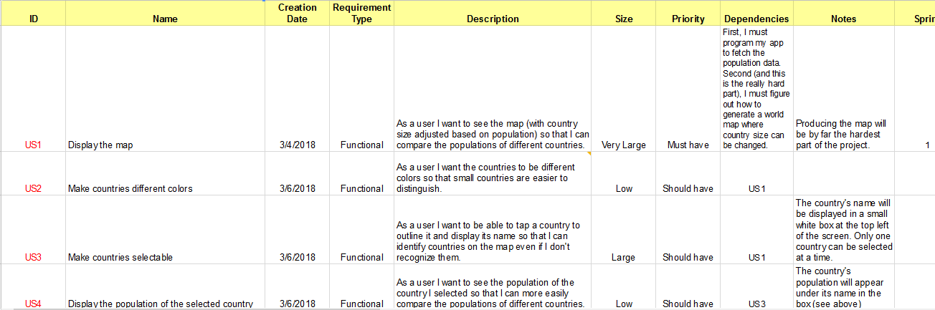
Requirements
Notes:
I captured the requirements by brainstorming and coming up with a list. I showed the requirements to professor Scharff and she gave me suggestions. I updated it, and by that point I had almost all of the requirements.

Slide 9
User Stories
Total | 9 User Stories | 7 implemented
Sprint 1 | 2 User Stories | 2 implemented
Sprint 2 | 2 User Stories | 2 implemented
Sprint 3 | 3 User Stories | 3 implemented
Functional | 7 User Stories | 6 implemented
Non-functional | 2 User Stories | 1 implemented

Slide 10

Main Features

Slide 11
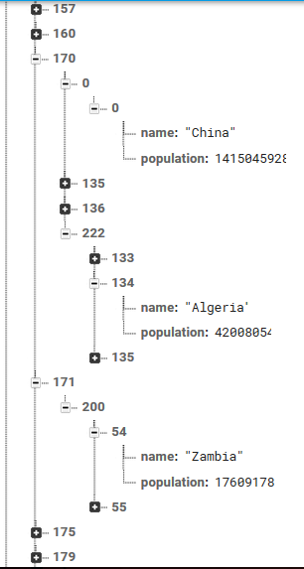

Slide 12
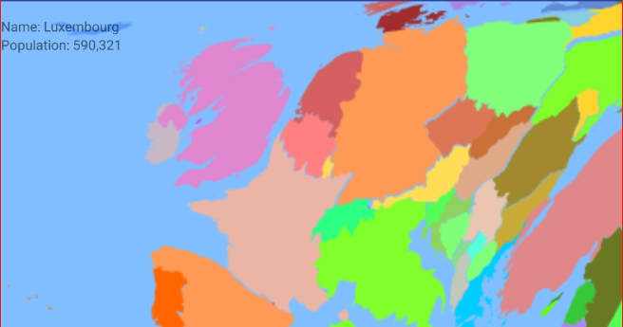

Slide 13
Architecture

Slide 14
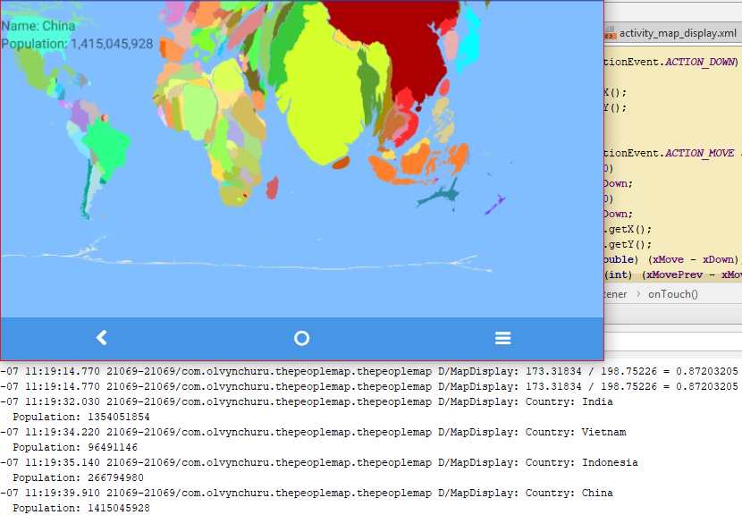
Testing

Slide 15
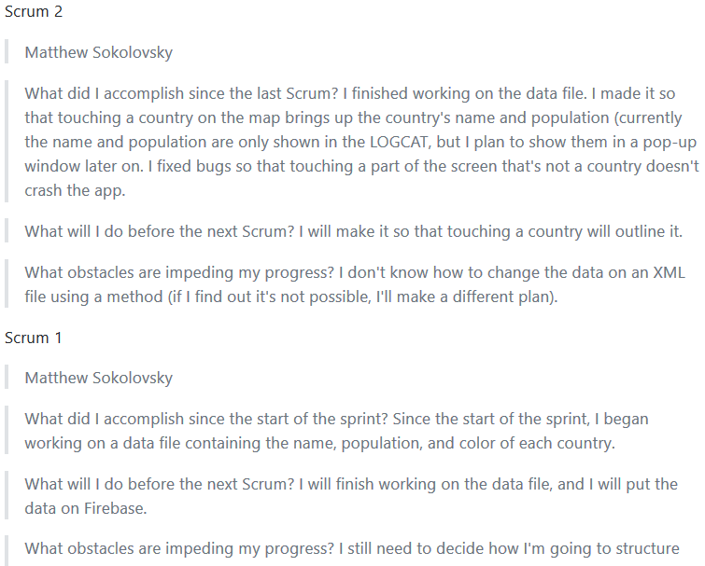
Process

Slide 16
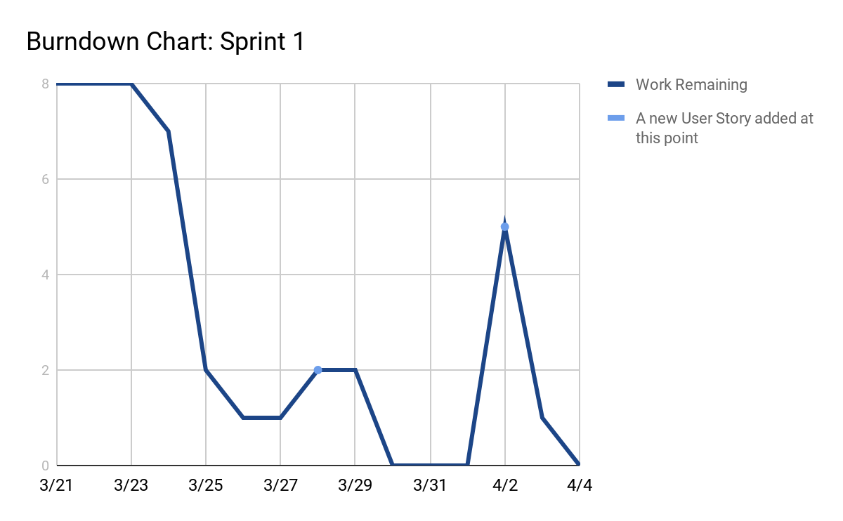

Slide 17
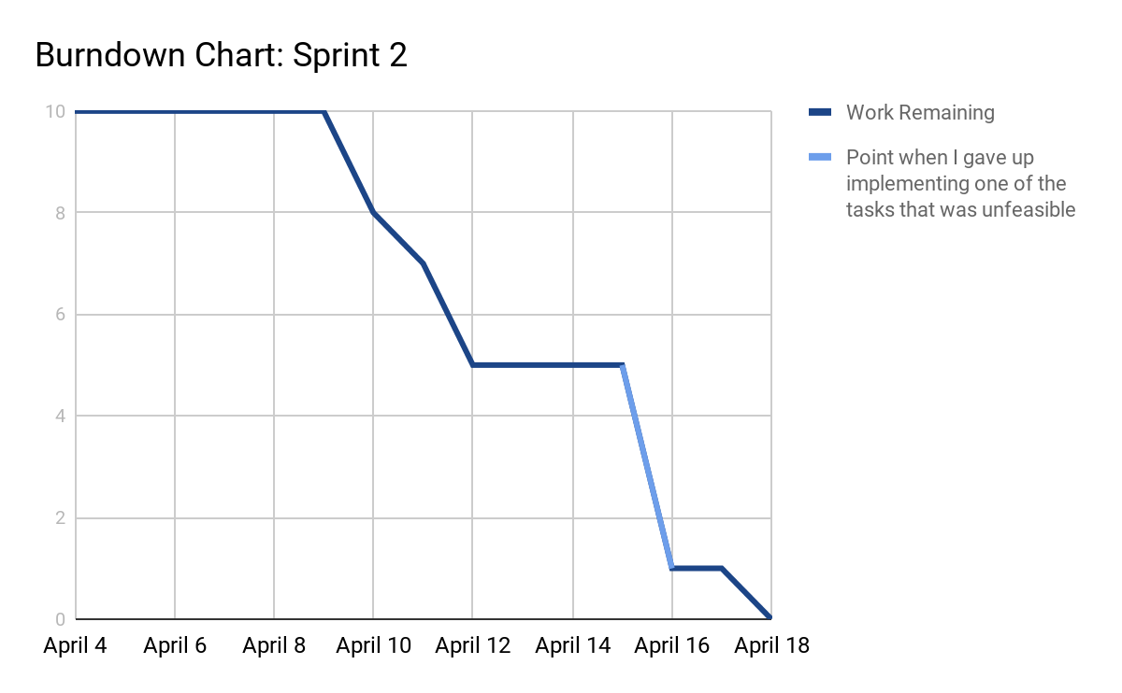

Slide 18
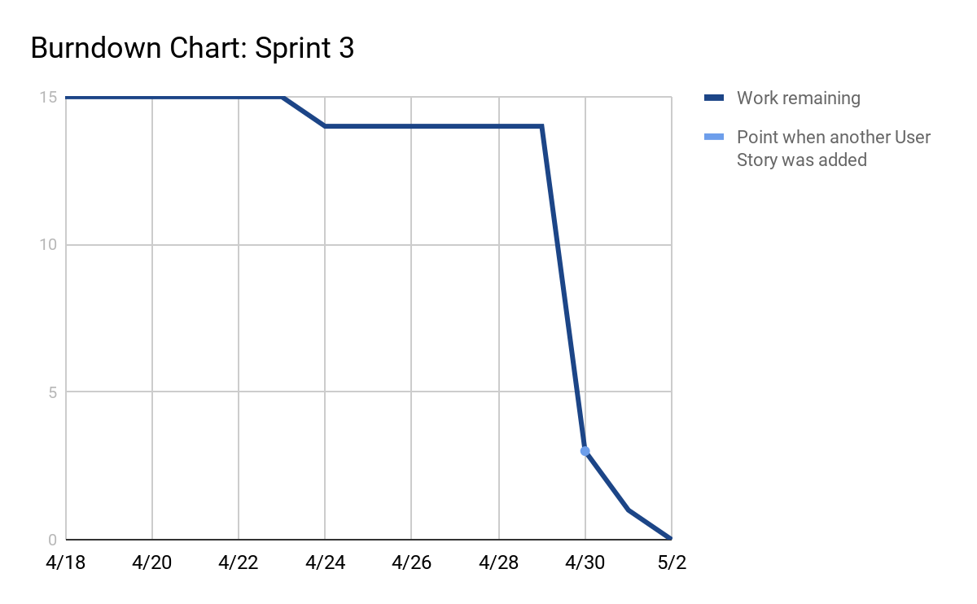

Slide 19
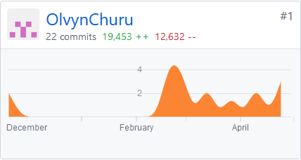
GitHub Statistics

Slide 20
Other Stats
# of communications | 11 (mostly with professor on Slack)
# hours worked | 60-108 (estimate)
# Java classes | 3
# Lines of code | 1514
# Issues | 2 (1 open, 1 closed)

Slide 21
What’s Next?
Notes:
I’m not going anywhere with this app. If I ever get it on Google Play, I’ll make it free. It’s not good enough that someone should have to buy it.

