Slide 1

MAP PHARMACIES
Sophia Munshi
Rahul sood
Pace university, NY
https://github.com/paceuniversity/CS6392016team4/wiki

Slide 2
Awareness
This Application has been developed to make people aware of the pharmacy stores around them.
This application will help you to locate all the pharmacies within few miles radius.
People usually have a fixed path to go to their work or home.
Due to which they are sometimes not aware of things which are nearby.

Slide 3
Users
This application is basically useful for everyone.
It is best for the people who are working, for instance someone doesn’t feel good or is sick or has some headache or anything.
With this application a person can make a quick run to the nearest store and get some medication.

Slide 4
features
It can give information about a particular medicine such that on which store it is available.
It can show which medicines are available on prescription and which are not.
There will also be an option where users can find which medicines are on discounted price.

Slide 5
technology
This application has been developed using:
Android Studio
Java
Google Maps API

Slide 6
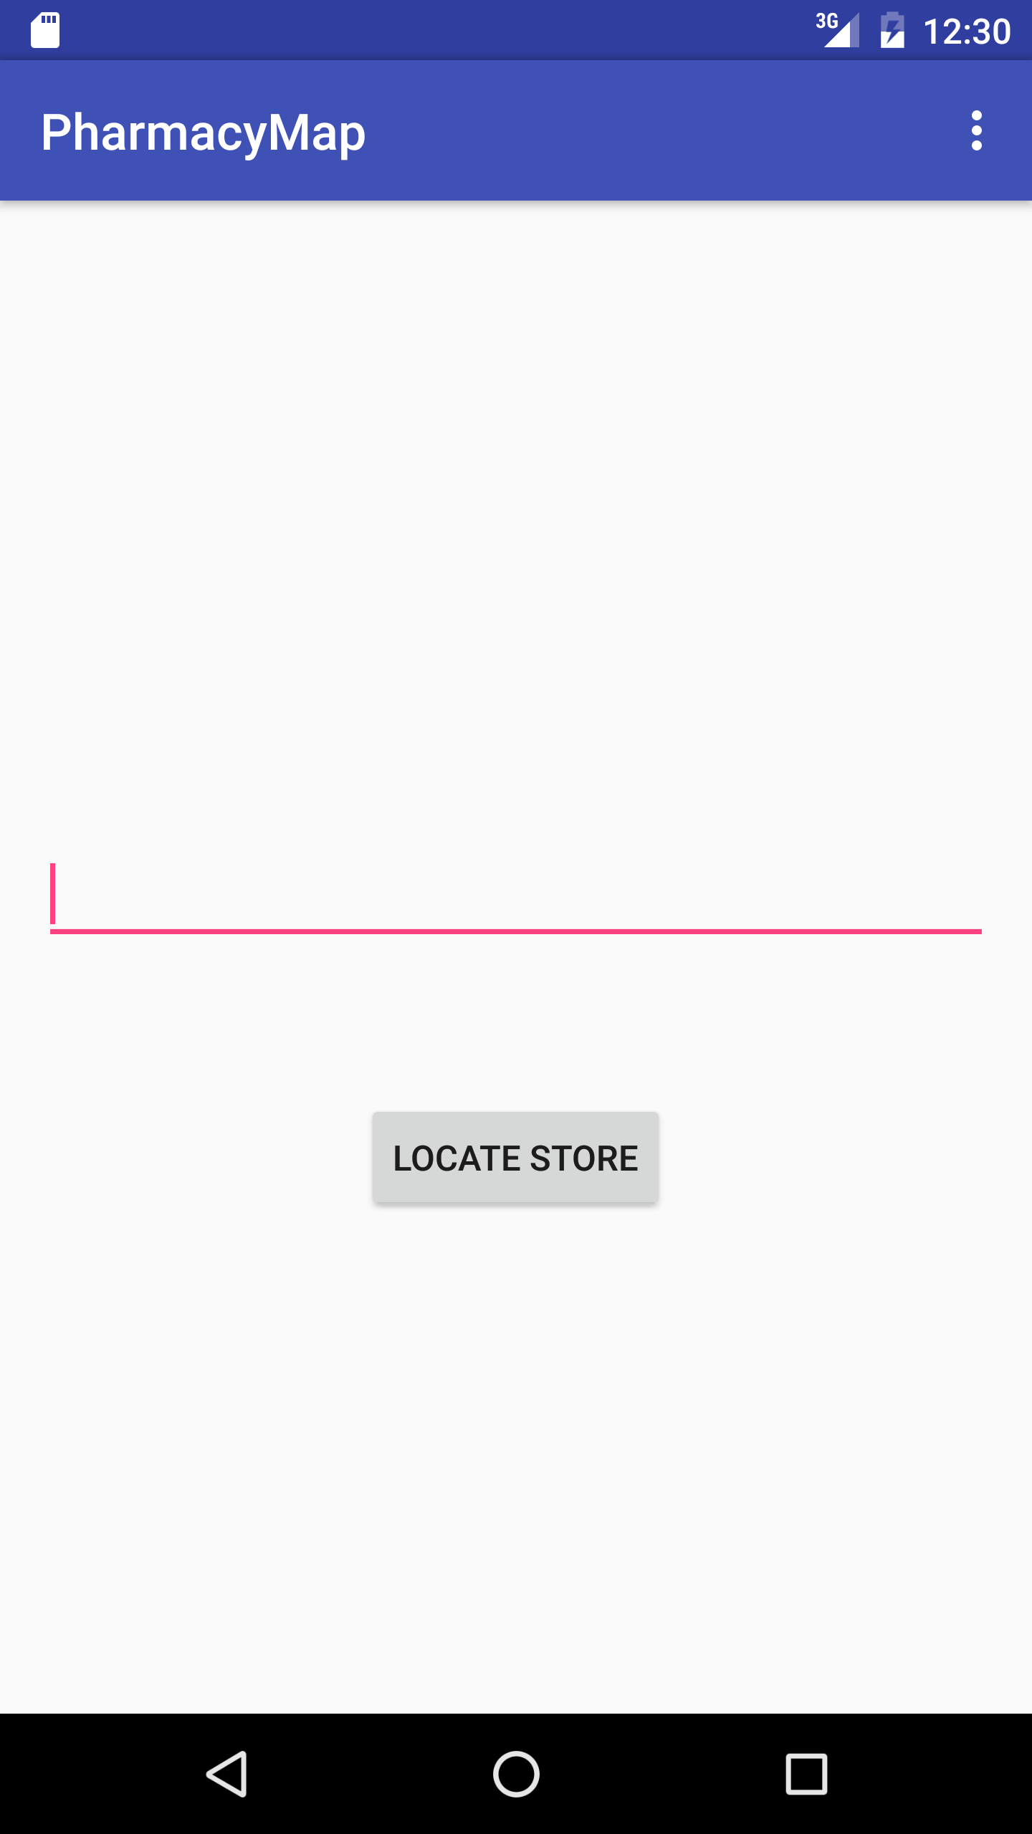
Screenshot

Slide 7
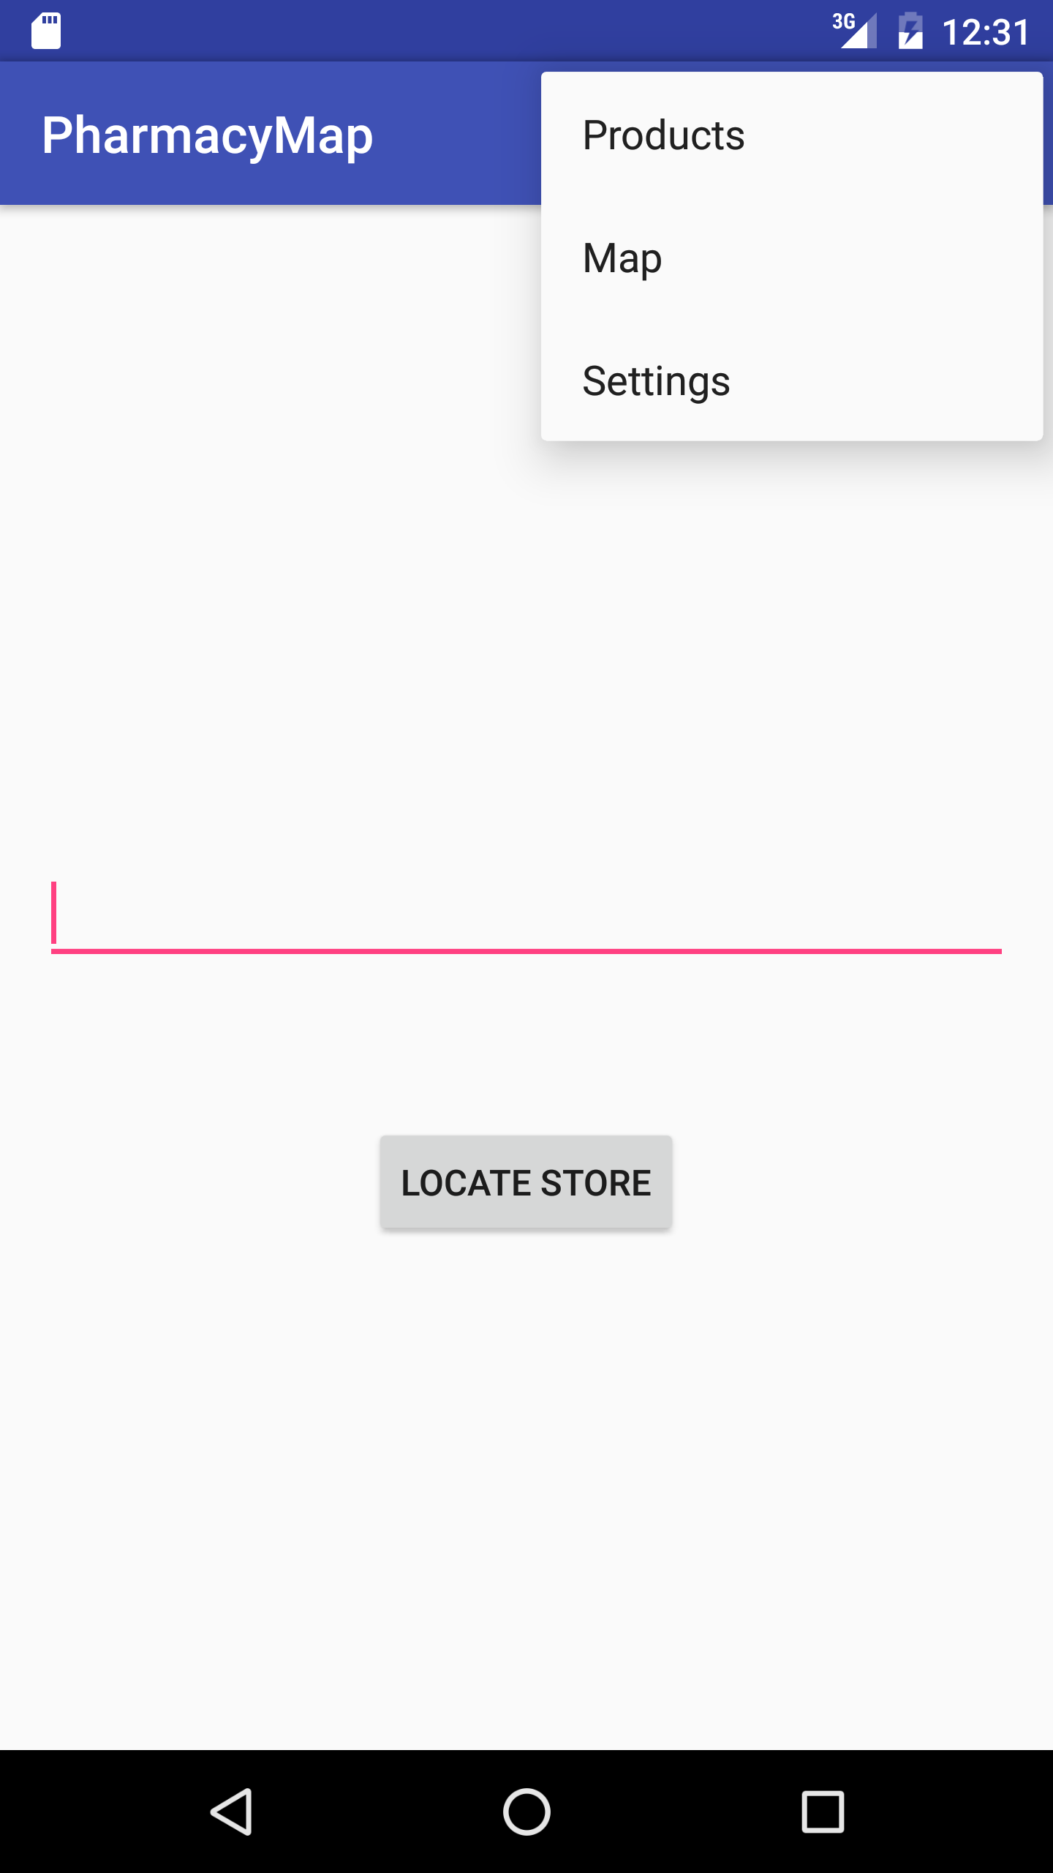
screenshot

Slide 8
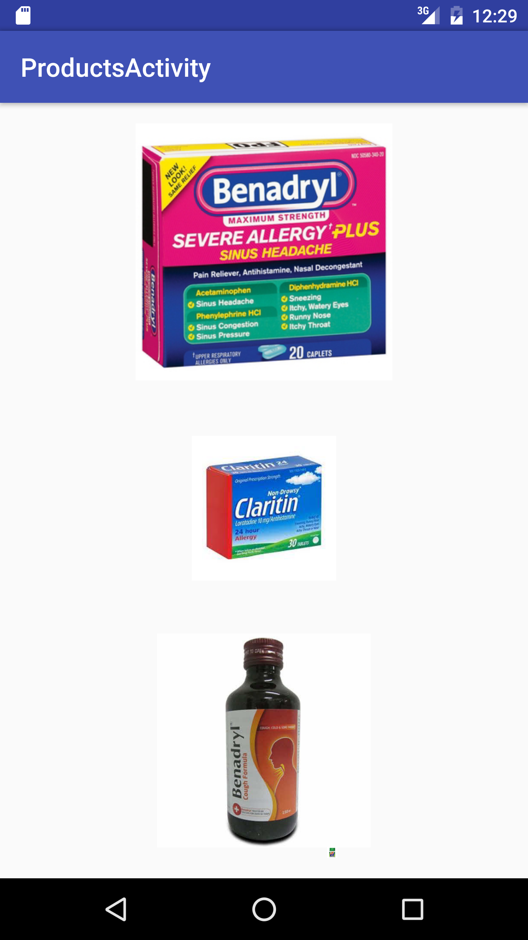
Screenshot

Slide 9
status
The application is still being developed.
There is a menu which contains options to have a look at the products.
From homepage user can just type in the zip code and can receive the pharmacies on the map along with their address.

Slide 10
Problems encountered
We had issues in getting the current location of the user on the google maps.
There are also some problems with the data of the NYC stores, as their address is not accurate.

