Slide 1
SwaEng
Michael Cornell, Salvatore Torcivia
Software Engineering

Slide 2
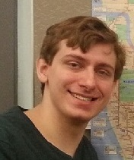
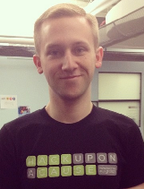
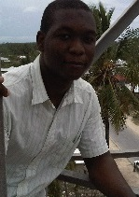
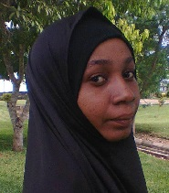
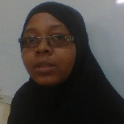
OUR TEAM
Michael Cornell
Sal Torcivia
Mgeni Mgeni
Mwanaidi Shehe
Zainab Abdulrahman

Slide 3
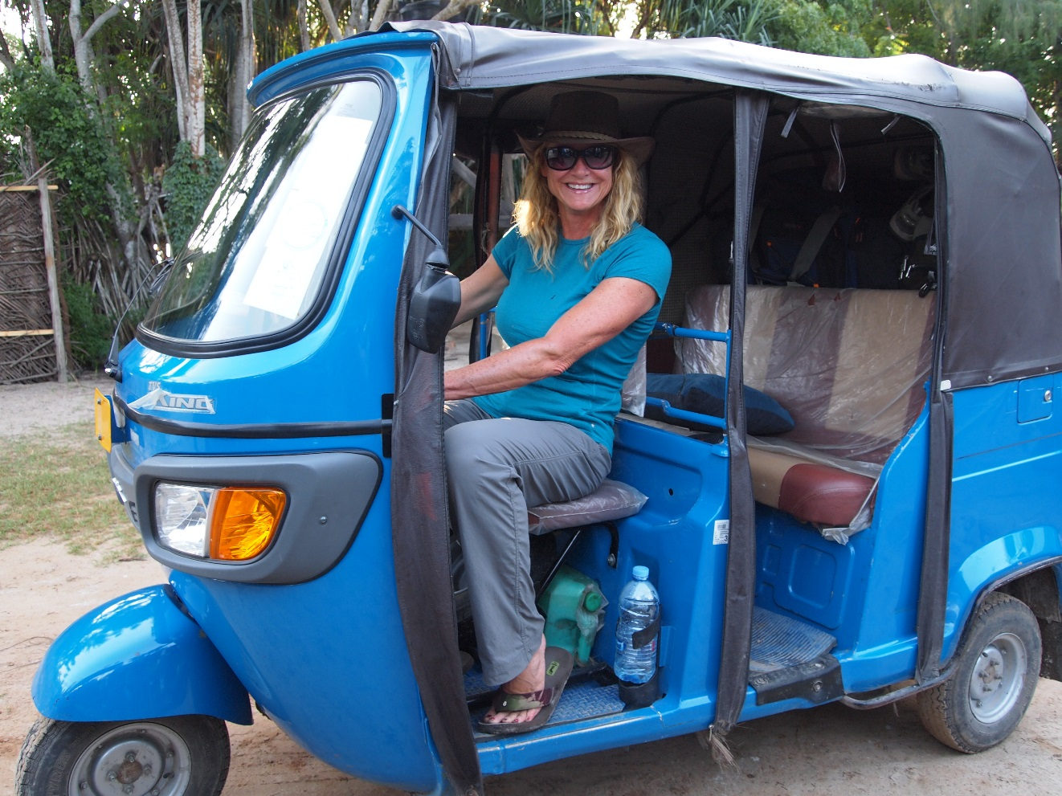

Target Users

Slide 4
Requirements
Intuitive UI
Easy to update or edit
Available offline
Notes:
We didn’t want to have the user struggle to understand the UI for the sake having a verbose system
We wanted this app to be used easily by any tourist

Slide 5
Content
Copyright-free from Zanzibarians
Easy setup and download
Local storage
Dynamic content
Notes:
Our initial data comes from our Zanzibar counterparts
We have flashcard pack functionality built into the API Michael built to easily store flashpacks
Our data is stored locally and can even be transferred via usb storage
Our content is dynamic in the sense that users can add new definitions and phrases all using JSON

Slide 6
Process
function process(effort, function(res){ console.log(“Good job!”); });
Notes:
We had a system of trying new things out and if they didn’t work then we congratulated ourselves on having tried, then we tried something else
Our initial struggles with process was communication which we eventually overcame
We saw how certain features wouldn’t necessarily fit with others that we had planned to do
-

Slide 7
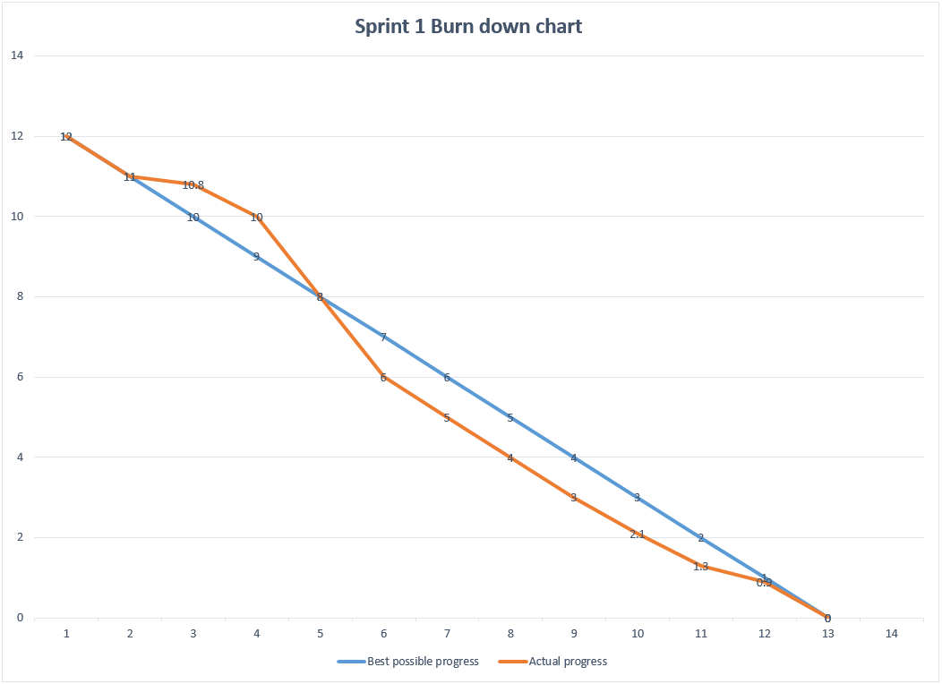

Slide 8
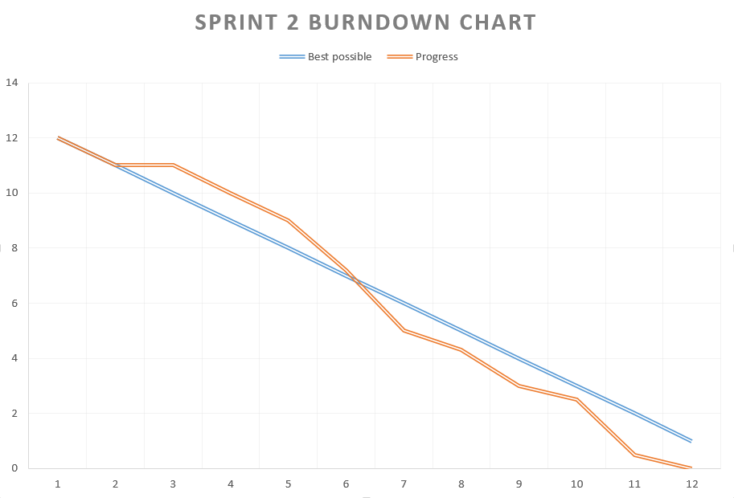

Slide 9
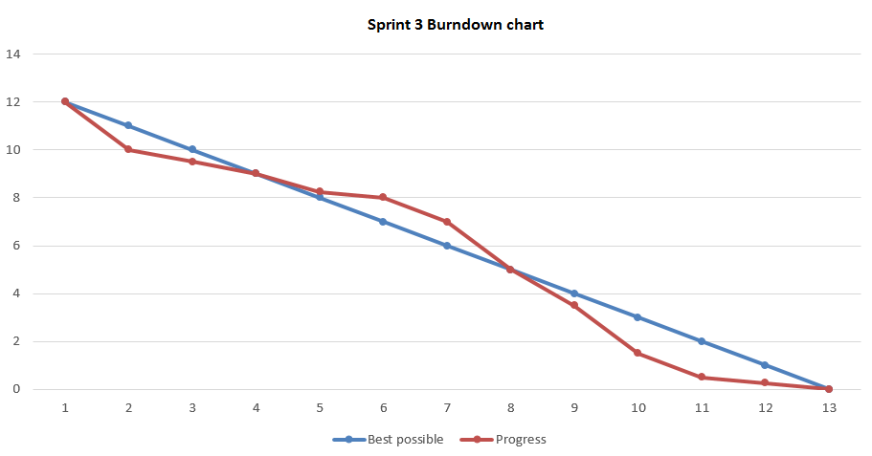

Slide 10







Technologies and Tools

Slide 11
Communications and commits
~81 Email exchanges
2 Skype sessions with Zainab
Semi-regular google hangout discussions with the Zanzibar team mates

Slide 12
User stories
Began with 7 user stories
Implemented 6
~63 hours
6 Scrum meetings
54 commits

Slide 13
Culture and assumptions
Assumed constant internet access – accounted for
Learned about family life, daily life, and average diet

Slide 14
Where we are now
Deployment in mid August
App will be free
Notes:
App will be free as to promote easy use of a necessary tool when in a foreign country

Slide 15
Learning experience
Communication
Team work
Version Control
GitHub

