Slide 1
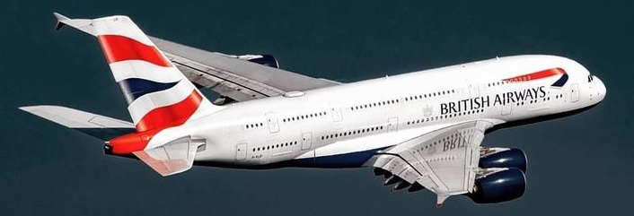
BRITISH AIRWAYS
Predicting Customer Buying Behaviour

Slide 2
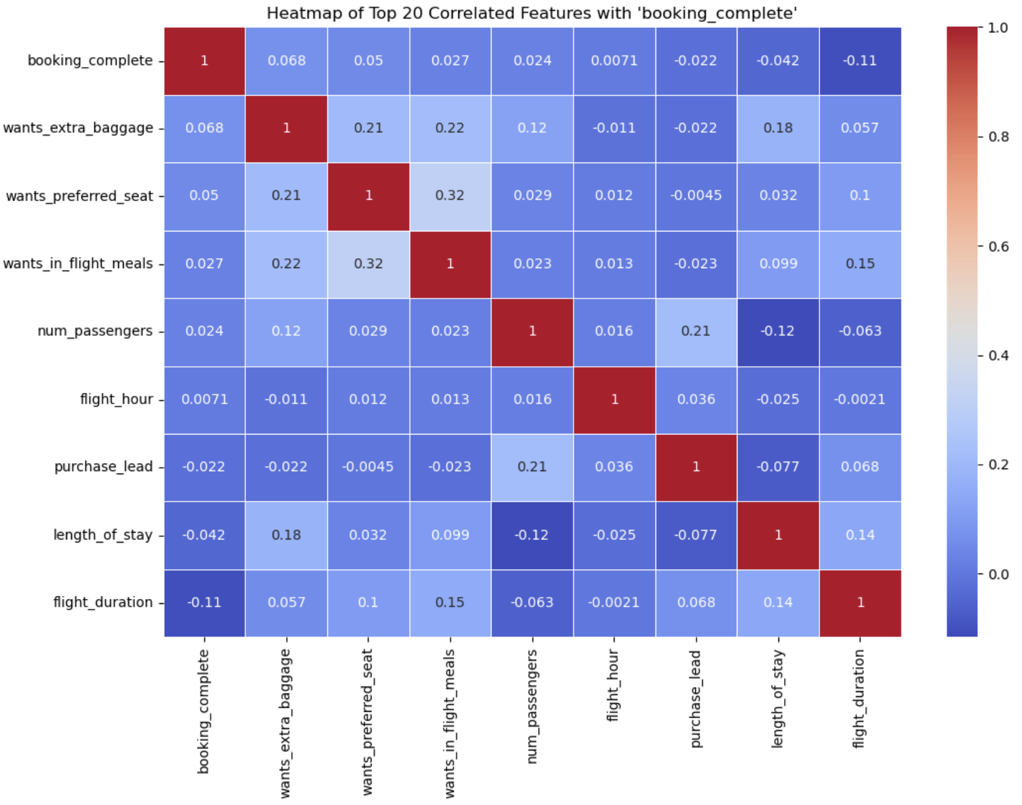
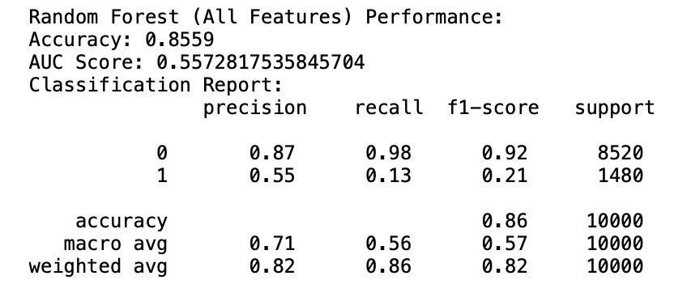
TOP CORRELATED FEATURES WITH BOOKING COMPLETE
wants_extra_baggage
wants_preferred_seat
wants_in_flight_meals
num_passengers
flight_hour
MODEL:
Random forest classifier with all features has the highest accuracy than logistic regression and Random forest with correlated features.

