Slide 1

NYC Airbnb Data Analysis
- Chandana Pacha

Slide 2
Problem Statement
Hosts encounter difficulty in accurately pricing their Airbnb listings, impacting their ability to attract guests and optimize earnings.
Guests face challenges in assessing fair pricing for Airbnb accommodations, leading to uncertainty and potentially affecting their booking decisions.

Slide 3
Objectives
Objective: Develop and compare predictive models for estimating Airbnb listing prices using linear regression techniques.
Importance: Highlight the significance of comprehending the factors influencing pricing decisions in the dynamic Airbnb market.
Evaluation: Assess the performance of both simple and multiple linear regression models in accurately predicting listing prices.
Outcome: Aim to provide hosts and guests with reliable pricing estimates, enhancing transparency and decision-making in the Airbnb ecosystem.

Slide 4
Methodology
Data Collection
Obtain Airbnb listing data
-Location
-Room Type
-Minimum Nights
-Number of Reviews
Data Preprocessing
Clean the data set by
-Removing outliers
-Transforming variables
-Handling missing values
-Converting numerical variables
Exploratory Data Analysis
Explore relationship between predictor variables and target variables through visualizations
Model Evaluation
Assess models performance using metrics such as R- squared, MSE and visual inspection of residuals
Model Building
Develop simple and multiple linear regression models to predict listings prices

Slide 5
Data Overview
This New York City Airbnb data is collected from Kaggle datasets which is collected in 2019.
https://www.kaggle.com/datasets/dgomonov/new-york-city-airbnb-open-data
The Dataset contains 48895 observations and 16 independent variables.

Slide 6
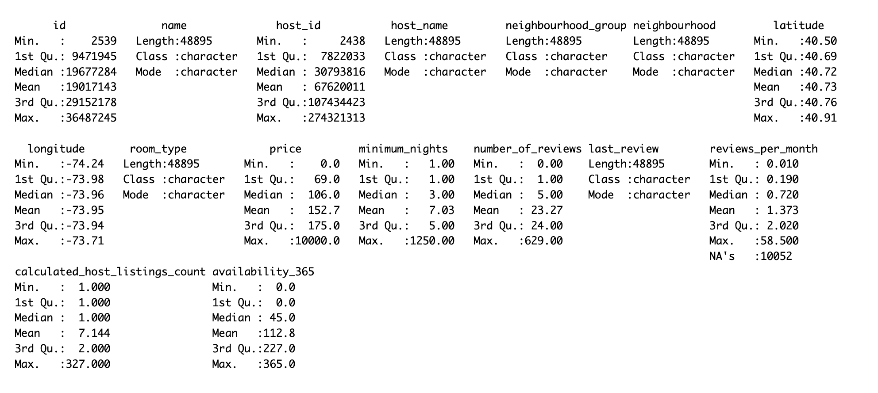
Summary Statistics

Slide 7
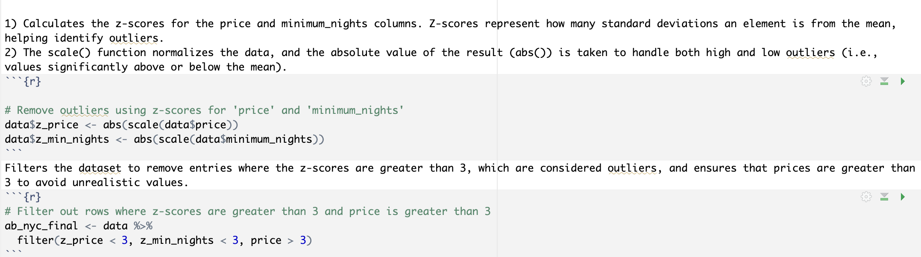
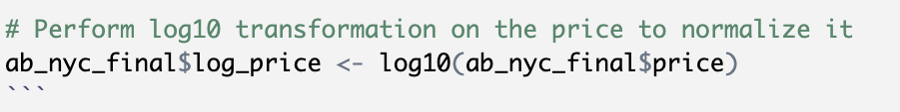
Data Preprocessing
Removing outliers using z scores
Perform Log transformation

Slide 8
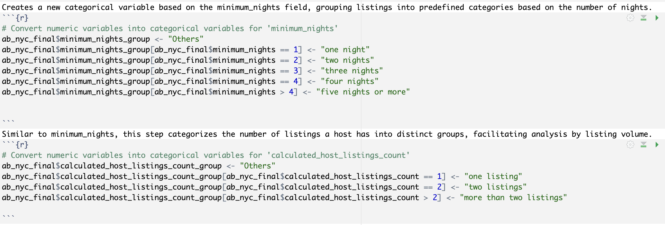
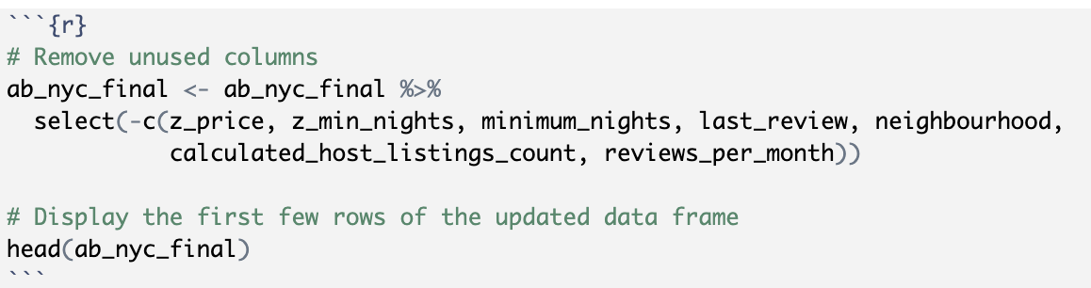
Converting numerical variables into categorical variables.
Remove unused columns.

Slide 9
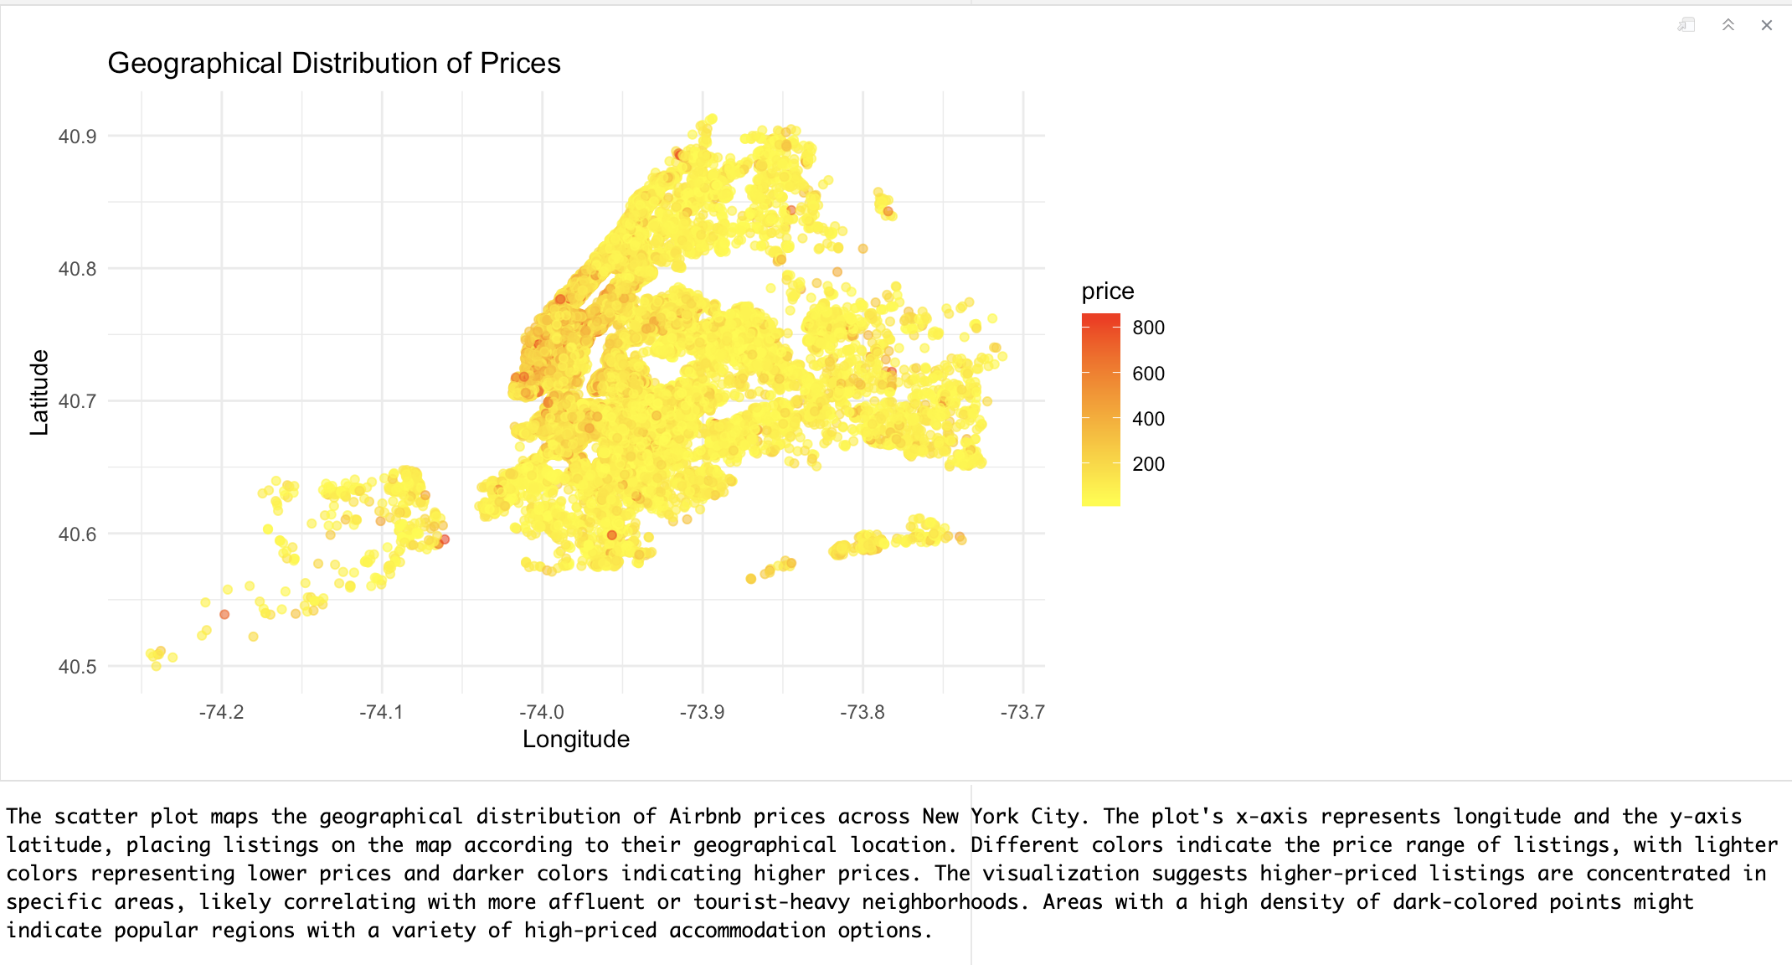
Exploratory Data Analysis

Slide 10
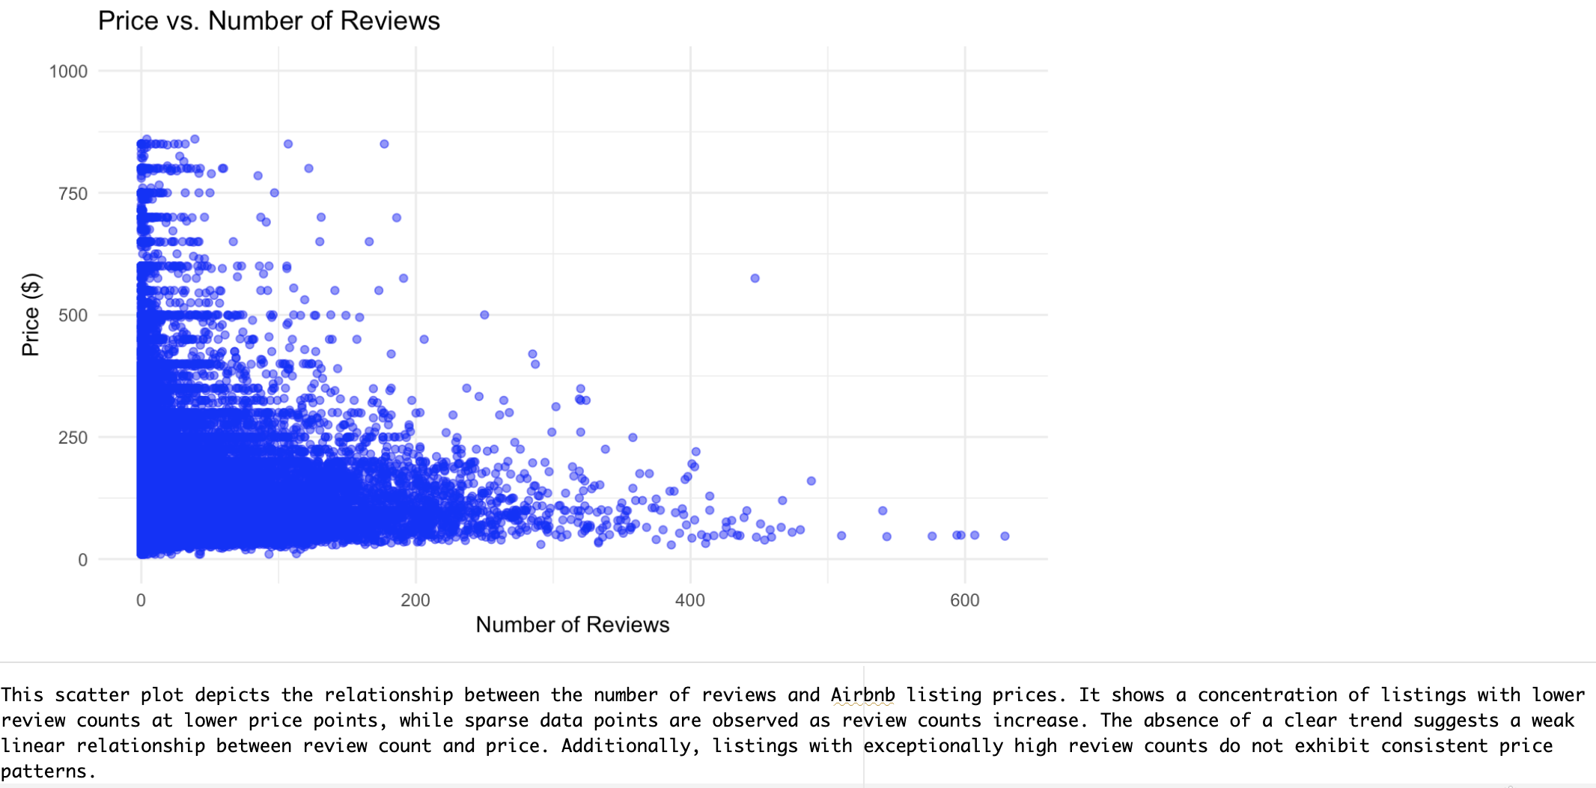

Slide 11
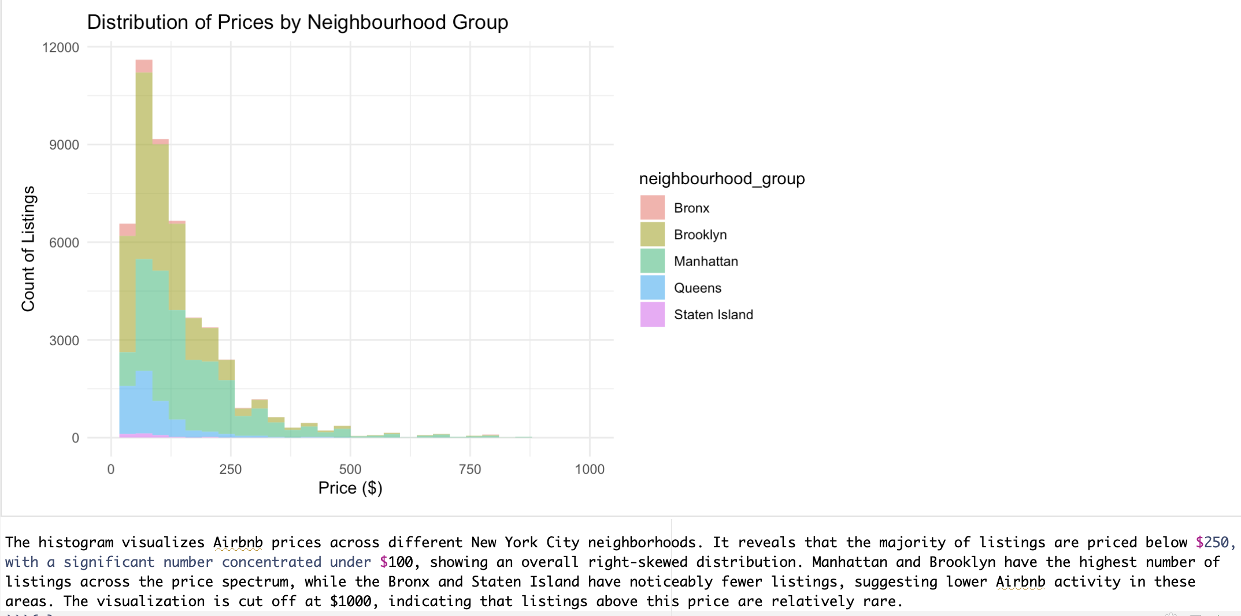

Slide 12
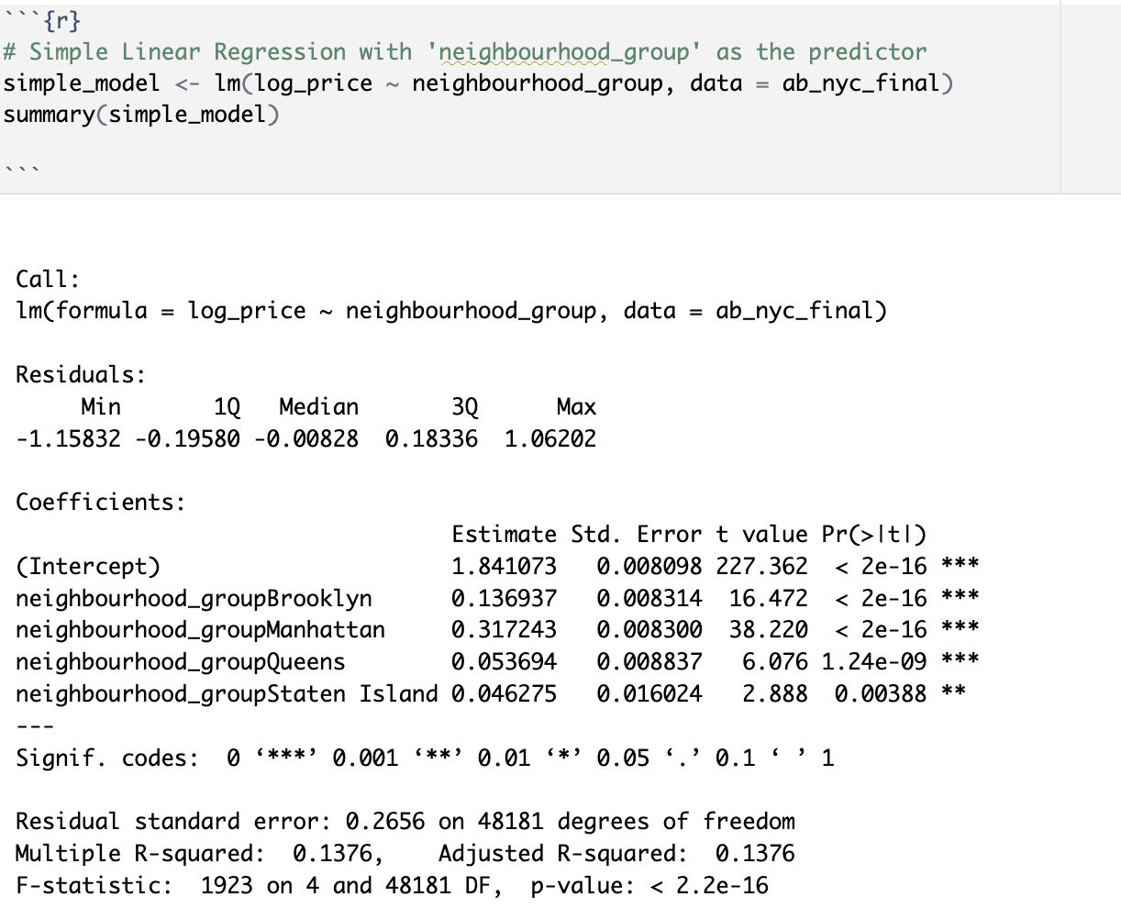
Model Building
Linear Regression Model

Slide 13
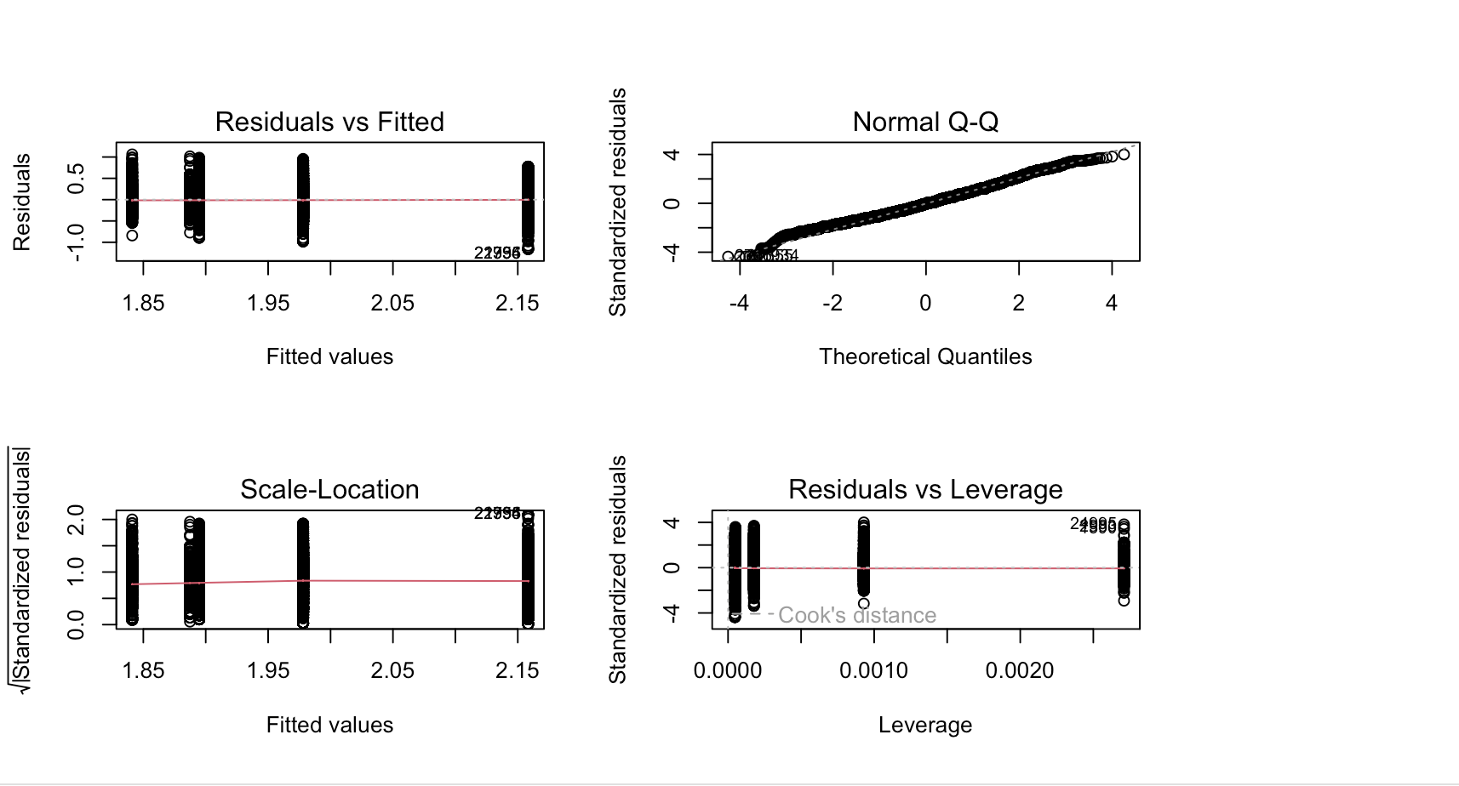
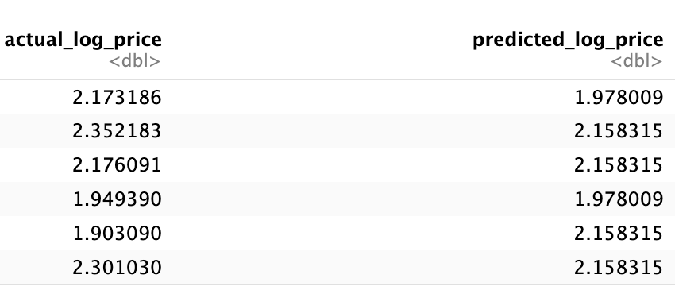

Slide 14
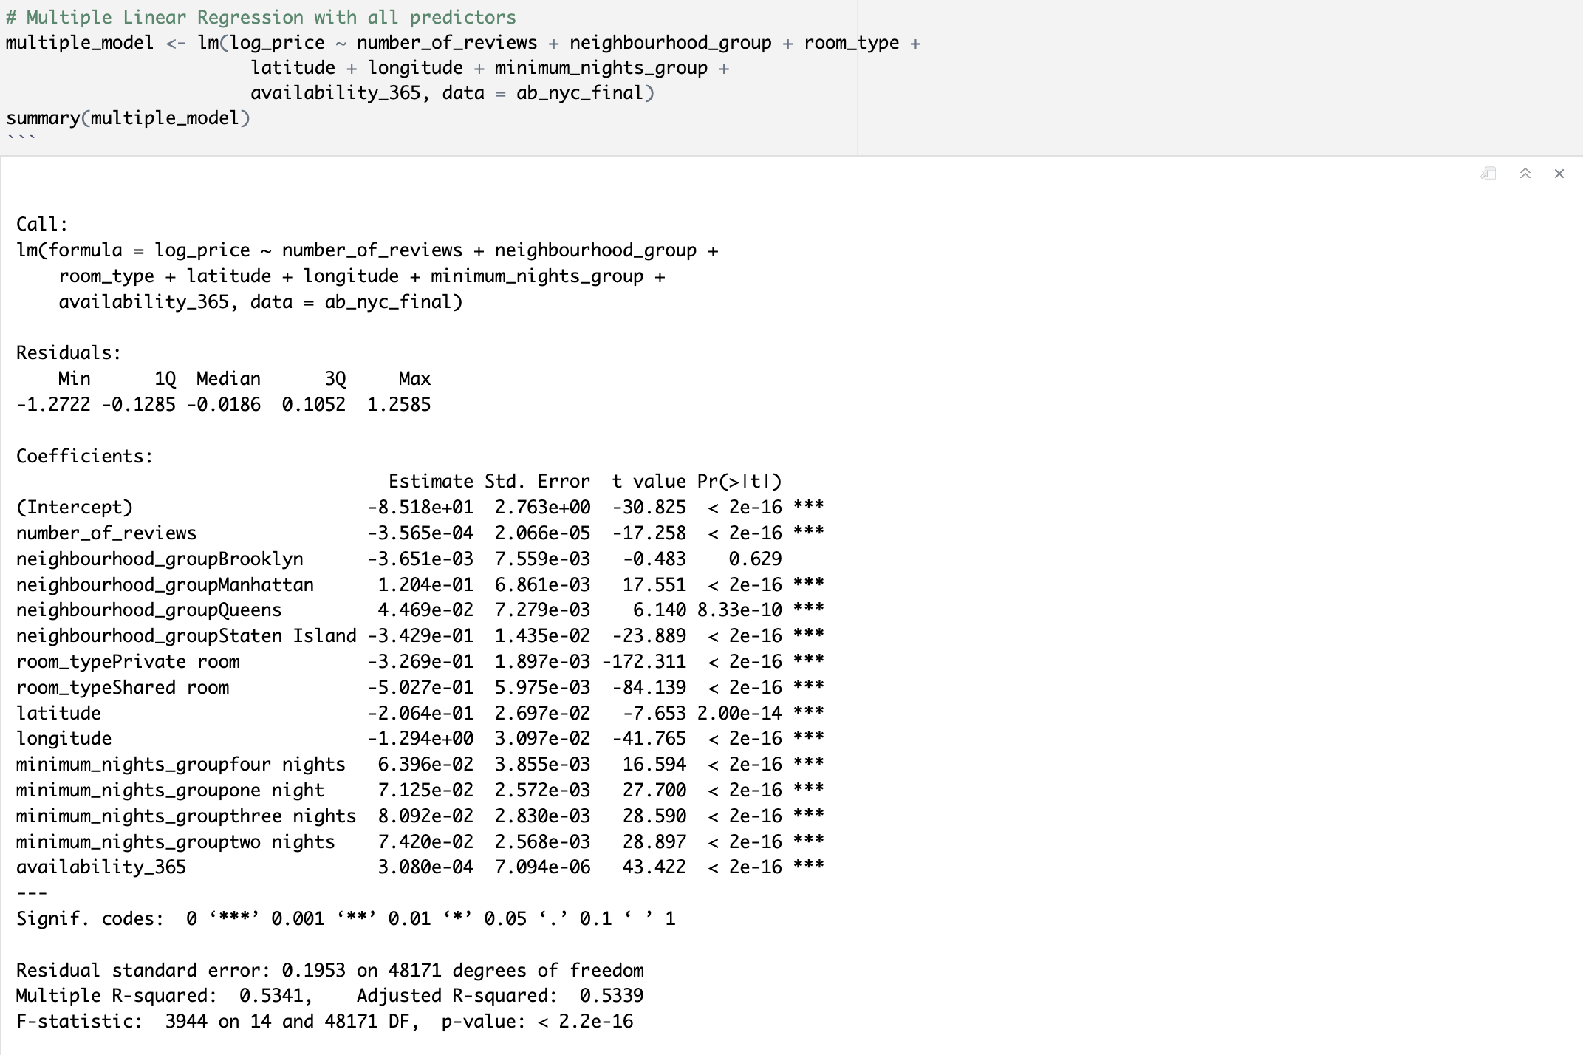
Multiple Linear Regression Model

Slide 15
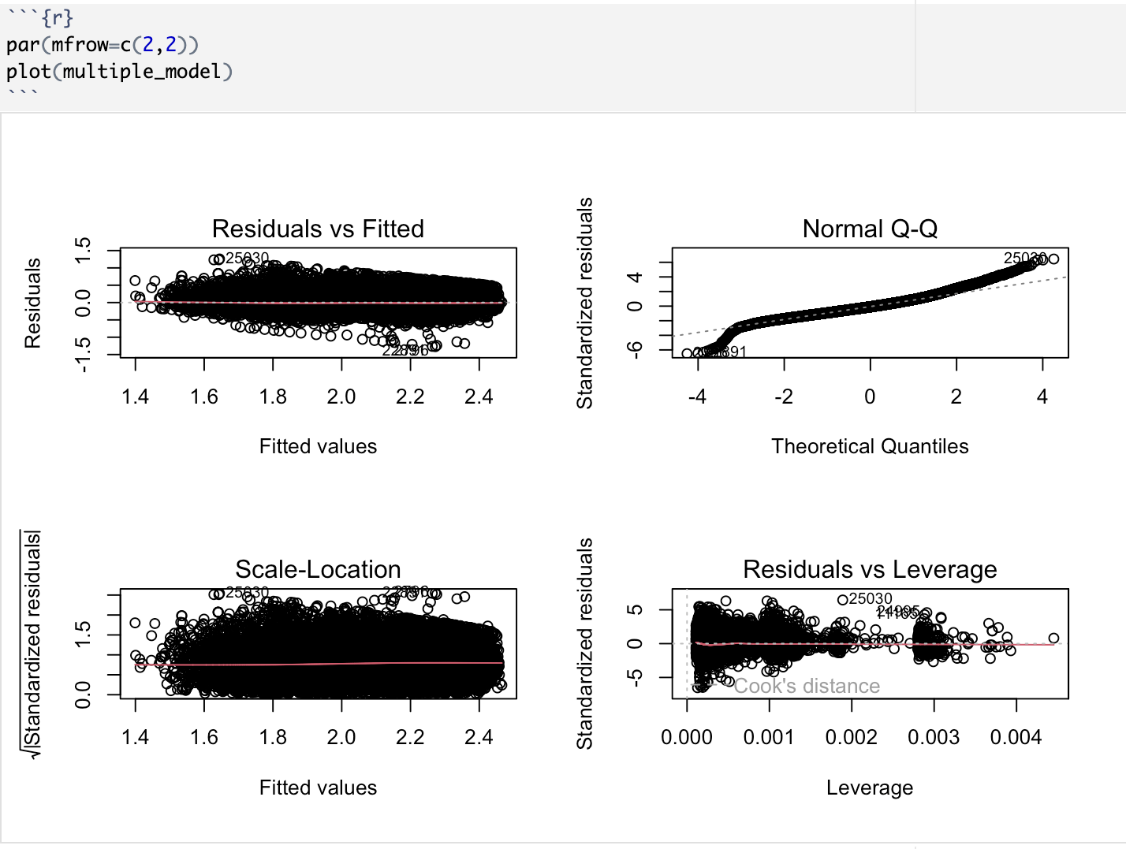
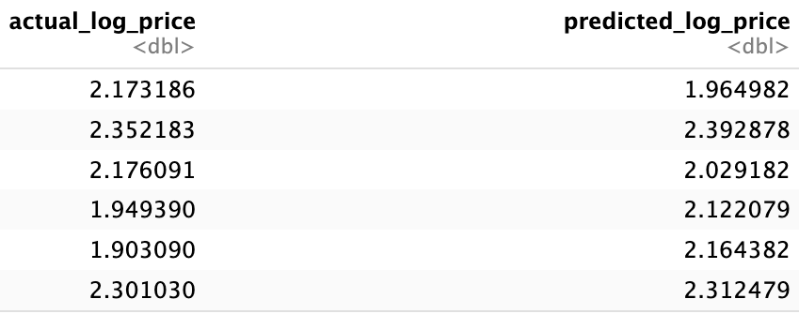

Slide 16
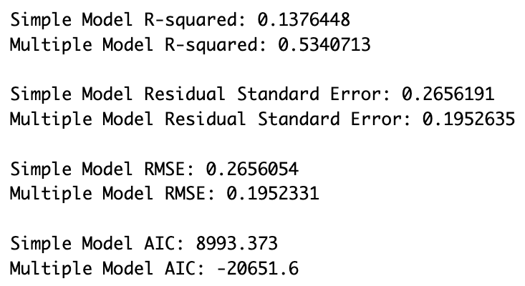
Model Evaluation
Assessing both Model’s performance using R- Square values, RMSE values, AIC value.

Slide 17
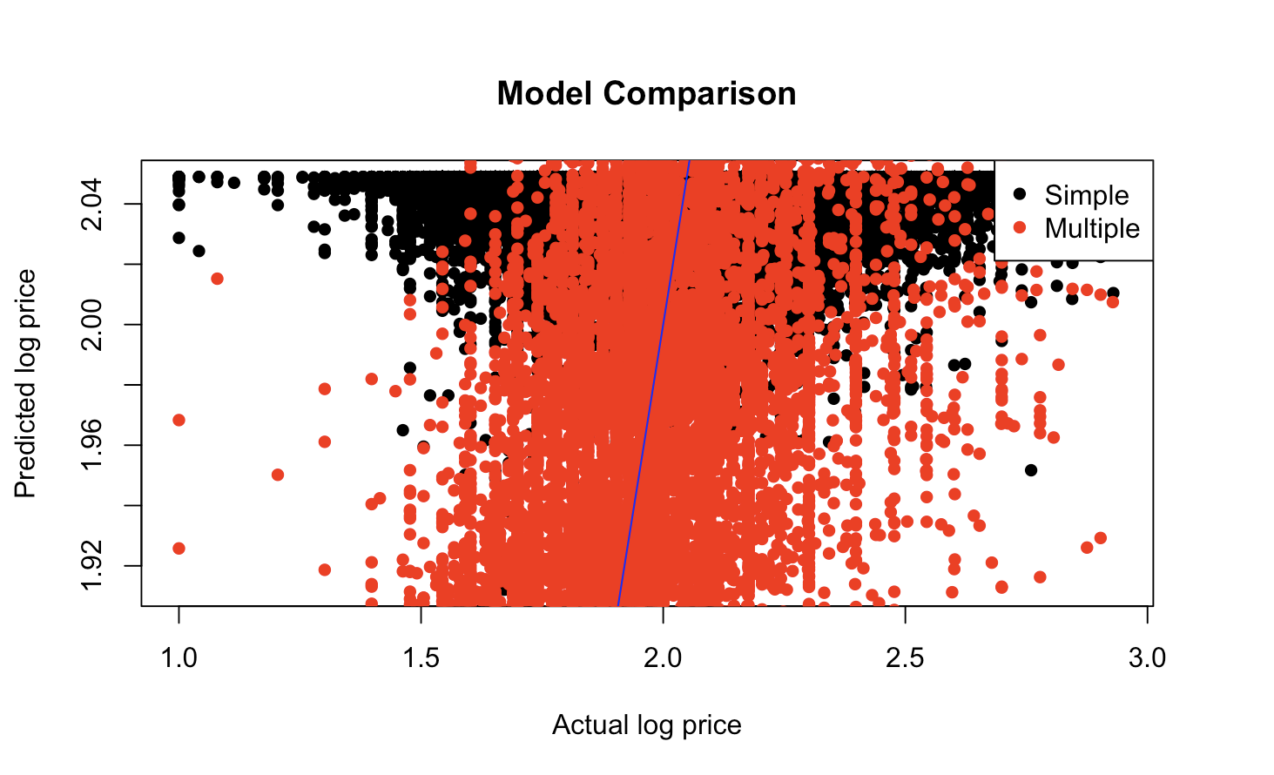
Comparing the actual and predicted values for both the models using plot.

Slide 18
Final Model
lm(formula = log_price ~ number_of_reviews + neighbourhood_group + room_type + latitude + longitude + minimum_nights_group + availability_365, data = ab_nyc_final)

Slide 19

Thank You

