Slide 1


Customer Shopping Trends Dashboard Overview
In depth Analysis using Tableau
-DV Pair 7
Chandana Pacha, Ramineni Meghana

Slide 2
Introduction
Purpose: Introduce our Tableau dashboard designed to analyze key customer shopping trends.
Insight into Metrics: The dashboard helps visualize critical metrics such as sales volume, revenue, and customer satisfaction.
Strategic Aid: It serves as a strategic tool for decision-makers to guide business initiatives and optimize operations.
Outcome: Enhances customer engagement by leveraging data-driven insights to improve overall business performance.

Slide 3
Objectives
Identify key demographics and analyze their specific shopping behaviors.
1
Understand how seasonal, geographical, and categorical factors influence purchases.
2
Assess the impact of marketing efforts like promotions and discounts on sales.
3

Slide 4

Target Audience for the Analysis
These insights are crucial for
1. Marketing executives
2. sales managers
3. product development teams.
Visual data provides a common ground for discussion and strategy formulation across departments.

Slide 5

Key indicators
We track several key indicators through our dashboard:
1) Previous Purchases
2) Purchase Amount (USD)
3) Number of Customers
4) Average Review Rating.

Slide 6
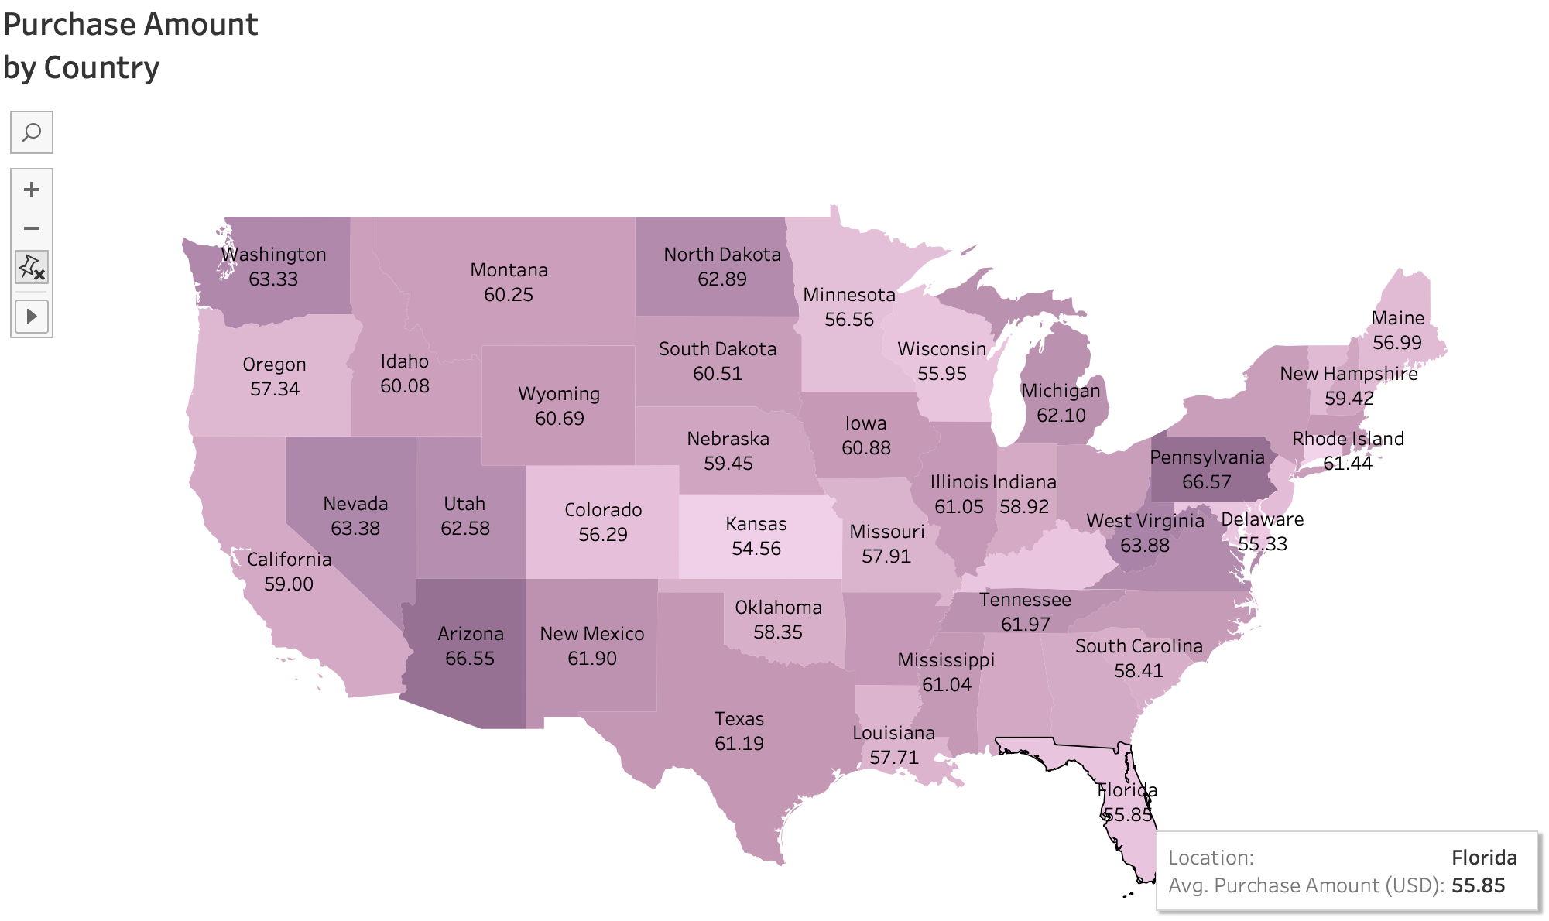
Visualizing Purchase Amount by Country
This map visualization illustrates the Purchase Amount (USD) geographically.
It highlights which regions generate the most revenue, allowing us to identify strong markets and areas with potential for growth.
Insights from this graph help tailor regional marketing strategies and resource allocation.

Slide 7
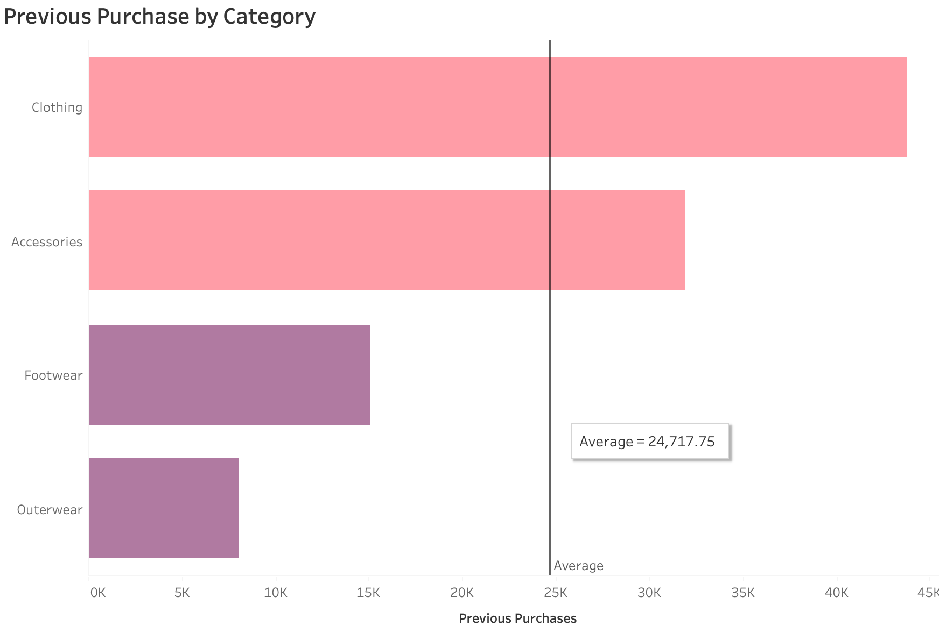
Analyzing Previous Purchases by Category
A bar graph displays the number of Previous Purchases by Category.
This visualization helps us understand product popularity and detect seasonal buying trends.
The graph provides a clear picture of which categories are consistently preferred by customers, guiding inventory management and promotional campaigns.

Slide 8
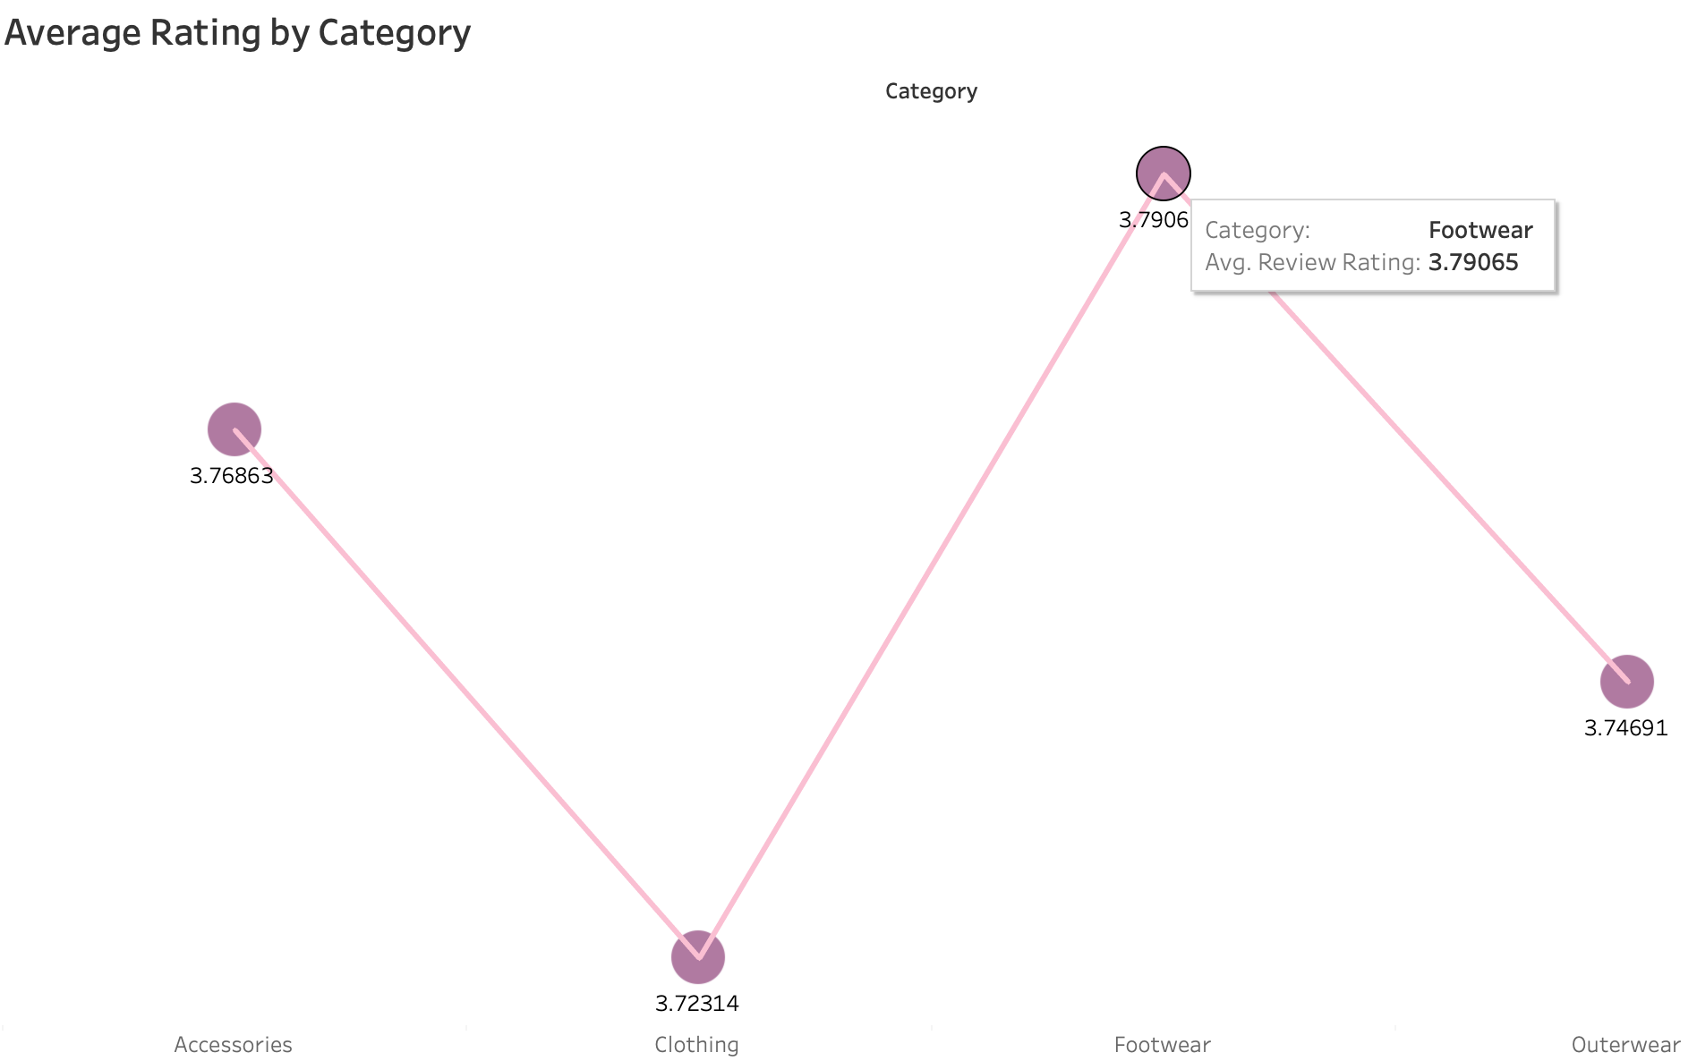
Trend Analysis with Average Rating by Category
A line graph presents the Average Review Rating across different product categories over time.
Peaks and troughs indicate categories that are well-received or require improvement.
This continuous feedback through visual trends is crucial for quality control and product development.

Slide 9
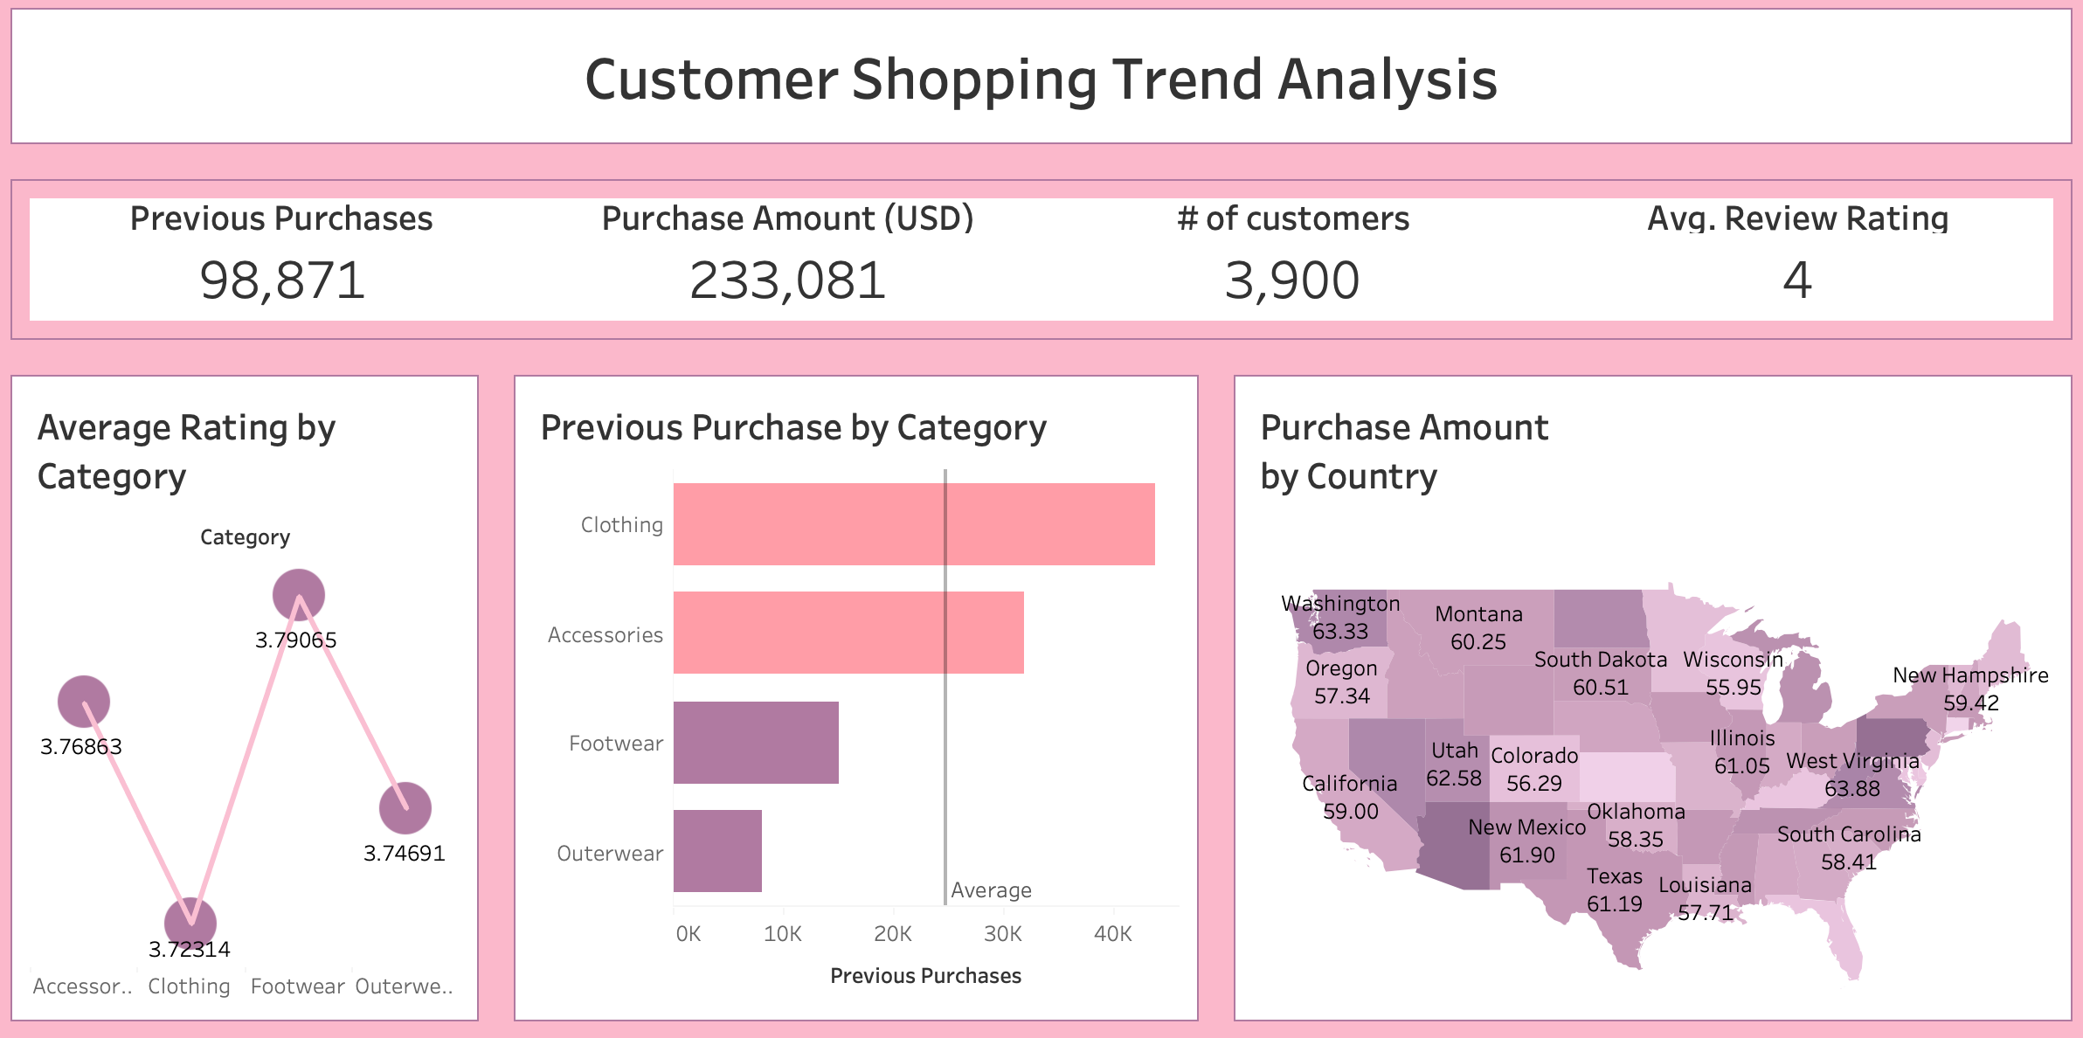
dashboard

Slide 10
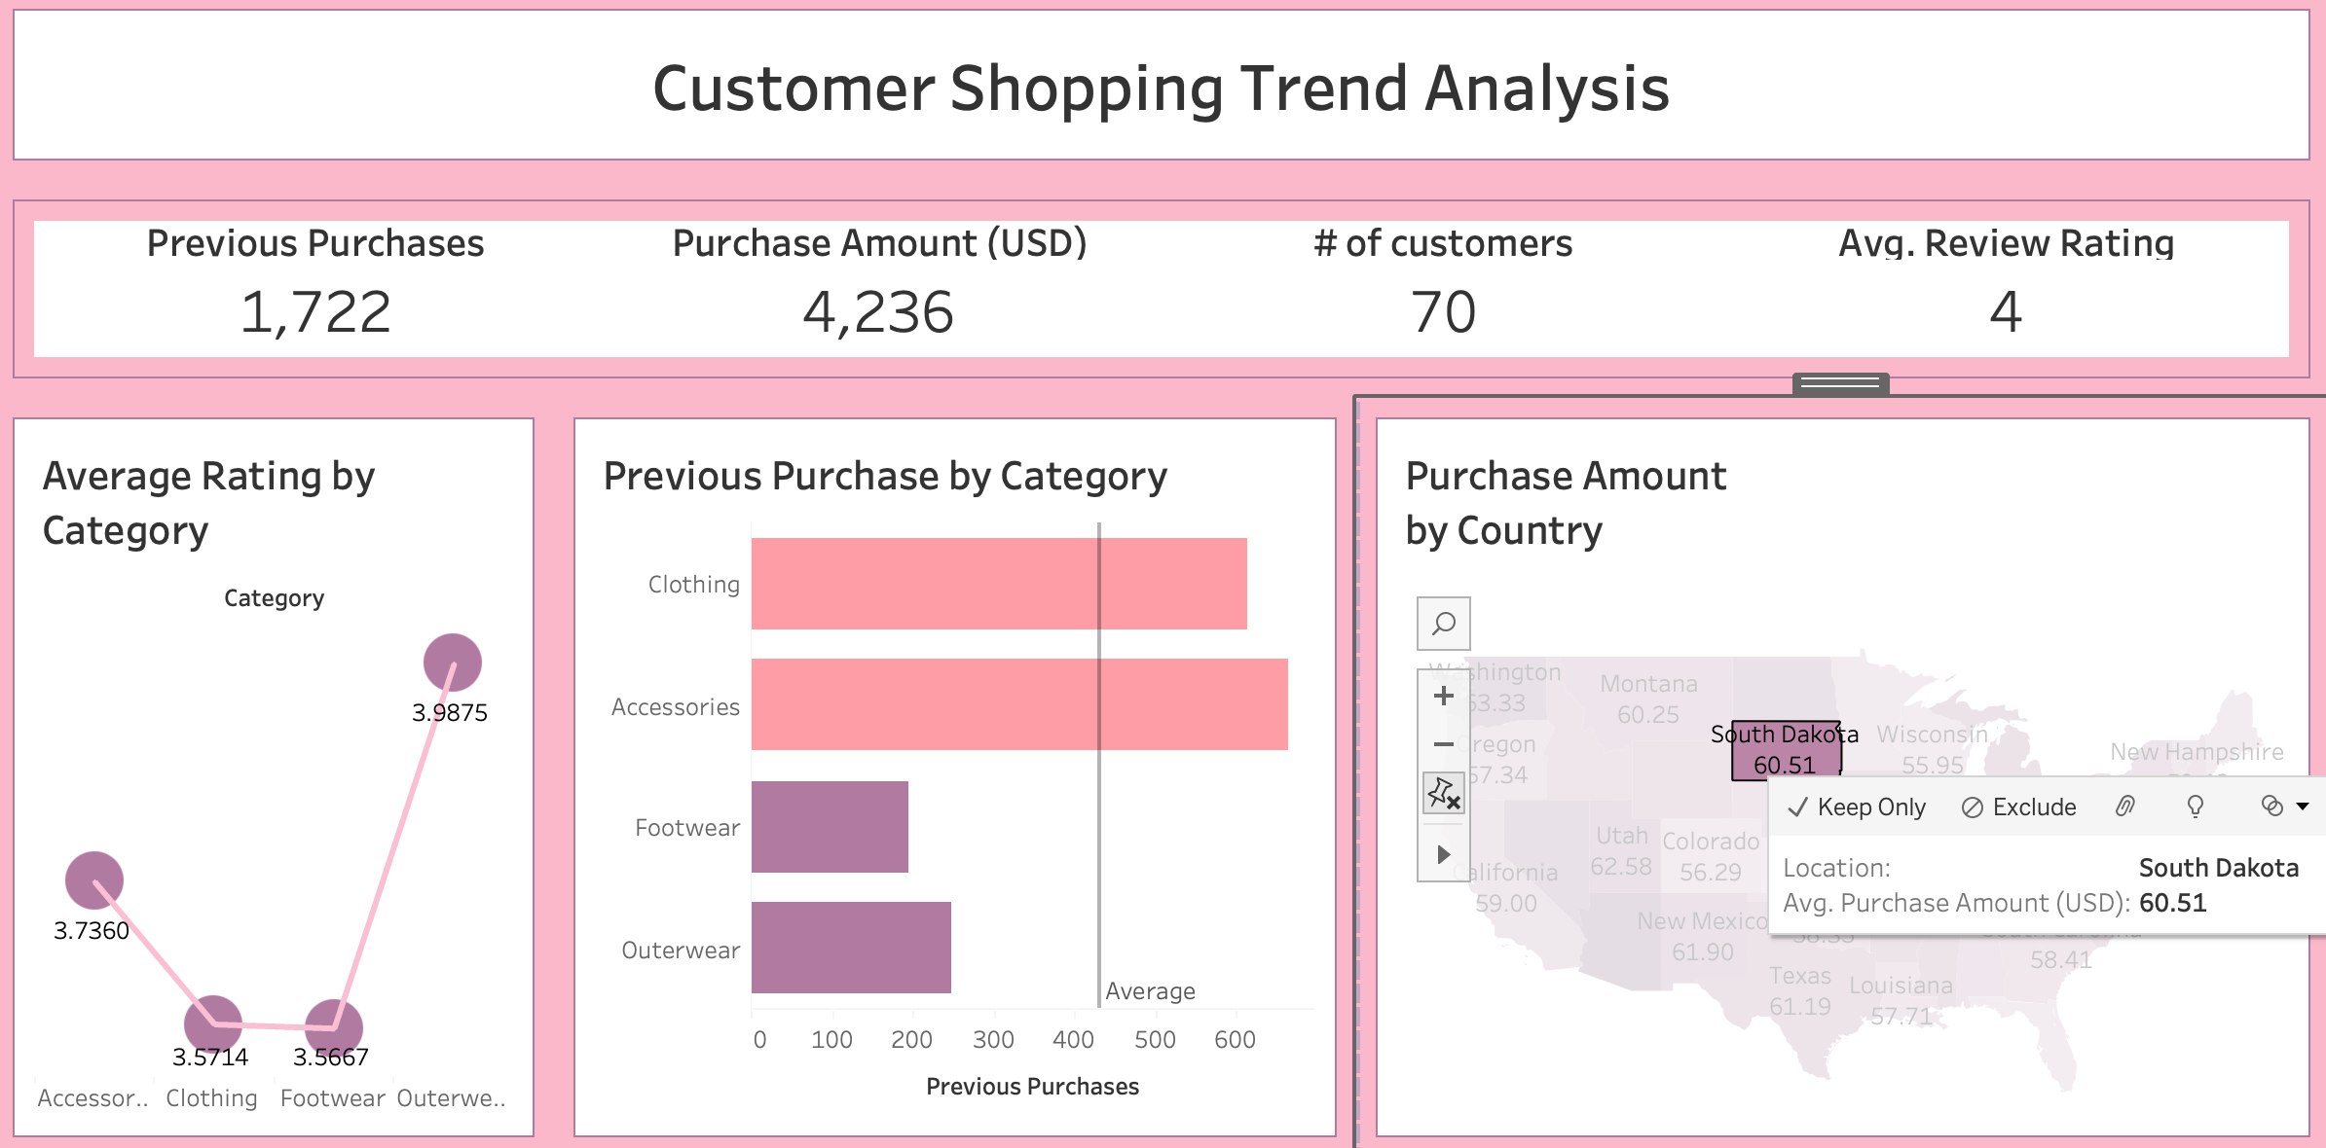
Dashboard showing filters
These filters enhance the dashboard’s usability by providing tailored insights into customer shopping trends.

Slide 11
Conclusion
Clothing and accessories dominate previous purchases, indicating strong market preference and potential areas for promotional focus.
California and Texas are high-revenue states, highlighting them as key markets for targeted sales strategies and potential expansion.
The average rating across categories shows variability, suggesting a need for product quality reviews and customer satisfaction improvements in specific areas.
Customer engagement patterns and spending behaviors presented through the dashboard support data-driven decision-making, optimizing marketing and product development efforts.

Slide 12

Thankyou

