Slide 1
Heart Sound Classification Using LSTM
Maryam Eskandari

Slide 2

Introduction
Heart auscultation: the primary tool for screening and diagnosis in primary health care
Stethoscopes to capture heart sound
Heart sound as PhonoCardioGram (PCG) data for diagnostic purposes
Goal: Diagnose murmur from normal heart sound

Slide 3
Data
One or more heart sound recordings for 1568 patients from auscultation locations
Pulmonary valve (PV),
Aortic valve (AV),
Mitral valve (MV),
Tricuspid valve (TV),
And other (Phc)
The recordings were collected sequentially (not simultaneously) from different auscultation locations using a digital stethoscope.
The number, location, and duration of the recordings vary between patients.

Slide 4
Data Preprocessing
PCG data were originally sampled to 4000 Hz
Each PCG was resampled to 1000 Hz
To reduce the data size
It also maintain useful information
Band-pass filtered between 25 Hz and 400 Hz
0-100 Hz,
100-200 Hz,
200-300 Hz,
300-400 Hz.
And then pre-processed to remove any spikes in the PCG

Slide 5
Data Preprocessing
There are 5 recordings per patients
Min length 7 seconds
Max length>30 seconds
We produced 4 band-pass filters per each channel
Therefore, 20 recording per patient (at most)
For each recording, it is split into windows of 1 second length with 0.5 second overlap

Slide 6
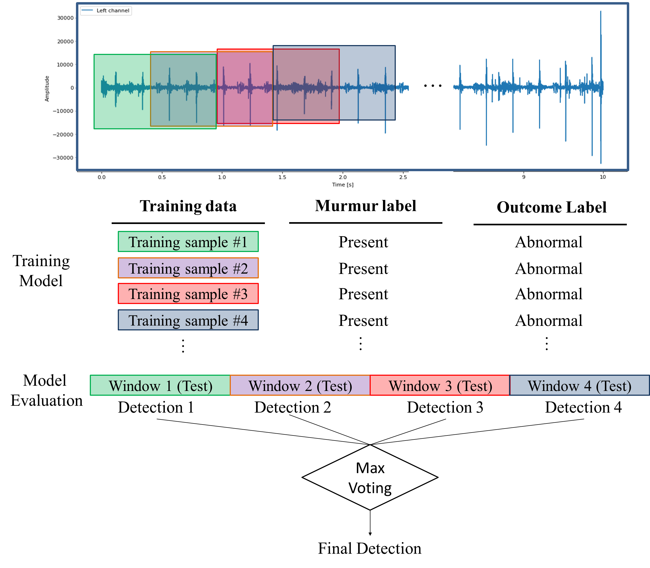

Slide 7
Approaches
XGBoost over Extracted Features
LSTM over preprocessed signals (signals not extracted features)
BiLSTM over preprocessed signals
GRU over preprocessed signals
Parallel LSTM over preprocessed signals

Slide 8
Feature extractions
We use two class of features extracted from 20 recordings and multiple windows (LibRosa library were used for feature extraction)
Time Domain Features
Frequency Domain Features

Slide 9
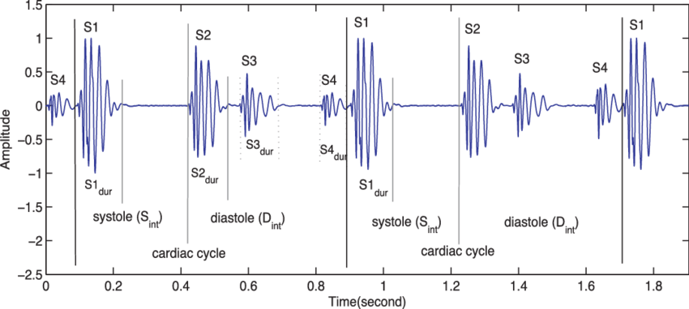
Time-domain Features
Mean and standard deviation (SD) of the following parameters were used as time-domain features (36 features):
PCG intervals:
RR intervals,
S1 intervals,
S2 intervals,
systolic intervals,
diastolic intervals,
ratio of systolic interval to RR interval of each heart beat,
ratio of diastolic interval to RR interval of each heart beat,
ratio of systolic to diastolic interval of each heart beat.

Slide 10
Time-domain Features (Cont.)
Average and STD of PCG amplitudes:
ratio of the mean absolute amplitude during systole to that during the S1 period in each heart beat,
ratio of the mean absolute amplitude during diastole to that during the S2 period in each heart beat,
skewness of the amplitude during S1 period in each heart beat,
skewness of the amplitude during S2 period in each heart beat,
skewness of the amplitude during systole period in each heart beat,
skewness of the amplitude during diastole period in each heart beat,
kurtosis of the amplitude during S1 period in each heart beat,
kurtosis of the amplitude during S2 period in each heart beat,
kurtosis of the amplitude during systole period in each heart beat,
kurtosis of the amplitude during diastole period in each heart beat

Slide 11
Frequency-domain Features
The power spectrum was estimated using a Hamming window and the discrete-time Fourier transform.
The median power across 4 frequency bands was calculated.
Then, the mean of the median power of the 4 frequency bands were used as frequency-domain features.
Additionally, mel-frequency cepstral coefficient (MFCC) were extracted

Slide 12
Results of XGBoost on extracted features
 | Absent | Present | Unknown
Absent | 138 | 0 | 0
Present | 29 | 6 | 1
Unknown | 10 | 2 | 2
 | Absent | Present | Unknown
Absent | 100% | 0% | 0%
Present | 81% | 17% | 3%
Unknown | 71% | 14% | 14%
Overall Accuracy = 78%

Slide 13
Training folds as well as validation and test folds for developing five models for murmur detection
To have a more generalizable model, a stratified 5-fold cross-validation was used.
Model | Training Folds | Validation Fold | Test Fold
1 | 0,1,2 | 3 | 4
2 | 1,2,3 | 4 | 0
3 | 2,3,4 | 0 | 1
4 | 3,4,0 | 1 | 2
5 | 4,0,1 | 2 | 3

Slide 14
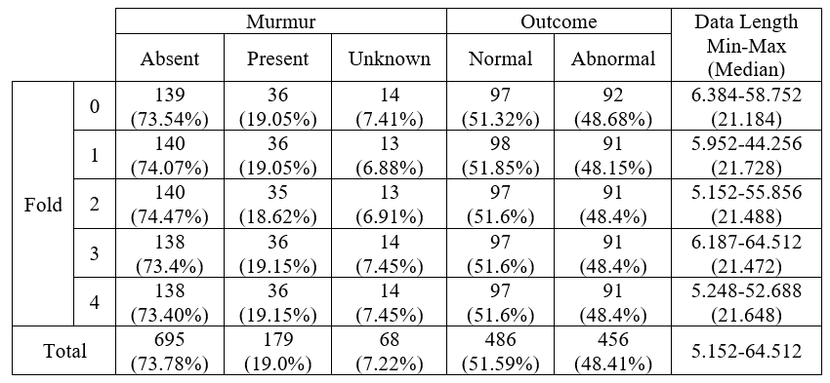
Data distribution after stratified 5-fold splitting

Slide 15
Accuracy on Preprocessed Signals
Test | LSTM | BiLSTM | GRU | Parallel LSTM
Fold 0 | 80 | 81 | 77 | 82
Fold 1 | 79 | 82 | 79 | 80
Fold 2 | 83 | 80 | 81 | 79
Fold 3 | 79 | 78 | 77 | 83
Fold 4 | 80 | 78 | 80 | 81
Average | 80.2 | 79.8 | 78.8 | 81

Slide 16
Parallel LSTM vs. XGBoost Fold 4 as test, Fold 3 as Val
Parallel LSTM
XGBoost
 | Absent | Present | Unknown
Absent | 100% | 0% | 0%
Present | 64% | 31% | 6%
Unknown | 57% | 21% | 21%
 | Absent | Present | Unknown
Absent | 100% | 0% | 0%
Present | 81% | 17% | 3%
Unknown | 71% | 14% | 14%
Accuracy: 81%
Accuracy: 78%
Issue: Still biased toward majority class

Slide 17
Solving biases toward majority class issue
Solution: Using class weights in the custom loss function
Results:
Parallel LSTM Before
Parallel LSTM After
 | Absent | Present | Unknown
Absent | 100% | 0% | 0%
Present | 64% | 31% | 6%
Unknown | 57% | 21% | 21%
 | Absent | Present | Unknown
Absent | 91% | 9% | 1%
Present | 33% | 61% | 6%
Unknown | 29% | 36% | 36%
Accuracy: 81%
Accuracy: 81%
No Change in accuracy but much more balanced results across classes

Slide 18
Another issue
Data
Data length is too long
Median 21 seconds
4000 hz
Murmur
The murmur can be detected in much smaller frequency (even 500 hz in some studies) too.
Solution
Resample the signals to lower frequency

Slide 19
Results of parallel LSTM after resampling
Different resampling were tested such as 2000 hz, 1000 hz, 800 hz, 500 hz
800 hz performed the best
Parallel LSTM After
 | Absent | Present | Unknown
Absent | 92% | 7% | 1%
Present | 28% | 69% | 3%
Unknown | 43% | 21% | 36%
Accuracy: 84%

Slide 20
Thanks

