Slide 1
Protein Secondary Structure Prediction (PSSP) Using Conditional Random Fields (CRF)
CSC 696H Fall’22 Final Project Presentation
(Moyeen Uddin)

Slide 2
Outline
1. Problem Definition
2. Background
3. Graphical Model
5. Things Learned
6. Progress and Ongoing Task

Slide 3
Problem Definition:
Protein Secondary Structure Prediction
Input: A sequence of Amino Acids
(eg: NISQHQCVKKQCPQNSGCFRHLDEREEC…)
Output: For each position, a label (from one of 3 or 8 chars)
(eg: HETHECGCE…..)
Q3: {helix (H), strand (E), and coil (C)} or
Q8: {helix (G), α-helix (H), π-helix (I), β-stand (E), bridge (B), turn (T), bend (S), and others (C)}
Parts of Speech Tagging
Input: Sequence of Words
(eg: “Reality is probabilistic…”)
Output: For each word, a parts of speech tag
(eg: <Noun> <Verb> <Adjective> …)

Slide 4
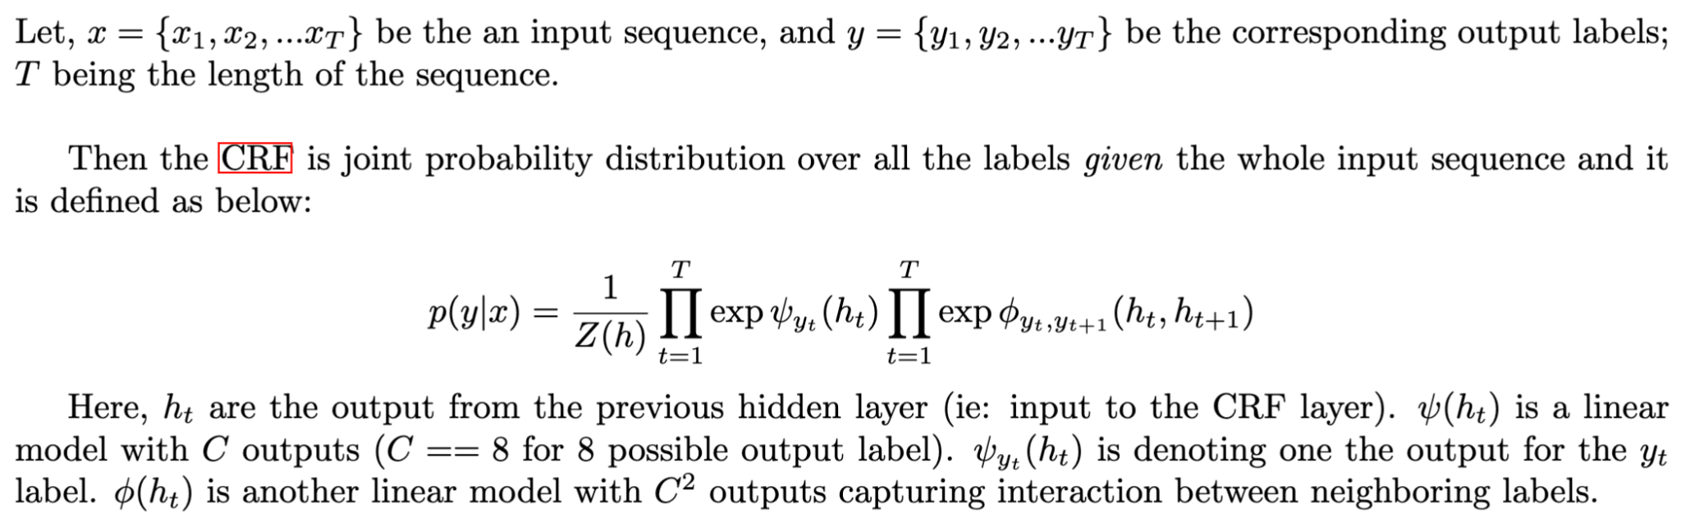
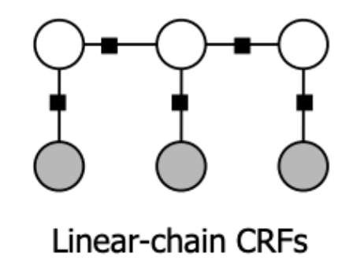
CRF: Definition

Slide 5
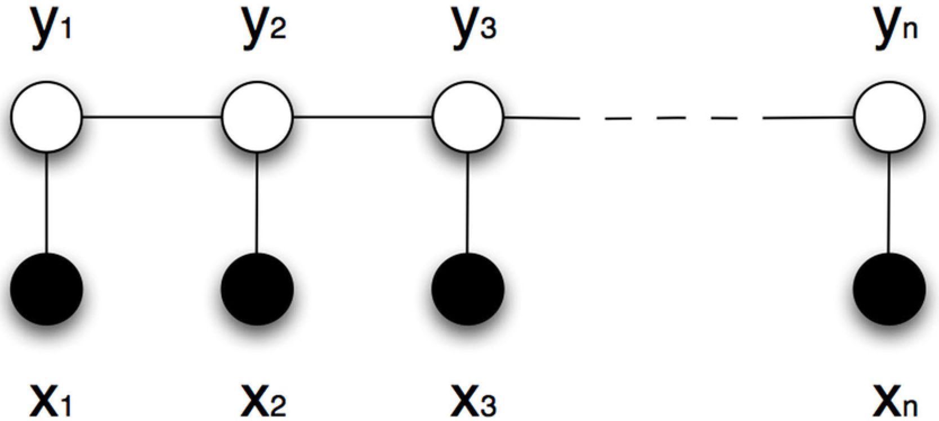
Label Prediction
During training, for each input point (x, y), the log-partition function Z has to be recalculated (polynomial using belief propagation)
During testing
Global:
Most Probable Sequence:
argmax_{𝘺} 𝑷(𝘠 | 𝑿)
(with Viterbi Decoding Algorithm)
Local:
Marginal Probability:
𝑷(𝘺ᵢ | 𝑿):
(eg: using sum-product algorithm in factor graph)
Notes:
Ref: https://www.researchgate.net/figure/Linear-chain-conditional-random-fields-model-Black-nodes-represent-observable-values_fig20_263324470

Slide 6
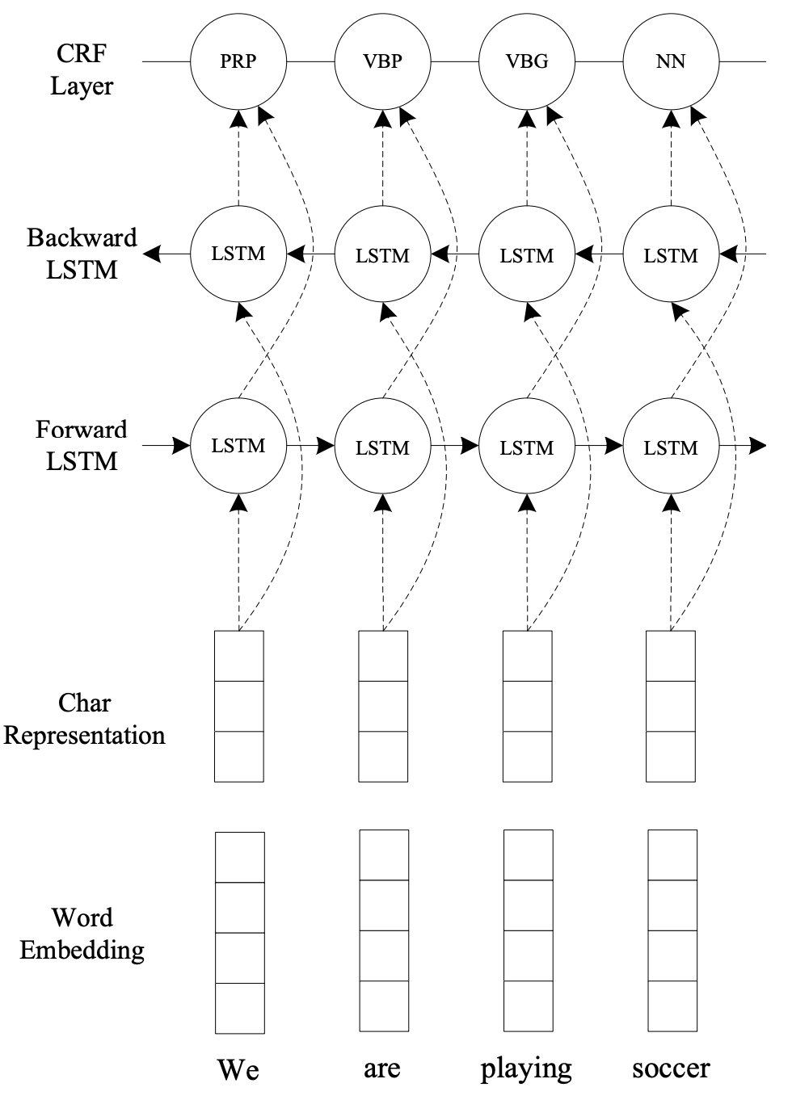
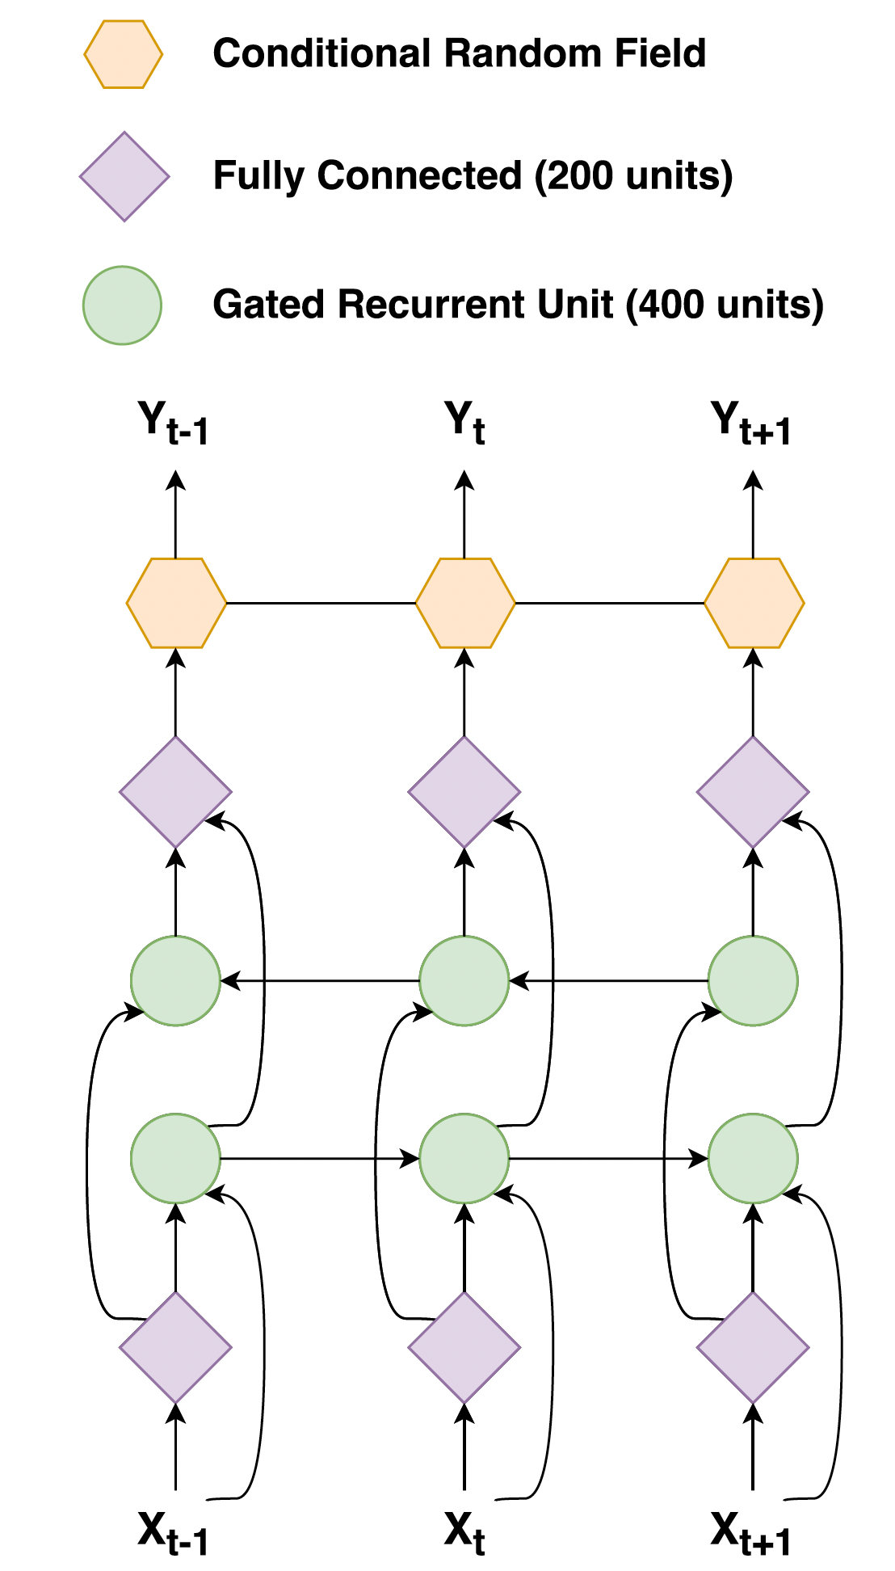
Architecture: BiRNN+CRF
(Johansen et al., 2017)
(Ma & Hovy, 2016)

Slide 7
Concerns
The Bidirectional RNN structure is supposed to already capture neighboring context
However, nothing is explicitly specified about the range/spread of this neighborhood.
And the context is derived from input sequence. We wish to have context on labels as well.
Motivation: With context-based approach, it might be possible to explicitly specify to put extra emphasis on specific length neighborhood on both side based on which label it is
ie: incorporating insights from domain knowledge (eg: window of 65 steps)

Slide 8
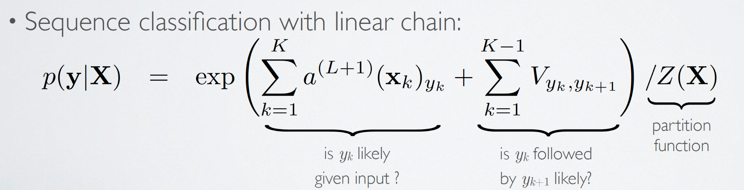
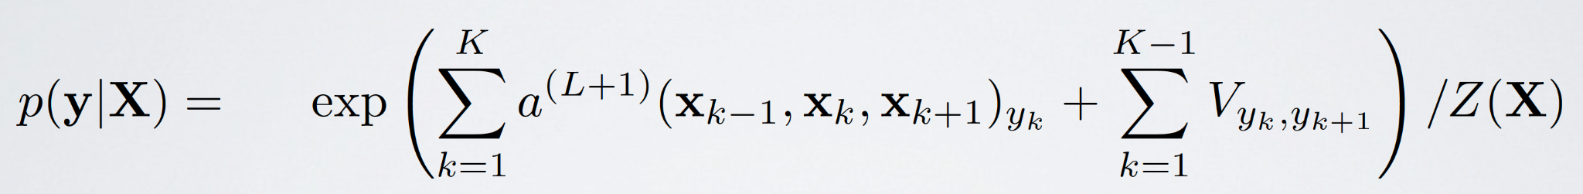
Linear Chain CRF
Adding a Context Window:

Slide 9
Progress
Data Preprocessing Focused:
Still working on a new encoding scheme for input features ‘x’ to feed to models
Experimental setup in HPC:
A CRF-based tool:
BiRNN-CRF (Johansen et al., 2017)
Tensorflow v1
A non-CRF-based tool:
CNN/BiLSTM+Attention (Drori et al., 2018)
Adding context/extra chains in such a way that belief propagation still works

Slide 10
Potential Improvement Directions to Look Into
Use a lib or modify the forward-backward algorithm to work with linear chain CRF with extra connections
Using PyTorch (link)
Higher-order CRFs (Chatzis & Demiris, 2013)
Approximate inference with fixed sized neighborhood.

Slide 11
References
Johansen, A. R., Sønderby, C. K., Sønderby, S. K., & Winther, O. (2017). Deep Recurrent Conditional Random Field Network for Protein Secondary Prediction. Proceedings of the 8th ACM International Conference on Bioinformatics, Computational Biology,and Health Informatics, 73–78. https://doi.org/10.1145/3107411.3107489
https://info.usherbrooke.ca/hlarochelle/ift725/3_02_linear_chain_crf.pdf
Ma, X., & Hovy, E. (2016). End-to-end Sequence Labeling via Bi-directional LSTM-CNNs-CRF. Proceedings of the 54th Annual Meeting of the Association for Computational Linguistics (Volume 1: Long Papers), 1064–1074. https://doi.org/10.18653/v1/P16-1101
https://lauraruis.github.io/2021/01/25/crfpt2.html

