Slide 1
Image Reconstruction Algorithm Based on Probabilistic Graphical Model
Shanrui Zhang
csc696

Slide 2
1.Problem
2.Approach
3.Results

Slide 3
Image Reconstruction
Image reconstruction
Image reconstruction is a technology that fills in the missing pixels in the image and reconstructs based on the pixel information of the background.
Compressed sensing
In the process of signal sampling, a few sampling points are used to achieve the same effect as full sampling.

Slide 4
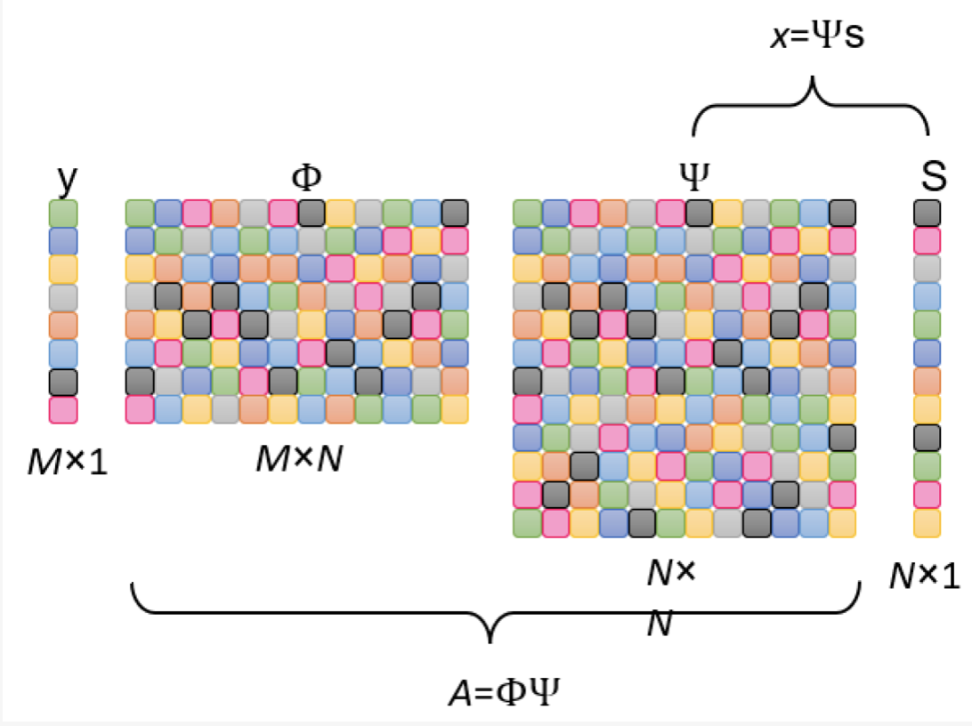
The observation matrix maps the high-demensional signal X to the low-demension space
y:observation value
(known,compressed image)(demension M)
Φ:observation matrix
(sparse sampling)
Ψ:sparse matrix
(Fourier transform)(signal->frequency)
s:sparse index
(natural singal x not sparse)
x:input signal
(unknow,we need to recover)
(demension N)

Slide 5
In general, the overall goal of signal representation is to estimate a vector from a mathematical model of
Among them, is the observation vector, is the additive Gaussian random white noise, its variance matrix is , and is the noise precision coefficient. Matrix is a dictionary matrix with columns greater than rows ( ). is the vector to be estimated.
Factorize the joint probability density function of and express it with a 3-L hierarchical prior model as follows:
The factor graph of the 3-L model can be obtained from the factorization of the 3-L hierarchical prior model. The vector graphical model of the 3-L hierarchical model.

Slide 6
Algorithm
1. Initialize , ,
2. Compute the mean and variance of during the first iteration:
3. Update , , , during subsequent iterations.
4. After several iterations, the estimated value of is obtained after the algorithm converges:

