Slide 1
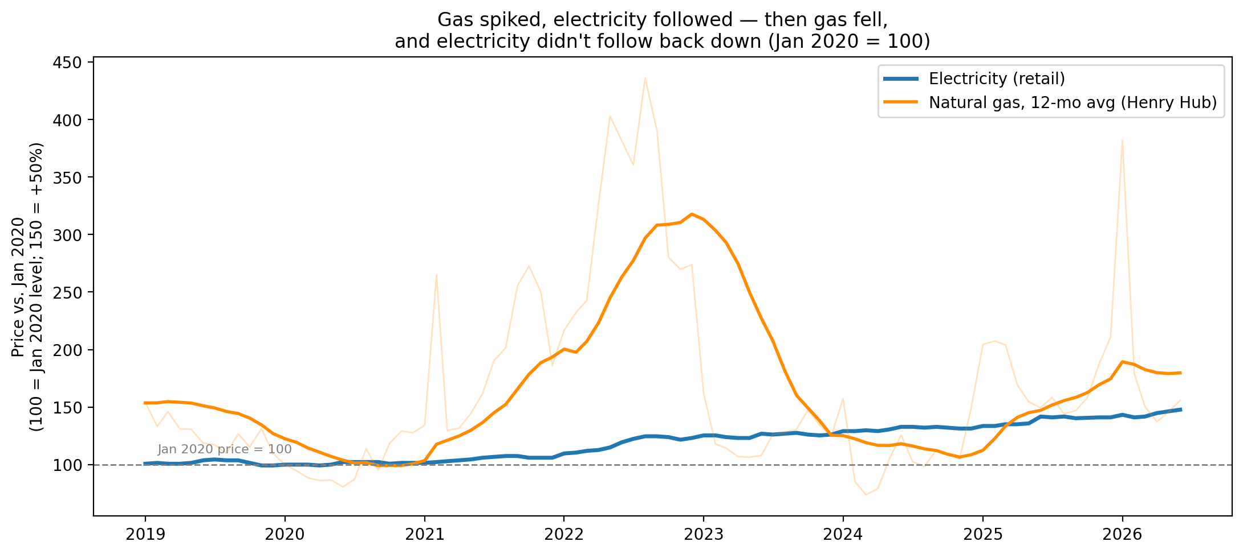
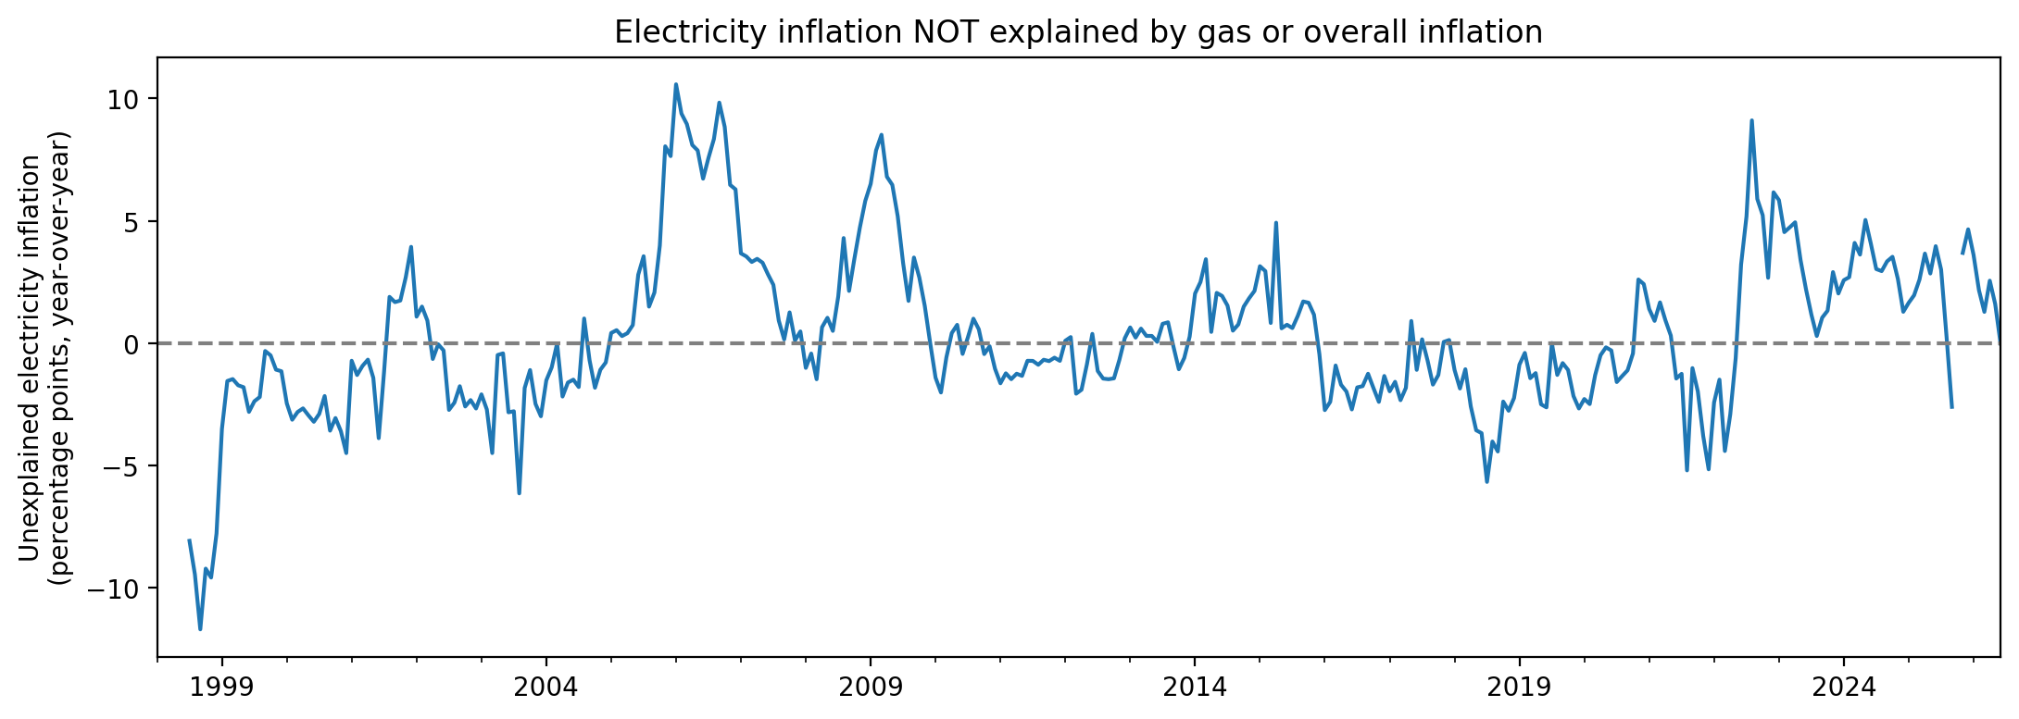
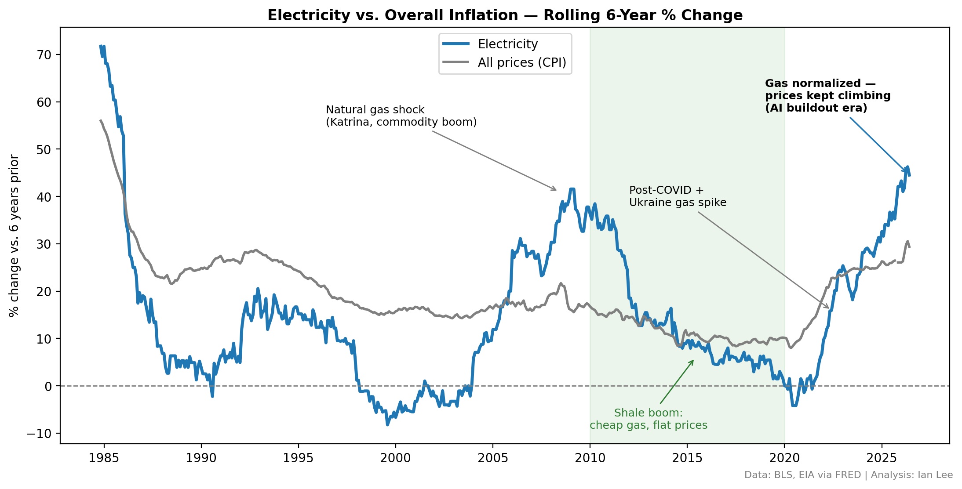
ENERGY ECONOMICS · DATA INVESTIGATION
Ian Lee
Independent data analysis
June 2026
Python · pandas · statsmodels
Why Your Electric Bill Stopped Following Fuel Prices
US electricity prices, natural gas, and the datacenter demand era — 1978–2026
For decades, US retail electricity tracked the price of natural gas. Around 2020 that link broke — fuel got cheap again, but bills kept climbing — and the timing lines up with the first sustained growth in US power demand in two decades: the AI datacenter buildout.
+48%
−65%
+19%
2.6 pts/yr
Retail electricity, since Jan 2020
Natural gas, from its 2022 peak
Electricity since that gas peak — it rose while gas fell
Inflation unexplained by fuel or CPI, since 2023
BLS
HENRY HUB
2022 → 2026
RESIDUAL
MOTIVATION
The ratchet
RESULT 01
The unexplained gap
RESULT 03
The question
From 2014 to 2020, average US electricity prices were essentially flat. Since 2020 they have risen 48%.
A jump like that usually has a simple cause: costlier fuel, or general inflation lifting everything. So — is this just fuel and inflation, or something genuinely new?
DATA & METHOD
47 years, three public series
A two-factor OLS model (6-month-lagged gas + CPI), trained only on pre-2023 data, predicts what electricity inflation should be. The residual sits near zero for most of history — then lifts to ~2.6 pts/yr after 2023 and stays there.
Retail electricity — $/kWh
APU000072610 · BLS · 1978–26
Consumer Price Index
CPIAUCSL · BLS · monthly
Henry Hub gas — $/MMBtu
MHHNGSP · EIA · 1997–26
FINDINGS
Both series indexed to Jan 2020 = 100. Gas spiked ~4× in 2022 and round-tripped to −65%; retail electricity followed it up — and never came back down.
1
Electricity ratchets. Follows gas up with a ~6-month lag (r = 0.53) but did not retrace when gas gave back its 2022 spike.
1 Benchmark electricity against overall inflation (CPI).
2 Lag-correlate electricity vs. gas, year over year.
3 Fit a two-factor model (gas + CPI); read what it can't explain.
Not just inflation
RESULT 02
2
A persistent ~2.6 pts/yr of electricity inflation since 2023 is unexplained by fuel or CPI — tracking the datacenter-driven return of demand growth.
Reproducible · live FRED endpoints · no API keys
3
Elevated, not unprecedented. Prior residual episodes (2005–09) decayed; this one hasn't — and its driver is still growing.
CONCLUSIONS
STATED LIMITATIONS
The residual is “not gas, not CPI” — it bundles datacenter demand with grid capex, plant retirements, and electrification. Not a clean causal estimate.
Overlapping YoY series are heavily autocorrelated (Durbin–Watson ≈ 0.2): a descriptive decomposition, not formal inference.
The link between fuel and your bill is broken. In the shale decade, cheap gas meant flat prices; that cool-off is absent today.
Whatever replaced fuel is growing, not fading. The honest claim isn't “unprecedented” — it's elevated, persistent, and attached to demand that keeps rising.
Rolling 6-year % change vs. CPI. The shaded band is the 2010s shale decade, when cheap gas kept prices flat. Today electricity is outrunning inflation — steeper than 96% of all 6-year periods since 1984.
Not everyone uses AI.
But everyone pays an electric bill.
Data: BLS & EIA via FRED. Reproducible end-to-end.
github.com/pachinkodealer/electricity-price-analysis
© Ian Lee 2026

