Slide 1


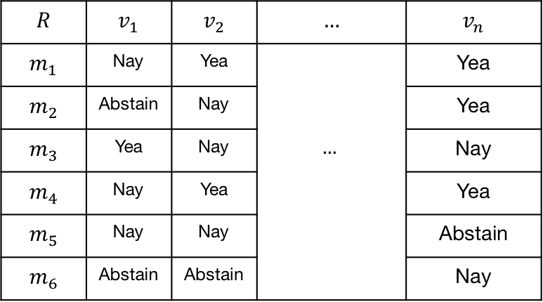
















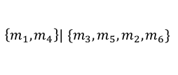
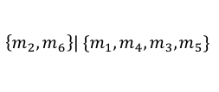
a
Roll-call Vote ($v$) Matrix $R$
b
Distance Matrix $δ$
$$M=$$
Set of senators
$$m_{i}$$
for
$$i=1…6$$
c
$$m_{6}$$
$$\left\{m_{2},m_{6}\right\}| \{m_{1},{m_{4}, m_{3},m}_{5}\}$$
d
$$m_{6}$$
Planar Splits Graph
1
$$m_{2}$$
$$m_{1}$$
$$m_{2}$$
1
1
0.5
4
1
$$m_{1}$$
Circular
Split System
$$∑$$
5
0.5
$$m_{5}$$
1
5
2
$$m_{5}$$
$$m_{4}$$
4
1
$$m_{4}$$
$$\left\{m_{1},m_{4}\right\}| \{m_{3},m_{5},m_{2}, m_{6}\}$$
1
1
$$\left\{m_{5}\right\}| \{m_{2},… m_{3}\}$$
$$m_{3}$$
$$m_{3}$$
$$R$$ | $$v_{1}$$ | $$v_{2}$$ | $$…$$ | $$v_{n}$$
$$m_{1}$$ | Nay | Yea |  | Yea
$$m_{2}$$ | Abstain | Nay |  | Yea
$$m_{3}$$ | Yea | Nay | $$…$$ | Nay
$$m_{4}$$ | Nay | Yea |  | Yea
$$m_{5}$$ | Nay | Nay |  | Abstain
$$m_{6}$$ | Abstain | Abstain |  | Nay

Slide 2
a
116th Senate Split Network
10.0
3
2
Democrat
Independent
Republican
Center
2
1
b
Republican Split Network
c
Democrat* Split Network
10.0
10.0
3
1

Slide 3
Correlation of L₁ and NNet Pairwise Distances
L₁ Distances
Neighbor-Net (NNet) Distances

Slide 4
a
(SANDERS,BOOKER,WARREN,HARRIS,KLOBUCHAR) Vote Disagreement
b
LOESS Fit
Vote Roll-Call Number
Vote Roll-Call Number
06/26/2019 – 01/08/2020
c
Primary Candidates Split Post-Abstention Removals
10.0

Slide 5
LOESS Fit
Vote Roll-Call Number

Slide 6
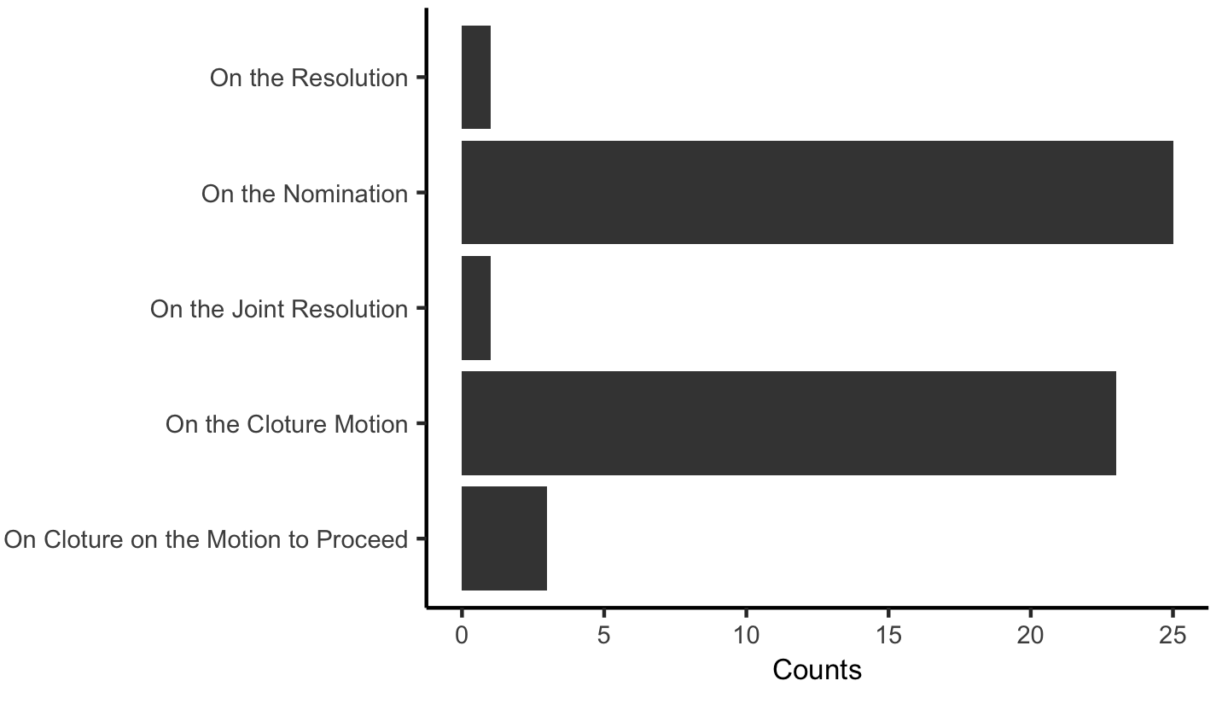
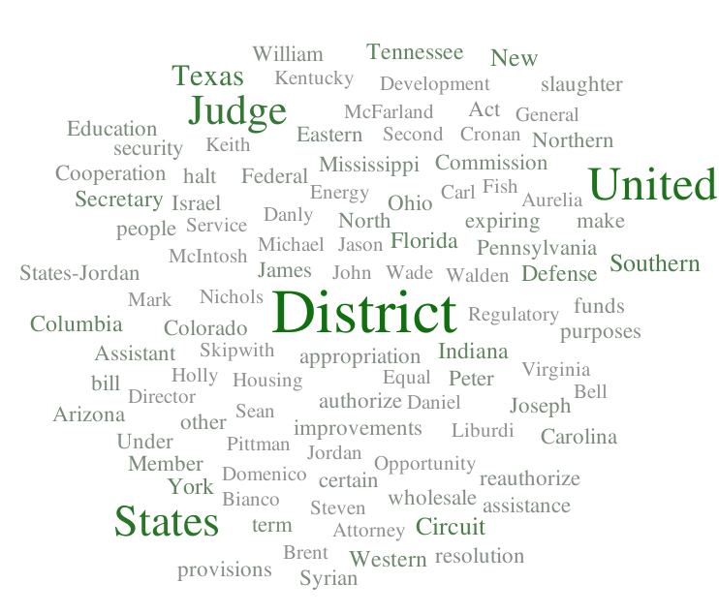
a
{MANCHIN,SINEMA,Jones} Vote Disagreement
b
Vote Roll-Call Number
Vote Roll-Call Number
c
Vote Topics for Top Ranked Votes
d
Word Cloud for Top Vote Descriptions

Slide 7
a
Party Agreement Over Time
Distance from Center
b
Center
Distance from Center
116th Senators

Slide 8
a
Party Agreement Over Time
Distance from Center
b
c
Range in Center Distances vs Majority Party
Center
*
< 0.032
g: 1.25 (large)
*
< 0.019
g: 1.35 (large)
Distance from Center
d
Correlation of DW-NOMINATE Coordinates and Center Distances

Slide 9
a
Sen. Loeffler Split Network
b
Sen. Isakson Split Network
10.0
10.0
c
Sen. McSally Split Network
10.0

Slide 10
a
Tree 1
Species 1,2 | Species 3,4
Species 1
Split
b
Species 3
Simplest Split-Network of Trees 1 & 2
Species 1
Species 1,2 | Species 3,4
Species 3
Species 2
Species 4
Tree 2
Species 1,3 | Species 2,4
Species 1
Species 1,3 | Species 2,4
Species 2
Species 2
Species 4
Species 3
Species 4

