Slide 1

MediCode Assist .
AI Powered assistance for everyone
Team members
Shubhankar Mahanta
Amresh Swain
Mahesh Kumar Jena

Slide 2
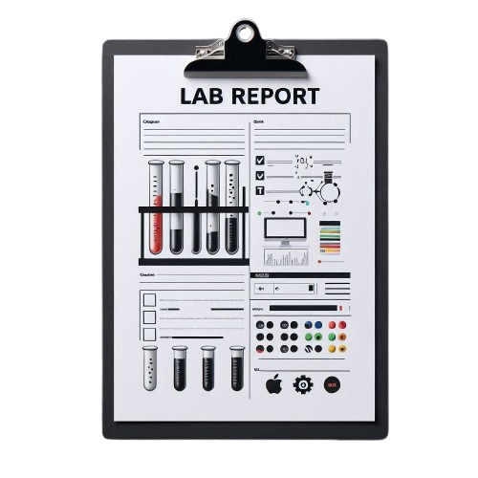
Medic Assistance System Overview
Introducing an AI-driven healthcare tool for diagnosis support, dose calculation, and emergency assistance. Our system enhances accessibility, provides tailored medication suggestions, and connects users to nearby medical help in real time.

Slide 3
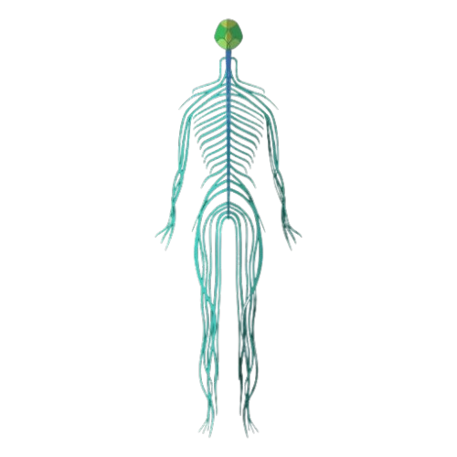
Challenges in Healthcare Access & Support
Many lack easy access to diagnostics, timely consultations, and personalized health guidance. Issues like geographic barriers and real-time medical needs during surgeries impact the quality of care, especially in emergencies.

Slide 4
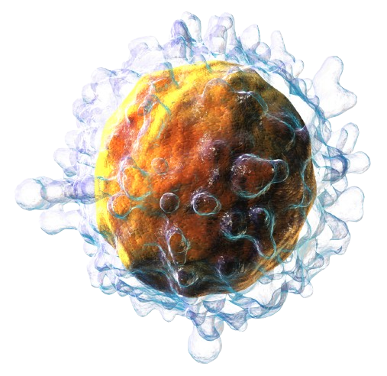
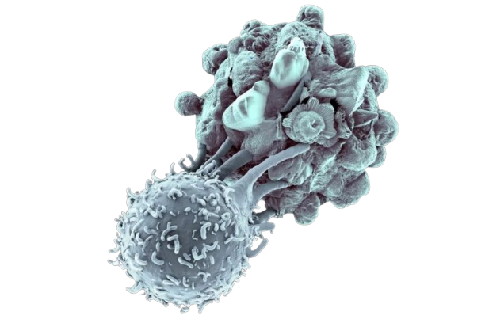
AI-Powered Medic Support System
Our AI system offers accessible diagnostics, calculates optimal doses based on age, severity, and symptoms, and recommends generic medicine alternatives. It also provides real-time image analysis and connects users to local healthcare professionals.

Slide 5
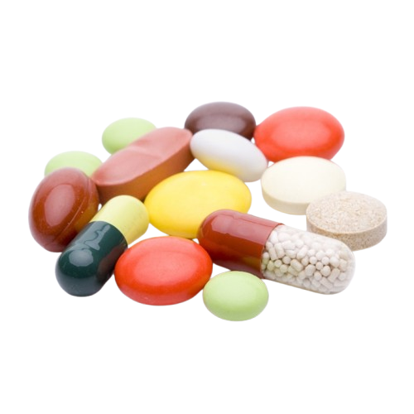
Interactive Diagnosis & Dose Calculation
The system reads prescriptions to suggest generic alternatives. It interactively gathers additional inputs from users to refine diagnosis and calculates precise doses in variants of 300/500/650mg as required.

Slide 6

Instant Support and Medical Connections
It locates nearby clinical assistance, calls emergency services when necessary, and alerts trusted contacts, family, or home nurses with pre-recorded messages if the user needs urgent help.

Slide 7

Advanced Disease Diagnosis & Lab Report Management
The AI system supports detailed disease diagnosis using inputs from symptoms, medical history, and previous lab reports, helping detect complex diseases early and suggesting further diagnostic tests as needed

Slide 8

Lifestyle Recommendations
Diet & Lifestyle Adjustments
Pre- & Post-Treatment Guidance
Offers recommendations on pre-treatment habits to enhance outcomes and post-treatment care tips to support recovery. This guidance covers exercise, nutrition, and other lifestyle factors for optimal healing.

Slide 9
Revolutionizing Healthcare with AI
Our medic assistance system empowers individuals with accessible, reliable, and real-time medical support, bringing healthcare closer to those who need it most. Together, we’ll be paving the way to smarter, safer healthcare.
Towards Smarter, Connected Healthcare

Slide 10
Thanks!
We are Team
Gandivadhari …

