Slide 1

JSS ACADEMY OF TECHNICAL EDUCATION BANGALORE
Web Based Monitoring of Soil Parameters Using Constrained Application Protocol(CoAP)
Project group
Girish E. (1JS10EC031)
Pramod S. (1JS10EC066)
Prashant Aithal (1JS10EC067)
Rajath B.R. (1JS10EC071)
Under the Guidance of
Kavitha H.S.
Asst. Professor
DEPARTMENT OF ELECTRONICS AND COMMUNICATION ENGINEERING

Slide 2
Contents
Objective
Introduction
Software view
Hardware view
Networking view
Applications
Conclusion
Tools used
Reference

Slide 3
Objective
In the project, the concepts of WSN have been applied to precision agriculture wherein soil parameters are measured in remote locations and are made available to the farmers.
This allows the farmers and agriculture scientists to analyze the parameters and determine the condition of the soil and initiate steps if necessary.

Slide 4

Introduction
The world has shrunk in size is a saying heard everywhere. This has been possible because of communication.
Communication is what defines our day-to-day activities. Communication technology encompasses a broad range of mediums.

Slide 5
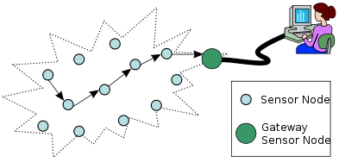
Wireless Sensor networks
Wireless Sensor Networks (WSNs) have become the ideal candidate to provide effective and economically viable solutions.
Wireless Sensor Networks are typically made of resource constrained devices that are low-cost, low-power, low bit-rate supporting short-range communications.
WSN networks generally operate in areas where a man cannot reach for activities.

Slide 6
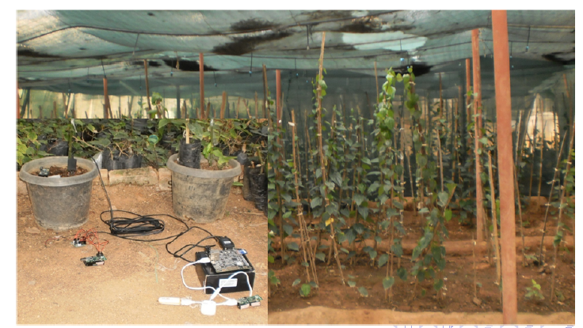
Precision Agriculture
Precision Agriculture is defined as a comprehensive system designed to optimize agricultural production by carefully tailoring soil and crop management.
Many wireless technologies have been put to different uses to implement wireless sensors in precision agriculture

Slide 7
Web Based Monitoring of Soil Parameters Using Constrained Application Protocol(CoAP)
In this project, a proof-of-concept WSN is presented, to collect soil parameters, which is one of the most fundamental data required for precision agriculture.
Monitoring of Wireless Sensor Networks using Constrained Application Protocol (CoAP) will be undertaken. In this context, measurement of the following soil parameters will be done,
Electrical Conductivity
Dielectric Content
Soil Temperature

Slide 8

CHALLENGES INVOLVED
Programming the Sensor Nodes
Establishing agricultural field network
Connecting agriculture field network to IPv6 backbone using the CoAP border router

Slide 9
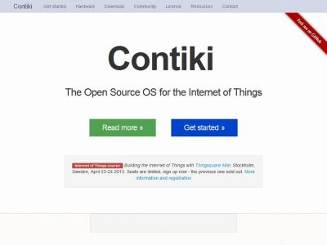
2. Software
Contiki OS-Contiki 2.7 embedded OS release is used with TelosB motes in the project.
Designed for Microcontrollers with small amount of memory
Contiki is an open source, highly portable, multi tasking operating system for the resource constrained wireless sensor networks.

Slide 10
CONTIKI
Features
Memory -10 KB of RAM and 30KB of ROM
Power -in the order of mWatt.
Speed - in the order of megahertz
Communication- in the order of hundreds of Kb/s
uIP TCP/IP stack, uIPv6 stack, rime stack

Slide 11
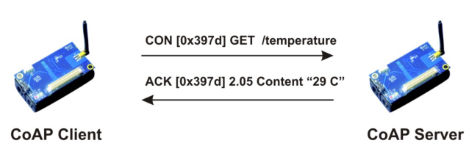
CoAP
Constrained Application Protocol (CoAP) is an application layer protocol that is intended for use in resource-constrained internet devices, such as WSN nodes.
CoAP is designed to easily translate to HTTP for simplified integration with the web.
Messaging models
Constrained web protocol fulfilling M2M requirements.

Slide 12
CoAP - Cu Plug In
‘Copper,’ a generic add-on for the Internet of Things based on the Constrained Application Protocol (CoAP).
Interaction through GET, POST, PUT, and DELETE
Resource discovery
Observing Resources

Slide 13
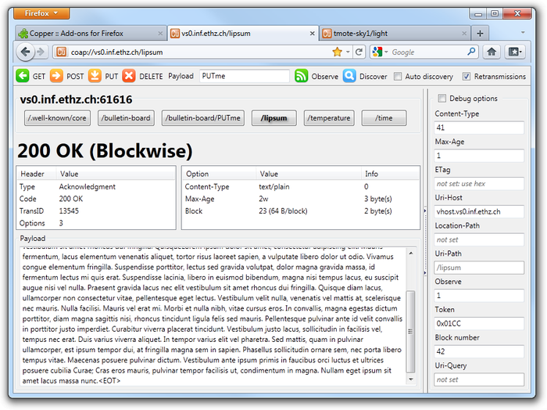

Slide 14

IPv6
Internet Protocol version 6 (IPv6) is the latest revision of the Internet Protocol (IP), the communications protocol that provides an identification and location system for computers on networks.
IPv6 was developed by the Internet Engineering Task Force (IETF) to deal with the long-anticipated problem of IPv4 address exhaustion.

Slide 15

Advantages of IPv6 over IPv4
IPv6 uses a 128-bit address, allowing 2¹²⁸, or approximately 3.4×10³⁸ addresses, or more than 7.9×10²⁸ times as many as IPv4, which uses 32-bit addresses.
IPv4 provides approximately 4.3 billion addresses.
With IPv6, everything from appliances to automobiles can be interconnected.

Slide 16

6LoWPAN
6LoWPAN is an acronym of IPv6 over Low power Wireless Personal Area Networks.6LoWPAN is the name of a concluded working group in the Internet area of the IETF.

Slide 17
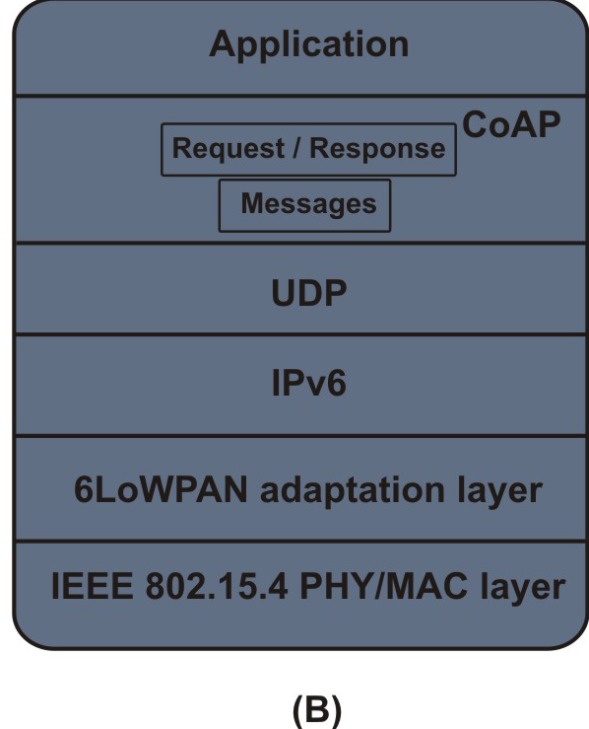
CoAP stack

Slide 18
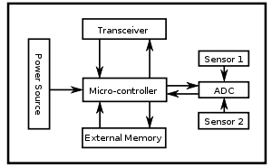
Agriculture Sensor Network Setup
Hardware
A sensor node, also known as mote, is a node in a wireless sensor network (WSN).
A wireless sensor node is a popular solution when it is difficult or impossible to run a mains supply to the sensor node.

Slide 19
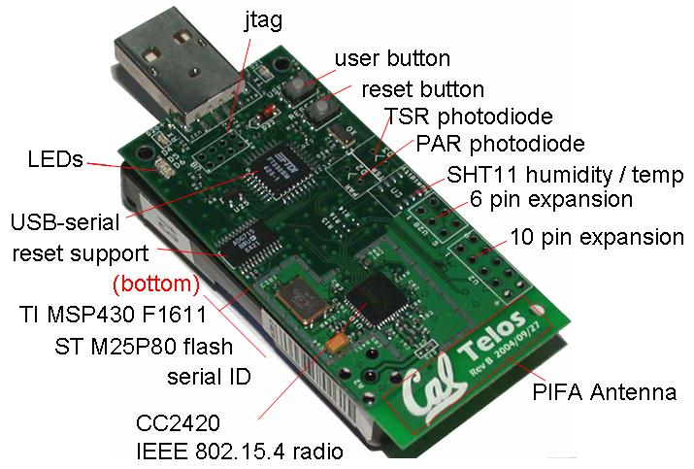
TelosB Mote
Salient Features
Texas Instruments MSP430F1611 Microcontroller
250kbits/s 2.4 GHz IEEE 802.15.4 Chipcon Wireless Transceiver
10kB RAM,48kB Flash
Telos run for years on a single pair of AA batteries.
Ultra-low current consumption
Fast wakeup from sleep (<6μs)

Slide 20
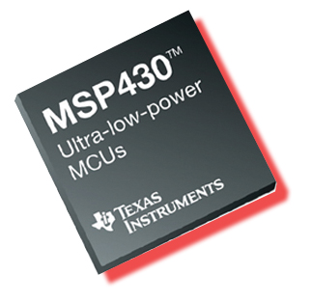
MSP430
The MSP430 is a mixed-signal microcontroller family from Texas Instruments.
Built around a 16-bit CPU, the MSP430 is designed for low cost and, specifically, low power consumption embedded applications.
The low power operation of the Telos module is due to the ultra-low power Texas Instruments MSP430 F1611 microcontroller.
This 16-bit RISC processor features extremely low active and sleep current consumption that permits Telos to run for years on a single pair of AA batteries.

Slide 21
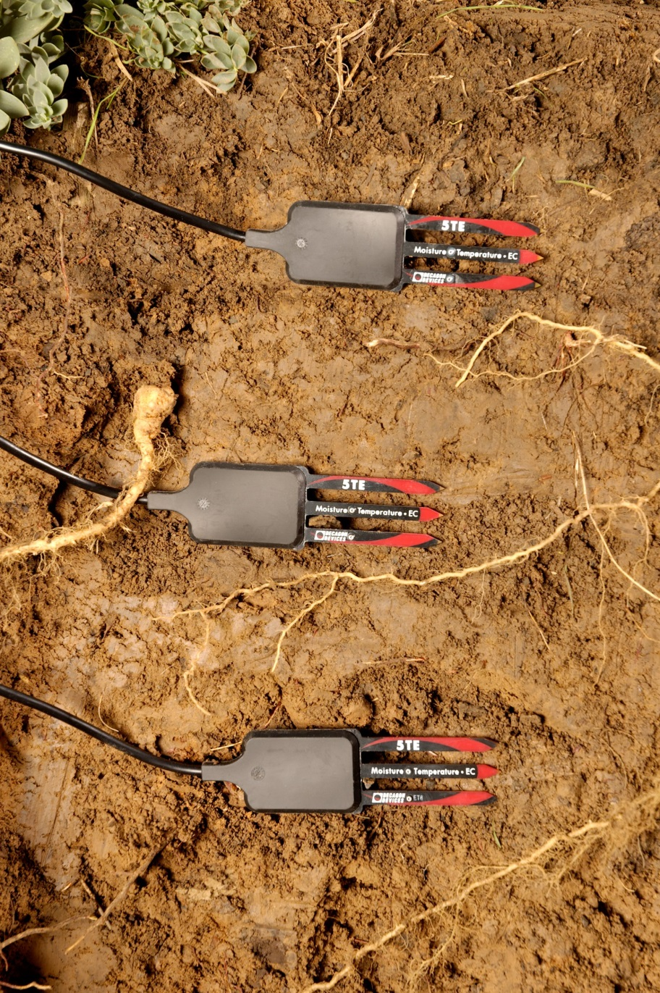
Soil Sensor
The 5TE soil sensor from Decagon device is used as a sensor. 5TE is an integrated sensor that can measure 3 different soil parameters - electrical conductivity (EC), soil temperature and volumetric water content.
The output from the sensor is in the form of raw data in Tera Term Language(TTL) format as given below:
56 432 645<0D>zG<0D><0A>
The raw data requires to be converted with suitable formula to arrive at the actual soil parameters.

Slide 22
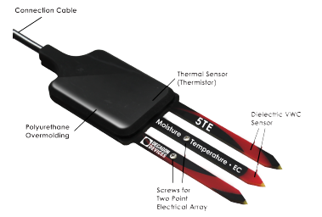
Soil sensor components

Slide 23
Dielectric Permittivity
The 5TE sensor uses an electromagnetic field to measure the dielectric permittivity of the surrounding medium.
The sensor supplies a 70 MHz oscillating wave to the sensor prongs that charges according to the dielectric of the material.
The 5TE microprocessor measures the charge and outputs a value of dielectric permittivity (dS/m) from the sensor.
Range: Apparent dielectric permittivity (εa): 1 (air) to 80 (water)
VWC = (4.3 ∗ 10⁻⁶ε³_{a} )- (5.5 ∗ 10⁻⁴ε²_{a} ) +)2.92 ∗ 10⁻²ε_{a} − 5.3 ∗ 10⁻² )

Slide 24
Electrical Conductivity
Electrical conductivity (EC) is the ability of a substance to conduct electricity and can be used to infer the amount of polar molecules that are in solution.
EC is measured by applying an alternating electrical current to two electrodes and measuring the resistance between them. Then the inverse is calculated to obtain EC.
Range: 0 to 23 dS/m (bulk)

Slide 25
Temperature
The 5TE uses a surface-mounted thermistor to take temperature readings.
The 5TE outputs temperature in ◦C.
Range: −40 to 50 ◦C
Accuracy: ±1 ◦C

Slide 26
UART communication
UART is usually an integrated circuit used for serial communications over a computer or peripheral device serial port. UARTs are included in microcontrollers.
The Universal Asynchronous Receiver/Transmitter (UART) takes bytes of data and transmits the individual bits in a sequential fashion.
Serial transmission of digital information (bits) through a single wire or other medium is less costly than parallel transmission through multiple wires.
The data format is 1-start bit, 8-data bits & 2-stop bits.
The right-most (least significant) data bit is always transmitted first. If parity is present, the parity bit comes after the data bits but before the stop bit(s).
Bit number | 1 | 2 | 3 | 4 | 5 | 6 | 7 | 8 | 9 | 10 | 11
 | Start bit | 5–8 data bits |  |  |  |  |  |  |  | Stop bit(s)
 | Start | Data 0 | Data 1 | Data 2 | Data 3 | Data 4 | Data 5 | Data 6 | Data 7 | Stop

Slide 27
DATA FORMAT DESCRIPTION
The data string output by the sensor should be in a format similar to the one below: 56 432 645<0D>zG<0D><0A>
Meta data:
z | Sensor Type. This character is used to indicate the sensor type. z is used for 5TE sensors, and x is used for 5TM sensors.
G | Checksum. This one character checksum is used in our instruments to ensure that the data transmitted are valid. The checksum is used for sections listed above: 56 432 645<0D>z See the following function for an example of how to implement the checksum algorithm in C.
<0D><0A> | The carriage return and line feed are used to signal the end of the meta data section and the end of the transmission.

Slide 28
Networking
The block diagram shown below shows the monitoring of remote agricultural sensor resources using CoAP. The architecture has two network segments, namely Agricultural field network and Monitoring Network.
Via Field network CoAP
Host
IPV6 Backbone
CoAP border router
TelosB mote
Sensors deployed in Agricultural
Field

Slide 29
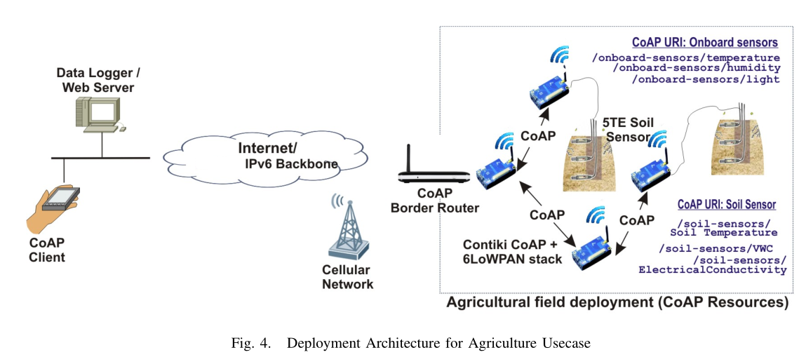
Field Network
Field network consist of motes that are interfaced to soil sensors. The motes run CoAP server managing the monitorable CoAP resources. The soil sensor resources and onboard sensor resources can be discovered and CoAP methods can be acted on them.

Slide 30
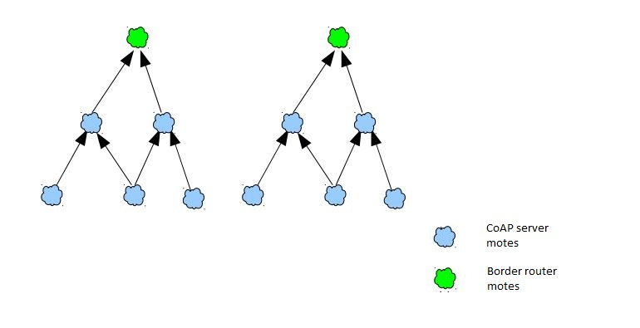
Routing Protocol for Low power and Lossy Networks (RPL) in a DODAG configuration

Slide 31
Monitoring Network
Monitoring network consists of CoAP client node(s) and web server. CoAP clients can be utilized for real-time access to sensor data, while web server can give access archived data to the farmer and the agricultural scientist.

Slide 32
Procedure
A Wireless Sensor network is established by setting up the TelosB motes at a distance away from each other.
The sensors require a trigger.
On pressing the GET button in the Copper Add-on in the Mozilla Firefox Window, the 5TE soil sensor will be triggered by the Mote by a value of 3V.
The sensor will measure the soil parameters and the data will be sent by the sensor to the RX pin of the mote. UART mode of communication takes place and the mote will receive the sensor data through the RX pin of the mote.
The data will be received sequentially. The received data is in ASCII value which needs to suitably converted into a decimal value to obtain the soil parameters in a recognizable format.
The Data can be viewed on the Copper plugin in Mozilla Firefox Browser in real-time.

Slide 33
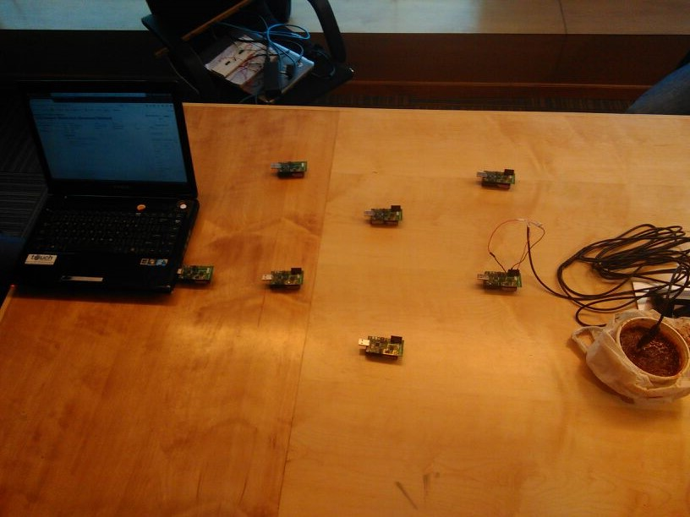

Slide 34
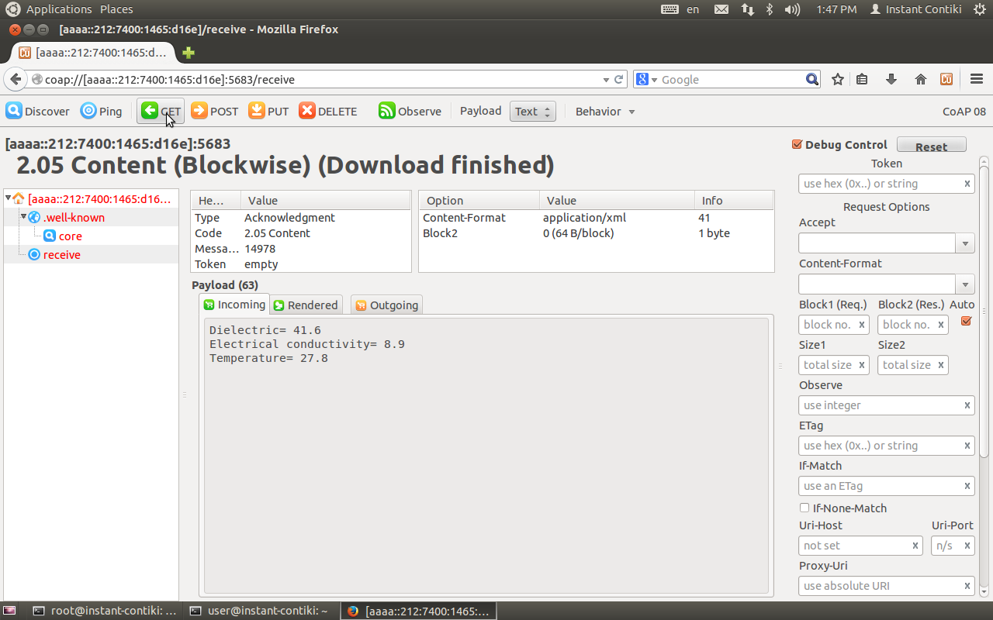

Slide 35
APPLICATIONS
Wireless sensor networks can be used in precision farming and to get water properties in dams, rivers, lakes and oceans, as well as underground water reserves are monitored.
Collection of data for monitoring of environmental information can be done.
Based on the received data some sort of actuating process corresponding to the environmental changes can be done.
The real time data can be obtained from any place of the world having IPv6 connectivity

Slide 36
Conclusion & Future Scope
Wireless sensor networks are be implemented in precision agriculture where even minute details of soil parameters is given importance.
The concept of Internet Of Things (IOT) can be implemented for a smarter world. The next generation of Internet applications using IPv6 would be able to communicate with devices attached to virtually all human-made objects because of the extremely large address space of the IPV6 protocol.
Sensor Node can be connected to a water sprinkler. This sprinkler is operated when acidity of the soil increases or when a threshold temperature is reached. This is an added advantage to the farmers as dependence of labour is not there.

Slide 37
Tools Used
Contiki OS 2.6
TelosB mote (TI MSP430F1611)
Cooja Simulator
5TE soil sensor

Slide 38
References
[1] “Leveraging CoAP towards monitoring agriculture sensors network”-A. Paventhan, Sai Krishna Allu, V. Gayathri, Sameer Barve and N. Mohan Ram
ERNET India R&D Centre, (An autonomous scientific society under the
Ministry of Communications & Information Technology, Government of India).
[2]” A Prototype Wireless Sensor Network for Precision Agriculture”-Jao, J. ; Bo Sun ; Kui Wu,Distributed Computing Systems Workshops (ICDCSW), 2013 IEEE 33rd International Conference on Distributed Computing Systems Workshops.
[3]” MSP430 Microcontroller Basics”-John H. Davies
[4]” Embedded Systems: A Contemporary Design Tool”, 1st Edition-James K. Peckol
[5] IEEE Std 802.15.4 Specifications for Low-Rate Wireless Personal Area
Networks WPANs. IEEE Computer Society, September 2006.

Slide 39


