Slide 1
Next step:
1. Clean items not explicitly noted under “ISSUE” on the test node (basically Attribution/ ID / Name / Location updates).
2. Update safe issues in the production node (I would follow this order, can start early next week):
Attribution rename and new networks insert;
Additional/ new stations insert;
ID / Name / Location updates;
Items not explicitly noted under “ISSUE” (should be all related with 3)
Simple delete (according to station ID)
The other issues have been solved
3. Get confirmation for the other issues (listed in the following pages), then apply them to the production node.
4. The attribution update needs more thought, will deal with it after incorporating all other changes into production. Some thoughts discussed with John have been documented in the last two pages.
5. Mid-to-long term work: Checking the missing data condition, and giving updates.
BC AGRIWeather update, Fern inserting

Slide 2
Some issues need to be double-checked, or confirm about the decisions made
Purple: Questions
Green: Feedback from Ted
Blue: My post-meeting thoughts and action plan
Red sentences: Need follow-up from Ted

Slide 3
Additional (129 stations)
I used the summarized information to update the meta_station and meta_history tables.
After comparing the information in the PCDS form with Ted’s spreadsheet, I found 44 items that did not match. For these cases, I used the information from the PCDS form to insert the stations (see Sheet1_Addtional_mismatch_44items).
EJW - I have noted the required changes. Some have been made in my spreadsheet, others I still have questions about and am following up with MoF. Corrected values are highlighted in green
Double check Ted’s new summary sheet, incorporate the new change into next round, in the production knot

Slide 4
Concatenate
Concatenate old stations to new ones based on native_id.
Checks before concatenation: overlaps by variable/time, identical data points.
Concatenation: update history_id for non-overlapping entries only.
Cannot concatenate: new_native_id 452, T035, 77, E271963, E238705, 543 missing in DB.
Seems old stations summarized in the table on the right have metadata but no data records.
Next steps/questions:
Delete old stations after concatenation? Yes, delete the old ones are the default option.
Update station names to the new native_id (new station)? Yes
See next page
M102038 -> 60 -> 294; Combining these three stations;
Kamloops Federal Building -?> 267; neglect -?>

Slide 5
These new stations are missing in the PCDS
452 and 543 – likely crappy data – delete from the record for now, if data is recoverable over the long term they will be added to ENV’s database.
T035 – If no data, seek download from MVRD-AIR rep. This is likely a good idea for this station anyway as M104271 and Horeshoe Bay look like they had partial records
I don’t see a 77 in the data sheet I gave you.
E271963 is Powell River James Thomson School – has met data
E238705 is Powell River Pacifica – has met data.
We want to get the metadata information of 452, 543, T035, 77. Then conducting concatenating;
Powell River James Thomson School’s native_id is 122 (12238); Powell River Pacifica’s native id is 126 (1587). So we use 122 and 126 replacing E271963 and E238705, then concatenate old stations to the new ones
Remind us which networks will be available on the
Data mart in the near future (I remember
BC-Agriweather but I’m sure a second was
mentioned. Is it the three mentioned by email:
MVRD-WS, BC-AIR, and BC AGRIWeather?)
This old stations have metadata but no data records.
Pine River Gas Plant_60: contains met data – Time issues – Tree growth around the site
M102038 Harmac Pacific Met_60: contains met data
Birchbank Golf Course_60: contains met data
Burns Lake Fire Center_60: contains met data
Courtenay Elementary School: contains met data
Delete from list: Harmac Pacific: no met data, only TRS and Trail Columbia Gardens Airport: only TRS, met data are available in Trail Columbia Gardens Airport_60 (E237758) for this site
PG Marsulex: PG Marsulex Met_60 (E278829) contains met data,
Delete: Prince George Marsulex Acid Plant (E270963) only contains SO2 data
Prince Rupert Roosevelt Park School Met_60 (E288469): contains met data – some concerns about quality
Valemount Met_60: contains met data
E237758 Trail Columbia Gardens Airport_60: contains met data
This means no data record will be concatenated into the new station, that’s fine. Delete these stations.

Slide 6
Slide 5 - We want to get the metadata information of 452, 543, T035, 77. Then conducting concatenating; | 452 – Fraser Lake Endako Mines (_60), 125.095833 W, 54.034444 N, Elev. 1005 m, Network BC-AIR 543 – Skookumchuk Farstad Way(_60) – just went through a hardware upgrade (July 2025). Prior to that period, the data was not continuous. My recommendation is to delete the data up to August 1st, 2025. Metadata: 115.755613 W, 49.905404 N, Elev. 746 m Network BC-AIR T035 – Horseshoe Bay - Network is MVRD-AIR, This is one of the stations where meteorological data and air quality data were likely collected by separate loggers, and then – at some point in time, merged to one logger. Go with he information under PCIC station ID 12160 amalgamating any non-overlapping data in 2634. Metadata: 123.2766 W, 49.3686 N, Elev. 65 m 77 – I don’t see the reference in the Change spreadsheet posted to Google Drive to this native ID. Nor in my active station list.
Slide 5 - Remind us which networks will be available on the Data mart in the near future | Networks currently on Datamart – bc-RioTinto, bc-crd, bc-env-aq, bc-env-snow, bc-forestry, bc-mvrd (air), bc-tran (so much for my attempt to standardize between ECCC, PCIC, BC Gov ☹) I will add this to the todo list for the person replacing me. Networks expected on Datamart – BC Hydro – spring 2026? BC AGRI Weather Fall 2027/28? MVRD-WS Fall 2027/28? Networks with no plan as yet BC-FERN

Slide 7
Additional: Replaces (a station) with concatenated data record
All new stations have been inserted into the database.
Most old stations do not exist (no meta data) in the database (18 of 22 cases). Just treated them as “has been replaced”, so no action needed.
For the existing old stations: SBC19, 24547, bc65, SBC35 (native_id),
- Updated their history_id to point to the corresponding new stations.
- Deleted the old station records after successful update.

Slide 8
We based on new station_id to concatenate stations, then update the new stations’ native_id, new station’s name if has;
Native_id can be the same under different network, where they represent different stations.
Data needs concatenating with 12170 | M106010 -> 80 | New station: 12170 (102), rather than 80. So update the new station native_id to 80? Or concatenate them into the new native id 80?? The native_id 80 has the same station_name in the table
Data should be concatenated into one record | M109912 -> 144 | Only new station native_id (144) provided, the new station_id is 12254.
Amalgamated with 12559, then Delete
Info: E304453 -> AFU, Peace Valley Attachie Flat Upper Terrace_60 -> Peace Valley Attachie Flat Upper Terrace

Slide 9
Slide 7 – M106010 -> 80 - New station: 12170 (102), rather than 80. So update the new station native_id to 80? Or concatenate them into the new native id 80?? The native_id 80 has the same station_name in the table | I think this again is a transition between logger types – 2 loggers -> 1 logger -> new technology each making a unique native ID. My recommendation is to amalgamate all to Native ID 80 and go with the metadata reported in the SWOBML and in my spread sheet under station ID 12185. Metadata 128.639131 W, 54.066909 N, Elev. 94 m, Network BC-AIR
Slide 7 M109912 -> 144 only new station native ID (144) provided, the new station ID is 12254 | Good eyes – I see one that I missed for amalgamation please include data from Station 2601 with 12254. 122.7419W, 53.9147N, Elev. 588 m, Network BC-AIR
Slide 7 E316370 –> T050 | Not sure what the question is here – the data is from T050 Vancouver Clark Drive I would amalgamate the data from station ID 12582 with data from 12949 and then delete 12582

Slide 10
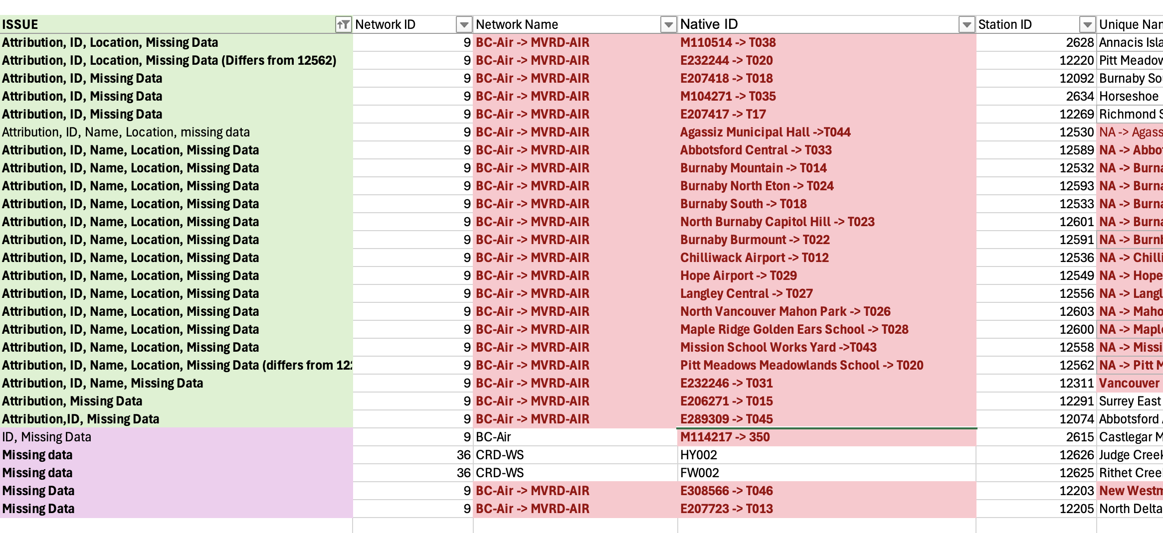
Missing data
The Missing data, anything we should or can do?
For these stations, maybe we wait for the updating of new records?
I think the best way to go is to make the attribution changes, then outline the stations where you have no data – this should be communicated to my replacement with a timeline attached for when the data should be reported and when it could be appended into the PCDS – they would then communicate this to the Network Coordinators.
For all stations, we want to record the gap each year. Take it as s data quality control routine in the future.
Might be automated later?

Slide 11
Slide 8 - For these stations, maybe we wait for the updating of new records? | Yes – absolutely! This will wait until datamart starts publishing BC AGRIWeather data and then PCIC and AGRIWeather can agree on a bulk download end date (somewhat aligned with the datamart publication start date.

Slide 12
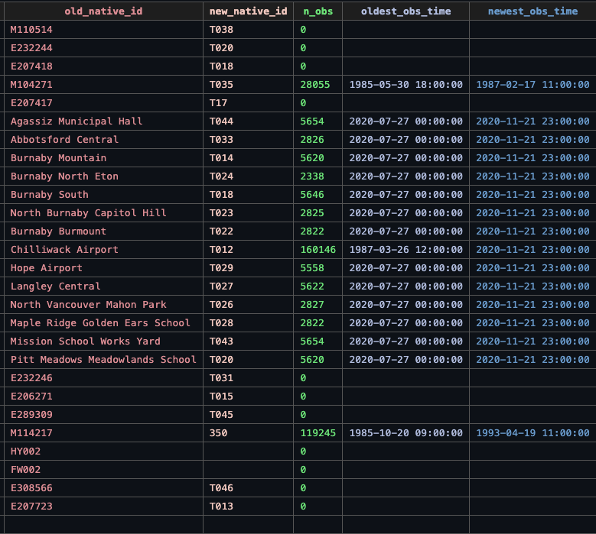

Slide 13
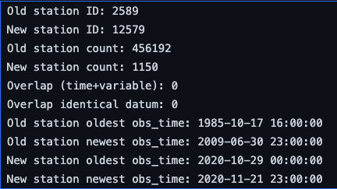
Closed
"Additional - Responsibility Change - move any data from 2436 collected from Octo0ber 1, 2022 to this site",
'Site CLOSED - Move all data collected post October 1, 2022 to new ENV-ASP site "Breanda Mines" Line 1718'
I’ve built the new station "Breanda Mines", and moved all data after Oct 1 of the closed station to the new station. We might want to leave the old station there.
CLOSED - Possibly Trail Butler park pre 2010 | 9 | BC-Air | M114902
Found Trail Butler Park (12579) as native_id in network 9.
I think we want to keep both the new and old station meta data?
Might be automated later? In this case, we delete the station

Slide 14
Closed
CLOSED - responsibility change - Move any data from this site collected from October 1, 2022 on to New addditional station (line 1932 - "Moyie Mountain", BC H)
14 BC-Snow 2C10P 2549 Moyie Mountain 115.767 W, 49.25 N, Elev. 1930 m
Additional - Responsibility Transfer - Move any data from 35092 collected post October 1, 2022 to this record.
First insert the new station;
Then founds old station 2C10P has 0 observation records
Also seems no station with id 35092 (no meta data)
I’ve added the new station, seems don’t need to move any data. So done.

Slide 15
NOT on ENV LIST | 5 | BCH-GSO-HMP | OMI | 2486 | Ominica R. ab Osilinka R. -> Omineca River above Osilinka River | 124.56 W, 55.94 N, Elev. 715 m
NOT on ENV LIST | 5 | BCH-GSO-HMP | OSP | 2488 | Ospika R. ab Alley Ck -> Ospika River above Alley Creek | 123.93 W, 56.46 N, Elev. 750 m
PARKS CANADA | 5 | BCH-GSO-HMP | FDL | 2458 | Fidelty Mtn. -> Fidelity Mountain | 117.7006167 W, 51.23741667 N, Elev. 1800 m
I think I need to update the station_names on my end, Ted probs want to do some updates on his end
Name, ID, | 5 | BCH-GSO-HMP | DBC -> DBC2? | 2452 | Duncan R. blw BB Ck -> Duncan River Below Blue Berry Creek 2
Name, Location? | 5 | BCH-GSO-HMP | ELK | 2455 | Elk R. ab Campbell Lk | BLANK
The red part need to hear back from Ted

Slide 16
Slide 12 – DBC and DBC2 | My understanding is that the DBC2 replaces DBC so the stations could be concatenated together – to be referenced as DBC2. Just looking through the spreadsheet you may not have any data from DBC2 This may have to wait until the BC Hydro station data comes on line – I am reasonably sure that the data will report through as DBC2.
Slide 12 – ELK Location? | My historic active stations list (Thank the gods that I kept them all from 2009) shows ELK at 125.8132639W, 49.85804722N Elev. 270 m Network BC Hydro

Slide 17
The attribution change (I will deal with it after incorporating all other changes into production)
Moving a station across networks also affects its associated variables.
However, we cannot simply update network_id in meta_station, because:
Variables are shared across stations
Updating a variable’s network_id would impact other stations
This would create station–variable mismatches if only the station is updated
Therefore, station reattribution must be handled more carefully.
Proposed approach (discussed with John):
Reattribution to a new network
Create new network
Copy variables from old network
Create new station
Move observations (possibly time-based, so need to know when the attribution chang)
Update observations with new variable IDs (match by net_var_name)
Reattribution to an existing network
Create new station
Move observations
Update observations with existing variable IDs (match by net_var_name)
If no match → create new variable in target network

Slide 18
Network_splite
After the spreadsheet updating,
FLNRO-WMB network needs to be split into BC-TS (12 stations) and BC-FWx (788 stations),
BCH, has been split into BCH-GSO-HMP (168) and BCH-SiteC (8).
Need to double check, and know which stations belongs to which new network, then update the network_id of stations
At this moment, the stations under the new network are all from reattributing, which might need to think carefully how to deal with them (like the steps summarized in last page).

