Slide 1
Progress
Completed updates (majority of “ISSUE” items in PCDS):
Additional
Delete
ID / Name / Location updates
Concatenate
Completed updates (selected specific “ISSUE” types):
Additional: Replaces * – Concatenate data record
Concatenate data and delete this station
Replaced by * – Move data record, delete station
Missing data
New (attribution pending)
Currently in progress:
Case-by-case “ISSUE” items
Not started yet:
Changes related to Attribution
Items not explicitly noted under “ISSUE”

Slide 2
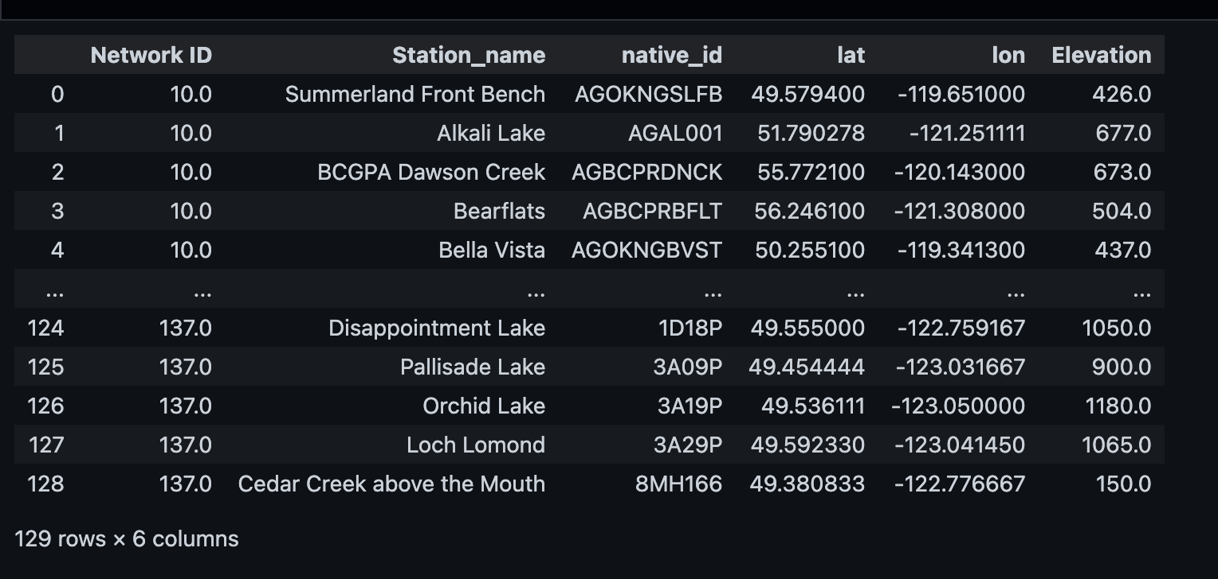
Additional
I used the summarized information to update the meta_station and meta_history tables.
After comparing the information in the PCDS form with Ted’s spreadsheet, I found 44 items that did not match. For these cases, I used the information from the PCDS form to insert the stations.

Slide 3
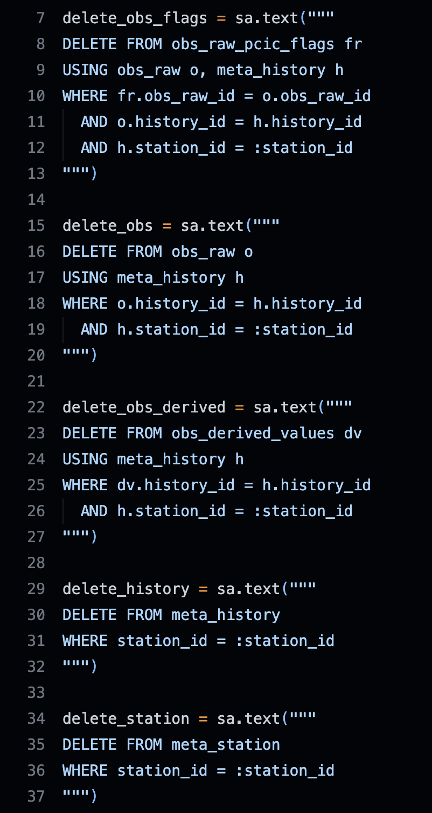
Delete
I deleted 346 entries based on their station_id.
Due to the logical relationships between database tables, the deletions had to be carried out in a specific order across the related tables.

Slide 4
ID / Name / Location updates
 | ISSUE | Station ID | Network ID | Network Name | old_native_id | new_native_id | old_station_name | new_station_name | n_names | old_lat | old_lon | old_elev | new_lat | new_lon | new_elev
0 | ID, Location | 3282 | 9 | BC-Air | E278829 | 233 | Prince George Marsulex Met | Prince George Marsulex Met | 1 | 53.845000 | -122.667222 | 535.0 | 53.967500 | -122.690800 | 577.0
1 | ID, Location | 1573 | 9 | BC-Air | E237431 | 344 | Merritt Granite-Garcia Mobile | Merritt Granite-Garcia Mobile | 1 | 50.112778 | -120.788889 | 500.0 | 50.112800 | -121.788900 | 500.0
2 | ID, Location | 2603 | 9 | BC-Air | 0450270 | 136 | Prince George Gladstone School | Prince George Gladstone School | 1 | 53.858056 | -122.761389 | 583.0 | 53.859200 | -122.763300 | 583.0
3 | ID, Location | 2649 | 9 | BC-Air | E231838 | 327 | Prince Rupert Galloway Rapids | Prince Rupert Galloway Rapids | 1 | 54.259722 | -130.268056 | 1.0 | 54.232200 | -130.288900 | 1.0
Extract station_id, old and new native_id, station_name, and geometries.
Based on the station_id:
Verify that the old native_id , station_name, and geometries matches the database.
If it matches, update it to the new one.
Confirm that the database now reflects the new one.

Slide 5
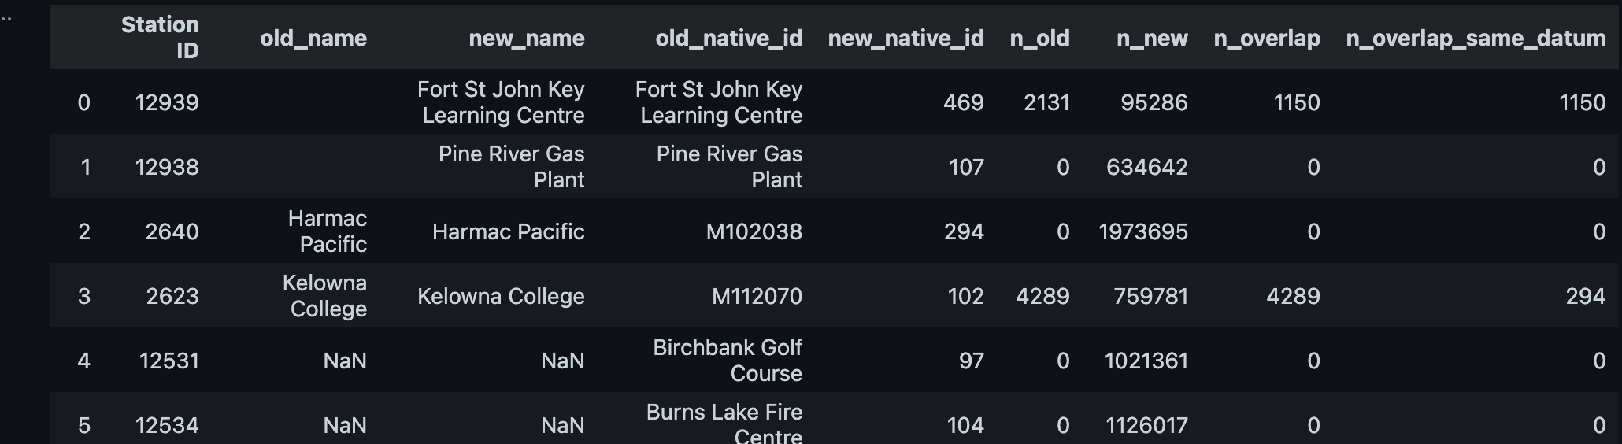
Concatenate
Concatenate old stations to new ones based on native_id.
Checks before concatenation: overlaps by variable/time, identical data points.
Cannot concatenate: 469, 452, T035, 77, E271963, E238705, 543 (missing in DB).
Concatenation: update history_id for non-overlapping entries only.
Next steps/questions:
Delete old stations after concatenation?
Update station names to the new native_id?
Horseshoe Bay → T035, attribution pending

Slide 6
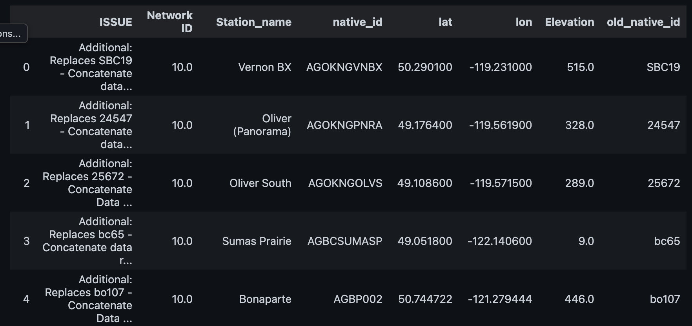
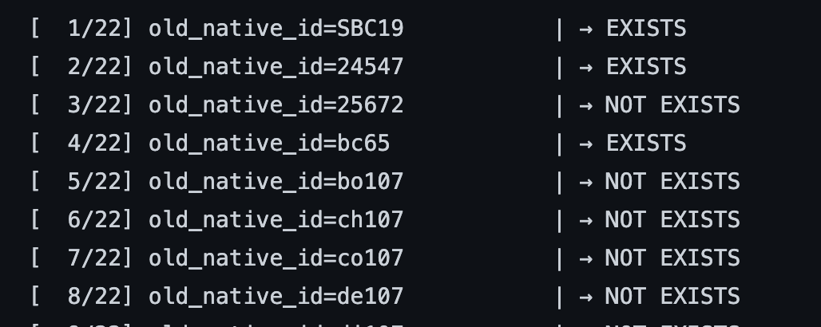
Additional: Replaces * – Concatenate data record
WORKING FLOW:
Check according to the new native_id and station_name, if not exits, insert these stations; -- > (ALL not exist)
Check if the old id exist, if yes, copy the obs records to the new Station (just change the history_id of the form obs_raw); -- > (Just four old station exist)
Delete the old ones? (Cause it marked as replace). -- > (Have deleted)

Slide 7
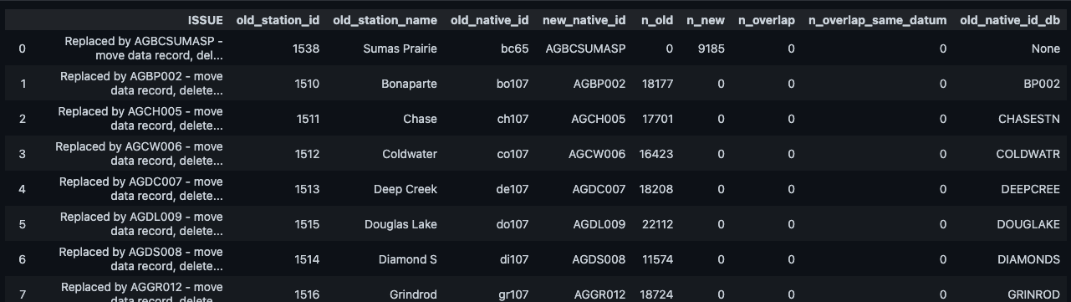
Replaced by * – Move data record, delete station
Identify stations:
Old stations by station_id (old native_id not found in DB).
New stations by native_id.
Existence check:
4 old stations missing → assumed replaced, no action needed.
1 new station missing → marked for review.
Concatenation process:
For pairs where both old & new stations exist:
Update history_id in obs_raw for non-overlapping entries.
Delete old stations from DB.

Slide 8
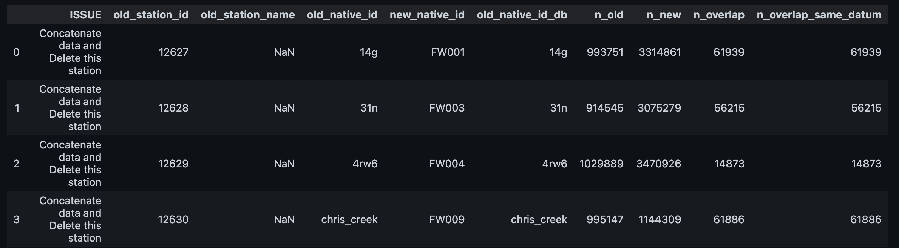
Concatenate data and delete this station
Similar as concatenate, based on station_id or native_id of old station to search get same entry.
Concatenate, then delete.

Slide 9
Missing data
The Missing data, anything we wanna do?
The Missing Data, because need to change the attribution, so deal with it later
New
The Network Name (BCH-SITEC) need to be update first

Slide 10
Case-by-case “ISSUE” items

Slide 11
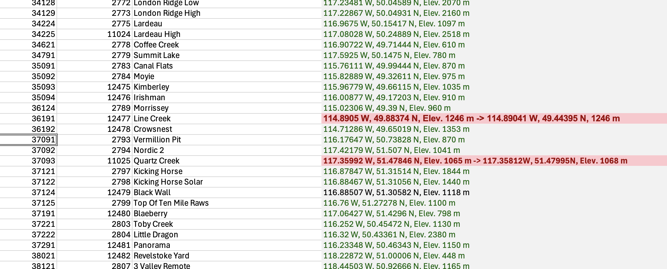
Items not explicitly noted under “ISSUE”
In the left PCDS part
Why are some geometries shown in green?
Do the red geometries indicate locations that need to be updated?

Slide 12
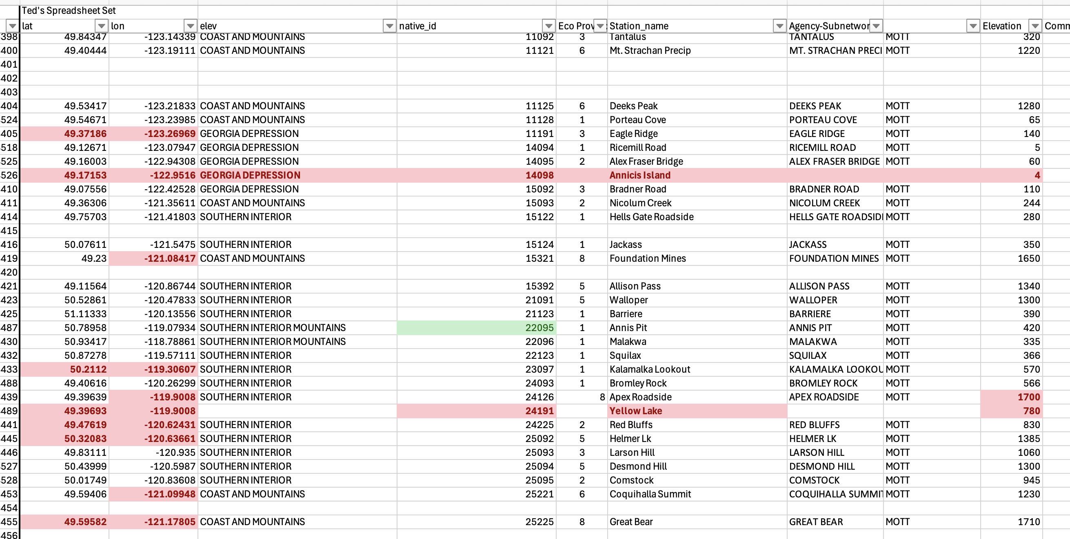
Items not explicitly noted under “ISSUE”
In the right Ted’s spreadsheet part
I randomly checked a few cases and found that they should be the same as, or very similar to, the geometries listed on the left. Anything I need to do with them?

Slide 13
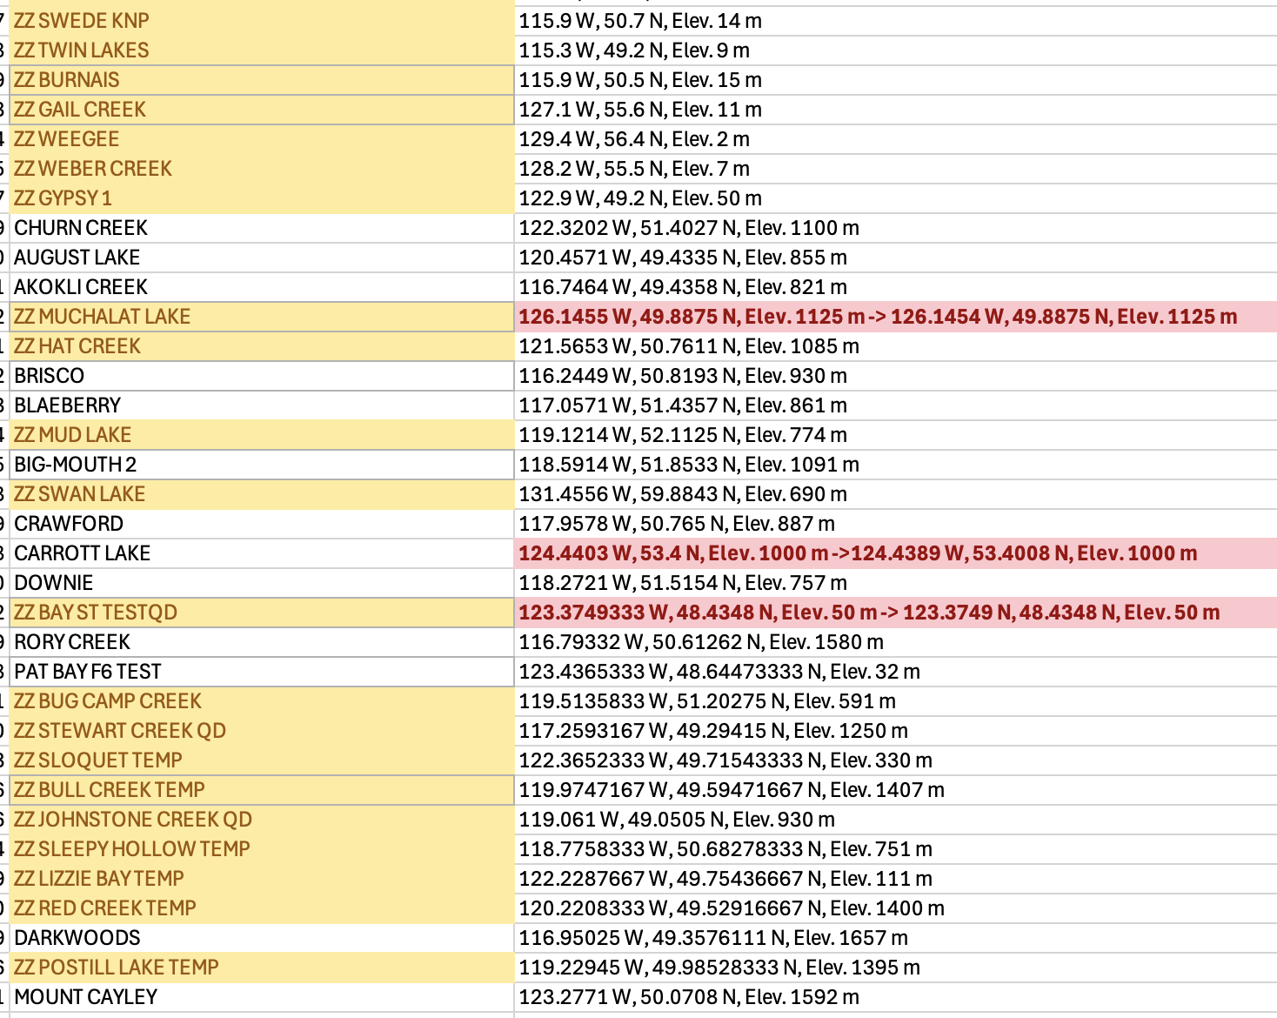
Items not explicitly noted under “ISSUE”
What the yellow painting means?
Do the red geometries indicate locations that need to be updated?

Slide 14
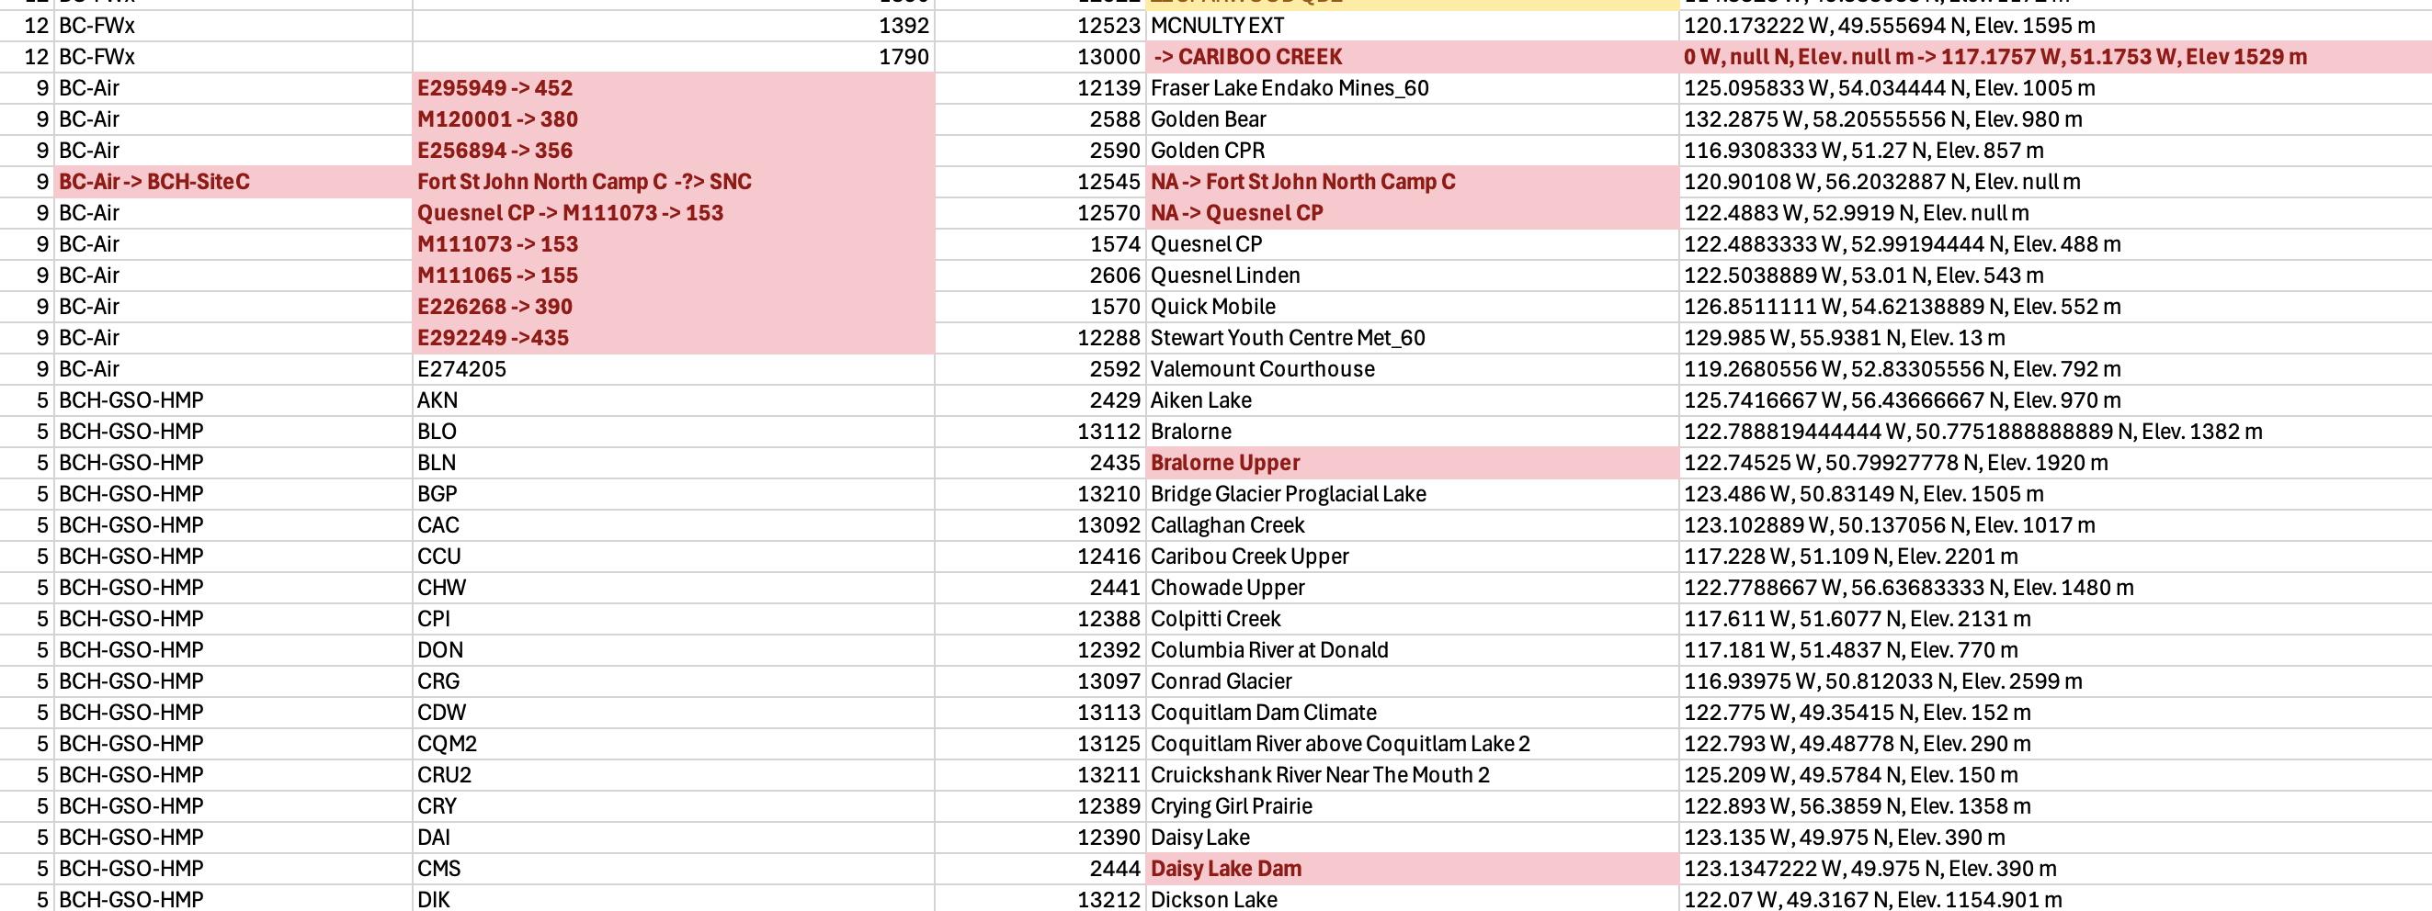
Items not explicitly noted under “ISSUE”
Do the red highlights indicate information that needs to be updated?
What about the items without any marking?
Do both the PCDS and Ted’s spreadsheet need to be cross-checked when data exist in both?

