Slide 1
Next step:
Clean items not explicitly noted under “ISSUE” (basically Attribution/ ID / Name / Location updates)

Slide 2
Items can be updated in the production knot (following the orders)
Safe:
Attribution rename and insert
Additional/ new station insert
Attribution/ ID / Name / Location updates;
Items not explicitly noted under “ISSUE” (should be all related with 3)
Simple delete (according to station ID)
Then:
Concatenate
Additional: Replaces * – Concatenate data record
Concatenate data and delete this station
Replaced by * – Move data record, delete station
Closed
Missing data
Progress (using ISSUEs terminology from Ted’s spreadsheet)
Completed updates (majority of “ISSUE” items in PCDS):
Additional
Delete
ID / Name / Location updates
Concatenate
Completed updates (selected specific “ISSUE” types):
Additional: Replaces * – Concatenate data record
Concatenate data and delete this station
Replaced by * – Move data record, delete station
New
Changes related to Attribution
Closed
Not started yet:
Items not explicitly noted under “ISSUE”
Missing data

Slide 3
Items not explicitly noted under “ISSUE” (should be all related with 3)
Items can be updated in the production knot (following the orders)
Safe:
Attribution rename and insert
Additional/ new station insert
Attribution/ ID / Name / Location updates;
Simple delete (according to station ID)
Then:
Concatenate
Additional: Replaces * – Concatenate data record
Concatenate data and delete this station
Replaced by * – Move data record, delete station
Closed
Missing data

Slide 4
Progress (using ISSUEs terminology from Ted’s spreadsheet)
Completed updates (majority of “ISSUE” items in PCDS):
Additional
Delete
ID / Name / Location updates
Concatenate
Completed updates (selected specific “ISSUE” types):
Additional: Replaces * – Concatenate data record
Concatenate data and delete this station
Replaced by * – Move data record, delete station
New
Changes related to Attribution
Closed
Not started yet:
Items not explicitly noted under “ISSUE”
Missing data

Slide 5
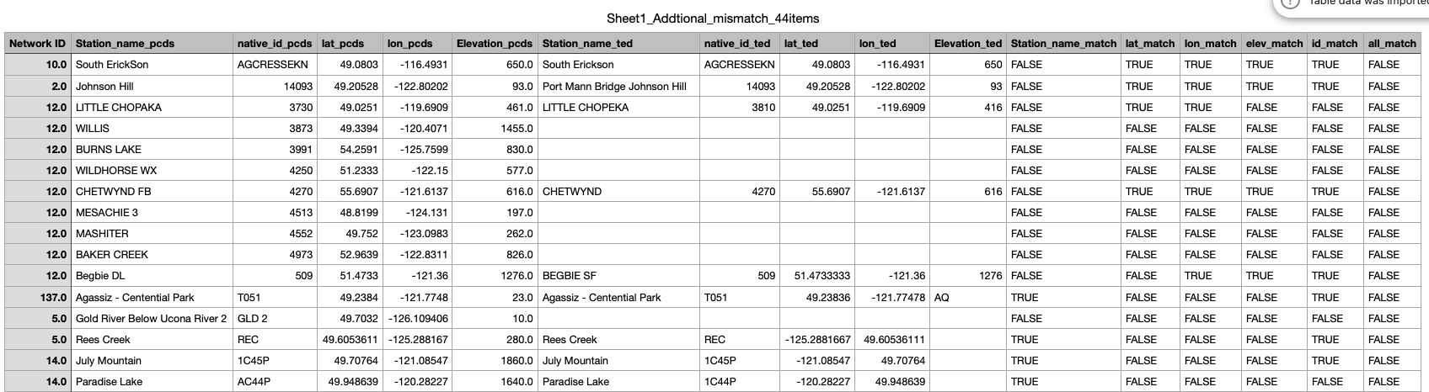
Additional (129 stations)
I used the summarized information to update the meta_station and meta_history tables.
After comparing the information in the PCDS form with Ted’s spreadsheet, I found 44 items that did not match. For these cases, I used the information from the PCDS form to insert the stations (see Sheet1_Addtional_mismatch_44items).
EJW - I have noted the required changes. Some have been made in my spreadsheet, others I still have questions about and am following up with MoF. Corrected values are highlighted in green
Double check Ted’s new summary sheet, incorporate the new change into next round, in the production knot

Slide 6
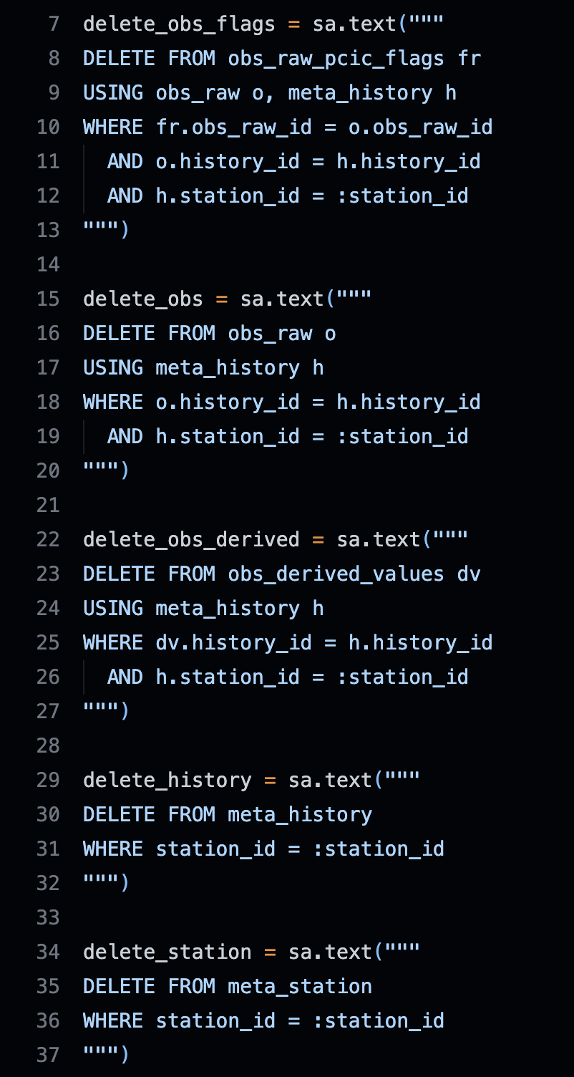
Delete
I deleted 346 entries based on their station_id.
Due to the logical relationships between database tables, the deletions had to be carried out in a specific order across the related tables.

Slide 7
ID / Name / Location updates
Extract station_id, old and new native_id, station_name, and geometries.
Based on the station_id:
Verify that the old native_id , station_name, and geometries matches the database.
If it matches, update it to the new one.
Confirm that the database now reflects the new one.
Tong found many small location/elevation typographical errors that she corrected
Examples:
commas instead of periods in the “Unique Location (String)”
Elevation in the wrong column (In Ted’s spreadsheet set)
Lat and long reversed (In Ted’s spreadsheet set)

Slide 8
Concatenate
Pine River Gas Plant_60: contains met data – Time issues – Tree growth around the site
M102038 Harmac Pacific Met_60: contains met data
Birchbank Golf Course_60: contains met data
Burns Lake Fire Center_60: contains met data
Courtenay Elementary School: contains met data
Delete from list: Harmac Pacific: no met data, only TRS and Trail Columbia Gardens Airport: only TRS, met data are available in Trail Columbia Gardens Airport_60 (E237758) for this site
PG Marsulex: PG Marsulex Met_60 (E278829) contains met data,
Delete: Prince George Marsulex Acid Plant (E270963) only contains SO2 data
Prince Rupert Roosevelt Park School Met_60 (E288469): contains met data – some concerns about quality
Valemount Met_60: contains met data
E237758 Trail Columbia Gardens Airport_60: contains met data
Concatenate old stations to new ones based on native_id.
Checks before concatenation: overlaps by variable/time, identical data points.
Concatenation: update history_id for non-overlapping entries only.
Cannot concatenate: new_native_id 452, T035, 77, E271963, E238705, 543 missing in DB.
Seems old stations summarized in the table on the right have no data records.
Next steps/questions:
Delete old stations after concatenation?
Update station names to the new native_id?
Native ID | Station ID
Pine River Gas Plant | 12938
M102038 | 2640
Birchbank Golf Course | 12531
Burns Lake Fire Centre | 12534
Courtenay Elementary School | 12539
Harmac Pacific | 12595
Trail Columbia Gardens Airport | 12580
PG Marsulex | 12560
Prince Rupert Roosevelt Park School | 12569
Valemount | 12581
E237758 | 2618
452 and 543 – likely crappy data – delete from the record for now, if data is recoverable over the long term they will be added to ENV’s database.
T035 – If no data, seek download from MVRD-AIR rep. This is likely a good idea for this station anyway as M104271 and Horeshoe Bay look like they had partial records
I don’t see a 77 in the data sheet I gave you.
E271963 is Powell River James Thomson School – has met data
E238705 is Powell River Pacifica – has met data.
Combining three stations; neglect -?>
M102038 -> 60 -> 294
Kamloops Federal Building -?> 267
What this means?

Slide 9
452 and 543 – likely crappy data – delete from the record for now, if data is recoverable over the long term they will be added to ENV’s database.
T035 – If no data, seek download from MVRD-AIR rep. This is likely a good idea for this station anyway as M104271 and Horeshoe Bay look like they had partial records
I don’t see a 77 in the data sheet I gave you.
E271963 is Powell River James Thomson School – has met data
E238705 is Powell River Pacifica – has met data.
Concatenate | 9 | BC-Air | Kitimat Riverlodge -> 77 | 12598 | NA
Use 126, 122 to concate
Pine River Gas Plant_60: contains met data – Time issues – Tree growth around the site
M102038 Harmac Pacific Met_60: contains met data
Birchbank Golf Course_60: contains met data
Burns Lake Fire Center_60: contains met data
Courtenay Elementary School: contains met data
Delete from list: Harmac Pacific: no met data, only TRS and Trail Columbia Gardens Airport: only TRS, met data are available in Trail Columbia Gardens Airport_60 (E237758) for this site
PG Marsulex: PG Marsulex Met_60 (E278829) contains met data,
Delete: Prince George Marsulex Acid Plant (E270963) only contains SO2 data
Prince Rupert Roosevelt Park School Met_60 (E288469): contains met data – some concerns about quality
Valemount Met_60: contains met data
E237758 Trail Columbia Gardens Airport_60: contains met data
Neglect _60;
No records, so don’t need to do anything
Why _60?
These stations are all exist (have meta data), just no data record

Slide 10
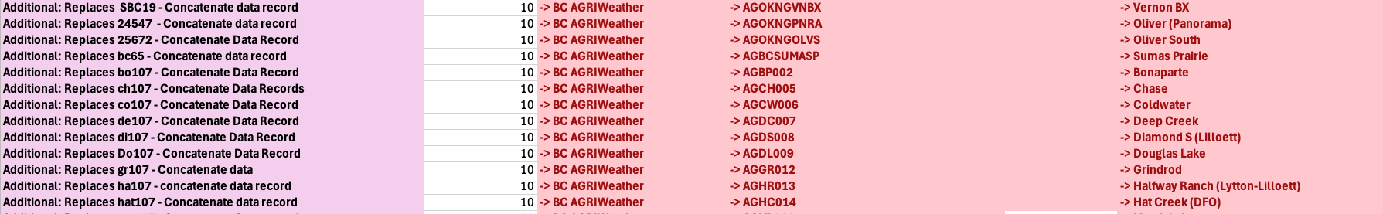
Additional: Replaces (a station) with concatenated data record
All new stations have been inserted into the database.
Issues (22 cases identified):
- It is not clear what to concatenate because only one station id for concatenation is identified
- Most old stations do not exist in the database (18 of 22 cases).
Action taken (4 cases):
- Existing old stations: SBC19, 24547, bc65, SBC35 (native_id).
- Updated their history_id to point to the corresponding new stations.
- Deleted the old station records after successful update.
Seems no action required (18 cases):
Old stations do not exist in the database and are assumed to have been replaced.
Okay – I am thinking that these are stations that may have been added to metadata table but no data at that time.
I think these 18 stations has no matedata, so neglect them

Slide 11
Replaced by new station native id – Move data record, delete station
Identify stations:
Old stations by station_id (based on native_id, no stations founded), so this means the station_id and native_id summarized in the table are not consistent
New stations by native_id.
Existence check:
4 old stations missing → assumed replaced, no action needed (station_id = 1538, 1523, 3102, 3110)
1 new station missing → marked for review (native_id = AMGL019)
Concatenation process:
For pairs where both old & new stations exist:
Update history_id in obs_raw for non-overlapping entries.
Delete old stations from DB.
Ted should probs double check the native_id and station_id summarized here;
1 new station missing → marked for review (native_id = AMGL019

Slide 12
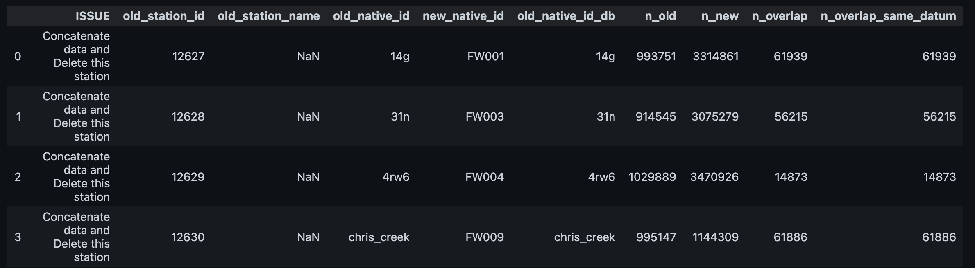
Concatenate data and delete this station
Similar to concatenate, based on station_id or native_id of old station to search, get same entry.
Concatenate, then delete.

Slide 13
Case-by-case “ISSUE” items
In the case of concatenating based on station_id, not sure how to deal with the native_id
ISSUE | Native_id | Notes
Concatenate data with 13217, then delete | JHL ->JHL | Original station id is 13218, both old and new native_id are JHL
Concatenate with 12283 and delete | M107005 -> 171 | New station: 12283 (171)
Concatenate with 12441 and delete | Smithers Muheim Memorial -> 563 | New station: 12441 (563)
Data needs concatenating with 12170 | M106010 -> 80 | New station: 12170 (102), rather than 80. So update the new station native_id to 80? Or concatenate them into the new native id 80?? The native_id 80 has the same station_name in the table
Data should be concatenated into one record | M109912 -> 144 | Only new station native_id (144) provided, the new station_id is 12254.
Update the new stations’ native_id

Slide 14
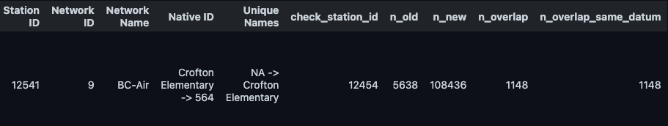
Confirm data time series overlap with 12454, if the same then delete, if gap fill the concatenate into 12454, and then delete
The station has been concatenated into station 12454, and the original station has been deleted.
It is unclear whether a native_id or station_name update is required, as native_id 564 appears to exist under network 12.
It shows concatenate with 12949, while this station itself is 12949…
How should I do with the native_id T050? Which is not exist. We want to update its native_id to T050?
Update the new stations’ native_id

Slide 15
Amalgamated with 12559, then Delete
Info: E304453 -> AFU, Peace Valley Attachie Flat Upper Terrace_60 -> Peace Valley Attachie Flat Upper Terrace
The new station 12559’s native_id is ‘Peace Valley Attachie Flat Upper Terrace’. Change it to AFU?
I checked the native_id AFU: it is under 5,BCH-GSO-HMP, with station_id 12342
Update the new stations’ native_id to AFU, name to new_name

Slide 16
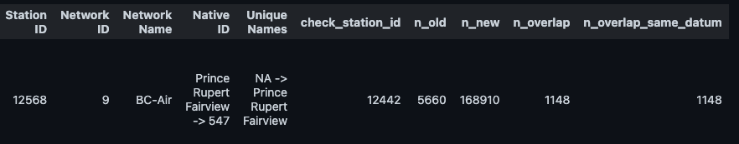
Confirm data time series overlap with 12442. If data time series is the same then delete, if not then concatenate with 12442 into the Additional PRPA station (ENV Native ID 547) and delete
Confirm data time series overlap with 12568. If data time series is the same then delete 12568, if not then concatenate with 12568 into the Additional PRPA station (ENV Native ID 547) and delete."]
Additional (see stations 12568 and 12442), native_id: 547
Have inserted the new station, have concatenated concatenate according to station id, have deleted the old ones.
The native_id 547 already exists in PCDS under network 12 (FLNRO-WMB). What native_id means? Why same one under different network?
Caution: Always double-check record counts and time coverage before deleting old stations.
Update the new stations’ native_id,
Different network, so doesn’t matter

Slide 17
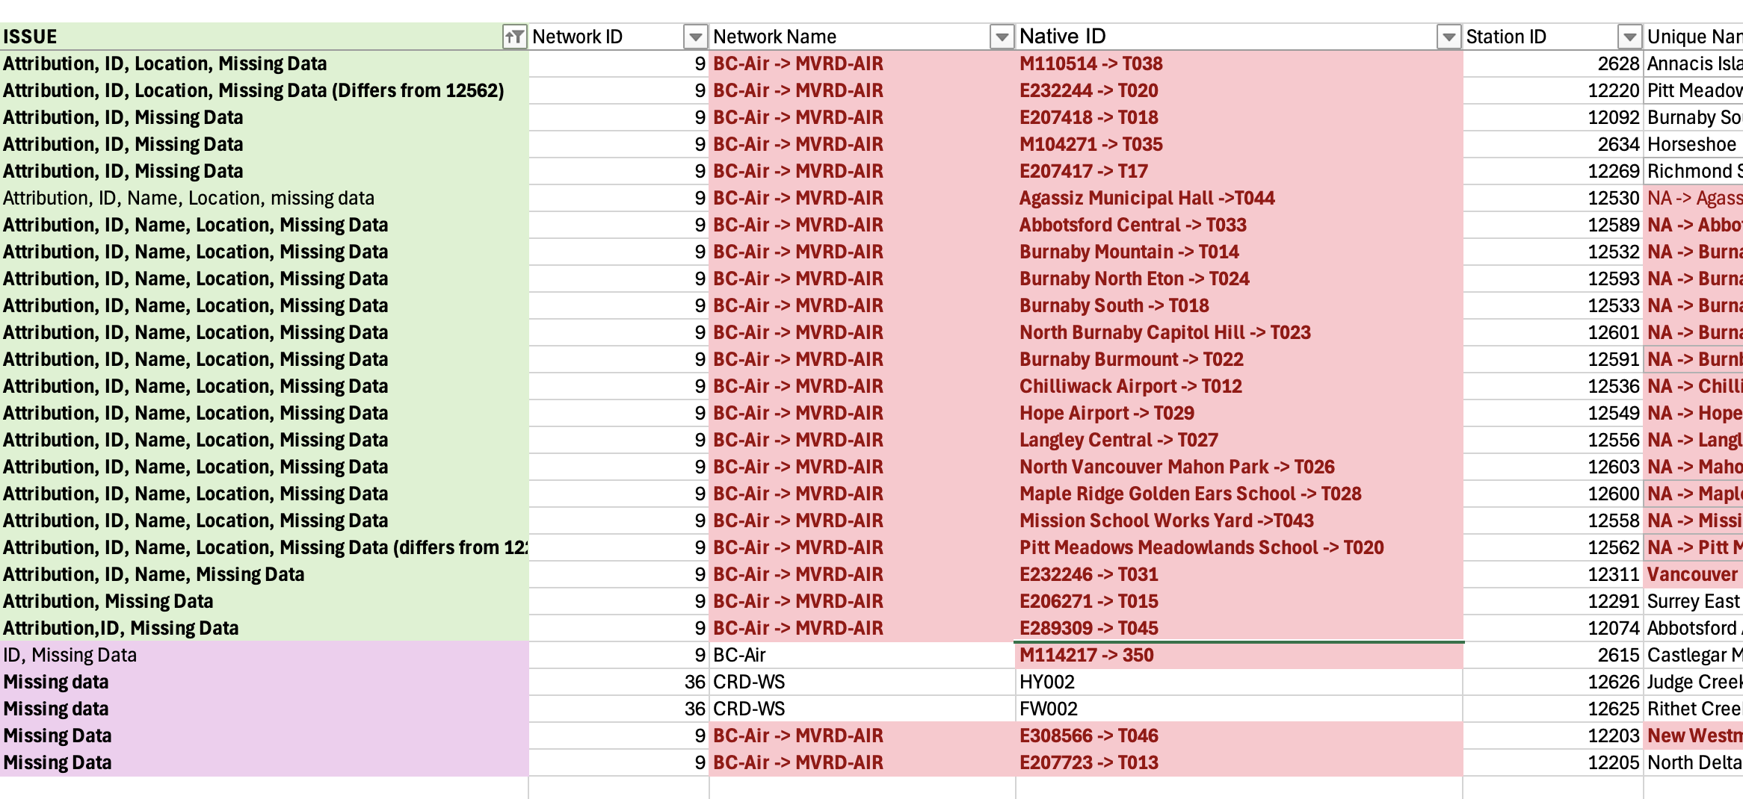
Missing data
The Missing data, anything we should or can do?
I think the best way to go is to make the attribution changes, then outline the stations where you have no data – this should be communicated to my replacement with a timeline attached for when the data should be reported and when it could be appended into the PCDS – they would then communicate this to the Network Coordinators.
Update data records, in the future?
For all stations, records each year obs gap

Slide 18
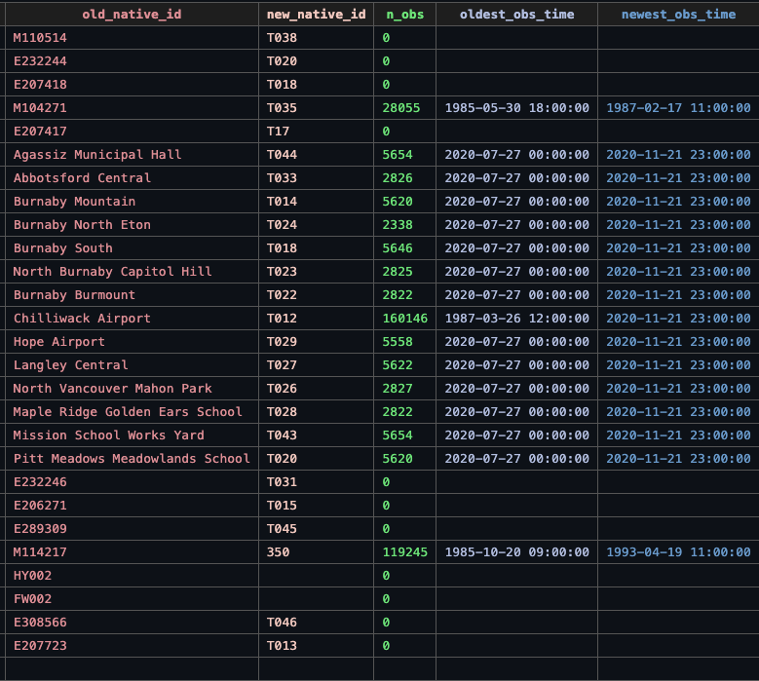

Slide 19
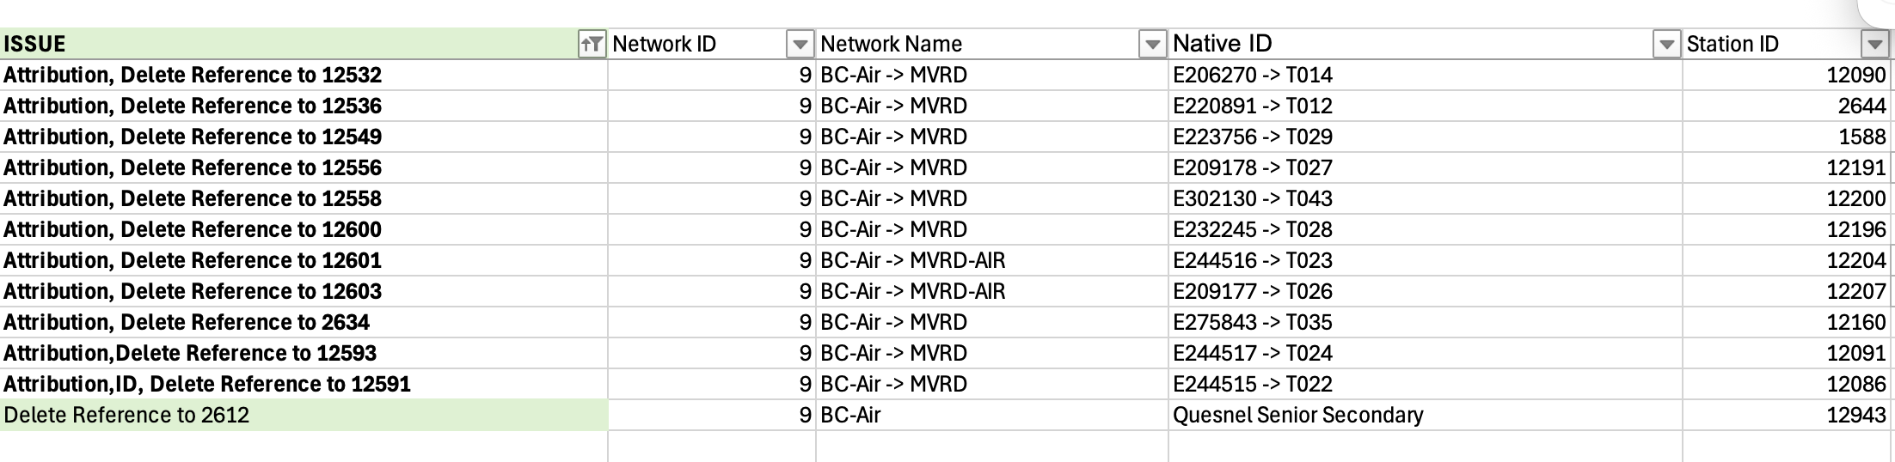
Attribution, Delete Reference to *
These old stations have no data records (the last one don’t have meta data, the others have). What do we want to do?
What delete reference to means?
Neglect it

Slide 20
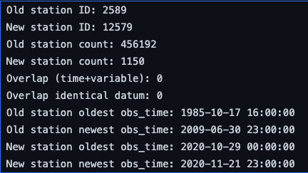
Closed
"Additional - Responsibility Change - move any data from 2436 collected from Octo0ber 1, 2022 to this site",
'Site CLOSED - Move all data collected post October 1, 2022 to new ENV-ASP site "Breanda Mines" Line 1718'
I build the new station "Breanda Mines" first, then select all data after Oct 1 of the closed station, points to the new station.
we still want to keep this station’s record before Oct 1, 2022, I guess? In this way, we have the same station_name “Brenda Mines” under two network
CLOSED - Possibly Trail Butler park pre 2010 | 9 | BC-Air | M114902
Found Trail Butler Park (12579) as native_id in network 9.
What do we want to do? Concatnate it to the 12579?
I forgot how do we want to do with this…
We want to keep both the new and old station, I think

Slide 21
Closed
CLOSED - responsibility change - Move any data from this site collected from October 1, 2022 on to New addditional station (line 1932 - "Moyie Mountain", BC H)
14 BC-Snow 2C10P 2549 Moyie Mountain 115.767 W, 49.25 N, Elev. 1930 m
Additional - Responsibility Transfer - Move any data from 35092 collected post October 1, 2022 to this record.
First insert the new station;
Then founds old station 2C10P has 0 observation records
Also seems no station with id 35092 (no meta data)
I’ve added the new station, seems don’t need to move any data.

Slide 22
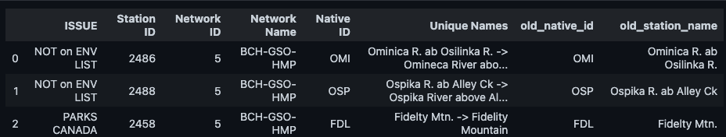
NOT on ENV LIST
PARKS CANADA
I want to replace their name? Also record geom, back to Ted
Seems all the information in the table are all correct, so we want to update their station name? What else we need to do to solve the ISSUE?
The red
Name, ID, | 5 | BCH-GSO-HMP | DBC -> DBC2? | 2452 | Duncan R. blw BB Ck -> Duncan River Below Blue Berry Creek 2
Name, Location? | 5 | BCH-GSO-HMP | ELK | 2455 | Elk R. ab Campbell Lk | BLANK

Slide 23
Attribution related (better double check to make sure I did correctly)
Seems don’t need to change attribution for these four stations.
Neglect it

Slide 24
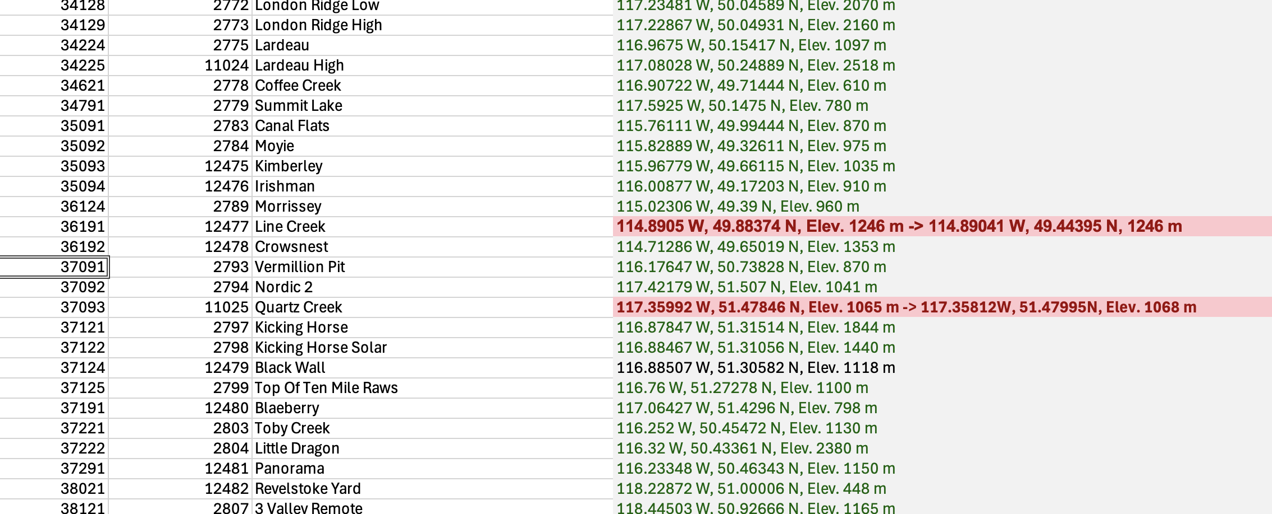
Items not explicitly noted under “ISSUE”
In the left PCDS part
Green means checked and okay
Why are some geometries shown in green?
Do the red geometries indicate locations that need to be updated?
Update red part

Slide 25
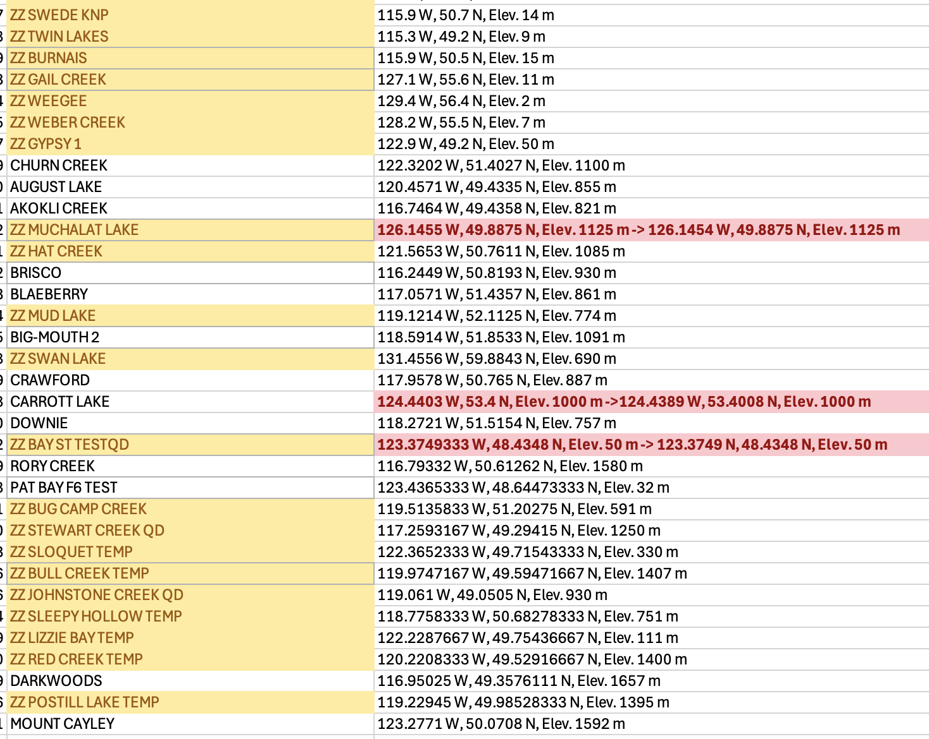
Items not explicitly noted under “ISSUE”
Yellow are “ZZ”
Neglect it
What does the yellow highlighting mean?
Do the red geometries indicate locations that need to be updated?
Red part need to be updated

Slide 26
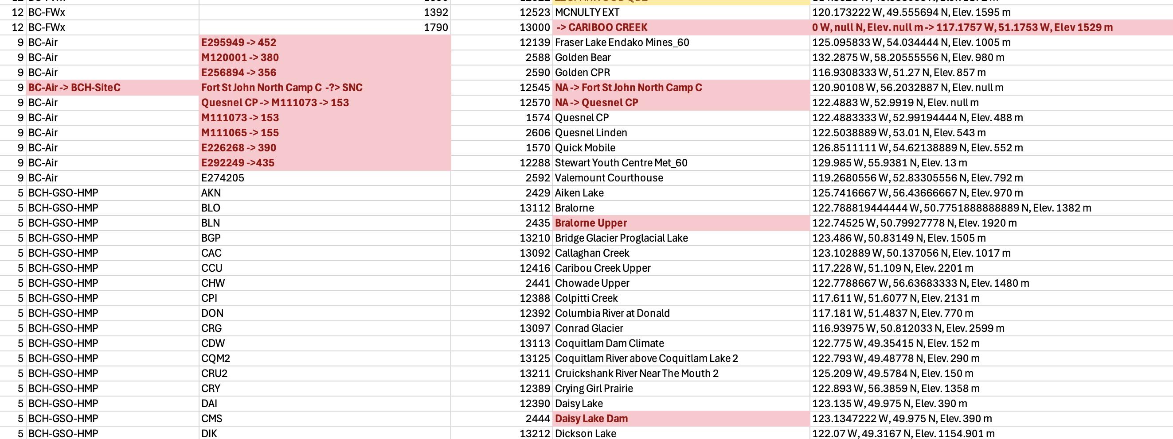
Items not explicitly noted under “ISSUE”
Do the red highlights indicate information that needs to be updated?
What about the items without any marking?
Do both the PCDS and Ted’s spreadsheet need to be cross-checked when data exist in both?

Slide 27
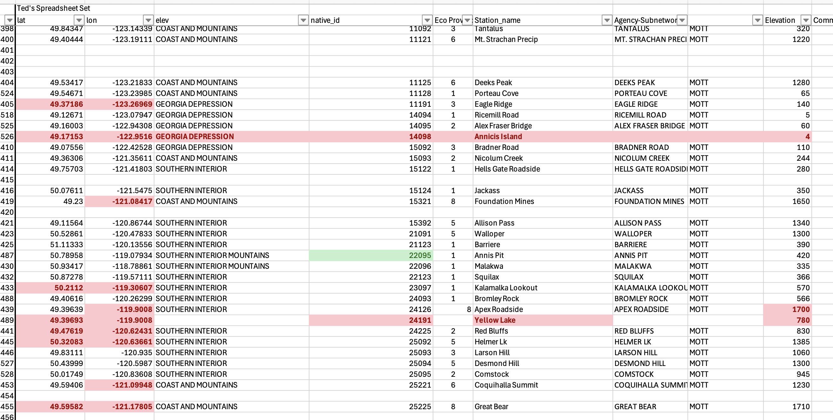
Items not explicitly noted under “ISSUE”
In the right Ted’s spreadsheet part
Neglect it
I randomly checked a few cases and found that they should be the same as, or very similar to, the geometries listed on the left. Anything I need to do with the right highlighted ones in Ted’s spreadsheet?

Slide 28
The update of AGRI network
The PCDS has been updated correspondingly.
Two issues:
- For the two rows AGDLTACRES->DLTACRES and AGCRESFLAT-> CRESFLAT, I’ve marked their issues as “ID”.
- For the native_id AGSC026, which you marked as “No data and station has been discontinued. Any Data associated with the closed site can be incorporated into "sp107" ”, there is no records in the PCDS, so I think I can delete this station?
Keep the meta station there

Slide 29
Network_splite
After the spreadsheet updating,
FLNRO-WMB network needs to be split into BC-TS (12 stations) and BC-FWx (788 stations),
BCH, has been split into BCH-GSO-HMP (168) and BCH-SiteC (8).
Need to double check, and know which stations belongs to which new network, then update the network_id of stations
Talk with John about network again

