Slide 1
EDUMUN 2015 DAIS TRAINING 2

Slide 2
Learning Targets
Learn ROP
Learn how to edit a working paper
Learn how to help create constructive debate

Slide 3
Seminar Overview:
introductions and getting to know delegates
know ROP extremely well
constructive criticism on working papers
learn how to get everyone's involvement
maintaining control of committee

Slide 4
Introductions:
Introduce yourself and explain role
Make yourself approachable
Explain in brief ROP to delegates
Explain any committee specific details

Slide 5
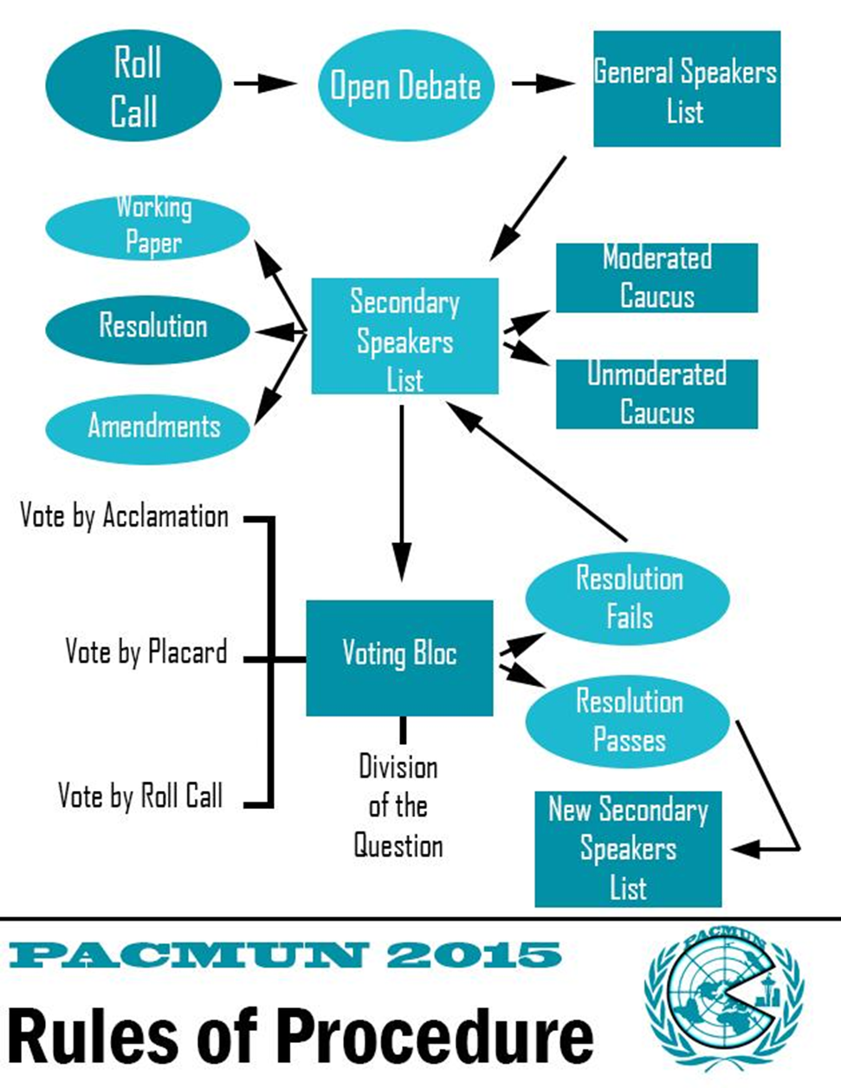
ROP

Slide 6
Activity #1: ROP
Get in groups of 2 and practice ROP
Practice all possible situations

Slide 7
Working Paper Editing
See handout for both format, suggestions and an edited copies of working papers

Slide 8
Heading
Draft Resolution X.0 [X.0 will be replaced by revision number (i.e 1.0, 2.0, etc.)]
Committee: Insert Here Topic: Insert Here
Sponsors: List here, in Alphabetical Order
Signatories: List here, in Alphabetical Order
[Sponsors have to vote “Yes” on your resolution. Signatories are in support but do not have to vote in favor.]
The Insert Committee Name, [italics]

Slide 9
Why (in Preambulatory clauses)
The preams should explain the exact reasons and existing circumstances that make a particular action necessary
All organizations and abbreviations of organizations’ names need to be introduced in preams before being mentioned in operative clauses

Slide 10
Who:
Specify organizations
Remember that the UN cannot force a country into action

Slide 11
What
Specify realistic actions
Have them explain every detail and don’t be afraid to ask for clarification
If money is involved have them be specific about where it is coming from

Slide 12
When
Have them outline a timetable of when programs will be implemented
Timetable should be in subclauses

Slide 13
Cont.
Hourglass Form
Perambulatory clauses should start with the broadest information and go to the most specific
Operative clauses should start with the most specific and go to the broadest
Matching Perambulatory to Operative
ALL operative clauses need to be explained in perambulatory clauses
ALL perambulatory clauses need to be clearly linked to an operative clause
If they are unnecessary get rid of them

Slide 14
extras
Member States not countries or nations
You cannot have one subclause
have good grammar
The resolution should read like a sentence
Discourage formation of UN subcommittees

Slide 15
Activity #2: editing working papers
Presentation of good edits
Make a new group of 3 to edit a bad working paper that will be handed out

Slide 16
Getting delegates involved
Call on delegates who have not spoken
Ask everyone to participate in a working paper (of course if it follows their countries policy)
Go around talking to delegates during unmods
Ask ones who have not spoken what there opinion of a specific topic is

Slide 17
Maintaining control of committee
Command respect by knowing ROP and working paper editing mostly by memory
Be engaged in the conference
Strictly follow conference rules (no internet, cell phones, etc.)
Speak clearly and loudly and ask delegates to do the same
Be approachable and knowledgeable

