Slide 1

EDUMUN 2015
Debate Practice

Slide 2


Learning Targets
To instruct and promote MUN-appropriate debate style
To emphasize efficiency in debate
To foster individualized tactics for debate
Notes:
https://www.flickr.com/photos/86530412@N02/8213432552

Slide 3

Seminar Overview
MUN Debate Style
Debate Strategies and Techniques
Finding your fit
Activities
Reflections
Questions
Be Sure to:
Take notes
Ask questions at the end of slides or during activities
Identify real-life applications

Slide 4
So You Think You Know MUN (Debate Style)?
How MUN is different:
Topics of international affairs
Organized accordingly to UN Committees
ROP
In Committee...
Use your knowledge and skills
Take initiative and dominate
How do you do it?
Research
Practice
Execute

Slide 5
How Can You Become Even Better?
Efficient debate strategies
Do your research
Know the context*
Be confident
What works
Thinking concise, yet effective
Bullet pointing key ideas to
share and debate
PRACTICE
What doesn’t work
Talking only about “yourself”*
Using unnecessary complex speech
“Winging it”
Notes:
*Know what you shouldn’t and should bring up in the debate
*Effective debaters know how to apply information to others beside themselves in order to unite delegates as a committee

Slide 6
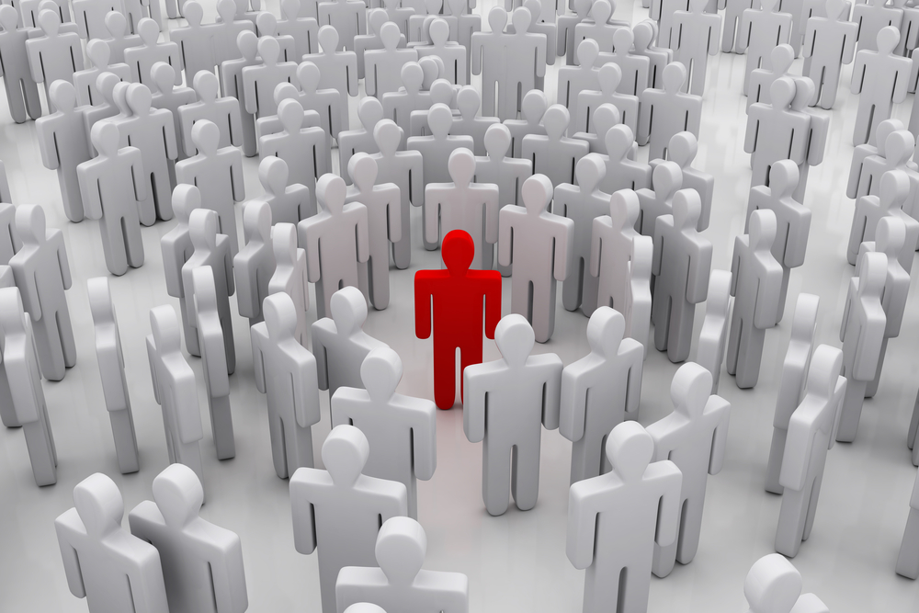
How to Individualize
Why is personalized debate important?
Everybody is different, create what matches your style
You are more dedicated and comfortable with what is “yours”*
How you were-->How you will be
Step 1: Self-reflect
Step 2: Use every opportunity as practice
Step 3: Mold and refine your tactics
Notes:
http://www.bid4u.com.au/userfiles/images/Valuations/Why%20Choose%20Bid%204%20U's%20Valuation%20Expertise/One%20person%20in%20crowd.jpg
* In this case, your style of debate

Slide 7
Time: 40 min.
Activity Slide
Progression of Debate Skills
Activity Steps
Round 1: Past debate style & Reflection
Round 2: MUN-type debate & Reflection
Round 3: Personalize MUN debate & Reflection
Congratulations! You are now an even more skilled debater.

Slide 8
Reflection
To instruct and promote MUN-appropriate debate style
Understood how to actively debate in a MUN setting
Practice with your fellow delegates and demonstrate your knowledge of MUN-style debate through research
To emphasize efficiency in debate
Learned how to be concise and memorable with public speaking and debate
Partake in the Speaker’s List and the Caucuses
To foster individualized tactics for debate
Grasped on how to develop your own personal style on debating and how it will be used
Research, practice, and apply it to conferences

Slide 9
Questions?

Slide 10
EDUMUN 2015
Thank you for your time!

