Slide 1

EDUMUN
Rules of Procedure

Slide 2

Learning Targets
Delegates will be able to:
Understand the form of debate used in MUN
Follow the Flow of Debate throughout a Conference
Understand and be able to use Formal Phrases in MUN
Notes:
Crystal

Slide 3

Seminar Overview
Committee Structure
Starting Committee: The First Session
The Majority of Session: Debate
Finishing a Topic: Voting Bloc
Transitions: Continuing Debate and Closing Committee
Notes: The Nuances
Be Sure to:
Take notes
Ask questions at the ends of slides or during activities
Notes:
Crystal:
-what is mun
-what you do during committee; what is the purpose of MUN (pass resolutions)
-different types committees (regular, specialized, crisis)

Slide 4
Committee Structure
Why use ROP?
Dais
Moderators of debate
Helps delegates facilitate debate
Facilitating Debate—Formal Mechanisms
Motions
Proposing
Voting
Points
Yields
Only during formal speeches
To other delegates, to questions, to comments, to dais
Notes:
Crystal

Slide 5
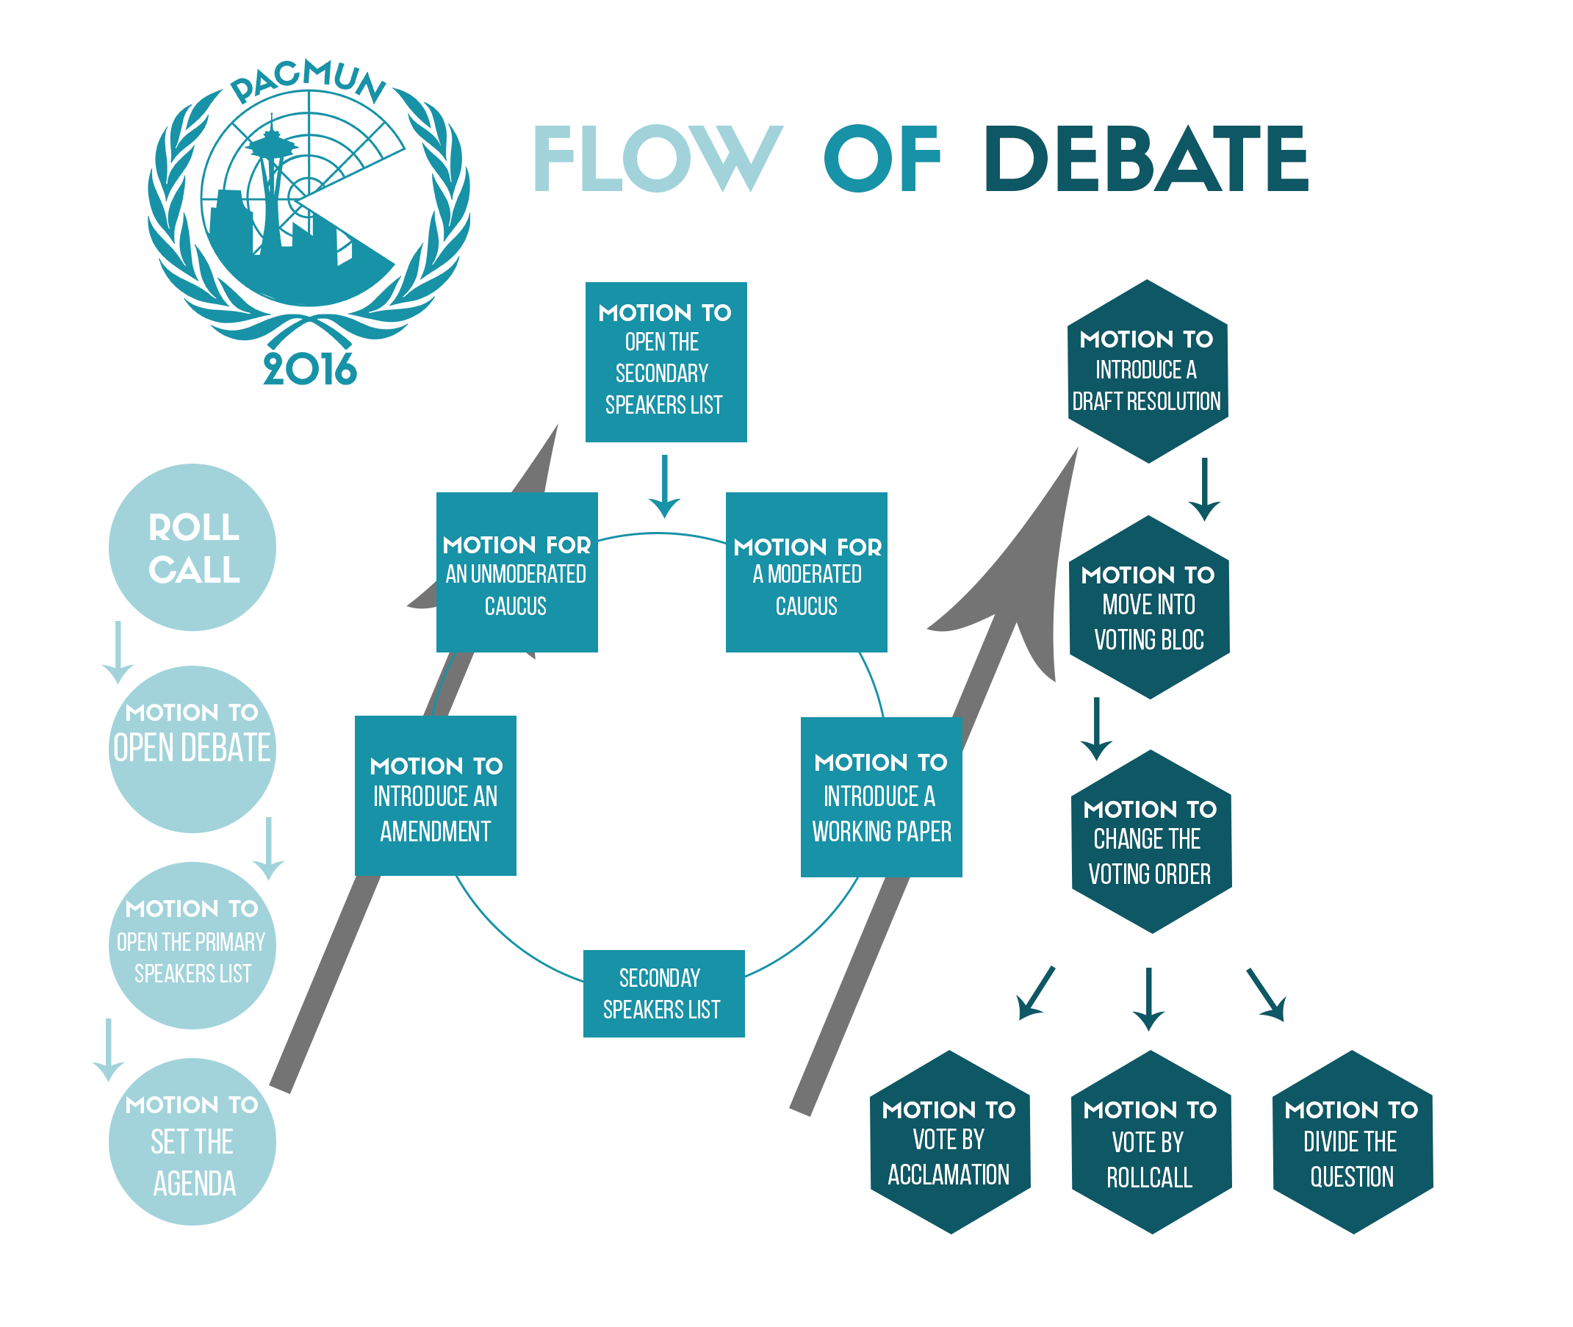

Slide 6
Starting Committee: The First Session
Roll Call
Attendance List
Present vs. Present and Voting
Setting the Agenda
Decide which topic to address first
Motion to Set the Agenda in the Order of Topic A followed by Topic B
Secondary Speakers List
Formal Speeches
Discuss the Topic
New List for each Topic
Motion to Open the Secondary Speakers List for Topic A (or B)
Opening Debate
Motion to Open Debate
Primary Speakers List
Formal Speeches
Discuss Topic Selection
Motion to Open the Primary Speakers List
Notes:
Alex

Slide 7
The Majority of Session: Debate
Moderated Caucus
State Duration, Speaking Time, Topic
Formal Speeches
Give Position/Debate
Unmoderated Caucus
Give Duration
Informal Discussion
Lobbying/Resolution Writing
Secondary Speakers List
Motion to change speaking time
If expired, committee automatically moves into voting bloc
Purpose: general, diversified
Notes:
Emma

Slide 8
Finishing a Topic: Entering Voting Bloc
Introduce a Working Paper
Motion to Introduce Working Paper [Name]
Discuss working paper
Dais approves “ideas”→ Working paper → Resolution
Introduce amendments
Close Debate
Motion to Close Debate
Motion to Close the Secondary Speakers List (for Topic A/B)
Enter Voting Bloc
Motion to Enter Voting Bloc
2 speakers for, 2 speakers against
Doors Close – No one allowed in
Notes:
Megan

Slide 9
Finishing a Topic: Voting Bloc
Placard
Default
Motion Vote on Draft Resolution [Name] by Placard
Raise Placards to vote
Acclamation
Motion to Vote on Draft Resolution [Name] by Acclamation
Ask for Dissent – Raise Placard to Vote “No”
Unanimous
Reverts to placard
Divide the Question
Motion to Vote on Draft Resolution [Name] by Dividing the Question
Vote on Each Clause Separately by Placard
Rare
Roll Call
Motion to Vote on Draft Resolution [Name] by Roll Call
Ask Each Delegate for their Vote
Notes:
Megan

Slide 10
Continuing Debate and Closing Committee
New topic begins
Open Secondary Speakers List (again)
Adjourn Committee
Notes:
Megan

Slide 11
The Nuances
Formal Speech Rules
Yields: The Delegate of [Name] yields his/her time to the
Chair
Delegate of [Name]
All speeches must be made in 3rd Person
Out of Order vs. Dilatory
Out of Order – Doesn’t Follow ROP
Dilatory – According to dais discretion
Suspension vs. Adjournment
See Specific Conference ROP
One will be used to end sessions, the other to end the conference
Now Time to Practice!
Notes:
Crystal

Slide 12
Time: 10 (minutes)
Activity: ROP Flashcards
In this activity, you will be given flashcards with the names of ROP items. Put them in the correct order as fast as you can!
The fastest group wins a prize!

Slide 13
Questions?

Slide 14
EDUMUN
Thank you for your time!

