Slide 1
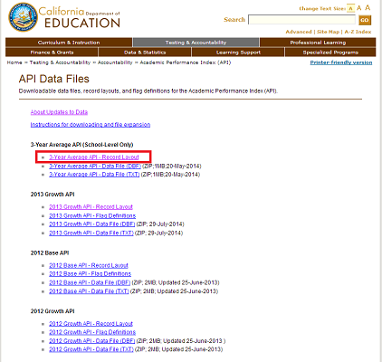
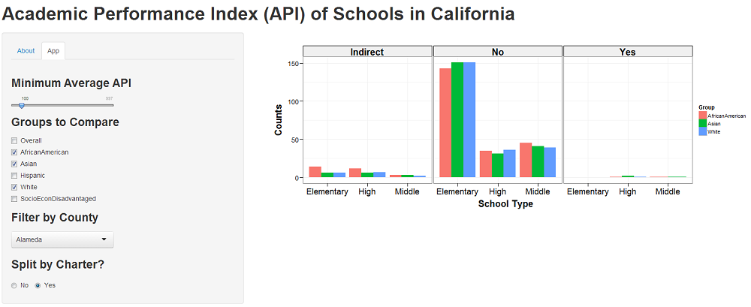
ShinyApp

Slide 2
1
2
6
3
4
5

