Slide 1
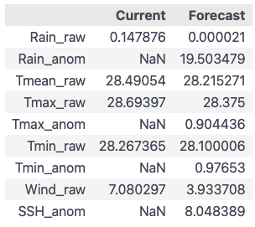
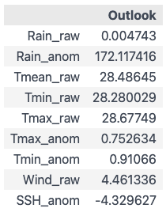
Two CSVs
Two data types:
Raw (Actual value)
Anomaly (Difference between averages and raw value)
Raw values could be converted to anomaly, but will take time to gather data
Raw values do not have an apparent gauge range (for now)
Ultimately up to user preference?
Run daily
Forecast: Weekly
Run monthly
3 months out

Slide 2
Rain – Current and forecast
Current
Forecast
1. Rain_raw
1. Rain_raw
Total rainfall for today (eg Jan 24, Palau time)
Source: CFS
Total rainfall 7 days from now (eg Jan 31, Palau time)
Source: CFS
2. Rain_anom
Rainfall anomaly, difference from average for next week (eg Jan 27 to Feb 2)
Source: BOM
Gauge ranges: -150 to 150 mm Img
* Unclear how the week range is determined. Updates biweekly
Notes:
Maybe weekly average is better, not just the average for t+7 days

Slide 3
Rain - Outlook
Outlook
Two options:
1. Rain_raw
Total rainfall for t+3 months (eg total rainfall in April)
Source: CFS
2. Rain_anom
Rainfall anomaly, difference from average for next three-month period (February to April)
Source: BOM
Gauge ranges: -400 to 400 mm Img

Slide 4
Temp – Current and forecast
Current
Forecast
1. Tmean_raw
1. Tmean_raw
Mean temp for today
Source: CFS
Mean temp for today
Source: CFS
2. Tmin and Tmax_raw
2. Tmin and Tmax_raw
Two gauges: Min and max temp for today
Source: CFS
Two gauges: Min and max temp 7 days from now (eg Jan 31, Palau time)
Source: CFS
3. Tmin and Tmax_anomaly
Two gauges: Min and max temp for next week (eg Jan 27 to Feb 2)
Gauge: +/- 6 deg Img
Source: BOM

Slide 5
Temperature - Outlook
Options:
1. Display Tmean_raw only
Mean temp for t+3months (eg mean temp in April)
Source: CFS
Can display up to 9 months ahead
2. Display Tmin/max_raw
Two gauges: Mean min/max temperature for t+3 months
Source: CFS
Can display up to 9 months ahead
3. Display Tmin/max anomalies (2 gauges)
Two gauges: Tmin/tmax difference from average, for next three-month period (eg Feb to April)
Source: BOM
Gauge ranges: -6 to 6 C Tmin & Tmax

Slide 6
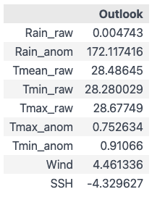
Wind Speed
1. Display wind speed (raw)
Mean wind speed
Source: CFS
Unit: m/s
Current: Average wind speed today
Forecast: t+7 day average
Outlook: Average three months away (Eg April)

Slide 7
SSH
Current
TBD
Forecast
SSH anomaly for next week (eg Jan 27 to Feb 2)
Gauge: -300/300 mm img
Outlook
SSH anomaly for next three-month period (eg Feb to April)
Gauge: -300/300 mm img

Slide 8
Data Sources and Other Notes

Slide 9
Rainfall
Current | Forecast | Seasonal Outlook
Source: CFS Total estimates for today, in mm Raw value | Source: BOM Difference from average (mm) Next week (e.g. Jan 25 to 31) Gauge ranges: -150 to 150mm Img | Source: BOM Difference from average (mm) Next 3 months (e.g. Feb to Apr) Gauge ranges: -400 to 400 mm Img
 | Notes: Updated Tuesdays and Thursdays Unclear what week boundaries they use. It’s varying Map’s legend range is for global scale. May change every week? | Notes: Updated every Tuesday
Currently using:
Also available data options:
Current | Forecast | Seasonal Outlook
Weather stations, yesterday’s rainfall Last month’s rainfall | 2 weeks ahead Monthly Probability of exceeding median (%) | Next 3 months (Mar to May) Probability of exceeding median (%)

Slide 10
Temperature
Current | Forecast | Seasonal Outlook
Source: CFS Total estimates for today, in Celsius Raw value
Currently using:
Also available data options:
Current | Forecast | Seasonal Outlook
Weather stations, yesterday’s rainfall Last month’s rainfall | 2 weeks ahead Probability of exceeding median (%) | Next 3 months (Mar to May) Probability of exceeding median (%)

Slide 11
SSH
Current | Forecast | Seasonal Outlook
Source TBD | Source: BOM Difference from average (mm) Next week (e.g. Jan 25 to 31) Gauge ranges: -300 to 300 mm (Img) | Source: BOM Difference from average (mm) Next 3 months (e.g. Feb to Apr) Gauge ranges: -400 to 400 mm (Img)
 | Notes: Updated Tuesdays and Thursdays Unclear what week boundaries they use. It’s varying Map’s legend range is for global scale. May change every week? | Notes: Updated every Tuesday
Currently using:
Lat/lon ranges:
Lat: 7-8
Lon: 134-135
Also available data options:
Current | Forecast | Seasonal Outlook
Weather stations, yesterday’s rainfall Last month’s rainfall | 2 weeks ahead Monthly Probability of exceeding median (%) | Next 3 months (Mar to May) Probability of exceeding median (%)

Slide 12
Wind speed
Current | Forecast | Seasonal Outlook
CFS (Link) Raw value (m/s) Average wind speed prediction for today Ex if today is Jan 23, avg 6-hourly wind speed for Jan 23 | CFS (Link) Raw value (m/s) Average wind speed prediction 7 days from now Ex if today is Jan 23, avg 6-hourly wind speed for Jan 30 | CFS (Link) Raw value (m/s) Average wind speed prediction for 3 months from now Ex if today is January, avg 6-hourly wind speed for all of April
 | Potentially able to calculate anomalies (eg X m/s above average) | Potentially able to calculate anomalies (eg X m/s above average)
Currently using:
Also available data options, not used:
Current | Forecast | Seasonal Outlook
Weather station hourly data | Monthly forecasts | 6-month forecasts

