Slide 1
CMS Data Element Library (DEL) Supporting Interoperability and Health Information Exchange
Post-Acute Care Interoperability Workgroup
May 1, 2019

Slide 2
Objectives
Clarify “what do we mean when we say ‘DEL’ during workgroup meetings”
Level set: Brief background on the DEL
Discuss different EHR approaches
Emerging issues/trends
Discuss Use Case Process and Data Classes/Data Elements
National standards – USCDI
FHIR resources, existing value sets
Standardized content available in PAC and Alignment with USCDI
Discuss when the DEL (aka Data Elements) should be considered in a use case

Slide 3
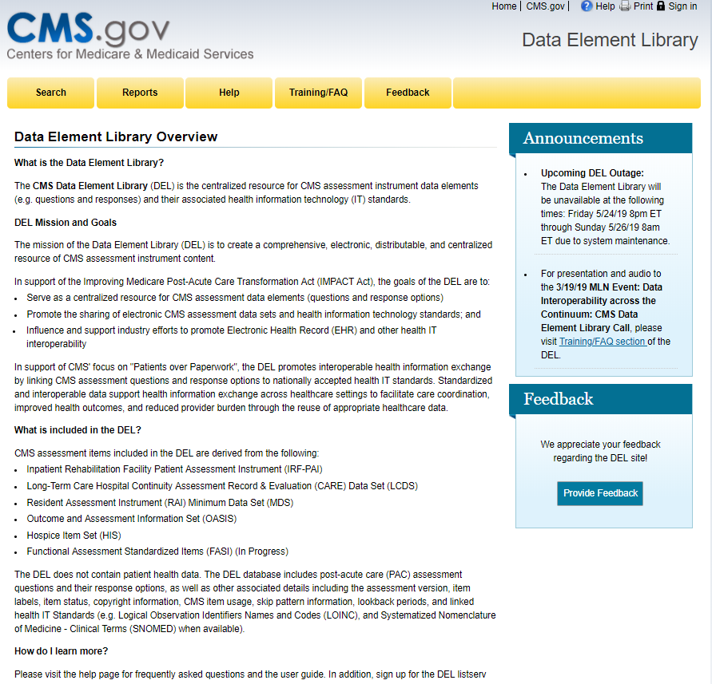
CMS Data Element Library
https://del.cms.gov

Slide 4
Vision of the CMS Data Element Library (DEL)
CMS Data Element Library
The vision of the DEL is to support standardization and interoperability of data, in order to promote health information exchange and improve care coordination
Serve as a resource for CMS data set/assessments and related data elements
Promote sharing of CMS assessment data sets, data elements and related health IT standards
Support industry efforts to promote electronic health records (EHRs) and interoperability.

Slide 5
DEL Contents
Post-Acute Care Assessments/Data Sets and Versions (e.g., MDS 3.0 v.1.16)
Data Element label (e.g.- GG0170)
Data Element status (Published, Active, Inactive)
Copyright information (if applicable)
Identification of skip pattern triggers and lookback periods
Health IT standards (e.g., LOINC, SNOMED)
Vendors, providers, standards developers and others can access the DEL to search and run reports on the PAC instrument, data elements, use of the data element (e.g. QM), and related health IT standards.

Slide 6
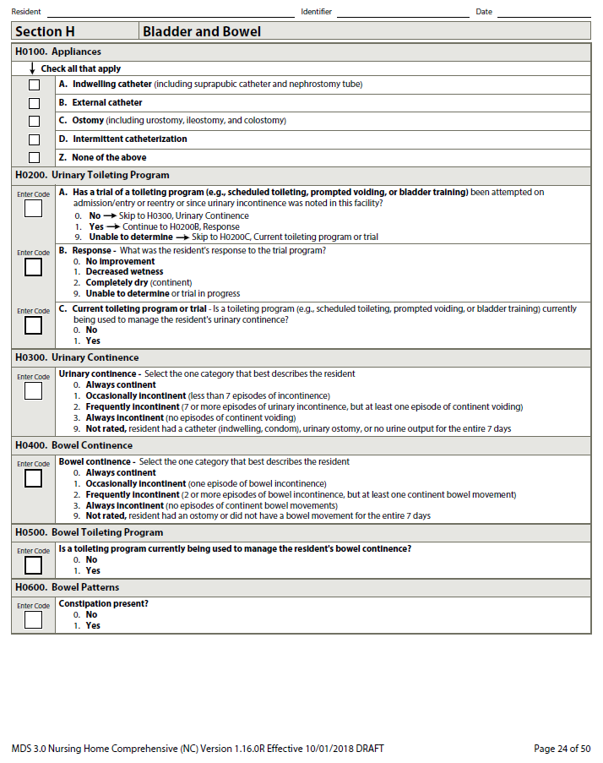
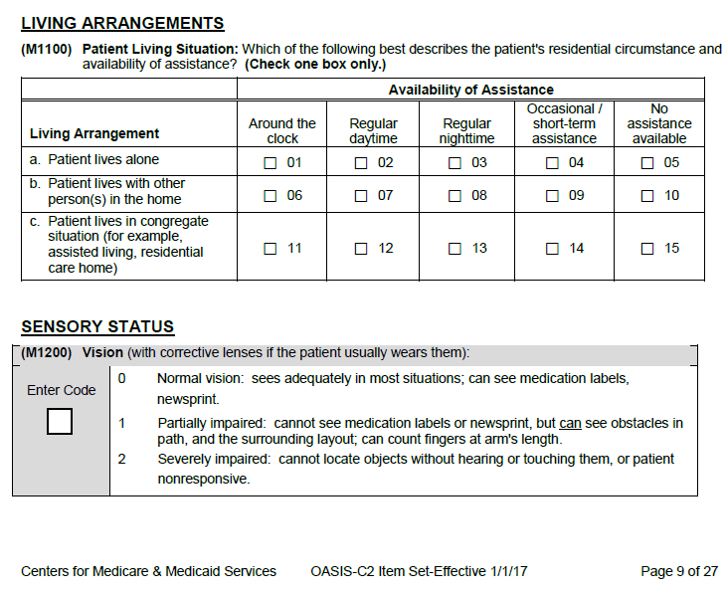
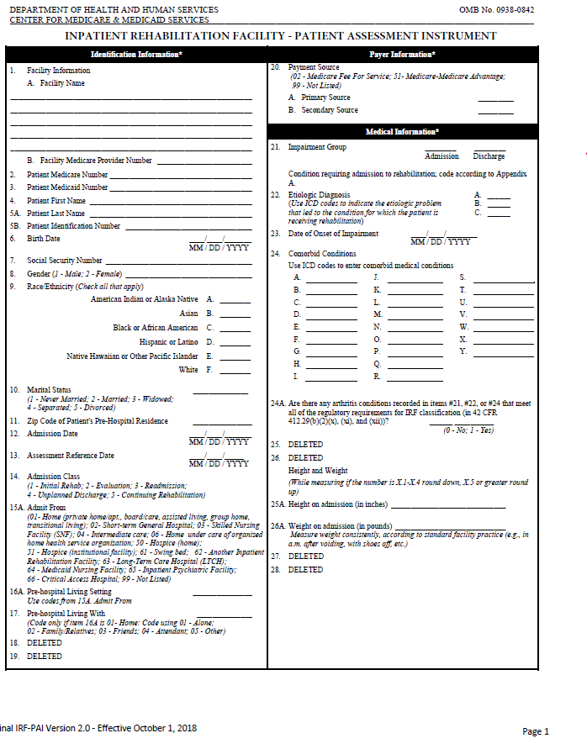
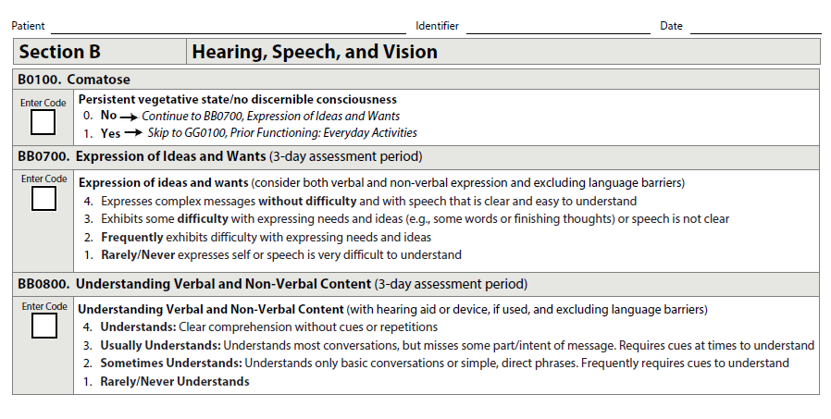

Post-Acute Care Assessments/Data Sets
CMS PAC Assessments
LTCH Continuity Assessment Record & Evaluation (CARE) Data Set (LCDS)
Resident Assessment Instrument (RAI) Minimum Data Set (MDS)
Outcome and Assessment Information Set (OASIS)
IRF Patient Assessment Instrument (IRFPAI)
Hospice Item Set (HIS)
OASIS C2

Slide 7
PAC Assessment Content: (Data classes of standardized data elements collected across PAC)
Administrative Content
Patient Name
Date of Birth
Race/Ethnicity
Marital status
Admission/Discharge dates
Admit from/Discharged to locations
Reason for admission
Provider NPI, CCN, Medicaid Provider #
Standardized Patient Assessment Data Elements (SPADEs) across instruments
Function (e.g., self care and mobility)
Cognitive function (e.g., express & understand ideas; mental status, such as depression and dementia)
Special services, treatments & interventions (e.g., need for ventilator, dialysis, chemotherapy, and total parenteral nutrition)
Medical conditions and co-morbidities (e.g., diabetes, heart failure, and pressure ulcers)
Impairments (e.g., incontinence; impaired ability to hear, see, or swallow)
Other categories
Clinical Content
Diagnosis/medical conditions
Mental/Cognitive Status (memory, orientation, consciousness, delirium, mood, behavior)
Communication (express needs, understanding verbal/non-verbal content, hearing and vision)
Functional Status (Self-care/ADLs, Mobility, Use of assistive devices)
Bladder and Bowel continence
Falls
Pressure ulcers and other skin conditions
Surgery
Nutritional and swallowing status
Medication information
Special treatments, procedures & programs
Height and Weight
Patient preferences and goals of treatment
Pain
Vaccinations
Therapy- PT, OT, SLT
Living arrangements/support availability
Care planning
Some data elements are standardized across all 4 PAC settings (SPADEs) ; Some are just in one setting.

Slide 8
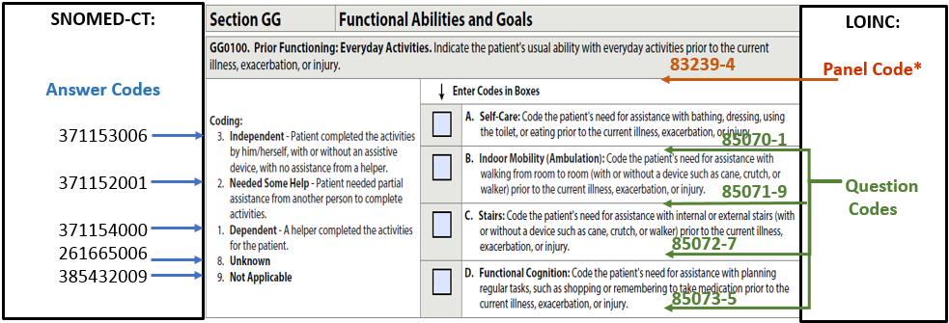
Each Information Class Includes Standardized Data Elements Mapped to LOINC and SNOMED*
SNOMED-CT and LOINC Codes: Item GG0100 as Shown on IRF-PAI
*SNOMED is used for data element responses. Not all information classes are applicable to SNOMED.

Slide 9

Different Approaches for Integrating Assessment/Data Set Content in EHRs

Slide 10


Different Approaches to Capturing Assessment Data Elements
Completion of Assessment Instrument
Data Elements Integrated at Point of Care for Data Collection
Populate Assessment/Data Set for Completion and Submission to CMS

Slide 11
Discussion: Emerging Trends
Data Element Design
Broader use of PAC standardized data sets and Data Elements
Designing data elements that support interoperability
Data elements that can be collected at point of care (integrated in clinical workflow)
Support industry movement to standardization and computability
Standardized content across patient populations for:
Care management
Quality measurement
Data analytics and clinical decision support
Health Systems and Value Based Care Models
Payers
HIEs

Slide 12


Use Case Development Process
When the DEL (standardized Data Elements) should be considered in a use case (and when not)

Slide 13
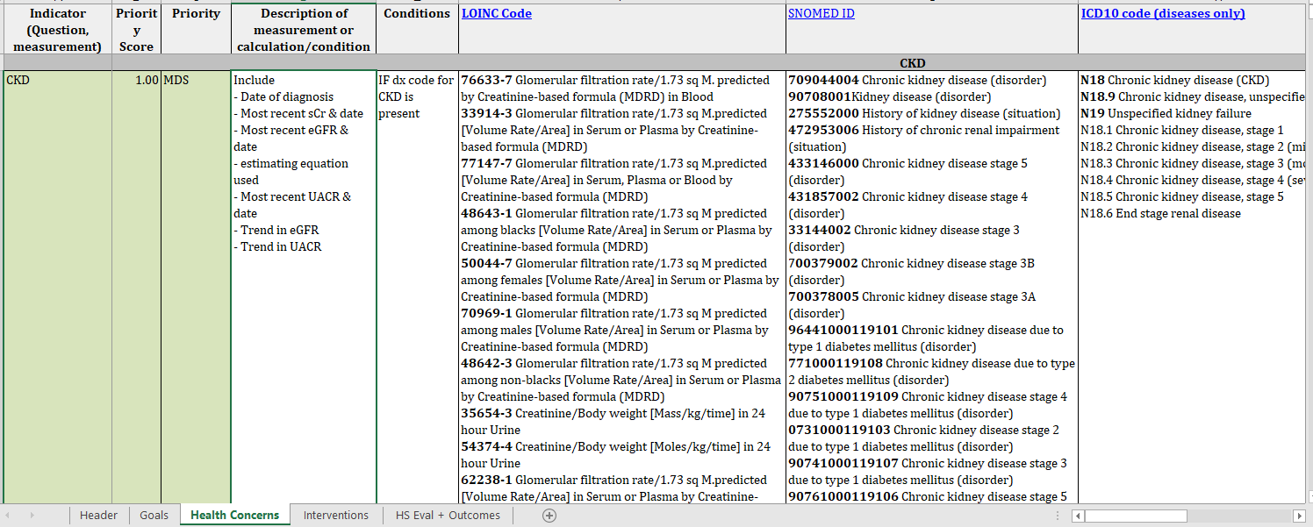
Use Case Model
Develop patient and provider persona’s for our use case
Examples:
Patient personas (the patient story, co-morbidities, what the person and caregiver wants and needs
Provider personas (the providers involved, the information they need, the challenges they face)
Draft set of data elements and linked terminology codes
Example: CKD Data Elements
When relevant to the Data Class needed for the use case then standardized DEL/Data Elements & related health IT codes could be identified

Slide 14
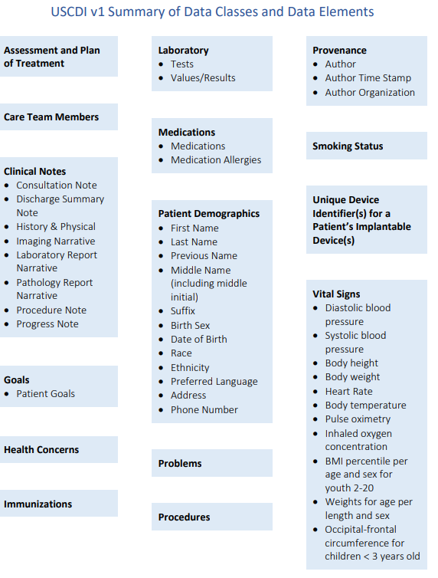
Sources for Data Elements and Linked Terminology Codes
National Standards – USCDI
Alignment USCDI v1 with PAC Data Elements in DEL:
Patient Name
Date of Birth
Race
Ethnicity
Vital Signs (Body Height and Weight)
Opportunities for Alignment with PAC Data Elements in DEL
Sex
Preferred Language
Problems
Smoking Status
Watch for Future Expansion Areas and Provide PAC Input
https://www.healthit.gov/isa/sites/isa/files/inline-files/USCDIv12019revised.pdf

Slide 15

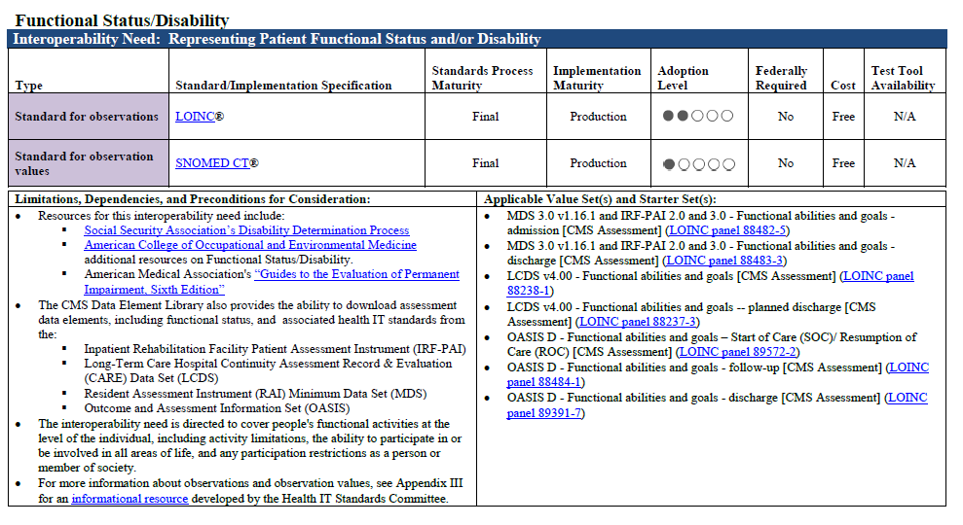
ONC Interoperability Standards Advisory
https://www.healthit.gov/isa/sites/isa/files/inline-files/2019ISAReferenceEdition.pdf
Notes:
Point out the goal of reaching a Common SET of Data Classes to help support interoperable exchange and how reached when hospitals, physicians, PAC providers are using same data classes.

Slide 16
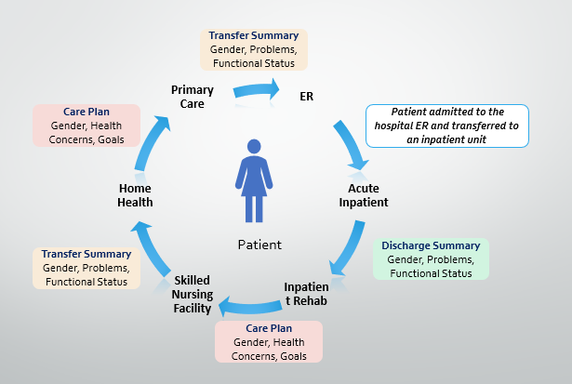
Sources for Data Elements and Linked Terminology Codes
FHIR Resources and Existing Value Sets
Expand Use of Standardized Content Used by PAC
As appropriate for patient populations, expand use of relevant data elements outside of PAC
Assessment Data Elements/Data Sets and Other Content
Opportunity to review existing resources and identify gaps for PAC
If applicable, the DEL/Data Element content could be used to fill the gap

Slide 17

Next Steps and Final Comments

