Slide 1

Dynatrace NBA Data
Tom MacEachern

Slide 2




Intro

Slide 3
The Problem
This dataset contains statistics on NBA player performance on a game by game basis. It is sourced from Kaggle (https://www.kaggle.com/nathanlauga/nba-games/).
It contains both dimension type tables and fact tables
We’re going to focus on how a dimensional data model would look for this data. This presentation is geared for a data professional audience

Slide 4
The Data
The datasets provided are:
Games: all games from 2004 through 2019-12-02
Game Details: stat lines from each game
Players: player names, teams by season
Rankings: a snapshot of each teams record by day
Teams: all teams in the NBA with descriptive data of location, stadium etc.
Overall, this data is relatively clean and well built
To improve is usability and performance in a production system, a dimensional data model will work well

Slide 5
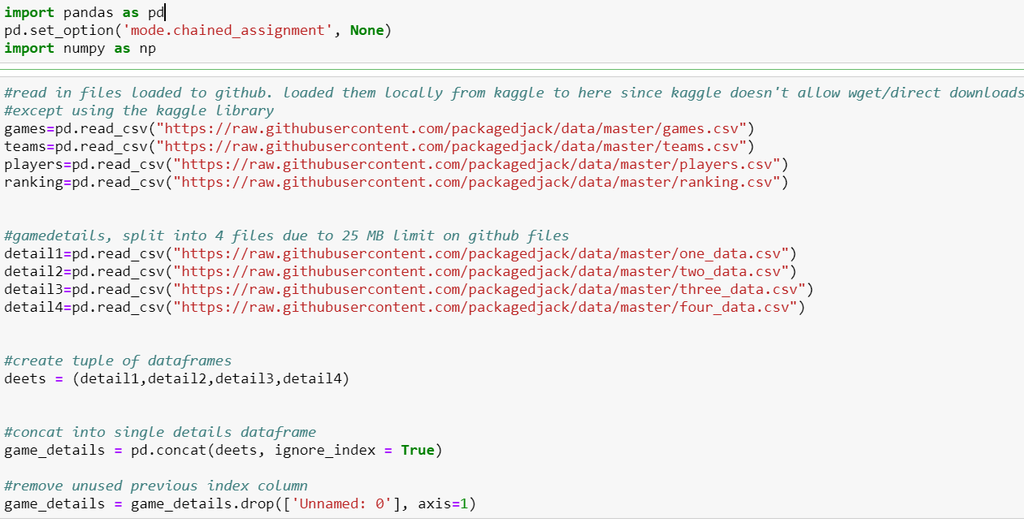
Data Cleaning and Loading
We will walk through some of the cleaning and loading steps from a Jupyter notebook
The first step was to get the data from Kaggle into a more data friendly environment, as Kaggle does not allow direct downloads unless using the Kaggle library.

Slide 6
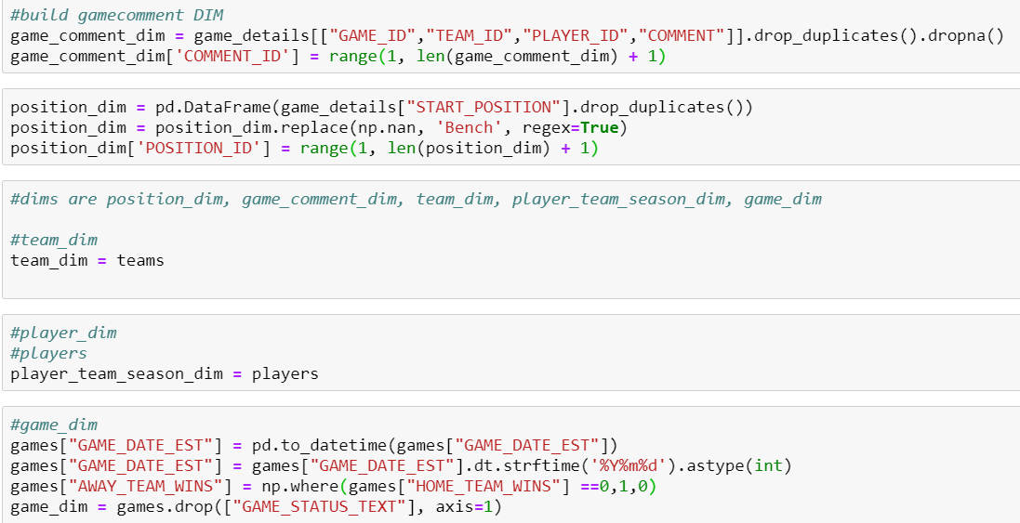
Data Cleaning and Loading(cont)
The next step was to start cleaning and building the dimension tables

Slide 7
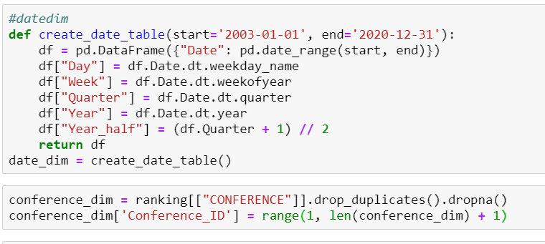
Data Cleaning and Loading(cont)
A very basic date dimension was also created.
Some additional data to add to this table would be specific to the NBA such as season start dates, playoff start dates etc.
A conference dim also was built but only contains 2 values. This mostly was built in case other conferences would be added in the future.

Slide 8
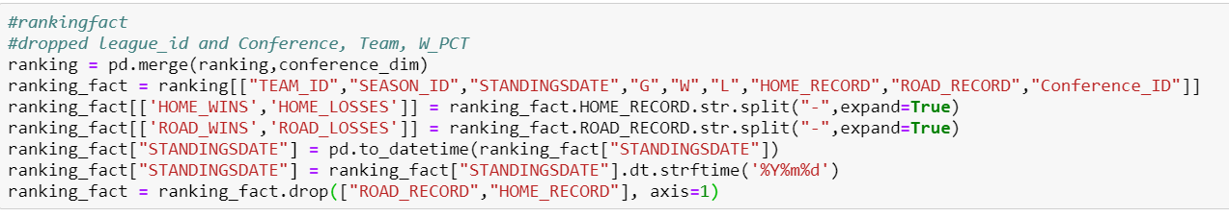
Data Cleaning and Loading(cont)
The fact tables were created next, this data called for 2 fact tables to be created.
The first was a ranking fact, the purpose of which is to have a snapshot of the rankings by day.
Some additional cleaning was done here to split out the records of both home and away teams to store them independently and as integers
The standings date field was also converted into an integer date

Slide 9
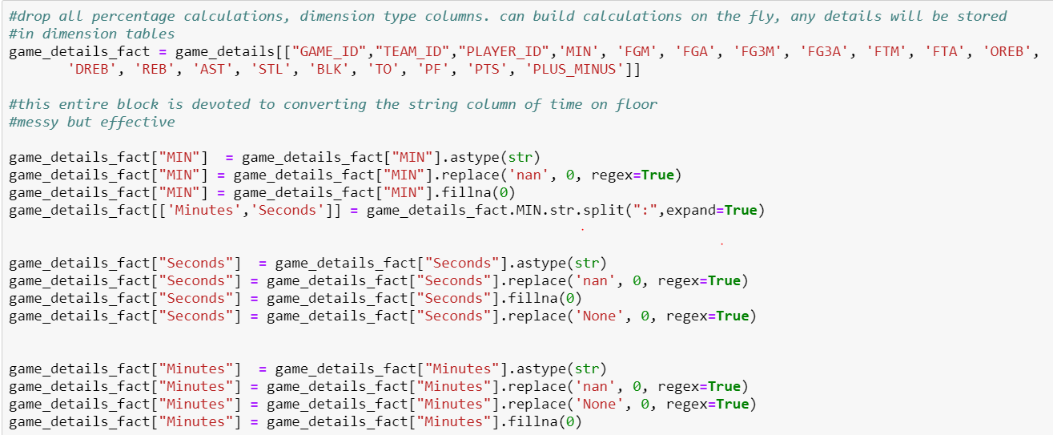
Data Cleaning and Loading(cont)
The second and more critical for this analysis is game_details fact
This fact table will contain the stat lines for each player by game

Slide 10
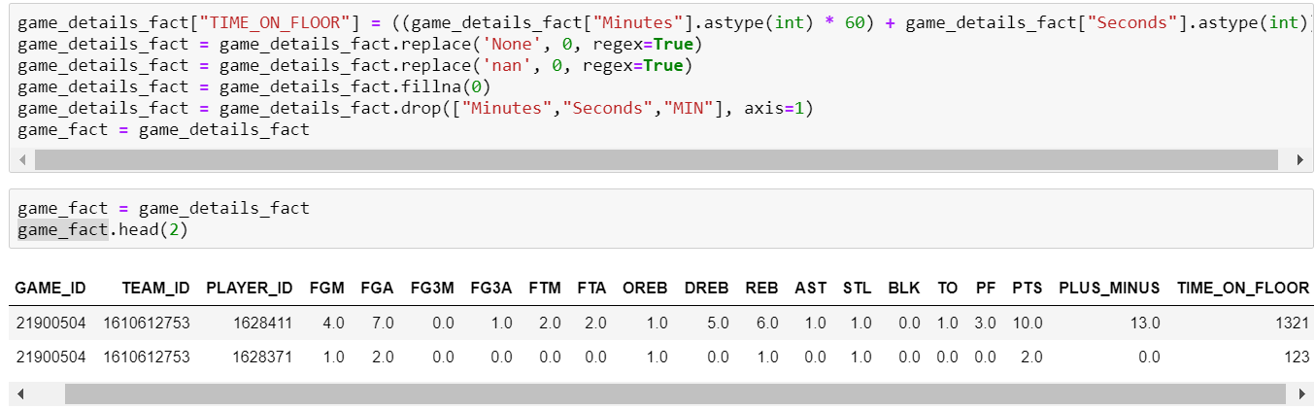
Data Cleaning and Loading(cont)
The amount of time on the court by each player was transformed into the number of seconds spent on the floor by team player.
Finally, a clean fact table with integers will be good for simplifying future data science and analysis applications

Slide 11
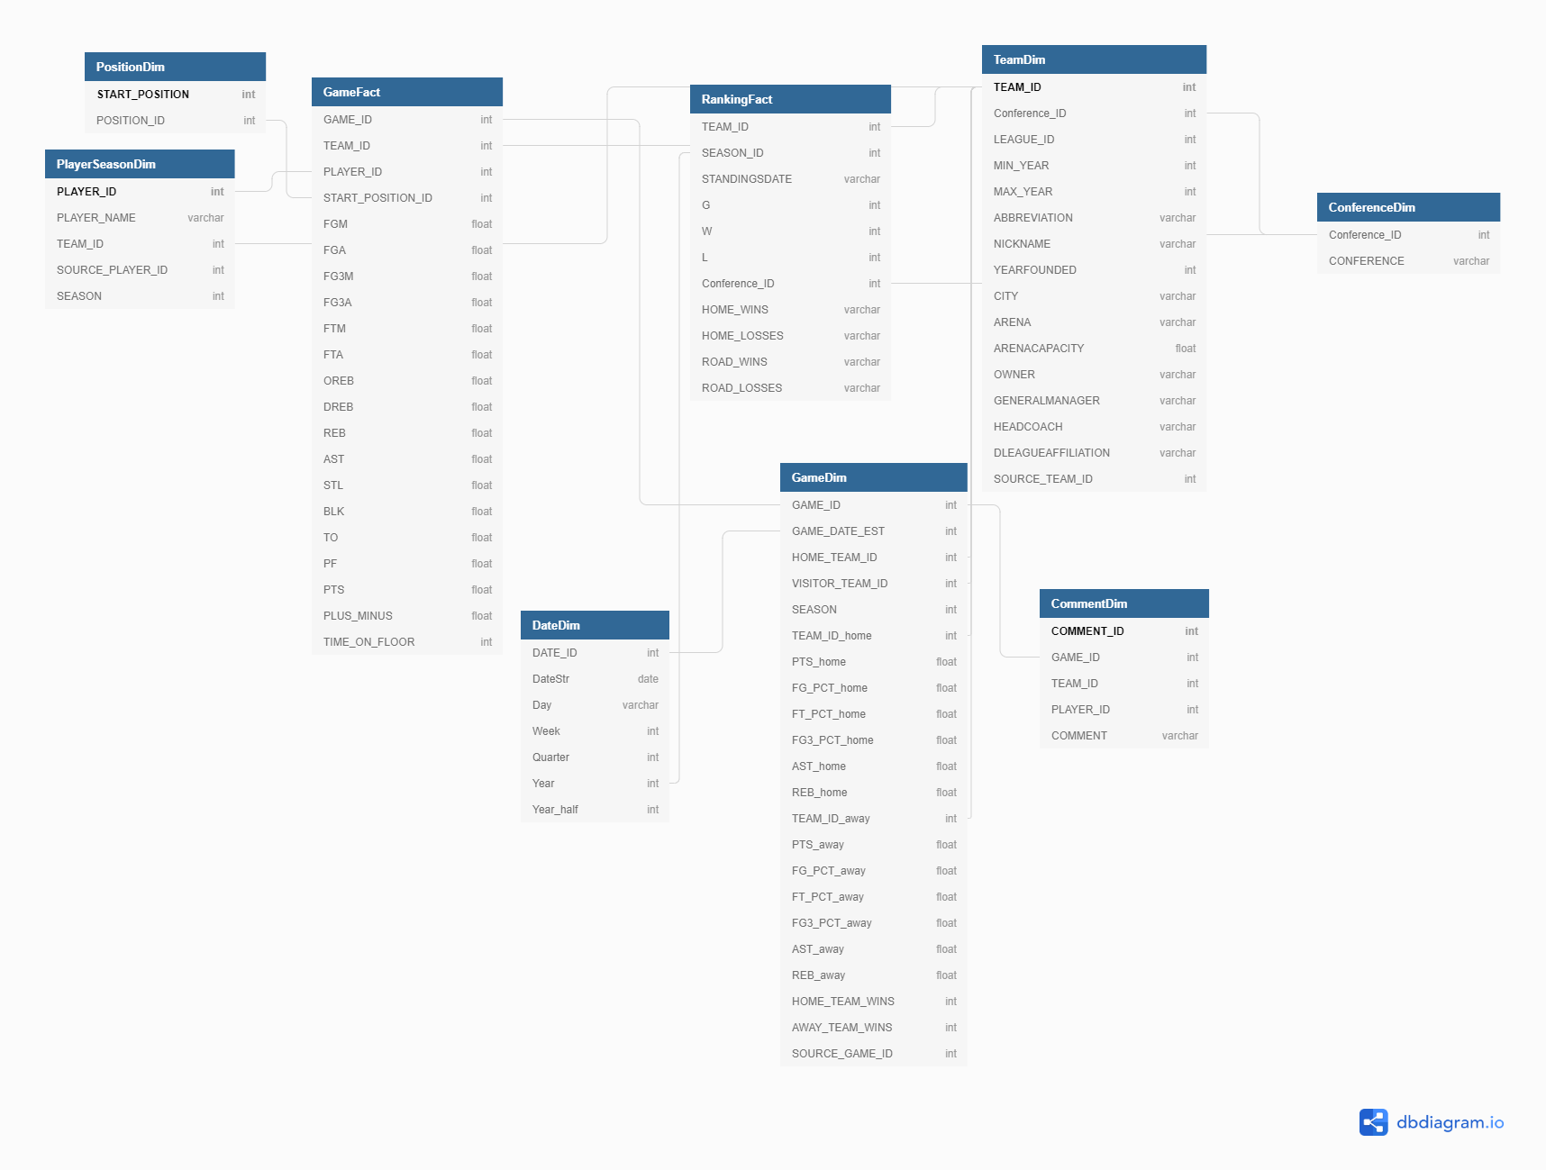
The Data Model

Slide 12
A Coaches Approach
Scenario: A coach wants to identify which players should be coached 1-1 to improve their performance. He has asked to identify which players need coaching the most based on their performance
This presents 2 interesting questions
1. What is the best way to measure performance?
2. How to quantify which players are under performing?

Slide 13
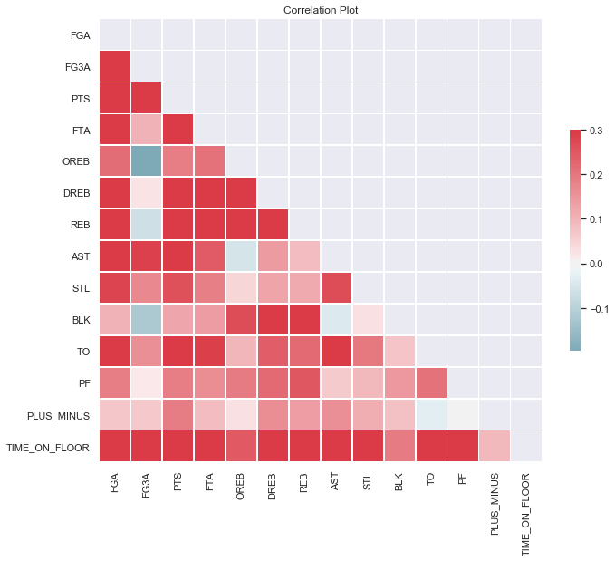
Correlation
Many of these variables are strongly correlated with each other
This indicates that this is a good dataset to attempt a model to predict the number of expected points due to there being many strong linear relationships between the variables
Since basketball is a game in which you are trying to score more points than an opponent, we will try to predict the number of points a player will score in game.

Slide 14
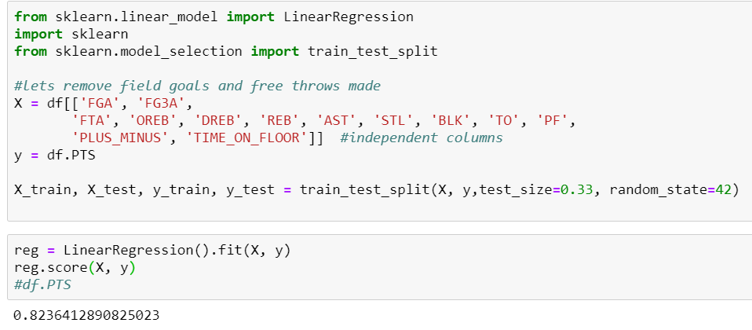
Training
Using a linear regression, the r2 score is quite high. It is likely overfit but for the purposes of generating an expectation for points scored, it works well

Slide 15
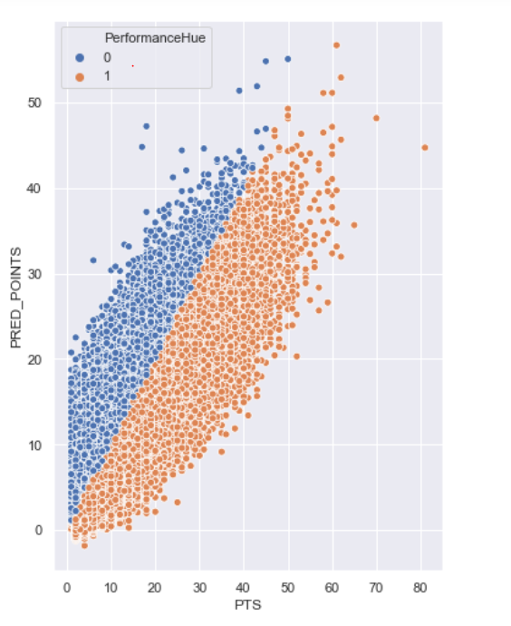
Prediction
When plotting the predicted points and the actual points, its clear the model has predictive power.
The chart is colored by if a player performed higher or lower than expectations

Slide 16
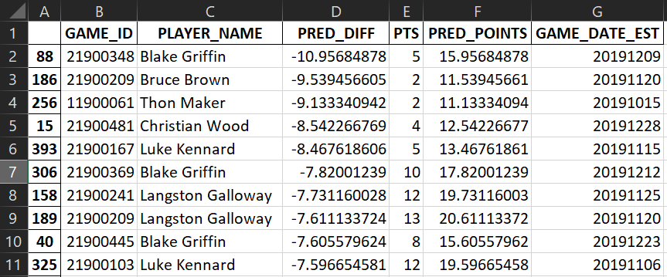
Which players need coaching?
Let's pretend that the coach asking these questions is Dwayne Casey, the Detroit Pistons head coach.
The players that need coaching the most are the ones that are under performing relative to their predicted points.
The excel output file highlights which players in which games performed the worst relative to our models expectations.

Slide 17
Summary
It is possible to identify players who under or over performed using a simple linear regression
If a more advanced method were to be used, more training and fitting would be required.
A missed opportunity on this project was not utilizing any cloud technology after the initial first step.
If additional computing power were required, using Google Cloud or another cloud provider for compute power would be something extremely useful.
Since this is a very simple regression, using a Lambda function + API gateway through AWS also could have likely worked out well, but configuring it would have taken too much time for this project

Slide 18
Questions?

