Slide 1
Protection Coordination for Dual Failure on Two-Layer Networks
Victor Liu, victor.liu@huawei.com

Slide 2
Contents
Goals and Motivations
Reuse Existing Single Failure Protection for Dual-Failure Protection ➔ “1+1”
Protect All Possible Dual-Failures on Two-Layer Networks ➔ “=2”
Protection Coordination on Two-Layer Networks: from 1+1 ≤ 2 to 1+1=2

Slide 3
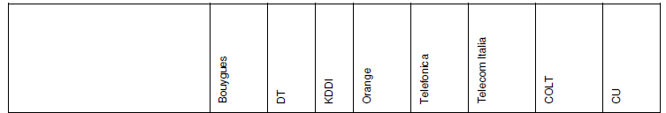
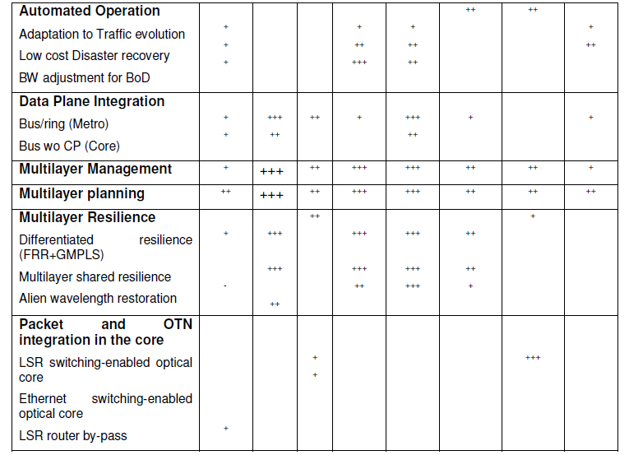
Goals and Motivations
Protect Dual Failures on Two-Layer Networks
Why Dual Failures
For Enhanced Service Reliability
Single failure might not be enough
Two-Layer Protection Coordination
Reusing Single failure Protection Scheme
Coordination across Two Layers
Source: J. P. Fernandez-Palacios, et. al., IP and Optical Convergence: Use Cases and Technical Requirements, Jan. 31, 2014.

Slide 4
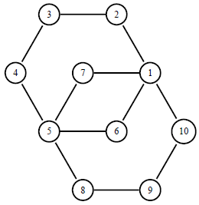
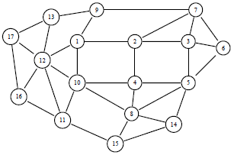
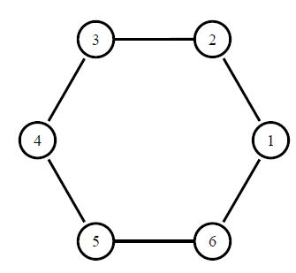
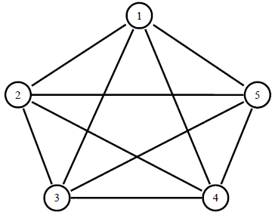
Protect Single Failure – Topology and Connectivity
Protect single failure is commonly available
Topology and connectivity
bi-connected, might not be tri-connected yet
Ring, multi-ring, full-mesh, partial-mesh

Slide 5
Protect Single Failure - Protection and Restoration
Protection versus Restoration
Route Planning: Preventive or Reactive
Spare Resource Reservation: Pre-planned or Dynamic
Spare Resource Overbooking: Dedicated or Shared
Working path
Backup path pre-planned
Protection
Restoration path computed afterward
Restoration

Slide 6
Shared Backup Path Protection (SBPP)
Shared Backup Path Protection (SBPP): Reduces capacity used by sharing among backup paths
End-to-end path protection versus local protection
Path protection: pre-plan limited number of disjoint backup paths for fast and guaranteed traffic recovery upon failure
Diversity requirements: link, node, shared risk link group (SRLG)
Avoiding traps – working path excludes possible disjoint backup path
Precise capacity assignment without loss of 100% protection coverage
Working path
Share Capacity
Backup path
Working path

Slide 7
Protection of Dual Fiber-Cuts – SBPP
SBPP – Two backup paths protect one working path
Three paths: mutually link disjoint
Topology: tri-connected
Minimize capacity by sharing among dual-failure cases
Working path
Primary backup path
Secondary backup path
1
1
2
2
3
2
4
1
3
6
4
5

Slide 8
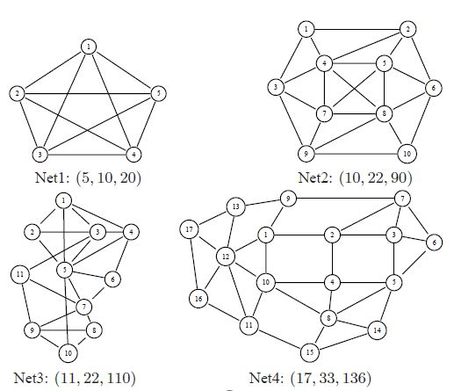
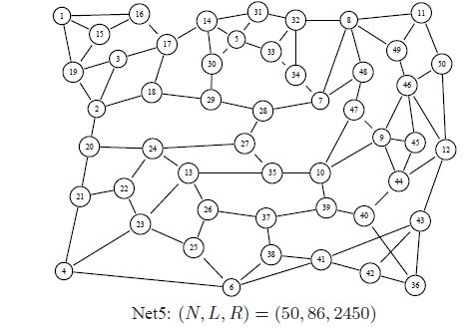
Protection of Dual Fiber-Cuts – Benefit
Significantly reduced redundancy, ratio of spare to working capacity
Protection | Primary Backup Path | Secondary Backup Path | Redundancy in 5 networks
1+1+1 | Dedicated | Dedicated | 313–400%
1+1:1 | Dedicated | Shared | 187–310%
1:1:1 | Shared | Shared | 96–180%
1+1 | Dedicated | n.a. | 130-200%
1:1 | Shared | n.a. | 33-50%
Source: V. Y Liu, D. Tipper “Spare capacity allocation using shared backup path protection for dual link failures,” Computer Communications, special issue on reliable network services, vol. 36, no. 6, March 15, 2013, pp. 666-677. http://dx.doi.org/10.1016/j.comcom.2012.09.007.

Slide 9
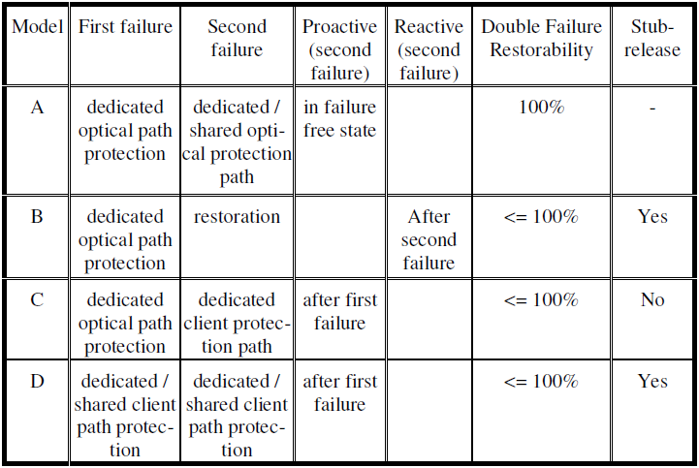
Multi-Layer Protection
Various Combinations
Single Layer Scheme
Two Layer Coordination
Single Layer Scheme with SRLG disjoint needs
Source: R.G. Prinz, A. Autenrieth, and D.A. Schupke, “Dual failure protection in multilayer networks based on overlay or augmented model,” in International Workshop on Design of Reliable Communication Networks (DRCN), Island of Ischia, Naples, Italy, Oct. 16–19 2005.

Slide 10
Protection Coordination for Dual Failure
Various Combinations
No | Packet Layer | Optical Layer | Doable? | Complications
1 | Protect dual failure | Not used | ? | Need to protect dual SRLGs, TODO
2 | Not used | Protect dual failure | In 2011 | See work in DRCN’2011
3 | Protect single failure | Protect single failure | Yes, but → | <100% dual failure coverage
4 | Protect single failure | Protect single failure | In 2014 | Use Protection Coordination

Slide 11
Protection Coordination for Dual Failure
Two Layer Networks where each layer has its single failure protection
Protection Coordination provides ultimate dual failure resiliency across layers
Protection Coordination | Top Layer Single Failure Protection | Bottom Layer Single Failure Protection | Dual Failure Restorability | Notes
None | Enabled | None | 41%-94%
None | Enabled | Enabled | 94%-99.7% [1]
Enabled | Enabled | Enabled | 100%
1+1≤2
1+1=2
Source:
[1] Z. Sui and V. Liu, “Dual failure resiliency on single failure protected packet optical integrated networks, ” in 11th Intl. Conf. on Design of Reliable Communications Network (DRCN), Kansas City, MO, USA, March 25-27, 2015.
11

Slide 12
Survivable Topology Mapping for Single Failure Protection
Topology mapping is shown in the interlayer information matrix H
Links/nodes are indexed numerically/alphabetically
1 indicates the upper link has its path over the lower link
Survivable Topology Mapping is to optimize H to
Guarantee the upper layer connected under any single lower failures
Minimize total capacity used at the lower layer
Columns are indexed by lower layer links
Rows are indexed by upper layer links
H
12

Slide 13
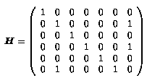
How to Accomplish the Protection Coordination
Optical Layer has two paths to support each packet links
In addition to the topology mapping matrix H,
A secondary topology mapping matrix W is used to represent the secondary path of each packet link
So that the optical layer is capable to protect any single failure cases
The packet layer is two connected and is capable to restore any single packet link failure
A packet-link failure only happens on the case of two optical failures tear down both of optical paths of this packet link
Design H and W wisely is the key!
0
1
1
H
H_{6*}
W_{6*}
W
13

Slide 14
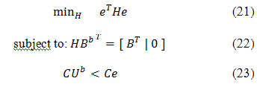
ILP Formulation for Survivable Mapping
Previously, how to design H, to satisfy packet layer is resilient to any optical link failures [7]:
Solution algorithms: SMART [8], and SMART related [13], etc.
Minimize total resource used by primary optical paths
Flow conservation constraints for primary optical paths
Guarantee any failure will not disconnect any cuts on packet layer
Compute the impacted packet links of all optical links
Source:
[7] E. Modiano and A. Narula-Tam, "Survivable lightpath routing: a new approach to the design of WDM-based networks," IEEE Journal of Selected Areas in Communication, May 2002.
[8] M. Kurant and P. Thiran, “Survivable Routing of Mesh Topologies in IP-over-WDM Networks by Recursive Graph Contraction,” IEEE Journal on Selected Areas in Communications, vol. 25, no. 5, June 2007.
[13] K. Thulasiraman, M. S. Javed, and G. Xue, “Circuits/Cutsets duality and a unified algorithmic framework for survivable logical topology design in IP-over-WDM optical networks,” in IEEE INFOCOM, 2009.
14

Slide 15
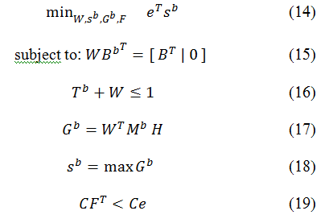
ILP Formulation for Protection Coordination
Given H, Find W to satisfy following constraints:
Minimize total resource used by secondary optical paths
Flow conservation constraints for secondary optical paths
Disjoint constraints for secondary optical paths
Compute Spare Capacity for secondary optical paths
Compute Shared Spare Capacity for secondary optical paths
Guarantee Any Dual Failure will not disconnect any cuts on packet layer
15

Slide 16
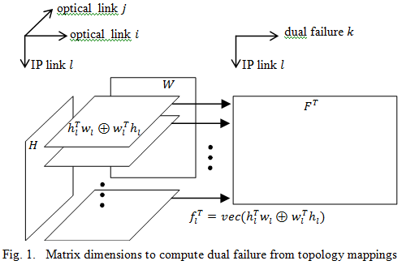


Compute Dual Failure Matrix
Dual Failure Matrix F
Depends on topology mappings H and W
Dual failure won’t partition packet topology

Slide 17
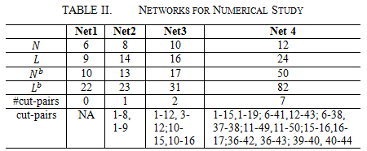
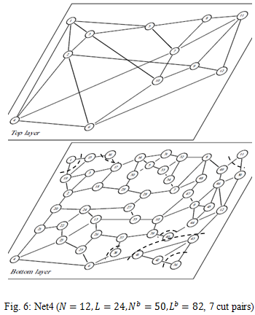
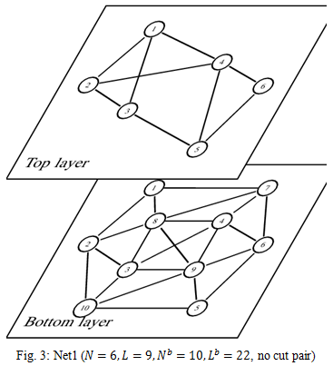
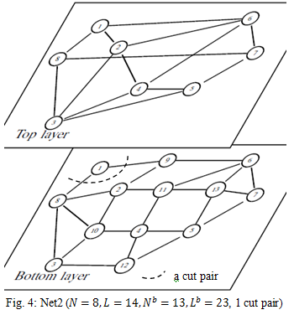
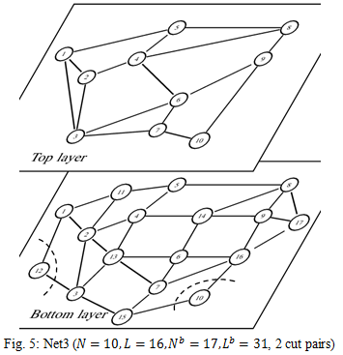
Four Networks under Study
Cut-pairs: a pair of links forming a cut

Slide 18
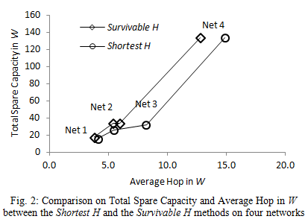
Impact of Different Methods for H
Two methods to find H
Using shortest paths
Using survivable topology mapping
Slightly longer paths on W when using the shortest path for H

Slide 19
Protection Coordination across Layers
Layers with Packet and Optical Separation
Will last for an extended period of time
Both have build-in restoration schemes
Protection coordination
+: Reuse single failure protection on both layers
=: Complete 100% coverage on dual failure
1+1≤2
1+1=2

Slide 20
Thank You!
Copyright©2015 Huawei Technologies Co., Ltd. All Rights Reserved.
The information in this document may contain predictive statements including, without limitation, statements regarding the future financial and operating results, future product portfolio, new technology, etc. There are a number of factors that could cause actual results and developments to differ materially from those expressed or implied in the predictive statements. Therefore, such information is provided for reference purpose only and constitutes neither an offer nor an acceptance. Huawei may change the information at any time without notice.
20

